Slide 1
Conceptual Model
Lower Columbia Estuary Partnership

Slide 2
Bed Armouring Process – Current FV module
Layer 1 :
Sed 1 : No Move
Sed 2 : No Move
Layer 1 :
Sed 1 : Move
Sed 2 : No Move
Layer 1 : Armoured
Sed 1 : Gone
Sed 2 : No Move

Slide 3
Bed Armouring Process – Current FV module
Layer 1 :
Sed 1 : No Move
Sed 2 : No Move
Layer 1 :
Sed 1 : Move
Sed 2 : No Move
Layer 1 : Armoured
Sed 1 : Gone
Sed 2 : No Move
Layer 1 : Armoured
Sed 1 : Gone
Sed 2 : Move

Slide 4
Bed Armouring Process
Armoured
 | S1 | S2
τ | < τ_{c1} | < τ_{c2}
L1 | No Move | No Move
L2 | Inactive | Inactive
 | S1 | S2
L1 | Move | No Move
L2 | Inactive | Inactive
 | S1 | S2
L1 | Gone | No Move
L2 | Inactive | Inactive

Slide 5
Erosion Process
Armoured
Armour layer thinning
Armour layer gone
 | S1 | S2
L1 | Gone | No Move
L2 | Inactive | Inactive
 | S1 | S2
L1 | Gone | Move
L2 | Inactive? | Inactive?
 | S1 | S2
L1 | Gone | Gone
L2 | Move | Move

Slide 6
Recovering Process
Deposition
Armour layer gone
 | S1 | S2
τ | < τ_{c1} | < τ_{c2}
L1 | Gone | Gone
L2 | No Move | No Move
 | S1 | S2
τ | < τ_{c1} | < τ_{c2}
L1 | Deposit | Deposit
L2 | No Move | No Move
Armour layer gone
 | S1 | S2
L1 | Gone | Gone
L2 | Move | Move

Slide 7
Re-Armouring
Deposition
 | S1 | S2
τ | > τ_{c1} | < τ_{c2}
L1 | Gone | Gone
L2 | Erosion | No Move
 | S1 | S2
τ | > τ_{c1} | < τ_{c2}
L1 | Gone | Gone
L2 | Erosion | No Move
 | S1 | S2
τ | > τ_{c1} | < τ_{c2}
L1 | Gone | Gone
L2 | No Move | No Move

Slide 8
Problem 1
Armoured by small mass of S1
 | S1 | S2
τ | > τ_{c1} | < τ_{c2}
L1 | Gone | No Move
L2 | No Move | No Move
 | S1 | S2
τ | > τ_{c1} | < τ_{c2}
L1 | Gone | No Move
L2 | Erosion | No Move
Minimum mass to form armour in Layer 1 !!!!

Slide 9
Problem 2
S1 will be eroded until its gone
 | S1 | S2
τ | > τ_{c1} | < τ_{c2}
L1 | Gone | Gone
L2 | Erosion | No Move
 | S1 | S2
τ | > τ_{c1} | < τ_{c2}
L1 | Gone | Gone
L2 | Erosion | No Move
 | S1 | S2
τ | > τ_{c1} | < τ_{c2}
L1 | Gone | No Move
L2 | No Move | No Move
Mechanism to push up layer 2 to 1????
dZ * portion of S2

Slide 10
Problem 2
S1 will be eroded until its gone
dZ
dZ

Slide 11
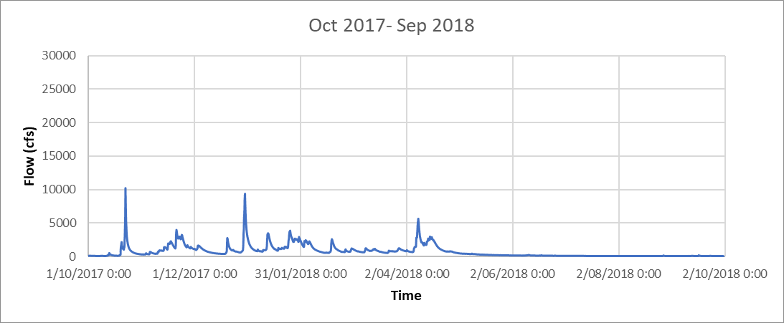
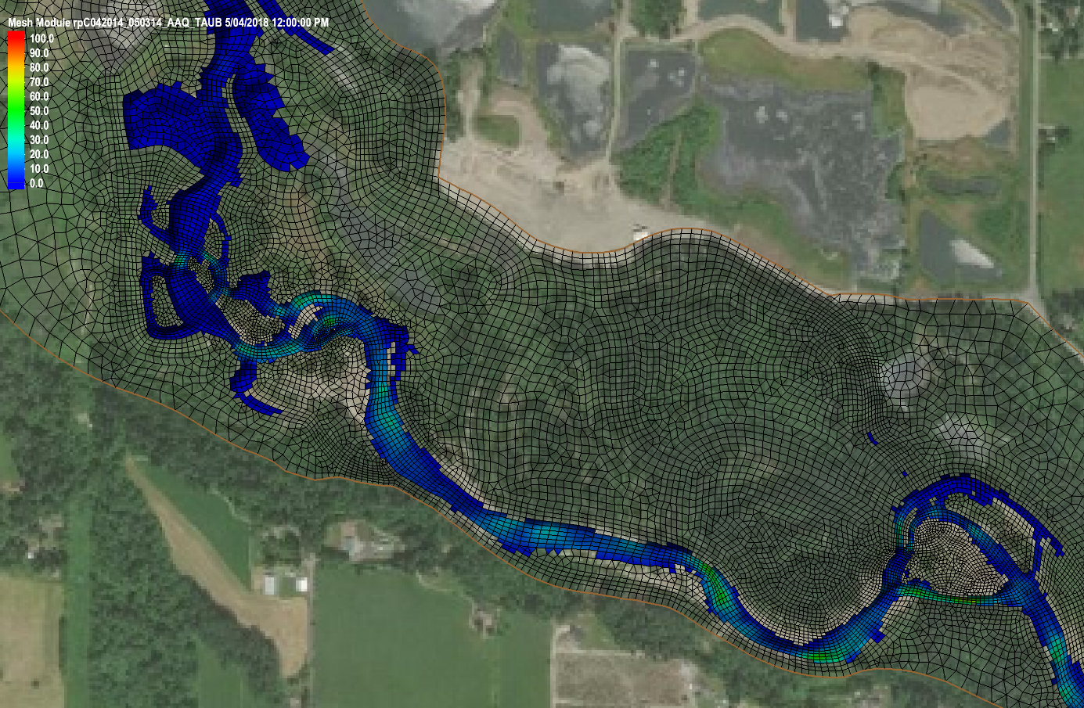
Base Flow
Q < 643 ft³/s
or 18.2 m³/s

Slide 12
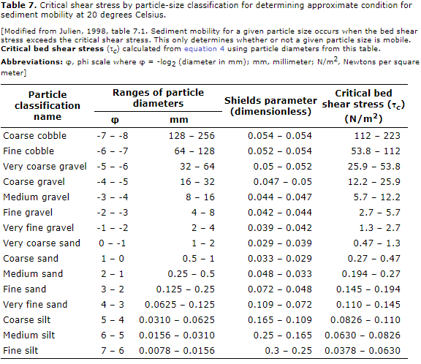
Base Flow

Slide 13
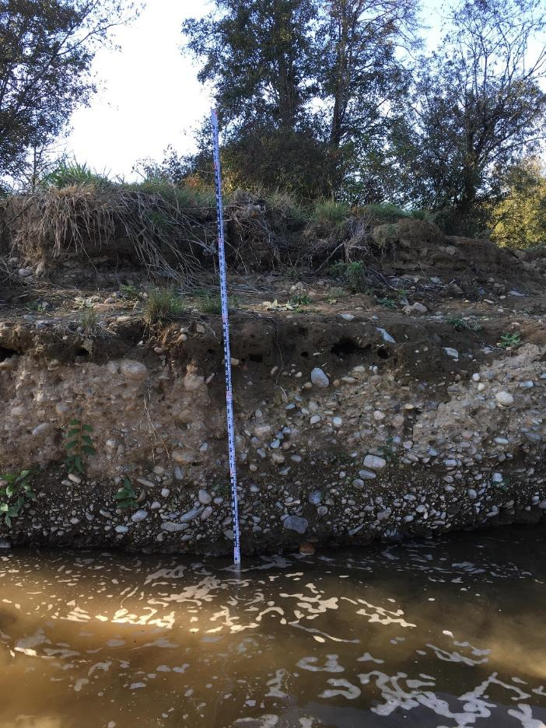
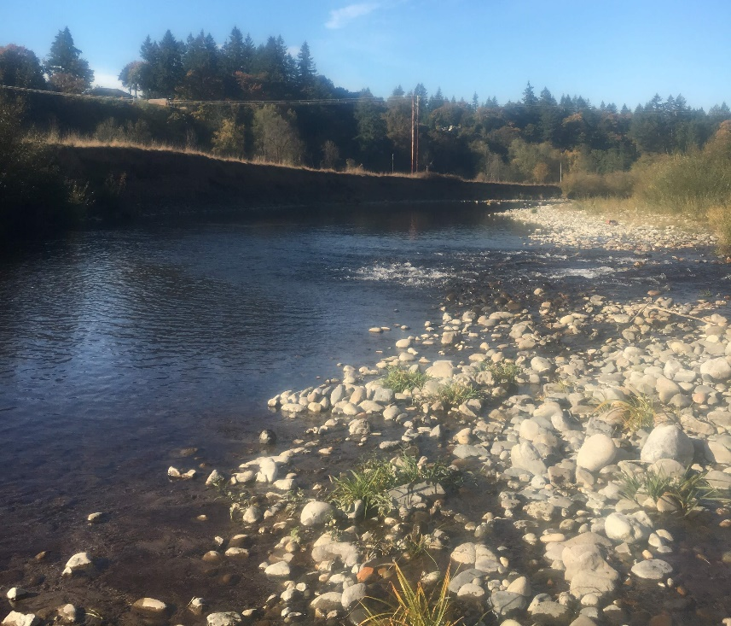
Base Flow
No change in morphology
Current not strong enough to move river bed material
Water level not high enough / current not strong enough to erode steep banks

Slide 14
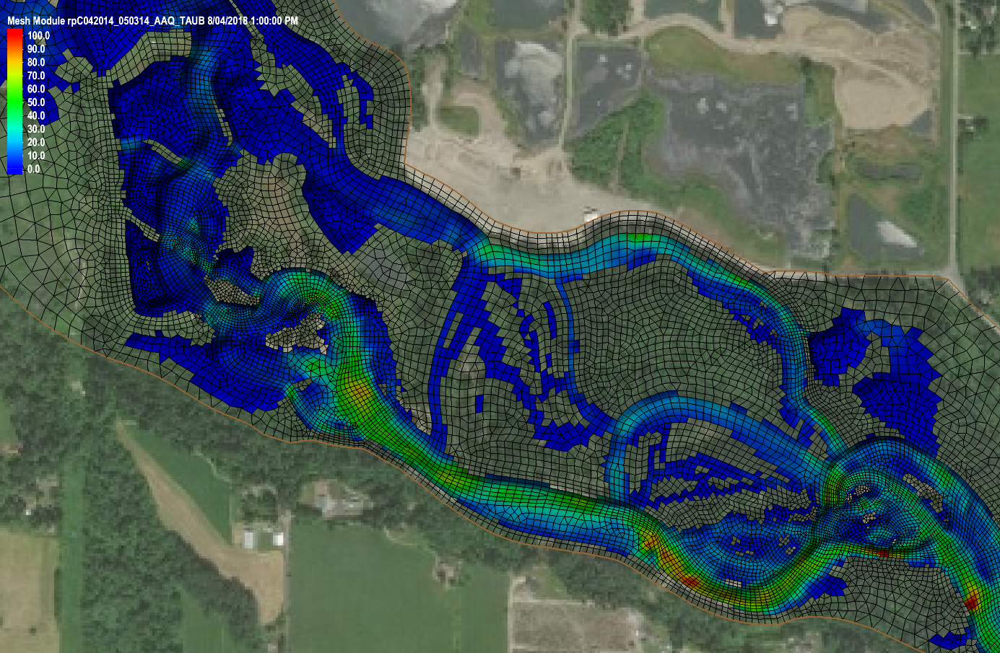
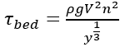
Small / Frequent Flood (1yr ~ 2yr)
Q = 5630 ft³/s
or 159.4 m³/s
For checking
V = 2.75 m³/s
h = 1.74 m
n = 0.04
= 98.6 N/m²
99.0 N/m²

Slide 15
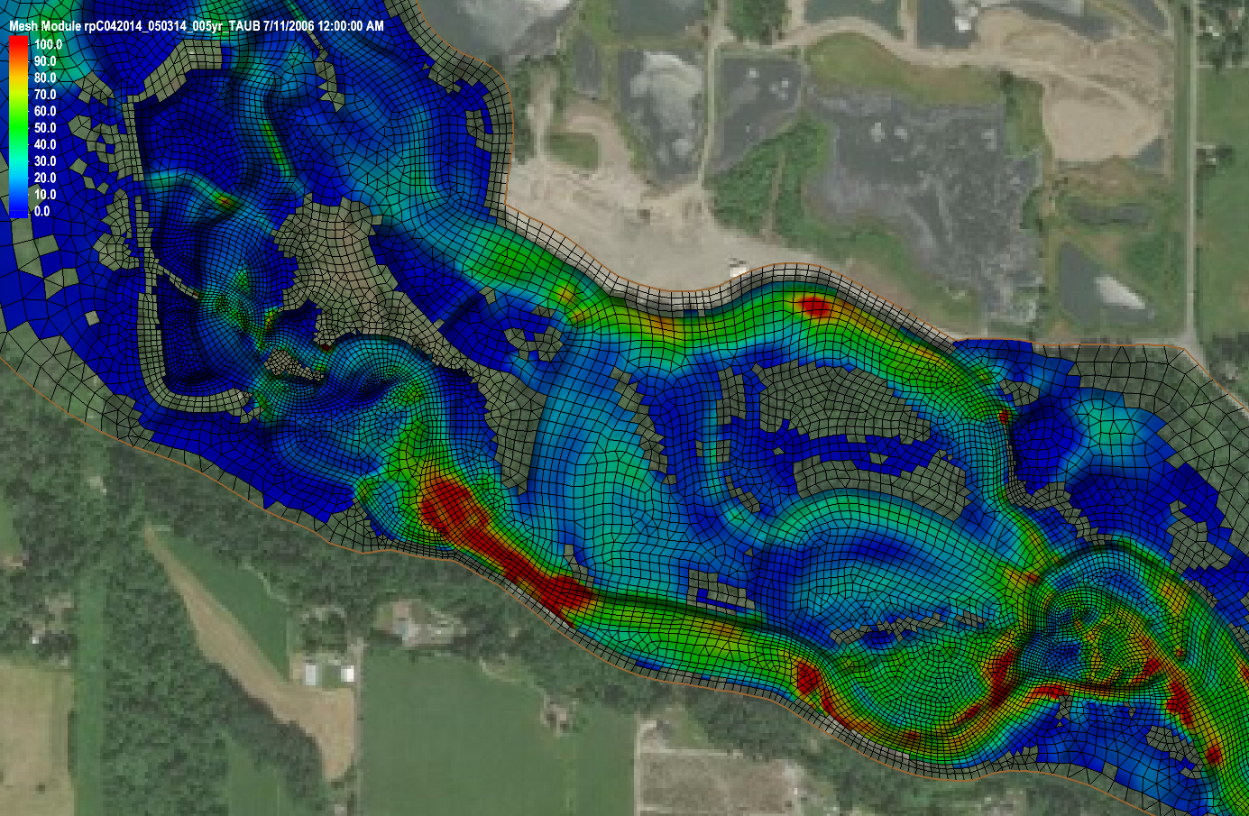
Result - Taub
5yr:
Q = 16000 ft³/s
or 453.1 m³/s

Slide 16
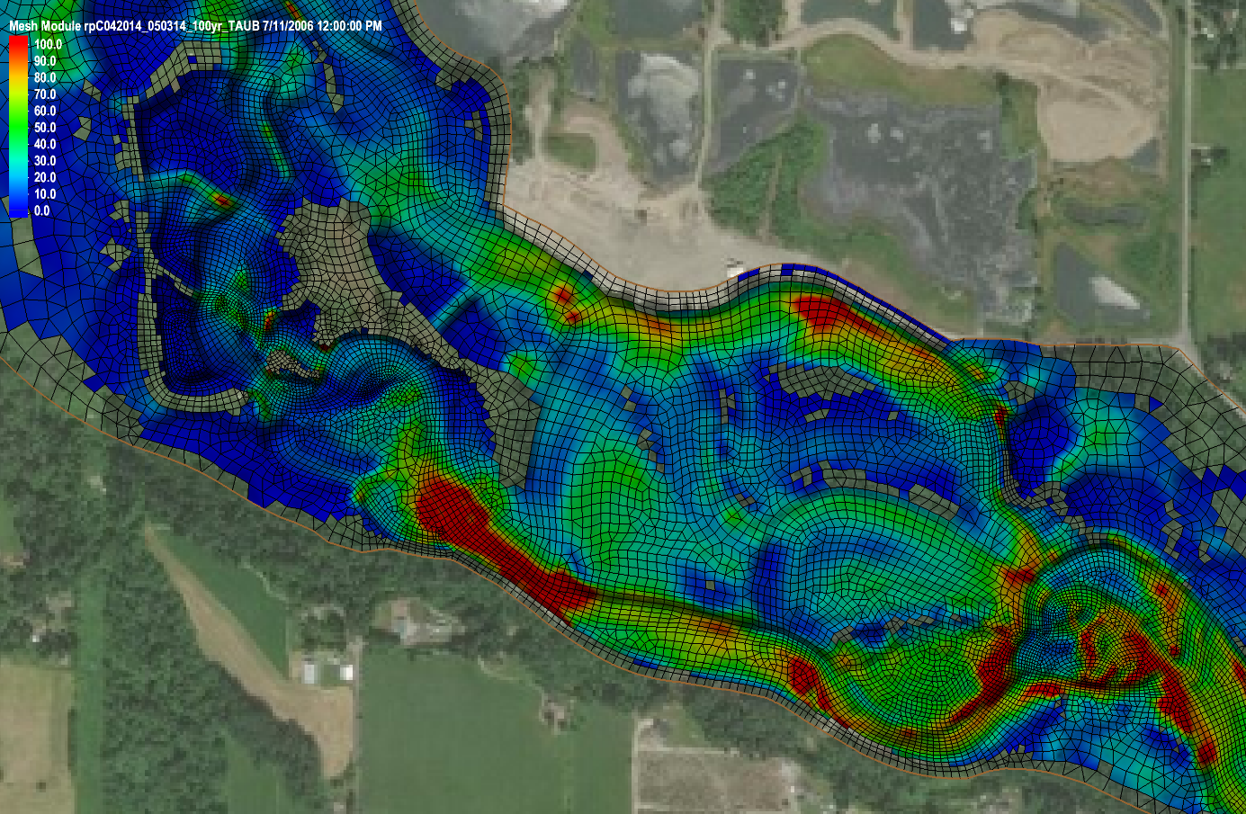
Result - Taub
100yr:
Q = 28800 ft³/s
or 815.5 m³/s

Slide 17
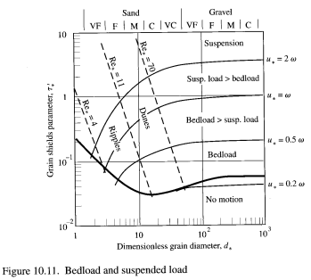
State of Sediment Transport
Bed Material | d (mm) | d* | ws (m/s) | Flow | base | 1yr | 5yr | 100yr
 |  |  |  | τb, max (N/m2) | 50 | 100 | 150 | 170
 |  |  |  | u*, max (m/s) | 0.22 | 0.32 | 0.39 | 0.41
 |  |  |  | u* /ws
Sand | 0.25 | 6.31 | 0.033 |  | 6.75 | 9.54 | 11.69 | 12.44
Coarse Sand | 1 | 25.22 | 0.098 |  | 2.28 | 3.23 | 3.95 | 4.21
Gravel | 10 | 252.20 | 0.328 |  | 0.68 | 0.96 | 1.18 | 1.26
Coarse Gravel | 25 | 630.50 | 0.519 |  | 0.43 | 0.61 | 0.75 | 0.79
Small Cobble | 60 | 1513.21 | 0.804 |  | 0.28 | 0.39 | 0.48 | 0.51
Cobble | 100 | 2522.01 | 1.038 |  | 0.22 | 0.30 | 0.37 | 0.40

Slide 18
Discussion
Even under the base flow condition, Taub can become as high as 50N/m² in some part of the river, which is strong enough to move bed material smaller than “Coarse Gravel”.
Under the 1yr flood event, Taub can reach 100N/m2 in small part of the river. The majority of the bed material can move but Cobbles can form armouring layer at most part of the channel. This is a high frequency event and the bank erosion at the highlighted area may shift the stream over time.
Under the 5yr flood event, water can get almost everywhere. Taub can reach 150N/m2 even in the potential river course at the south side of the domain.

Slide 19
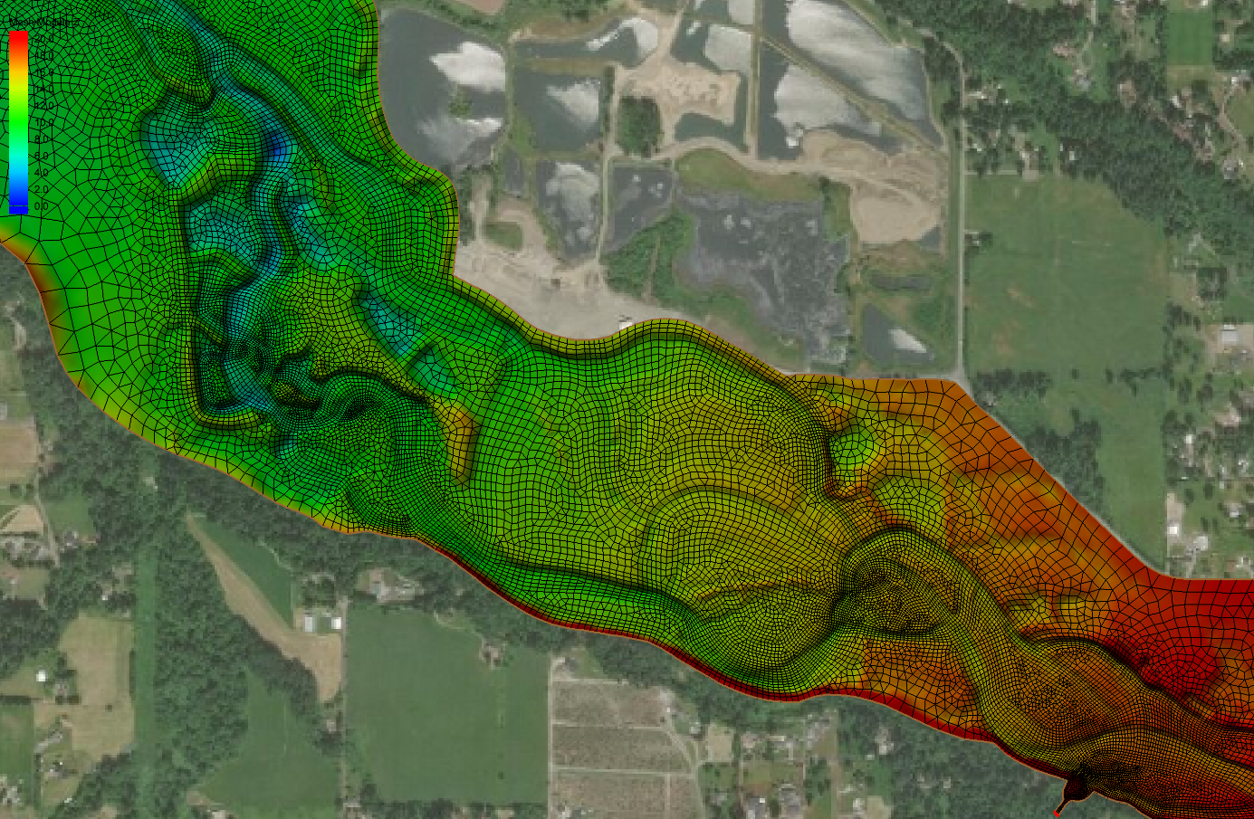
Geometry

