Slide 1
Review of Sediment Data
Lower Columbia Estuary Partnership

Slide 2
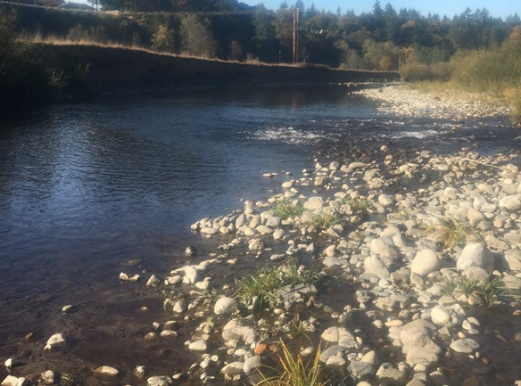
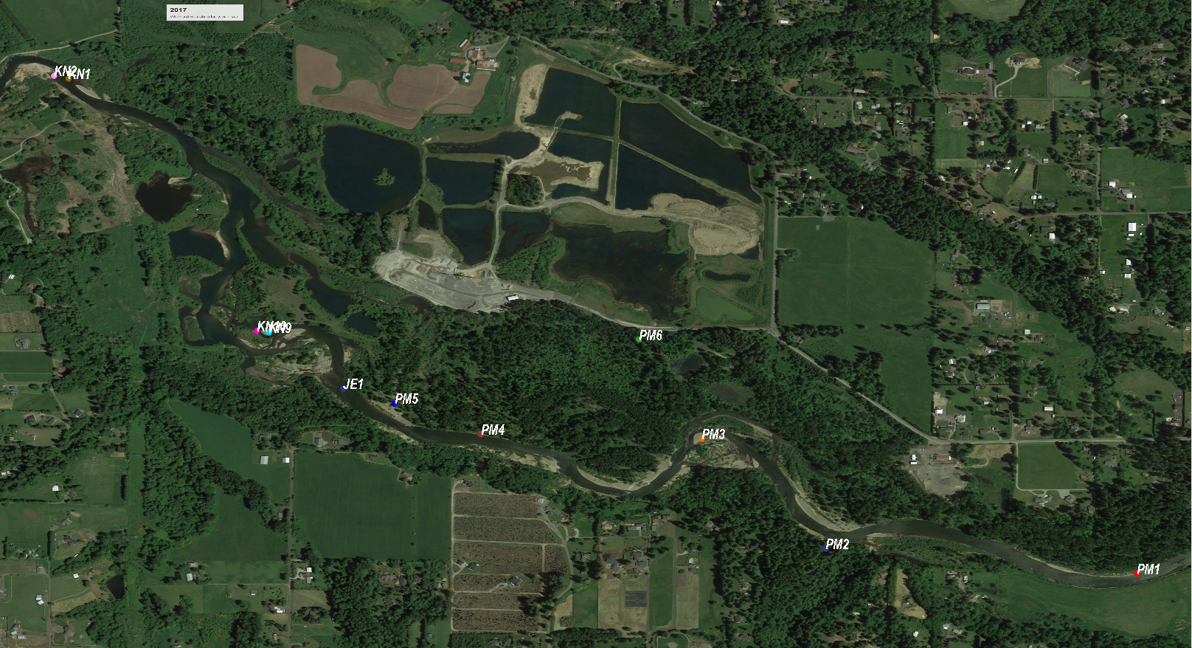
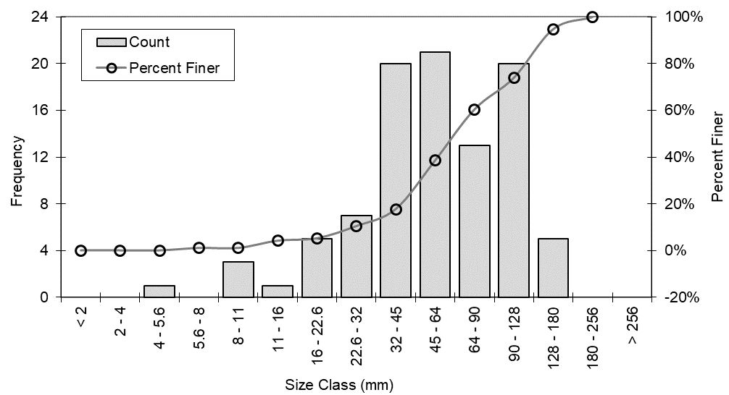
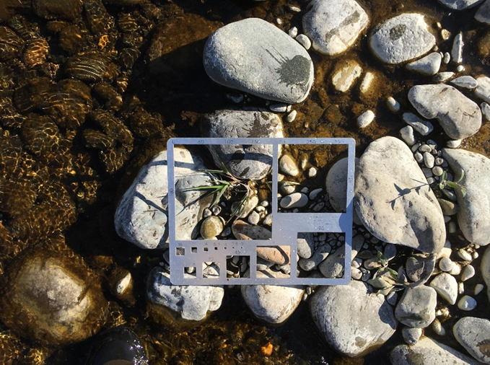
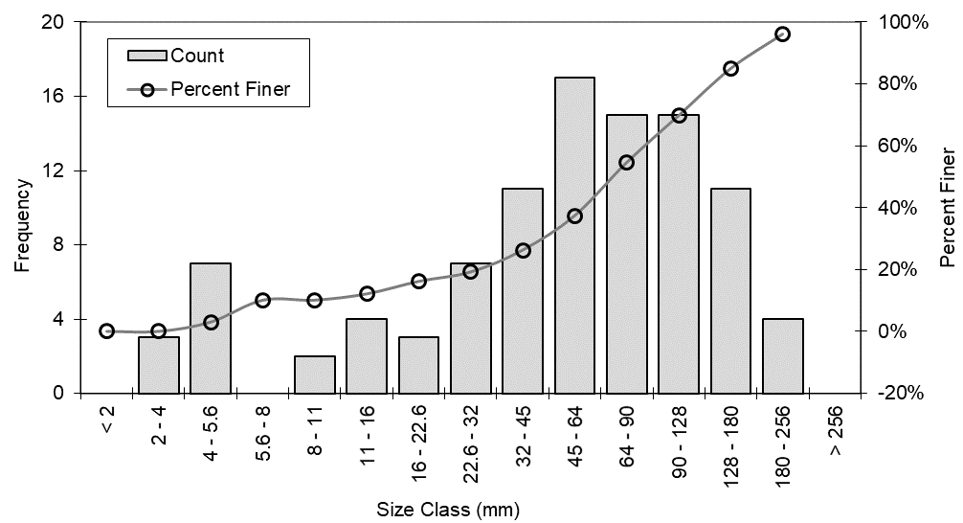
Riverbed Material

Slide 3
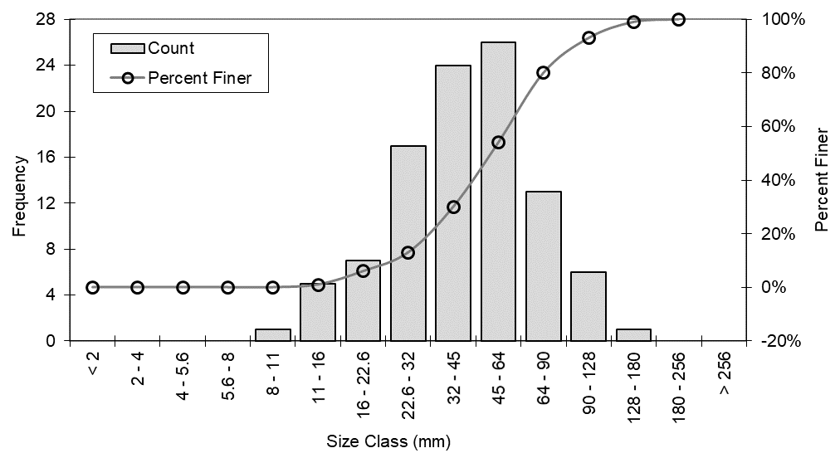
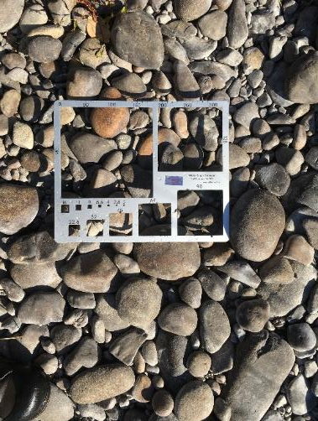
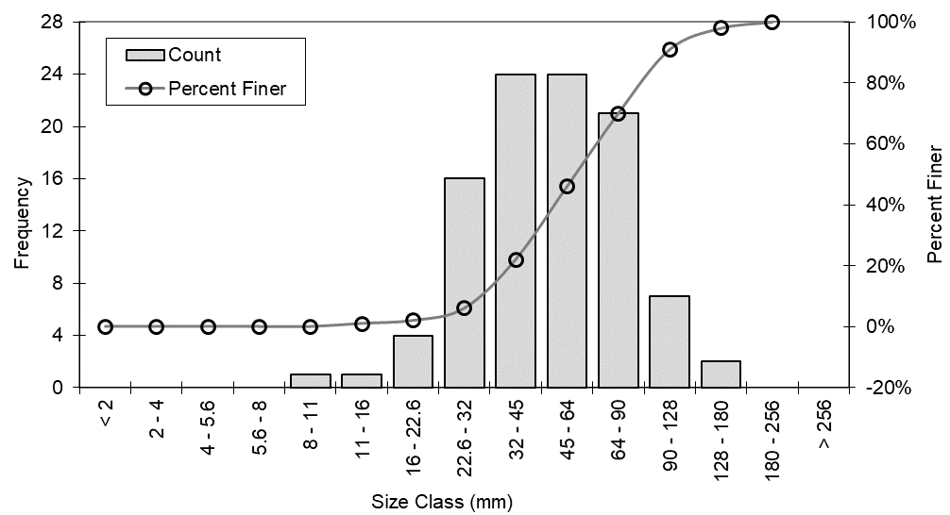
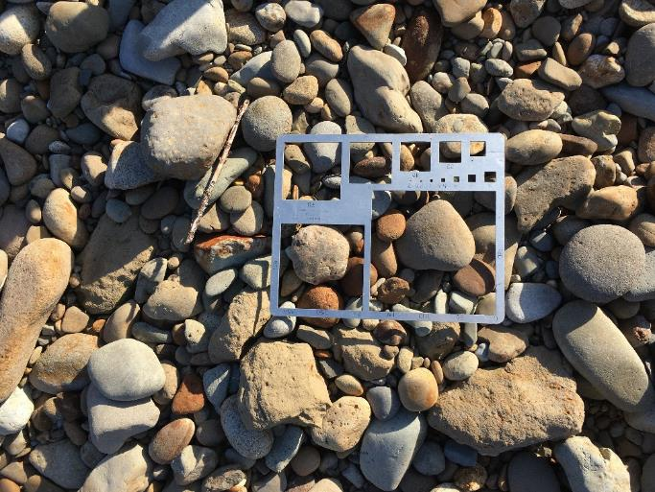
Riverbed Material

Slide 4
Riverbed Material
Relatively consistent size distribution throughout the study area
D10 ≈ 20mm Coarse Gravel
D50 ≈ 50mm Very Coarse Gravel
D84 ≈ 100mm Cobble

Slide 5

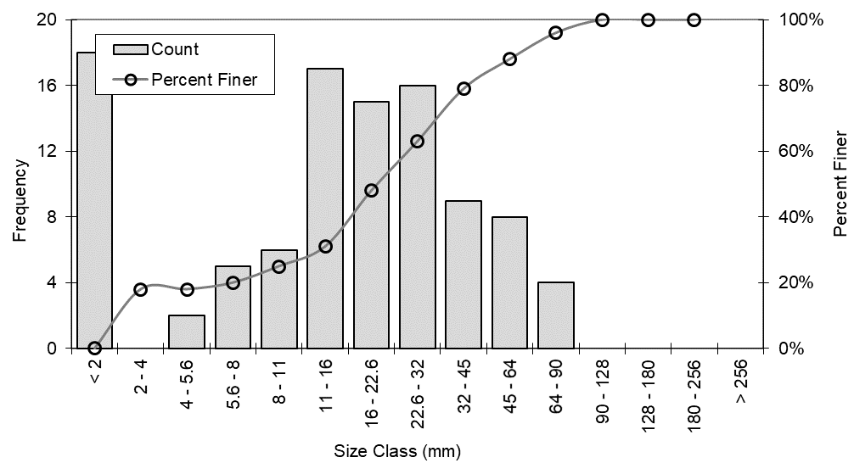
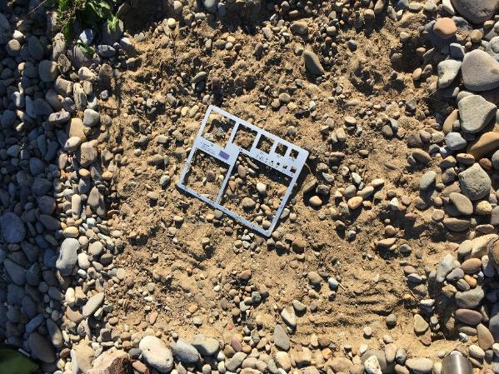
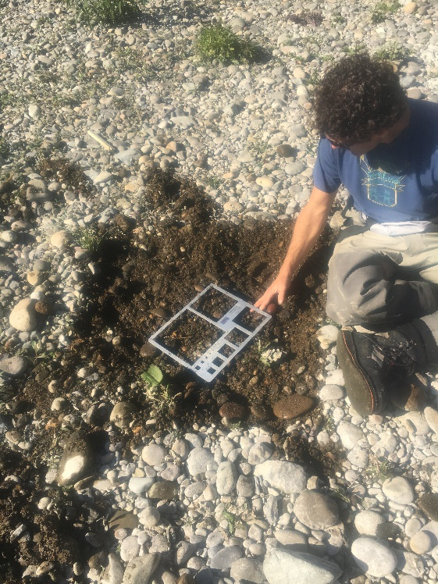
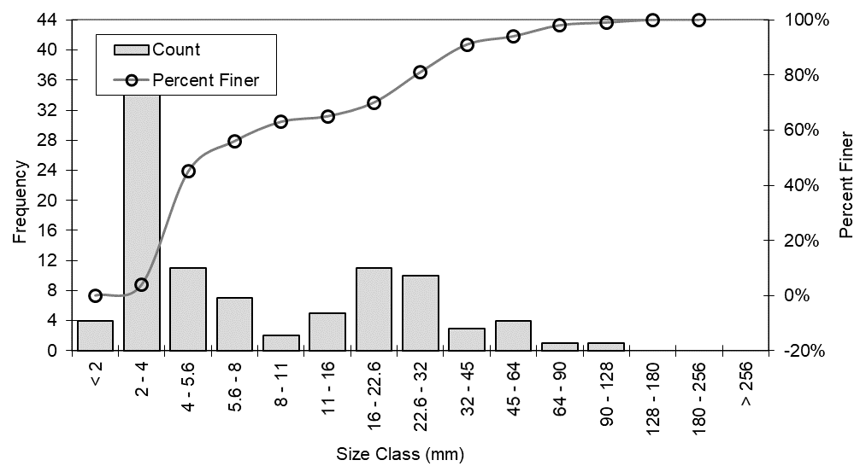
Riverbed Sub(2nd)-Layer

Slide 6
Riverbed Sub(2nd)-Layer
Two peaks in Grain Size, i.e. mixture of:
Coarse components: Gravel ~ Cobble, same as river bed
Fine components: Sands, even silts

Slide 7
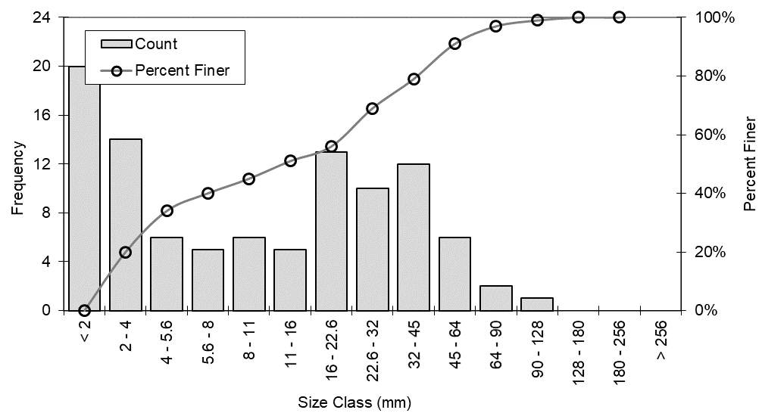
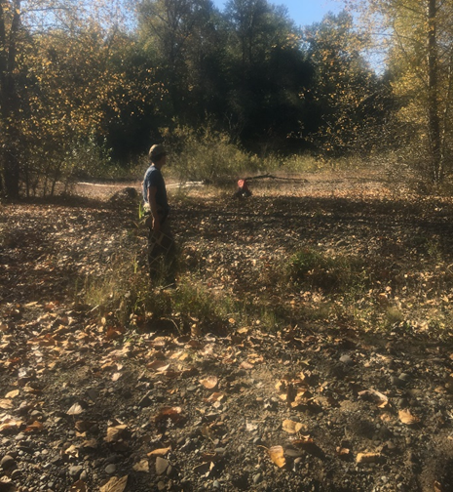
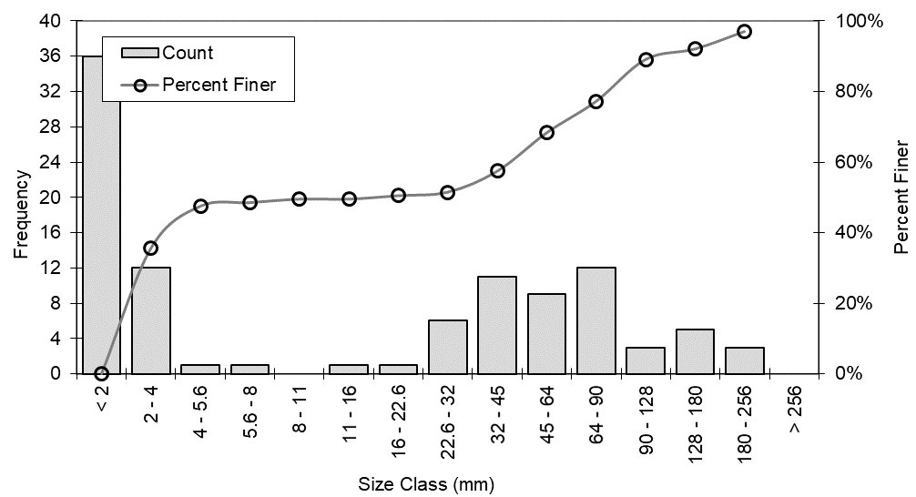
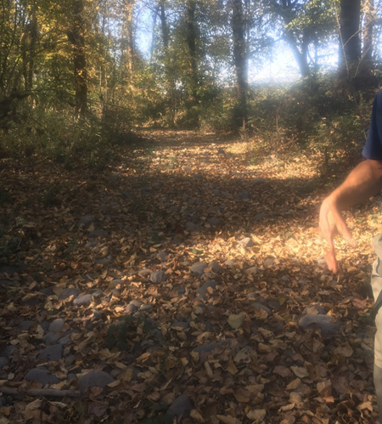
Floodplain Material

Slide 8
Floodplain Material
Also has two peaks in Grain Size. Similar with the riverbed sub-layer.

Slide 9
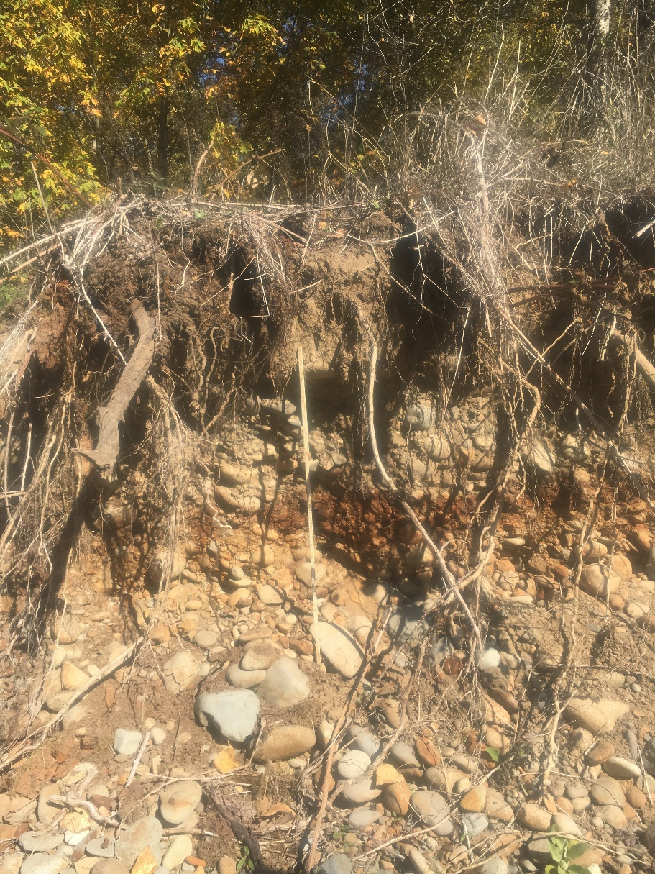
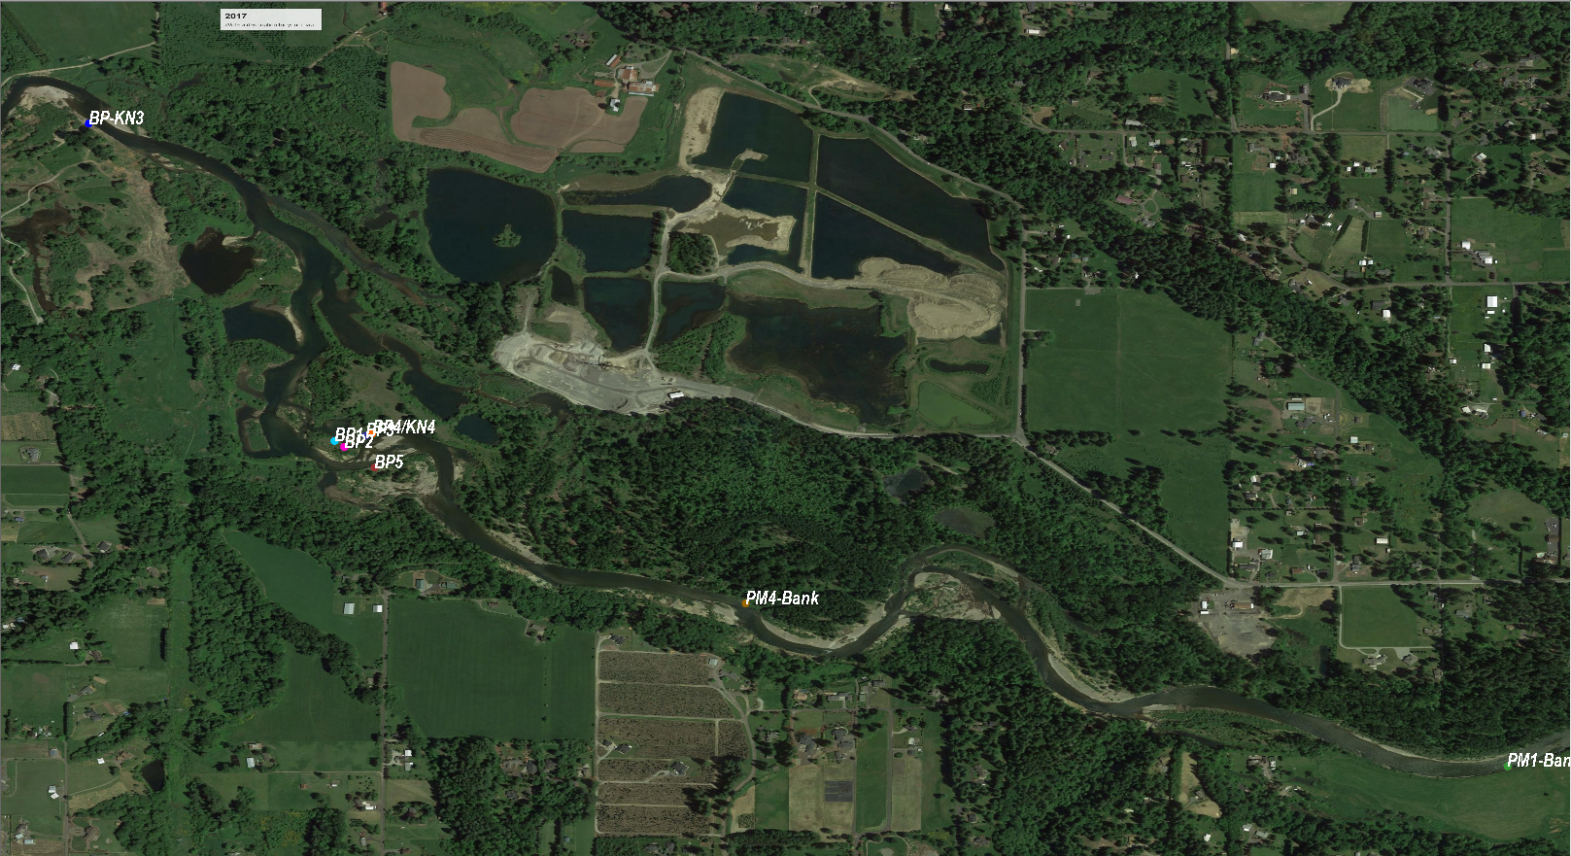
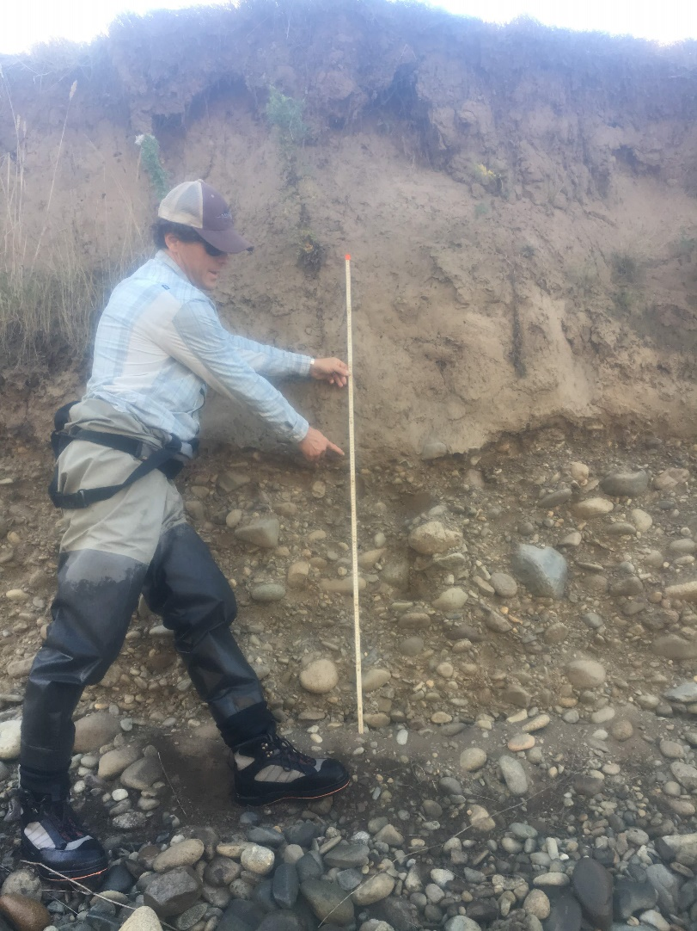
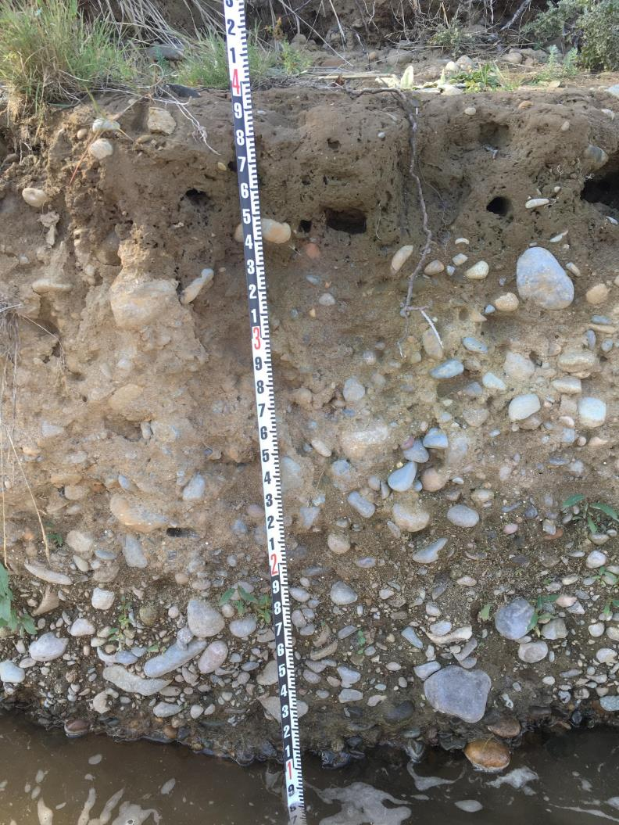
Bank Vertical Sediment Profile

Slide 10
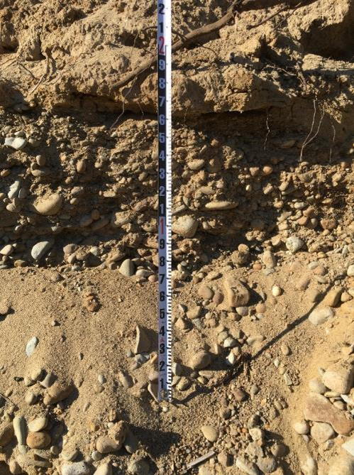
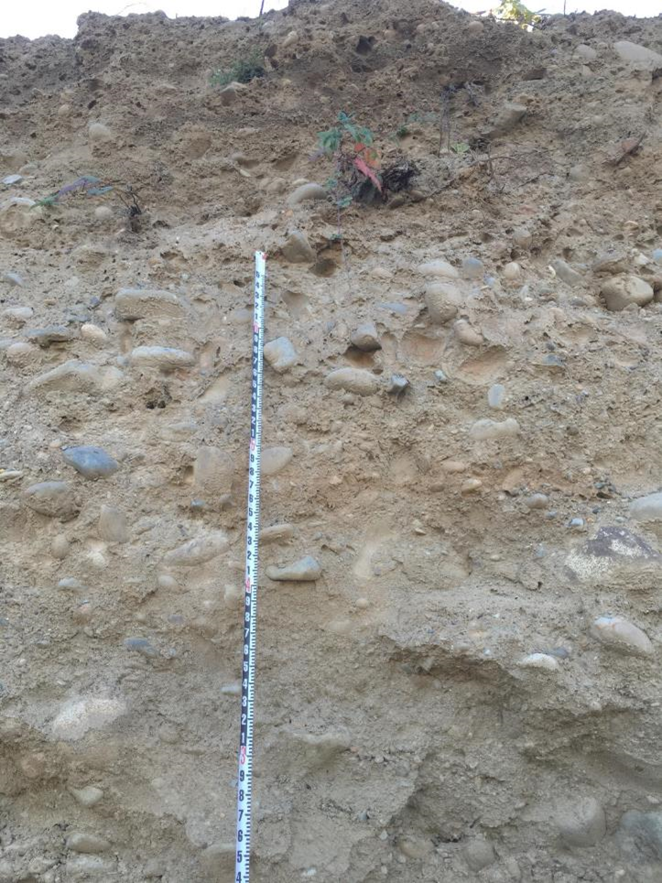
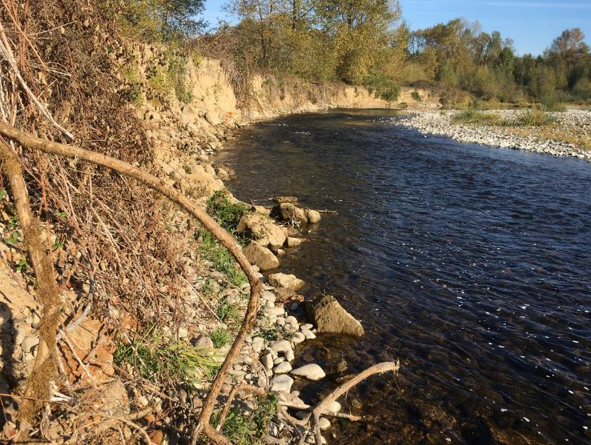
Bank Vertical Sediment Profile

Slide 11
Bank Vertical Sediment Profile
Type 1: Forestry floodplain, only have one layer of sediment, whose composition is the mixture of sand, gravel and cobble
Type 2: Most of the floodplain has two layers, with a thick sandy/silty layer on top of the Type1 layer.

Slide 12
Proposed Sediment Model Parameter
Sediment Type A: River Bed Top-layer
Example of grain size distribution

Slide 13
Proposed Sediment Model Parameter
Sediment Type B: River Bed/Bank Sub-layer, Forestry Floodplain
Example of grain size distribution

Slide 14
Proposed Sediment Model Parameter
Sediment Type C: River Bank Top-layer
One size:
Sand 1 or 2 mm

Slide 15
Proposed Sediment Model Parameter
Area | Layer | Sediment Type* | Grain Size
 |  |  | 2mm Sand | 20mm Gravel** | 50mm Gravel | 100mm Cobble
River Bed | 1 | A |  | √ | √ | √
 | 2 | B | √ | √ | √ | √
River Bank | 1 | C | √
 | 2 | B | √ | √ | √ | √
Forestry Floodplain | 1 | B | √ | √ | √ | √
* See pages above
** Is this 20mm Gravel necessary?

