Slide 1
Review of Hydraulic Conditions for Sediment Transport
Lower Columbia Estuary Partnership

Slide 2
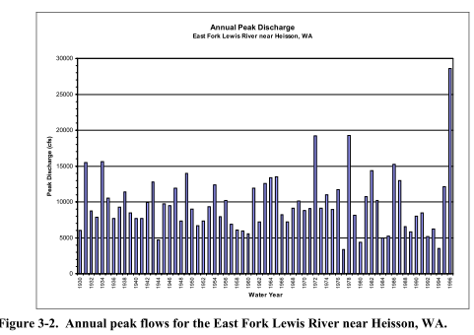
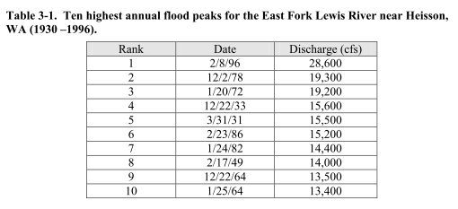
Flood History
Source: "O:\Projects\B23275.O.mjs_LCEP_RPMA\Document_Transfer\incoming\20180920_LCEP_PreviousReports\LCEP\Ridgefield_Pits\15052018093801-0001.pdf“

Slide 3
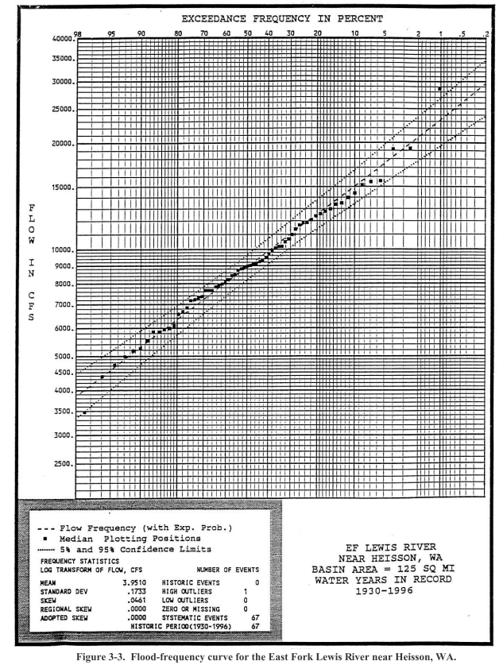
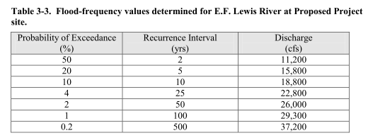
Flood Frequency Analysis
Source: "O:\Projects\B23275.O.mjs_LCEP_RPMA\Document_Transfer\incoming\20180920_LCEP_PreviousReports\LCEP\Ridgefield_Pits\15052018093801-0001.pdf“

Slide 4
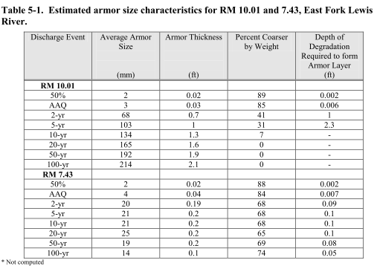
East Fork Lewis River Armoring Characteristics
The armoring calculations for the cross section at RM 10.01 show that, for discharges greater than the 5-year flood, the entire bed is mobilized.
At RM 7.43, it was estimated that the river is unable to transport material greater than about 1 inch (25 mm) in diameter. Thus, sediment sizes used for spawning are generally not transportable beyond this location.
Source: "O:\Projects\B23275.O.mjs_LCEP_RPMA\Document_Transfer\incoming\20180920_LCEP_PreviousReports\LCEP\Ridgefield_Pits\15052018093801-0001.pdf“

Slide 5
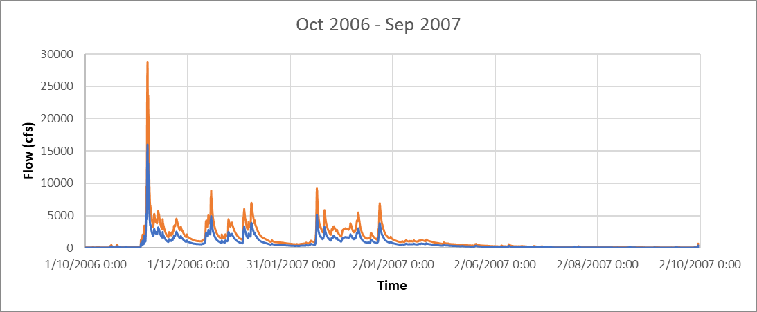
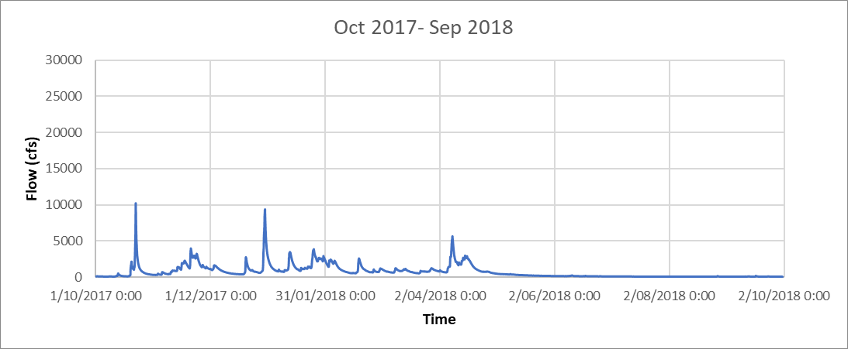
Flowrates for Hydraulic Conditions Assessment
Upstream Flow rate
100 yr: Maximun possible flow rate.
5 yr: Bed materials of all sizes flow in from upstream.
AAQ:

Slide 6
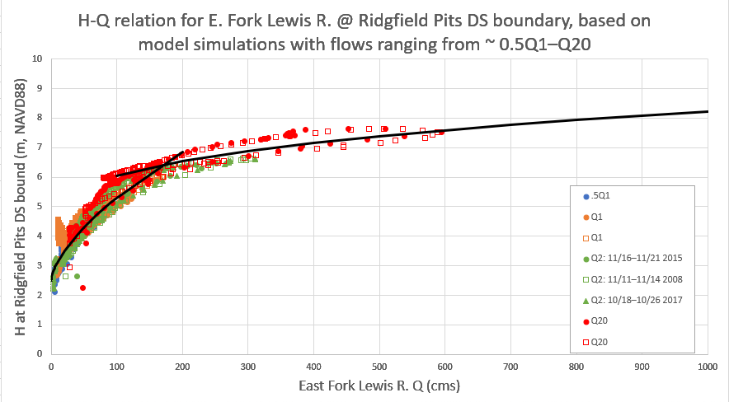



Flowrates for Hydraulic Conditions Assessment
Downstream Water Level Based on Rating curve:
C_{r}, β: rating curve constants
a: a constant which represents
the gauge reading corresponding
to zero discharge.
$$Q=C_{r}{\left(G−a\right)}^{β}$$
Over bank flow
$$Q=20{\left(G−4.3\right)}^{0.35}$$
$$Q=20{\left(G−2.5\right)}^{0.64}$$
In bank flow
O:\Projects\B23275.O.mjs_LCEP_RPMA\Document_Transfer\incoming\20180928_LCEP_HQ_Curve\HQ_relation_from_LaCenterBridge_outputs.xlsx

Slide 7
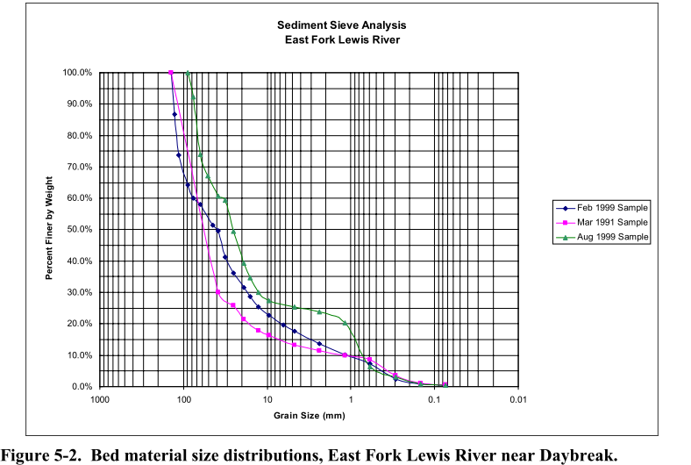
Grain Size and Critical Shear Stress
Grain Size

Slide 8
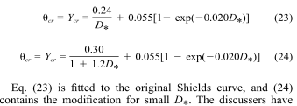
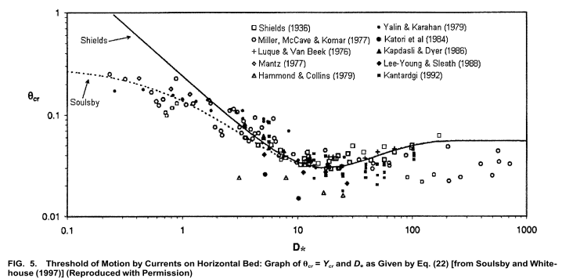

Grain Size and Critical Shear Stress
Critical Shear Stress
Description | Grain Size (mm) | Tau,c Shields’ (1936) (N/m2) | Tau,c Soulsby’s (1997) (N/m2)
Fine Sand | 1 | 0.50 | 0.50
Gravel | 10 | 9.0 | 9.0
Coarse Gravel | 25 | 22.4 | 22.4
Cobble | 100 | 89.1 | 89.1

Slide 9
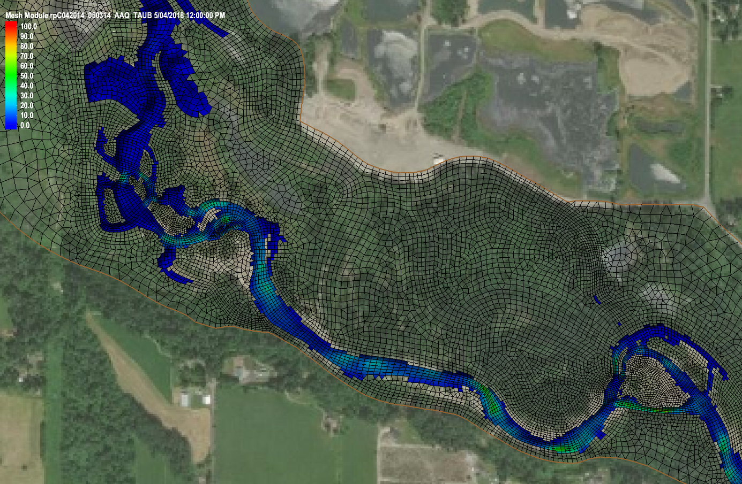
Result - Taub
Base Flow:
Q = 643 ft³/s
or 18.2 m³/s

Slide 10
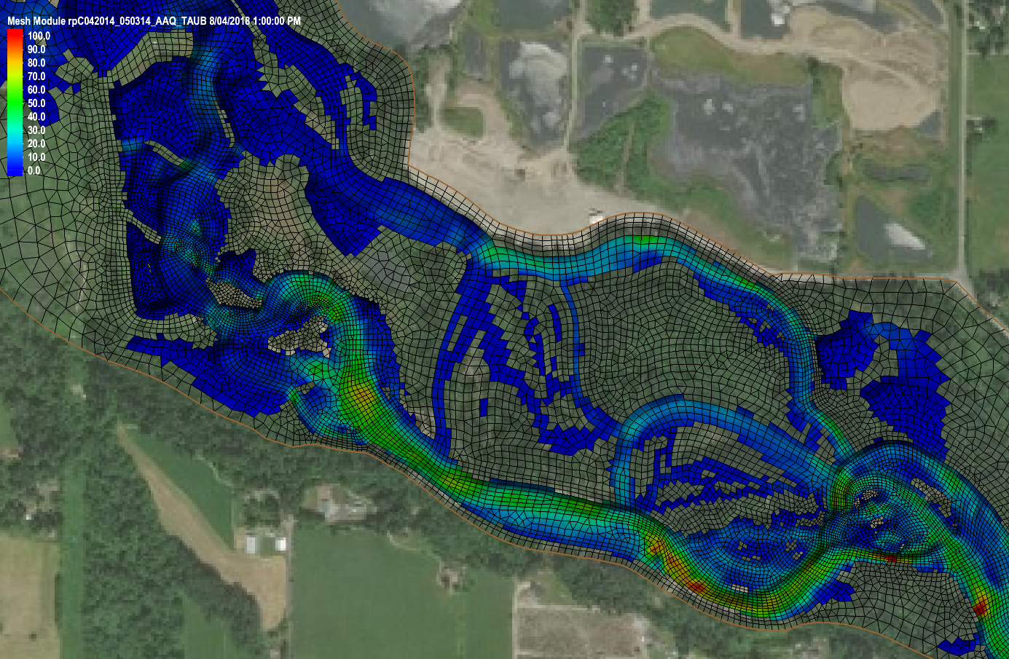
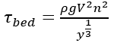
Result - Taub
1yr:
Q = 5630 ft³/s
or 159.4 m³/s
For checking
V = 2.75 m³/s
h = 1.74 m
n = 0.04
= 98.6 N/m²
99.0 N/m²

Slide 11
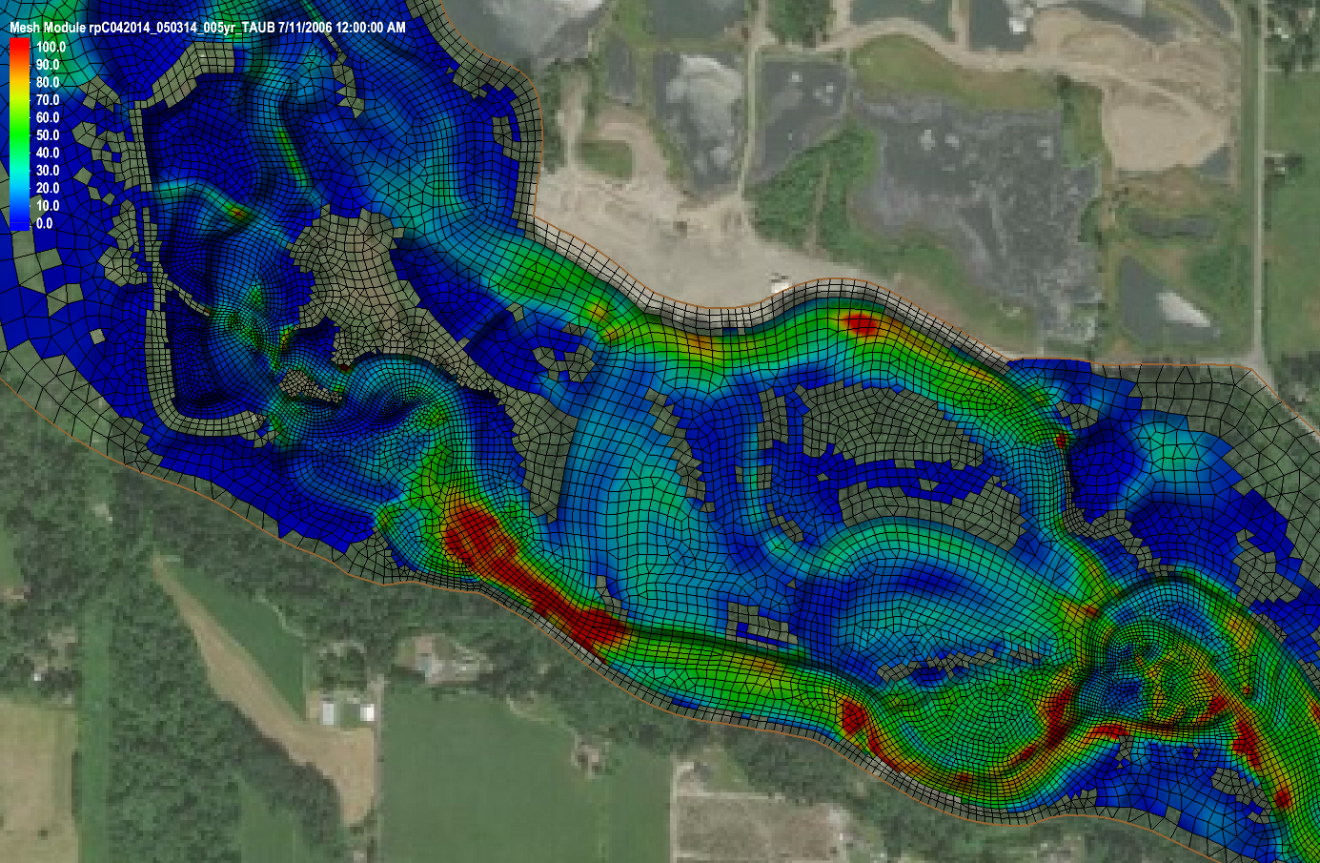
Result - Taub
5yr:
Q = 16000 ft³/s
or 453.1 m³/s

Slide 12
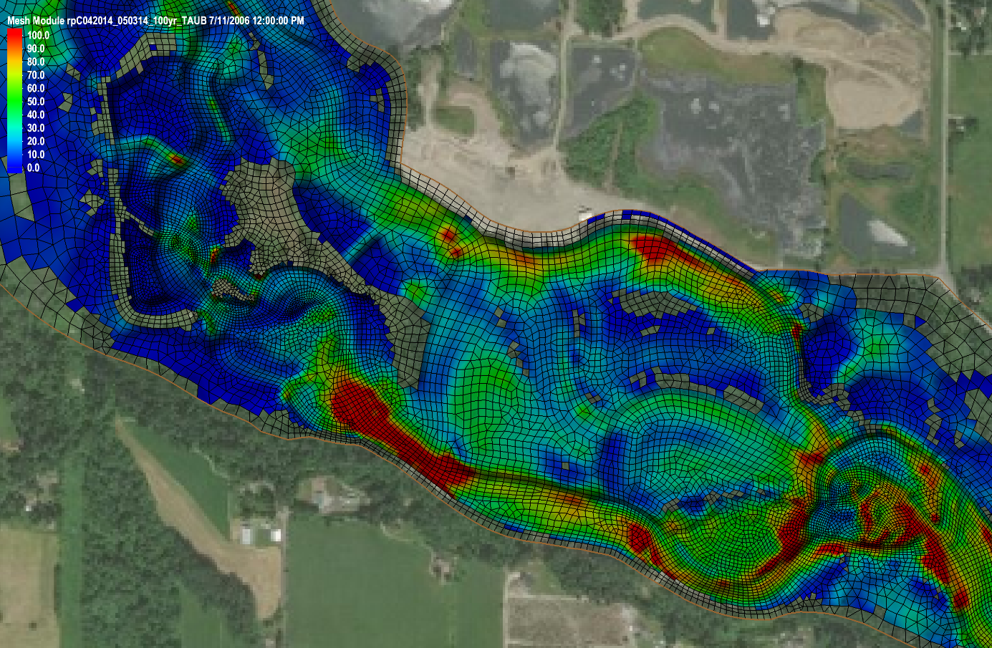
Result - Taub
100yr:
Q = 28800 ft³/s
or 815.5 m³/s

Slide 13
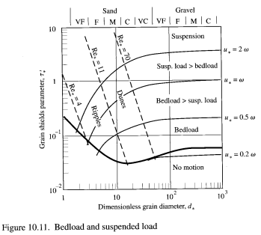
State of Sediment Transport
Bed Material | d (mm) | d* | ws (m/s) | Flow | base | 1yr | 5yr | 100yr
 |  |  |  | τb, max (N/m2) | 50 | 100 | 150 | 170
 |  |  |  | u*, max (m/s) | 0.22 | 0.32 | 0.39 | 0.41
 |  |  |  | u* /ws
Sand | 0.25 | 6.31 | 0.033 |  | 6.75 | 9.54 | 11.69 | 12.44
Coarse Sand | 1 | 25.22 | 0.098 |  | 2.28 | 3.23 | 3.95 | 4.21
Gravel | 10 | 252.20 | 0.328 |  | 0.68 | 0.96 | 1.18 | 1.26
Coarse Gravel | 25 | 630.50 | 0.519 |  | 0.43 | 0.61 | 0.75 | 0.79
Small Cobble | 60 | 1513.21 | 0.804 |  | 0.28 | 0.39 | 0.48 | 0.51
Cobble | 100 | 2522.01 | 1.038 |  | 0.22 | 0.30 | 0.37 | 0.40

Slide 14
Discussion
Even under the base flow condition, Taub can become as high as 50N/m² in some part of the river, which is strong enough to move bed material smaller than “Coarse Gravel”.
Under the 1yr flood event, Taub can reach 100N/m2 in small part of the river. The majority of the bed material can move but Cobbles can form armouring layer at most part of the channel. This is a high frequency event and the bank erosion at the highlighted area may shift the stream over time.
Under the 5yr flood event, water can get almost everywhere. Taub can reach 150N/m2 even in the potential river course at the south side of the domain.

Slide 15
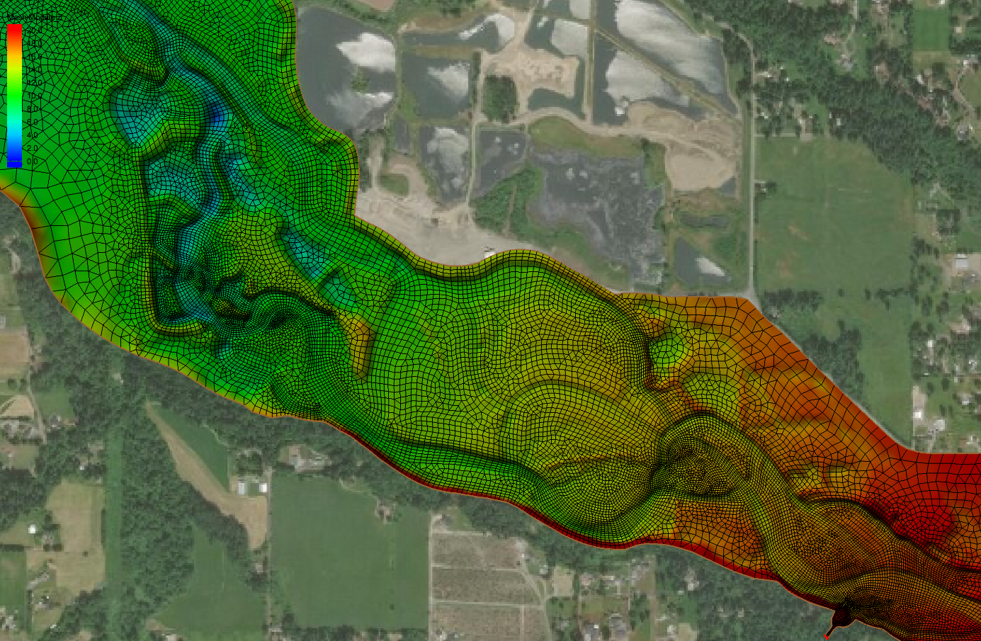
Geometry

