Slide 1
Ridgefield Pits Meeting
Welcome
*Please mute to start*
*Send comments via chat*
*Let us know if you are having any issues*
March 7th
Meeting Organizer
Paul Kolp- Lower Columbia Estuary Partnership

Slide 2
AGENDA
Recap. of where we are
Over the last several months- we’ve been focused on Alternative 3-Revised (Alt. 3 + Alt. 2)
Example Floodplain Grading- LCFEG (Brice C.)
Restoration Alternatives- Technical Analysis (presentation & discussion)
Next steps

Slide 3
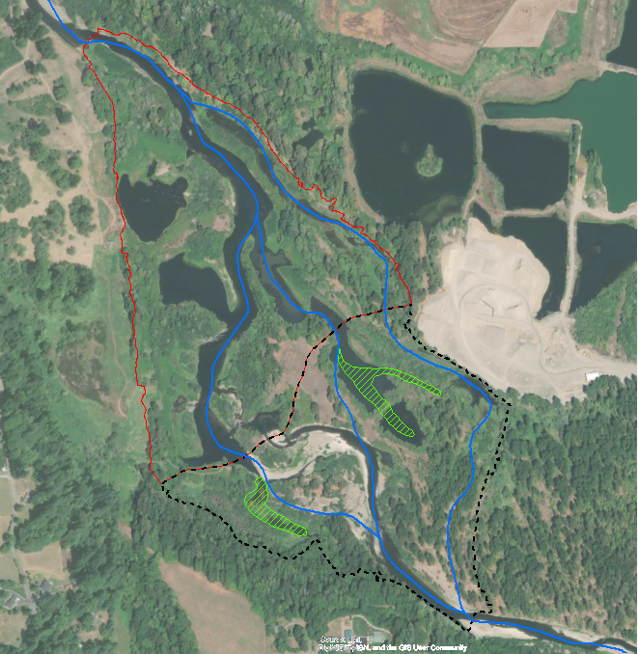
Analysis (since last meeting)- Alt 3 Revised
Creating habitat for fish: sediment, temperature, depths, velocities
Eliminate warm water sinks & connect to known cooler water
Floodplain inundation
Sediment transport through site & downstream (replenish gravels)
Grading plan
Risks to infrastructure

Slide 4

Example Project
…..South Fork Toutle River Tributary…….

Slide 5
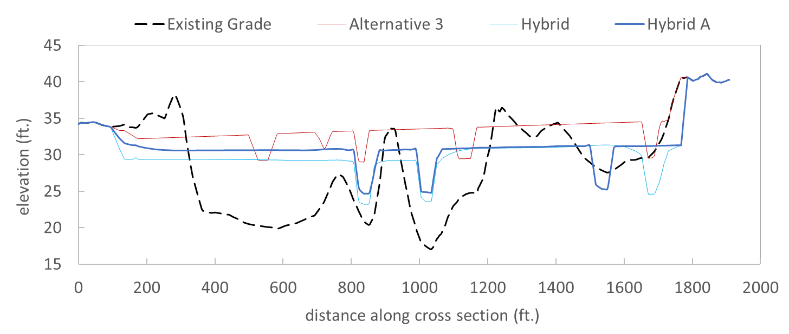
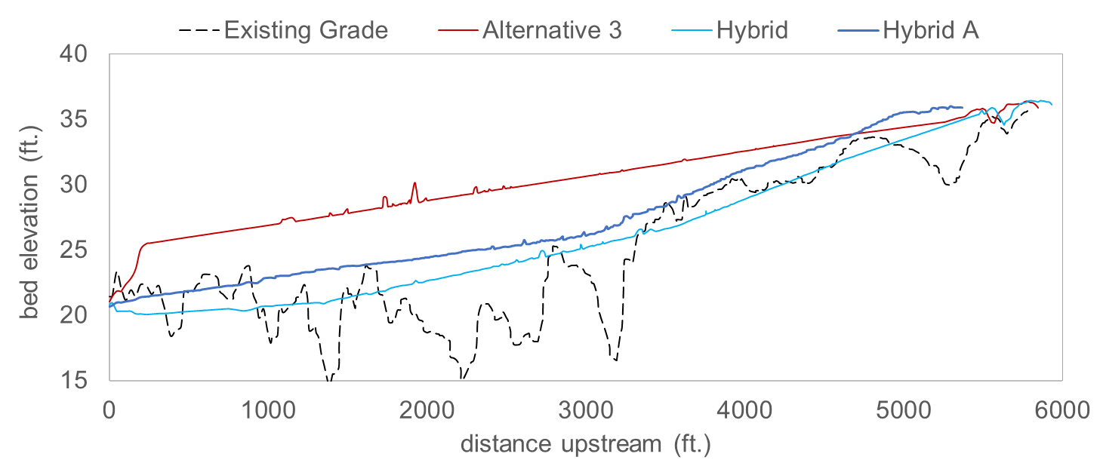
Pits Alternatives- Cut/Fill Balance
Existing Grade
Alt 3. multi-thread, 1st iteration
Alt 3 Revised.- multi-thread, 2nd iteration
Alt 3 Revised.- multi-thread, 3rd iteration
External Fill required: ~400,000 cy
External Fill required: -72,000 cy
External Fill required: 44,000 cy
Floodplain x-section profiles
Channel longitudinal profiles

Slide 6
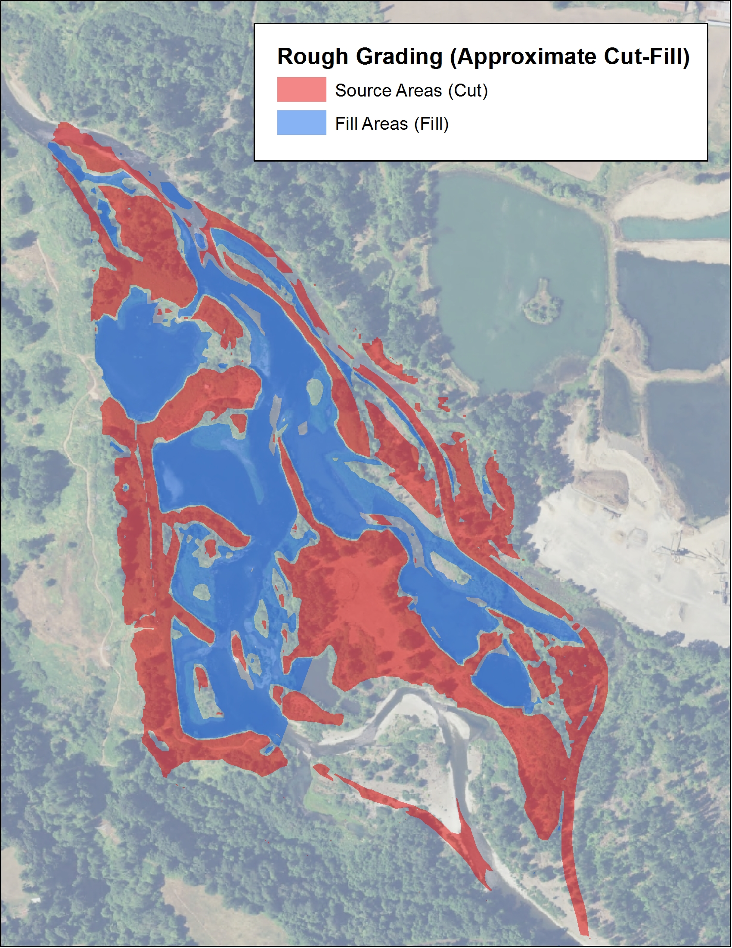
Grading Plan

Slide 7
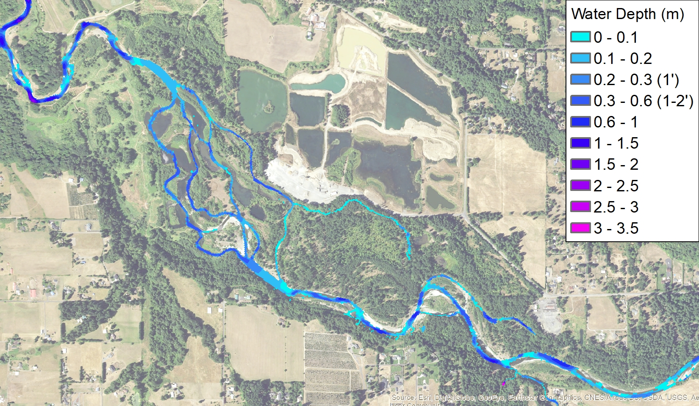
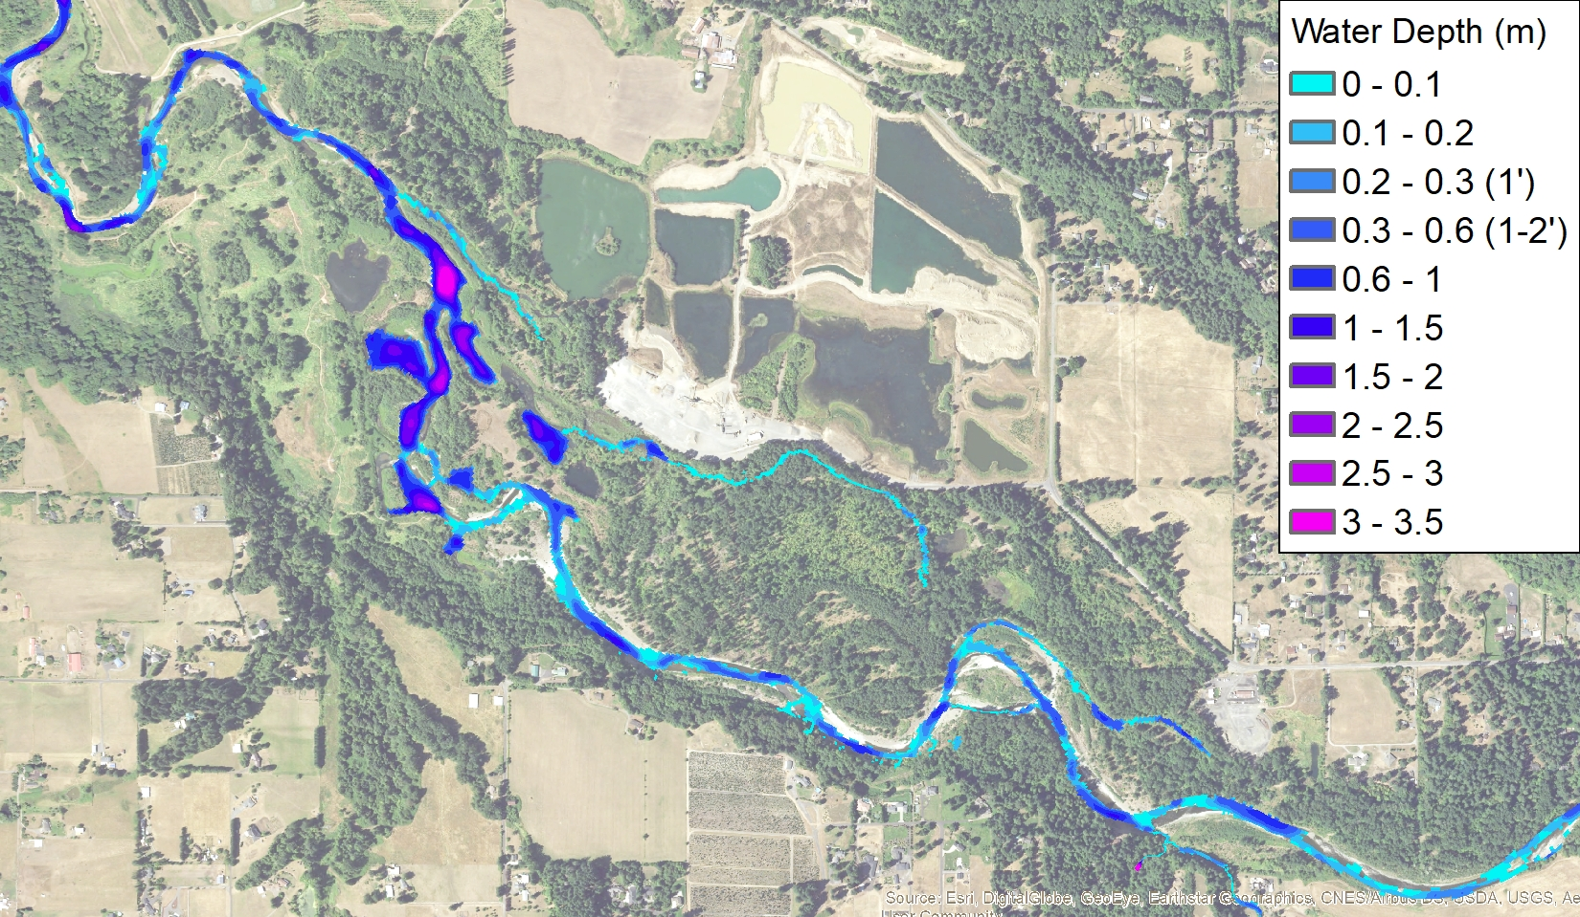
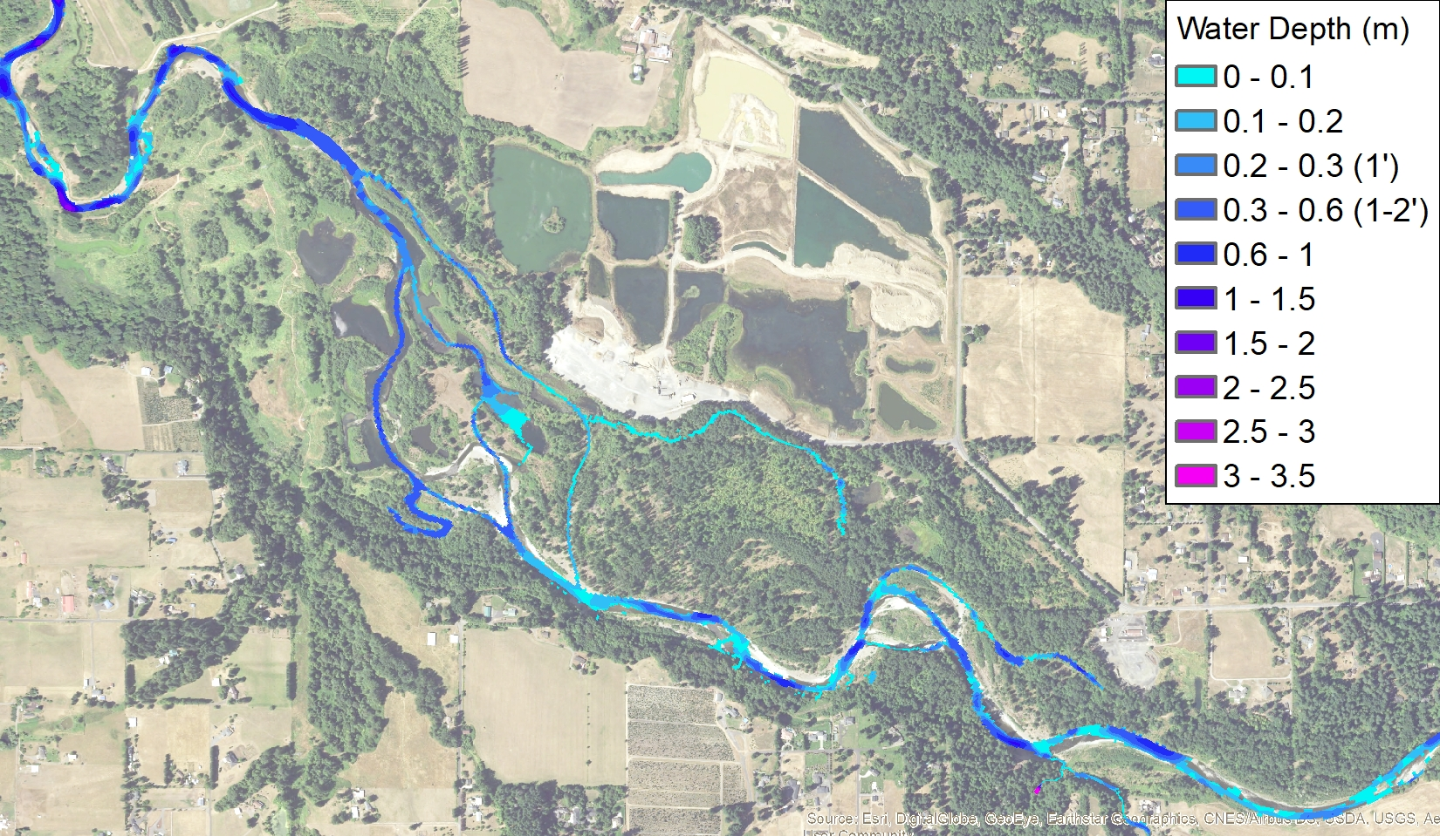
Alternative 3
Existing Condition
Baseflow Inundation – 35 cfs
Existing Condition: channel confined within deep pits
Alt 3 and Hybrid:
surface area available for solar heat addition is reduced
Hybrid retains accessible alcoves at low flows
Variation in depth will increase as designs are refined at the channel unit scale (pools, tailouts, riffles).
Alternative 3 - hybrid

Slide 8
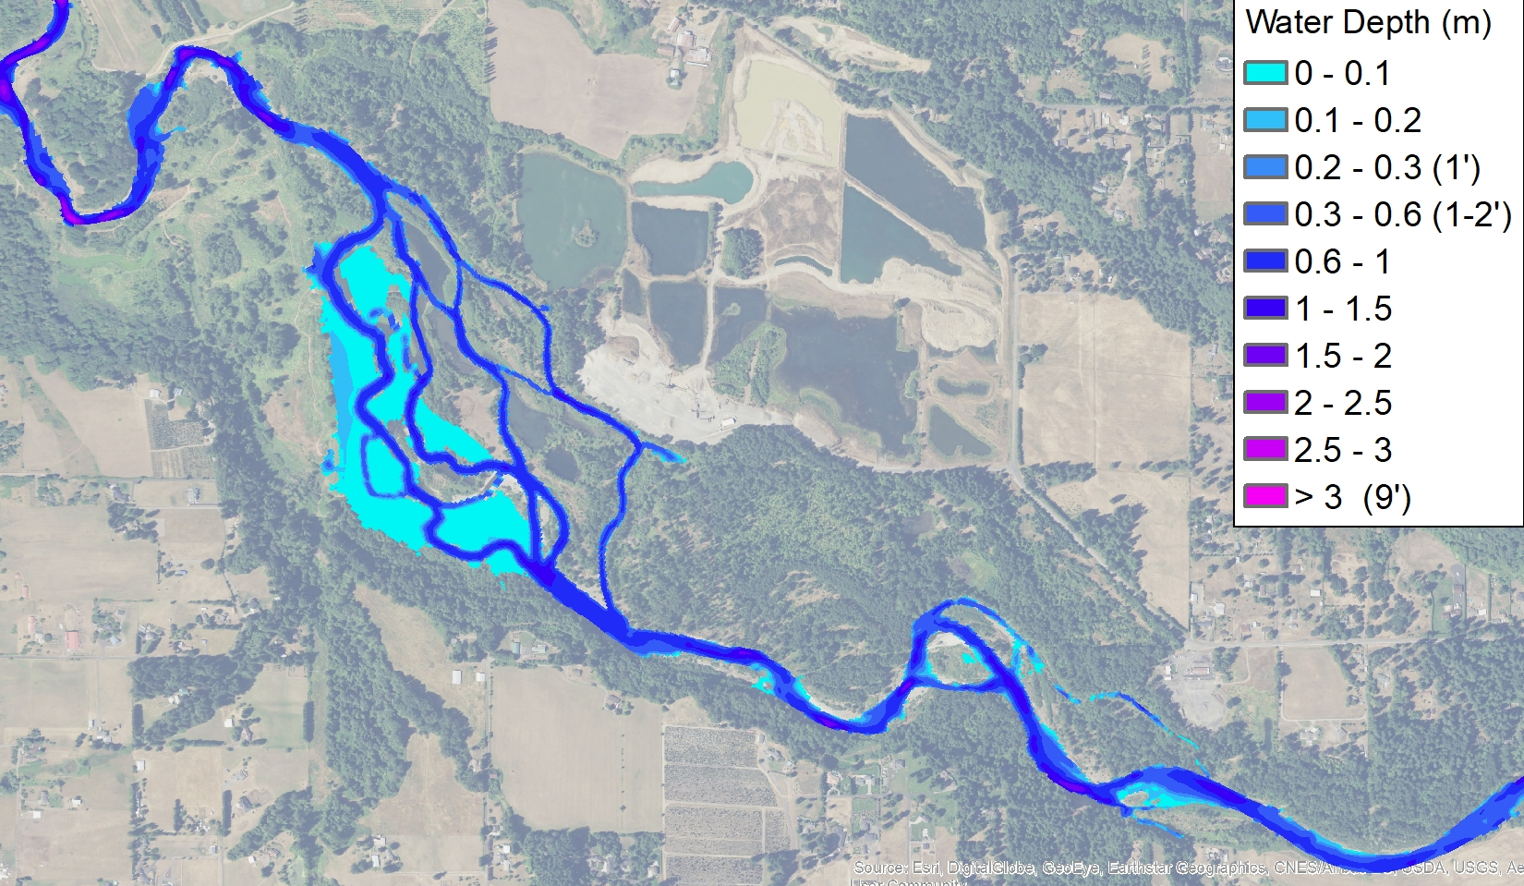
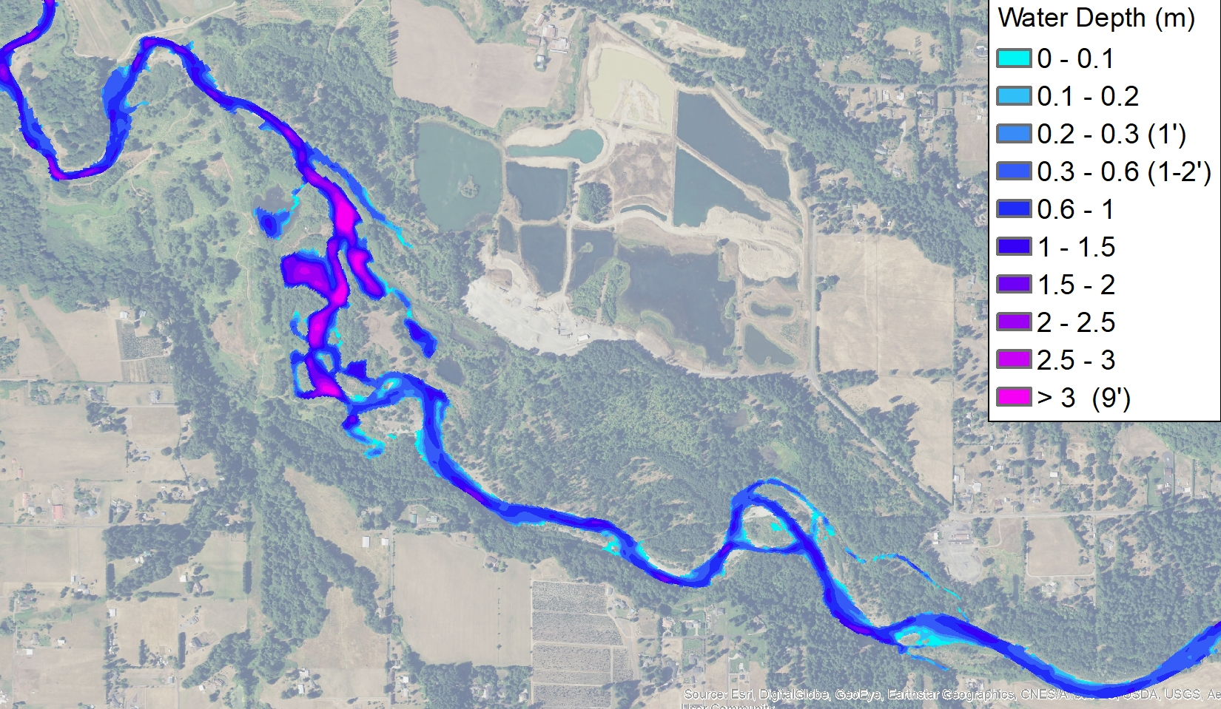
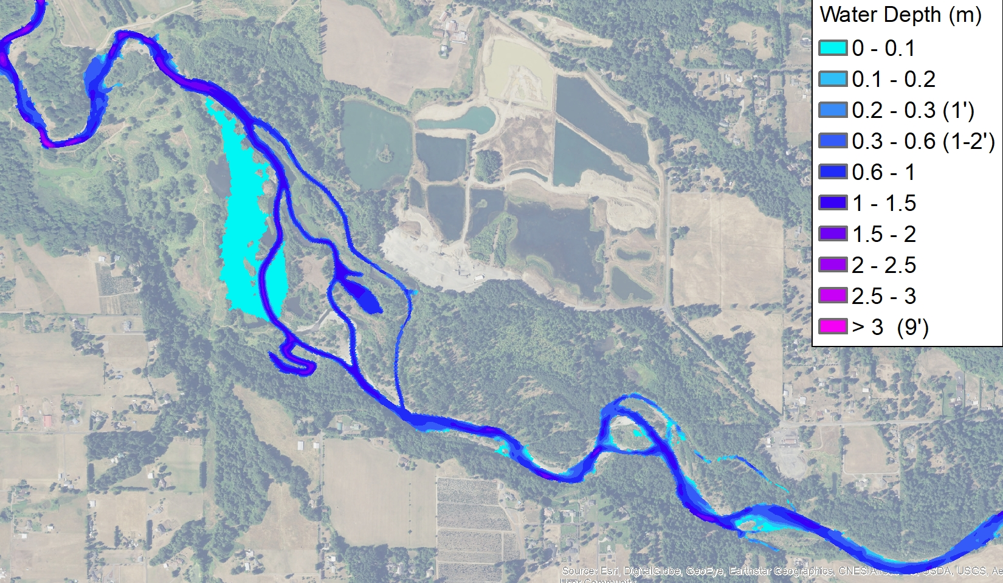
Alternative 3
Existing Condition
Typical winter flow – 1,000 cfs
Existing Condition: channel confined within deep pits
Alt 3 and Hybrid:
deep water habitat is reduced significantly
flow mostly contained within channels with some shallow wetlands
Alternative 3 - hybrid

Slide 9
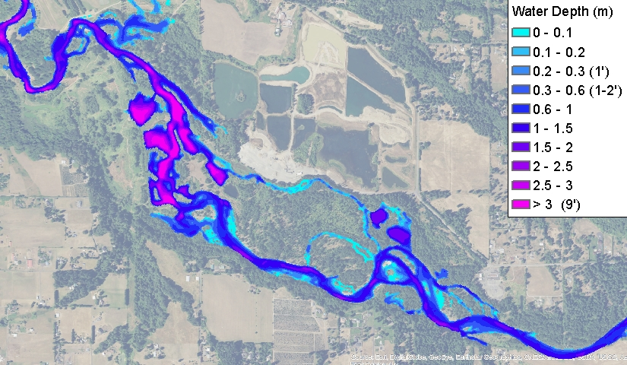
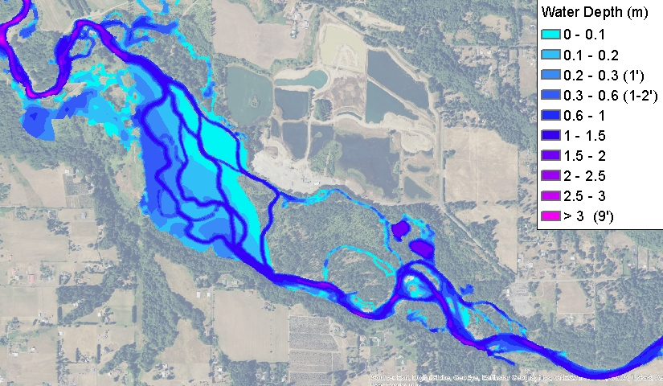
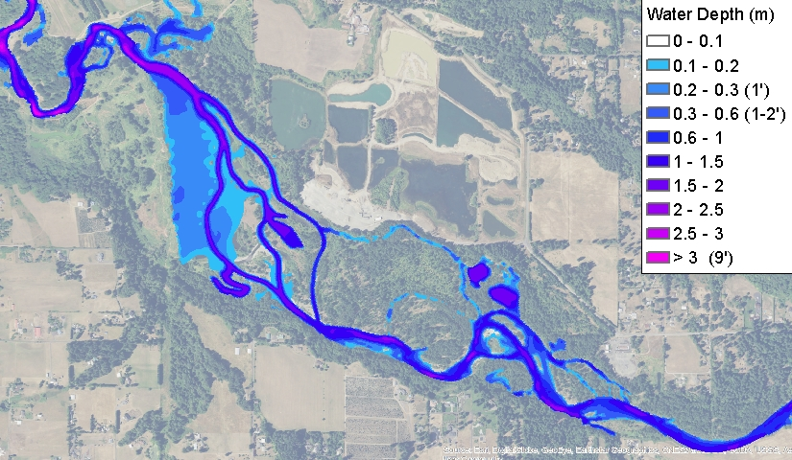
Alternative 3
Existing Condition
Moderate winter flow – 3,000 cfs
Existing Conditions: channel confined within deep pits
Alt 3 and Hybrid: Shallow floodplain inundation throughout much of reach
Alternative 3 - hybrid

Slide 10
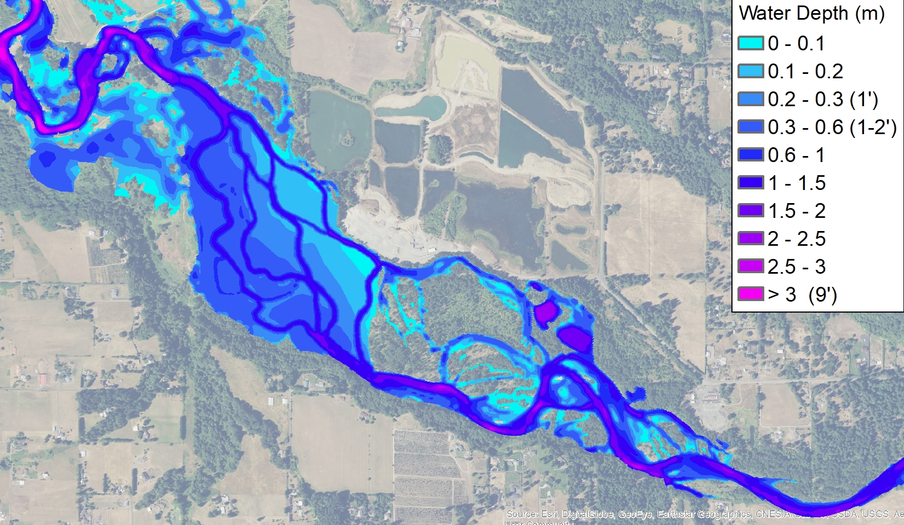
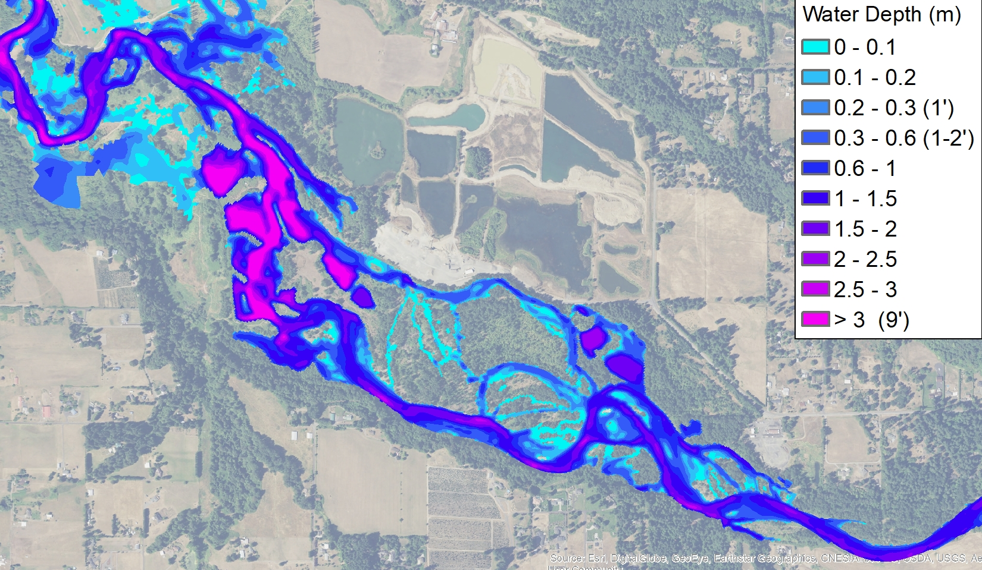
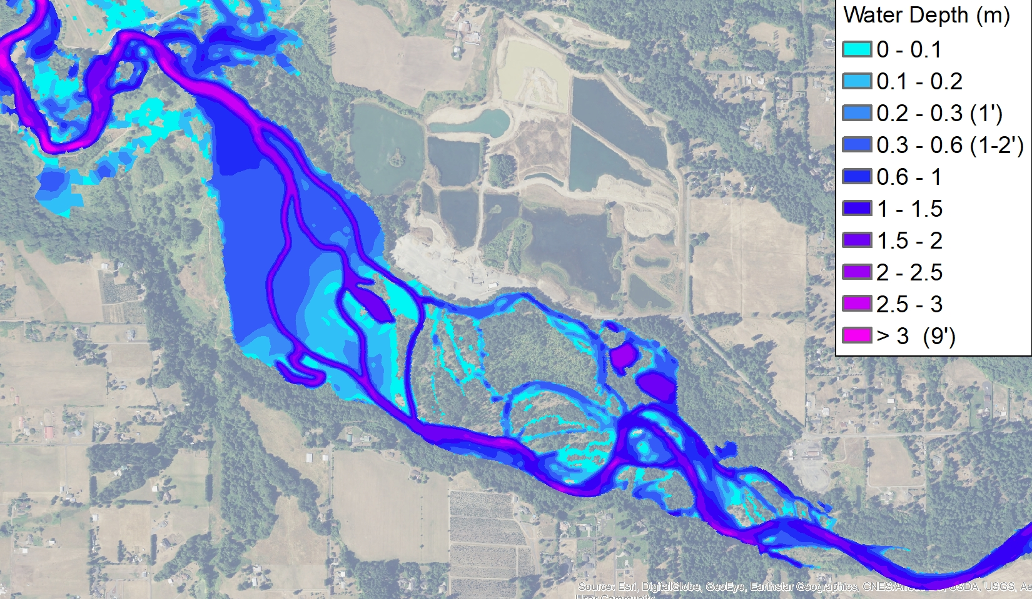
Alternative 3
Existing Condition
Annual Flood – 5,000 cfs
Existing Conditions: channel confined within deep pits
Alt 3 and Hybrid: Floodplain inundation covers most of pits reach
Alternative 3 - hybrid

Slide 11
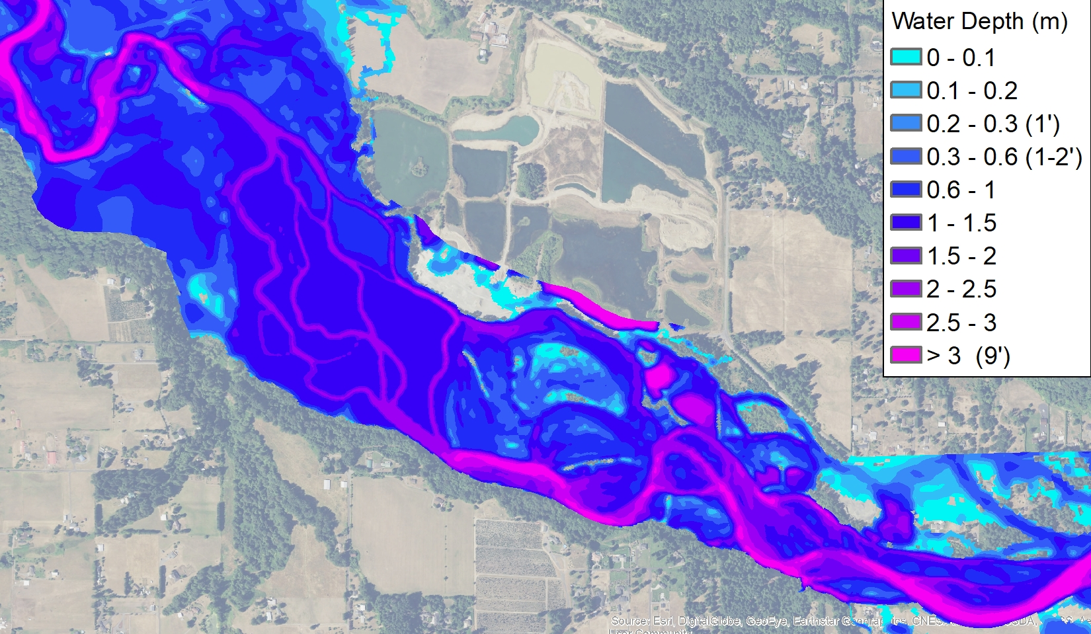
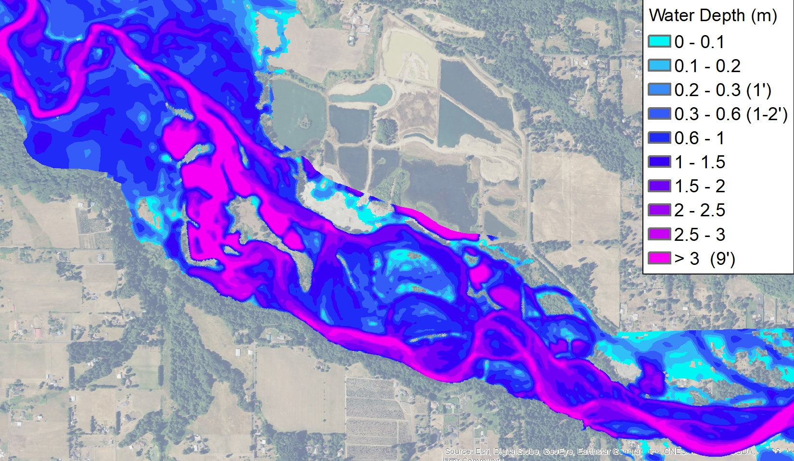
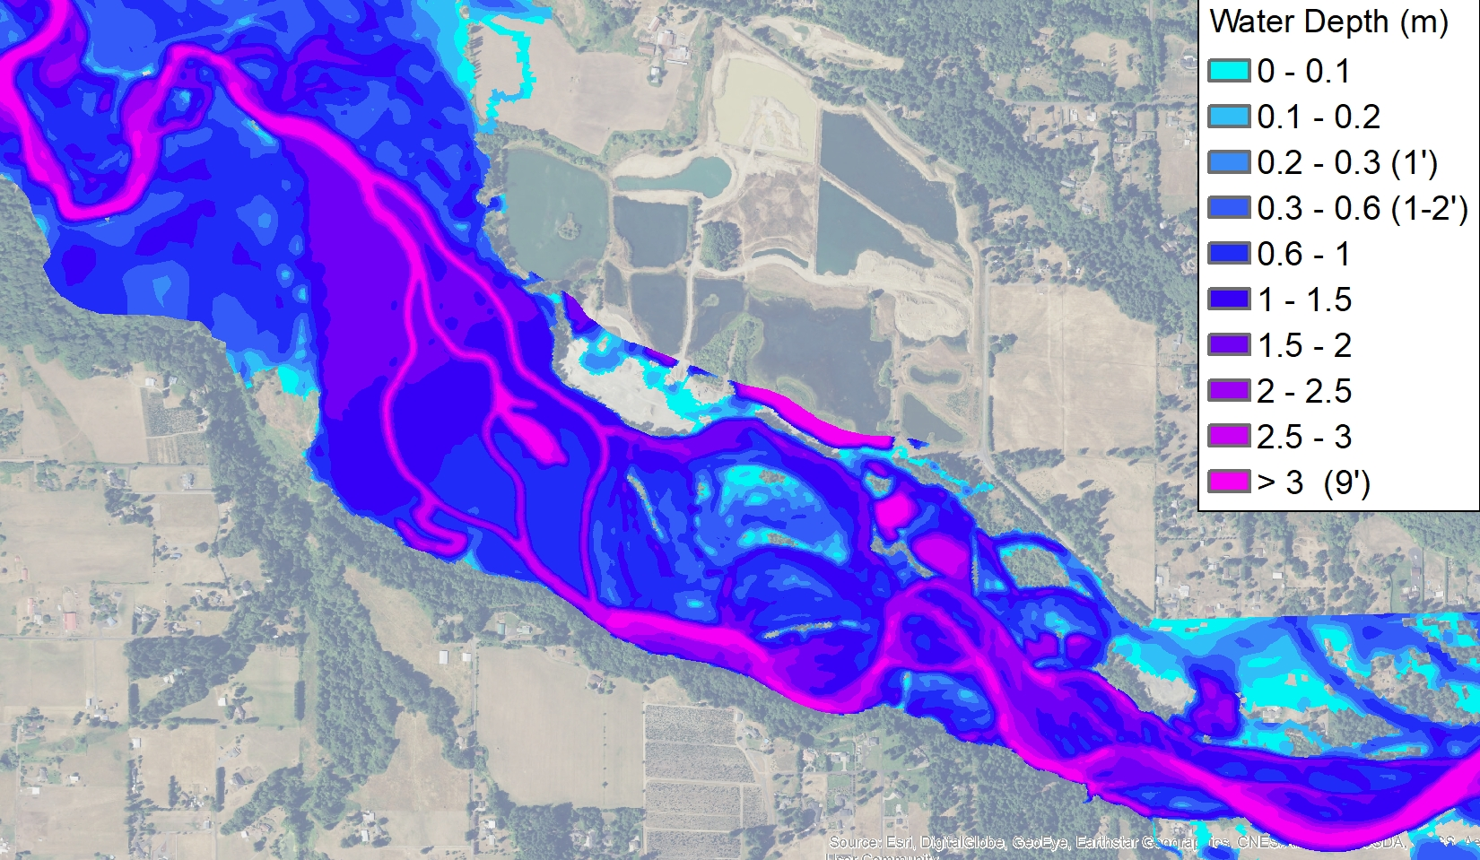
Alternative 3
Existing Condition
100 year flood – 28,600 cfs
Existing Conditions: High ground not inundated within pits
Alt 3 and Hybrid: Increase in floodplain inundation
Hybrid has increased depth across the floodplain at downstream end of the project
Variation in depth across the floodplain will increase as grading is refined to add form roughness and support a variety of riparian vegetation communities
Alternative 3 - hybrid

Slide 12
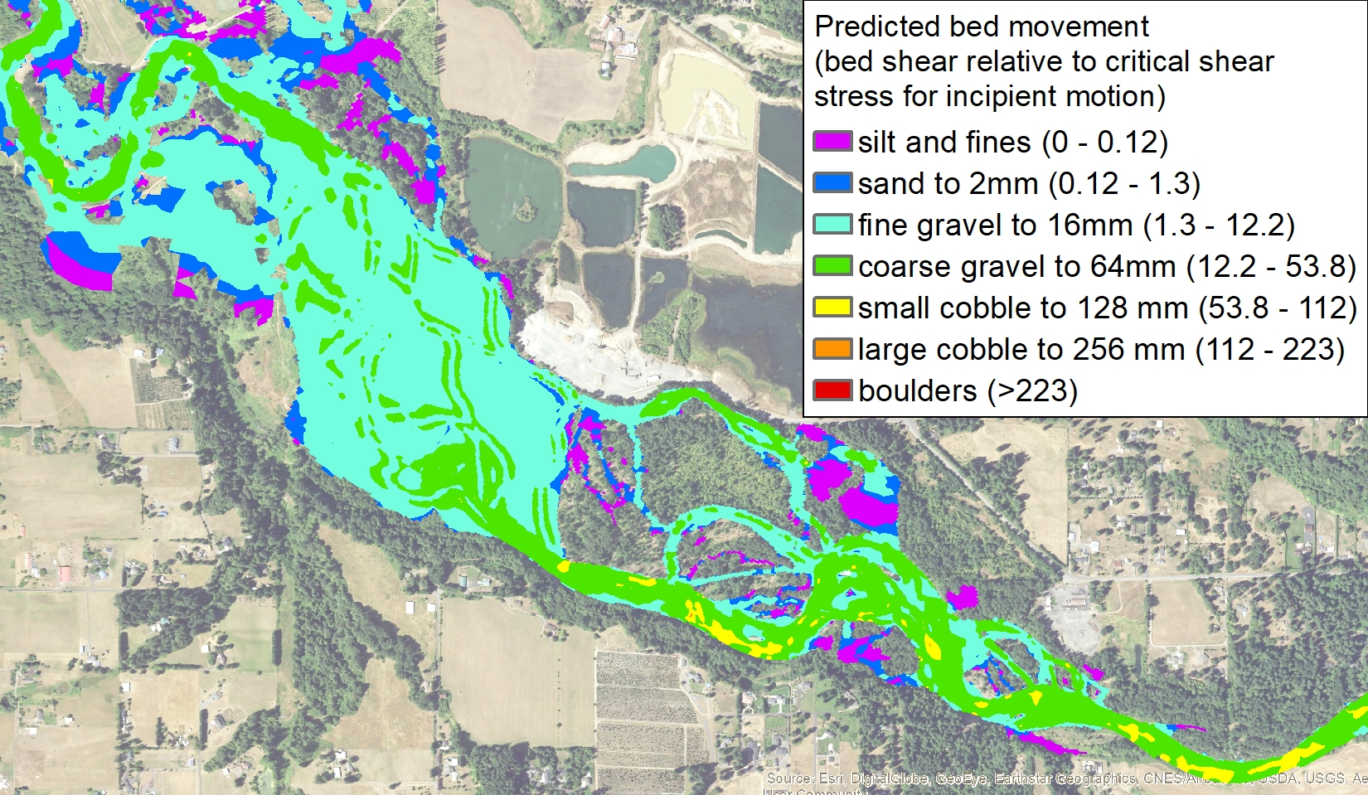
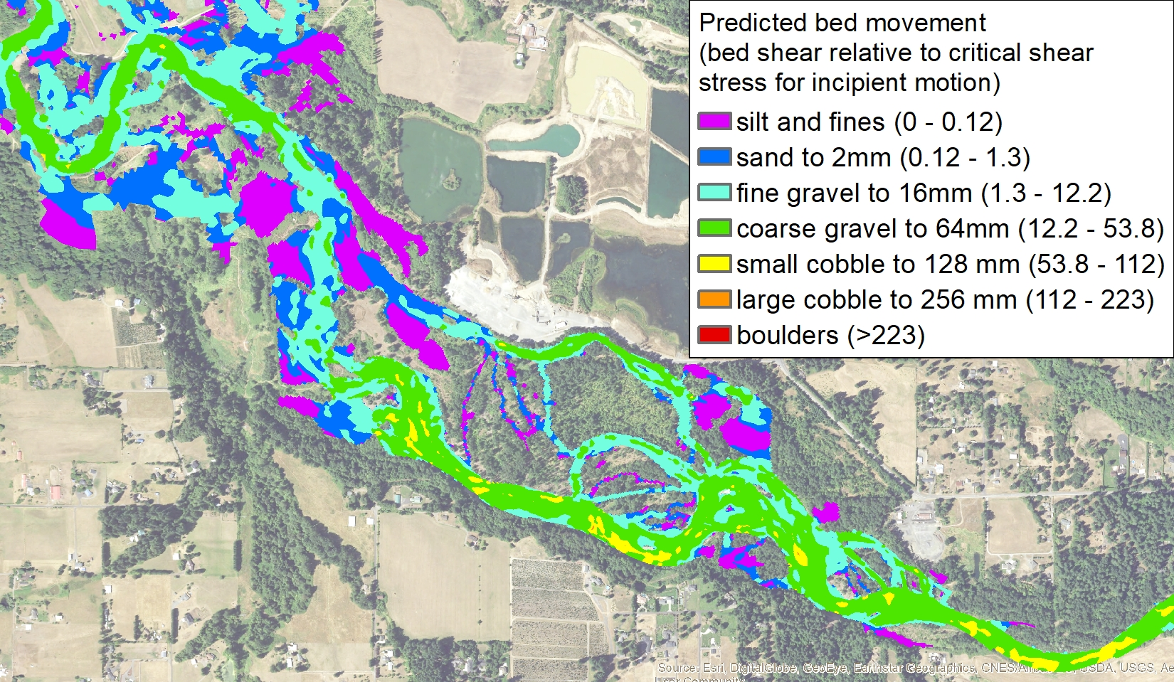
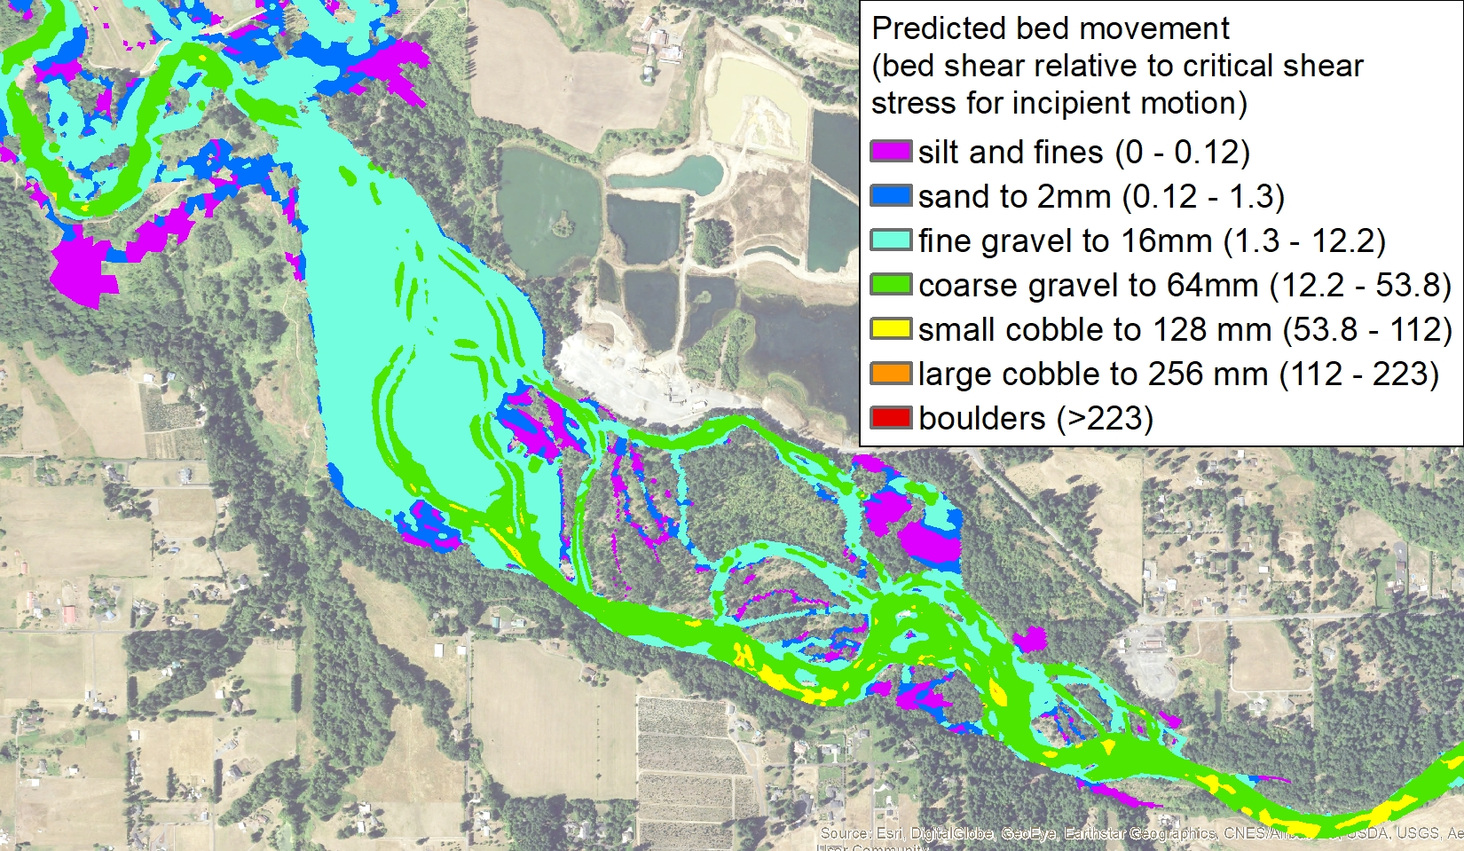
Alternative 3
Existing Condition
~Q1 - 5000 cfs
Existing Conditions: Sharp transition from gravels to fines in pits
Alt 3 and Hybrid:
Reduction in fines
Restored gravel transport throughout
Coarse gravel transport still limited at this flow
Alternative 3 - hybrid

Slide 13
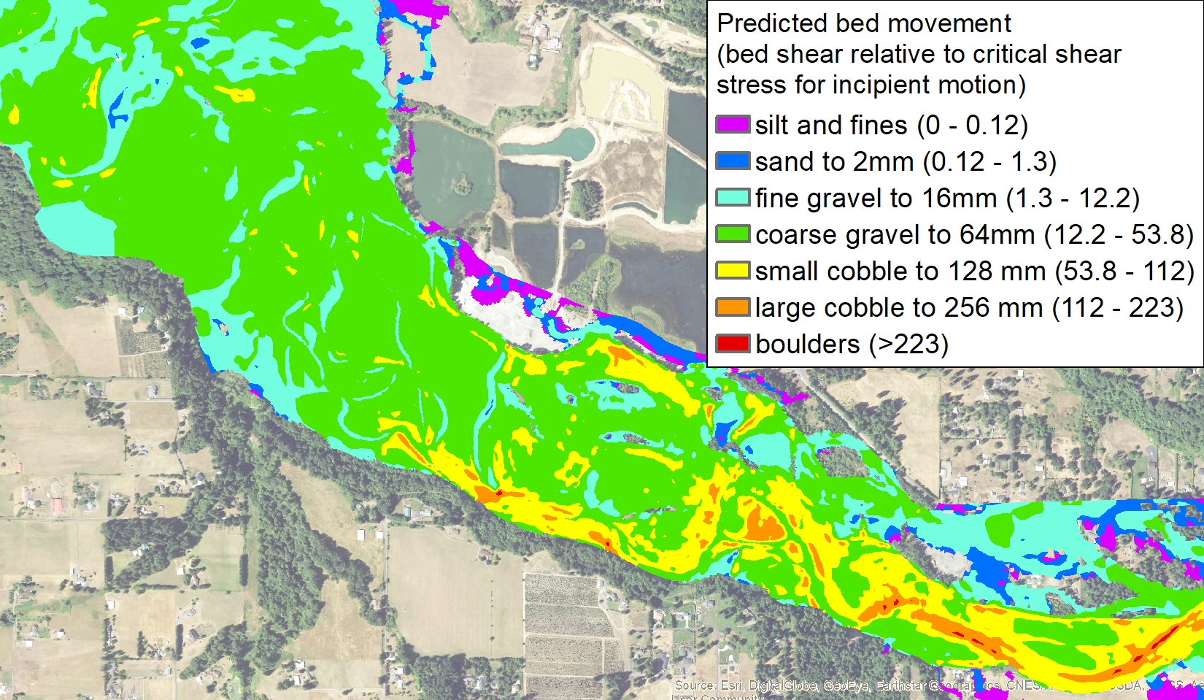
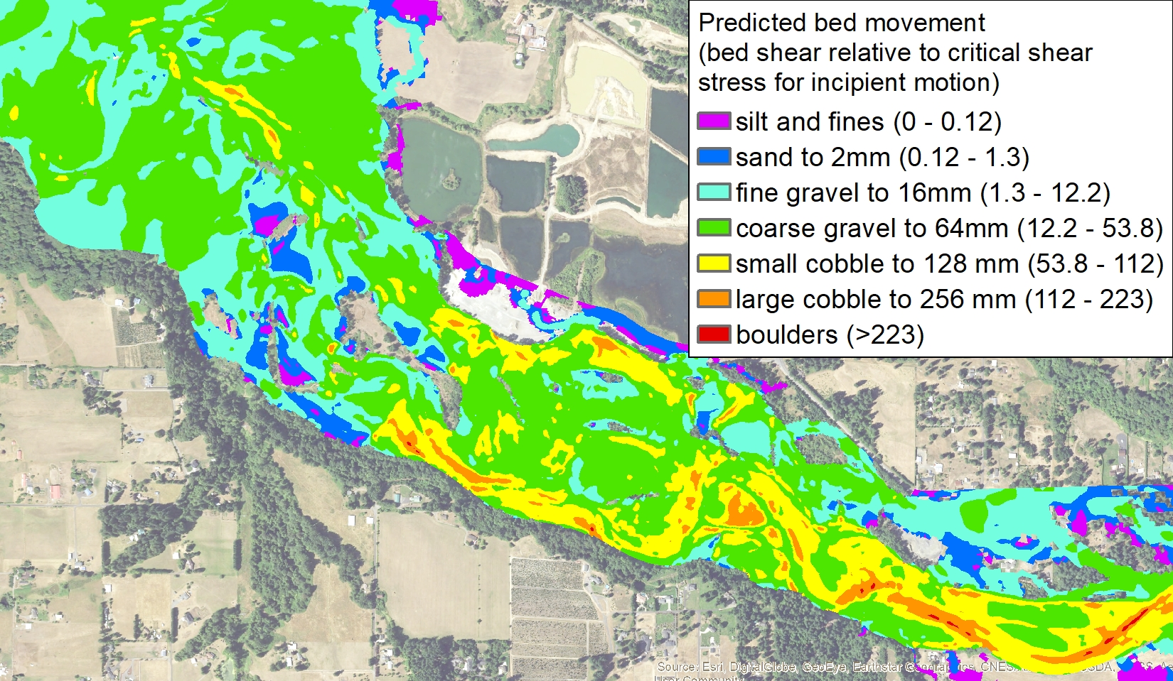
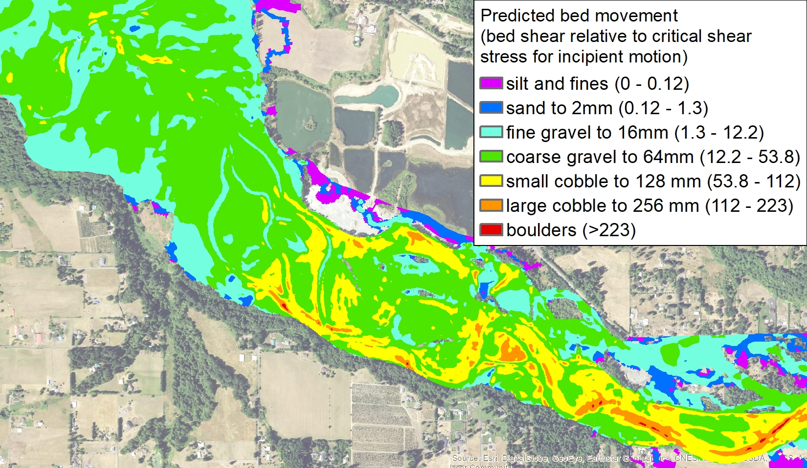
Alternative 3
Existing Condition
Q100 – 28,600 cfs
Existing Conditions: Pits segment still limited in transport capacity of coarse material - Discontinuity
Alt 3 and Hybrid: Restored coarse gravel transport and continuity to downstream reach
Infrastructure considerations
BPA power line towers
Daybreak Pits interface
Bluffs
Alternative 3 - hybrid

Slide 14
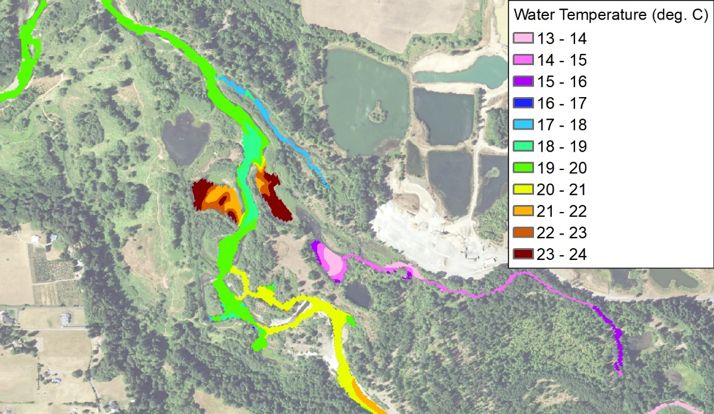
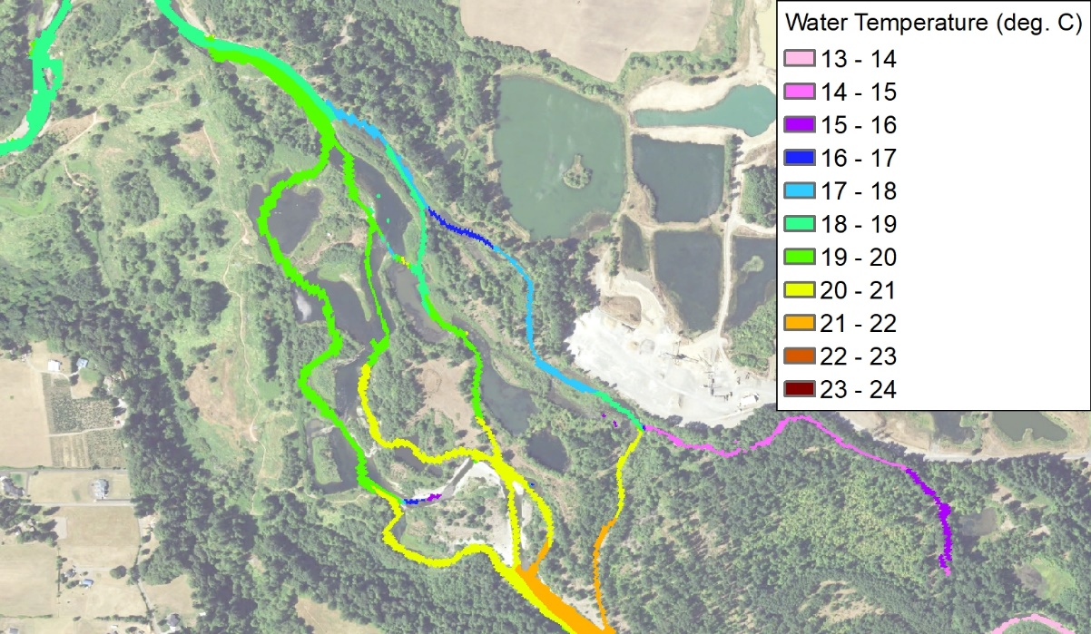
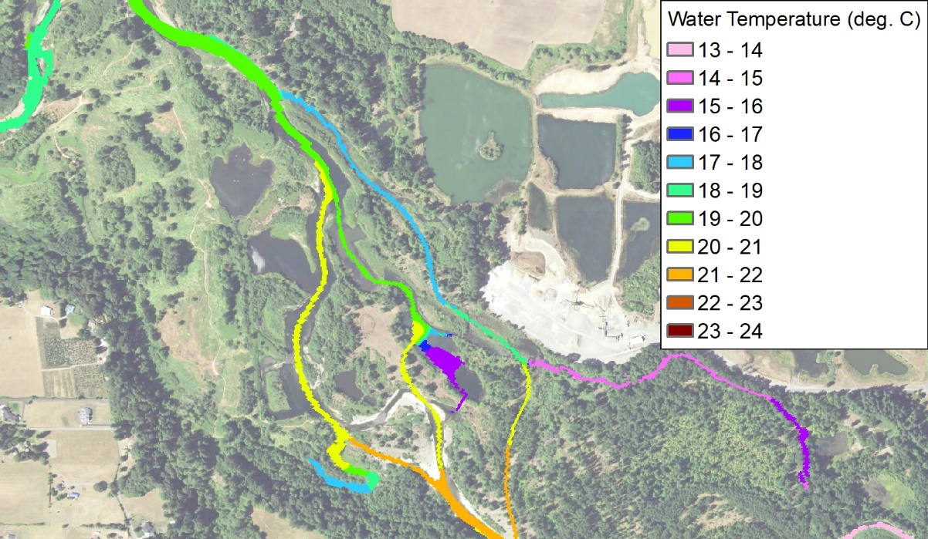
Temperature Analysis: Simulated Water Temperature @ 35 cfs
Pit 8 and side channel disconnected from river
Existing Conditions
Alternative 3
Model temperature input sources: - Quantum Thermal IR survey (2020)
- LCEP temp. monitoring (2018)
Model results observations for restoration alternatives:
- Warm water pits #5 and #7 eliminated
- Potential to provide connectivity to colder side channel waters
- Potential to provide connectivity to colder Pits #8 and 2
Additional thermal benefits predicted for restoration alternatives:
Reduced channel surface area should reduce heating potential
Existing Grade Alternative 3 Hybrid 3-chan Alternative
Wetted surface area (acres) 20.7 19.6 14.6
Alternative 3- Revised

Slide 15
Expected Geomorphic Trajectory
Existing Conditions:
Continued confinement within pits for >70 years
Very slow delta growth
Extremely depositional – dominated by fines downstream of delta
Limited floodplain inundation
Limited access to potential channel migration zone
Proposed Conditions:
Increased floodplain inundation
Increased channel migration zone width
Gravel transport (and deposition) restored throughout
Still DEPOSITIONAL! – but less than existing. Channels will be expected to continue to evolve due to channel response to bedload aggradation
Full pits area (channels and floodplain) will aggrade more uniformly over time, as opposed to the pronounced delta that currently exists

Slide 16
Risk Considerations
Existing Conditions:
High risk to habitat (channel form, temperature, food, invasives, fines)
Low risk to infrastructure (due to continued confinement)
Proposed Conditions:
Habitat improvement (immediate habitat created and trajectory set for increased habitat over time)
Risk of Daybreak Pits avulsion/breaching? – Possible due to increased channel migration zone and uncertainty with future planform changes. Will likely need to be addressed via armoring.
Risk to BPA Powerline Towers? – Possibly little-to-no risk based on no significant changes to floodplain inundation across powerline alignment. Warrants further investigation as part of Final Design plus consultation with BPA.
Risk to bluff erosion upstream? – Likely not based on model results and area of expected channel changes.

Slide 17
Next Steps
Present the results of model runs
Model revised alternatives (as needed)- Al3 Revised (this meeting)
Present results to the group- today
Preferred alternatives
Develop preliminary designs at three locations, engineering plans
cost estimates, quantities.

Slide 18
We did not get to the next 3 slides in the Meeting

Slide 19
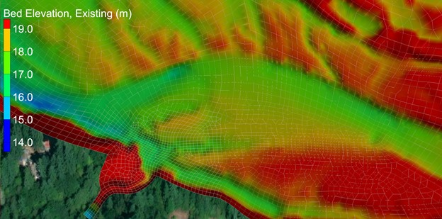
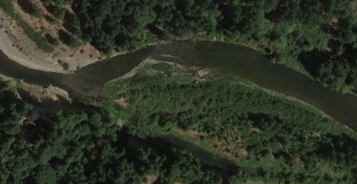
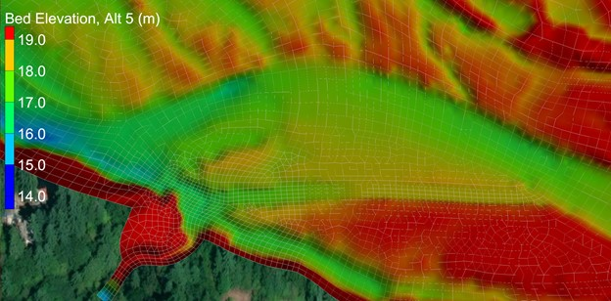
Existing Conditions
Mill-Manley Confluence
Alternative 5
Objective – increase scour of Mill confluence gravels in cold water alcove
Grading at the upstream edge of the gravel bar to encourage high flows routed through confluence zone
Alternative 5

Slide 20
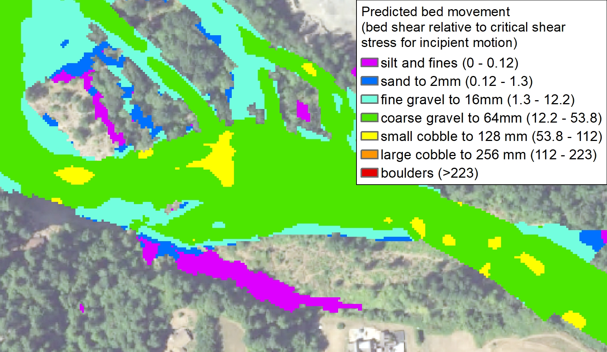
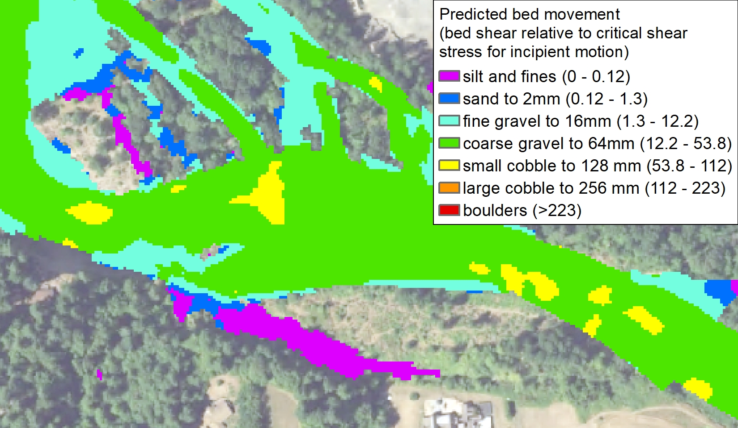
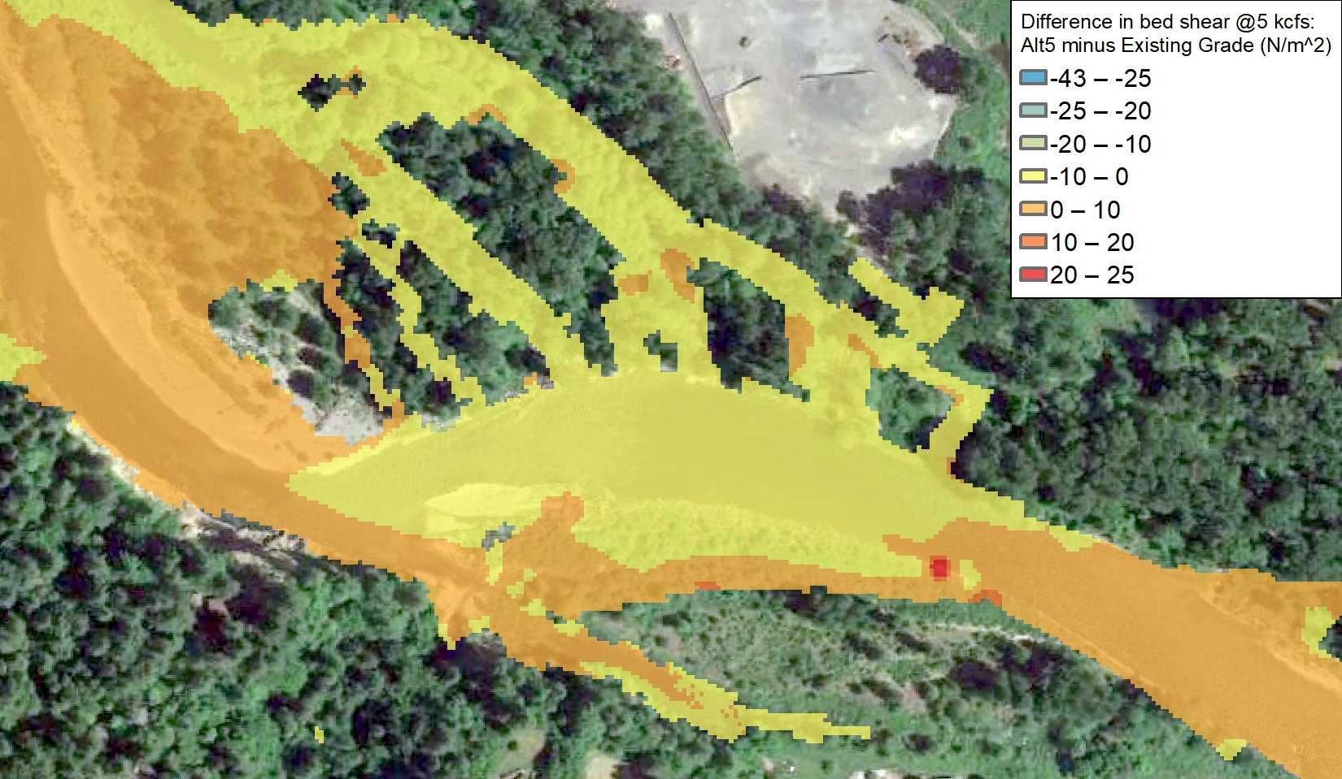
Existing Conditions
Alternative 5
Mill-Manley Confluence: ~Q1 - 5000 cfs
Alt 5 – Sediment Transport
Slight increase in shear stress in Alt 5
No dramatic changes to the sediment transport capacity at the confluence

Slide 21
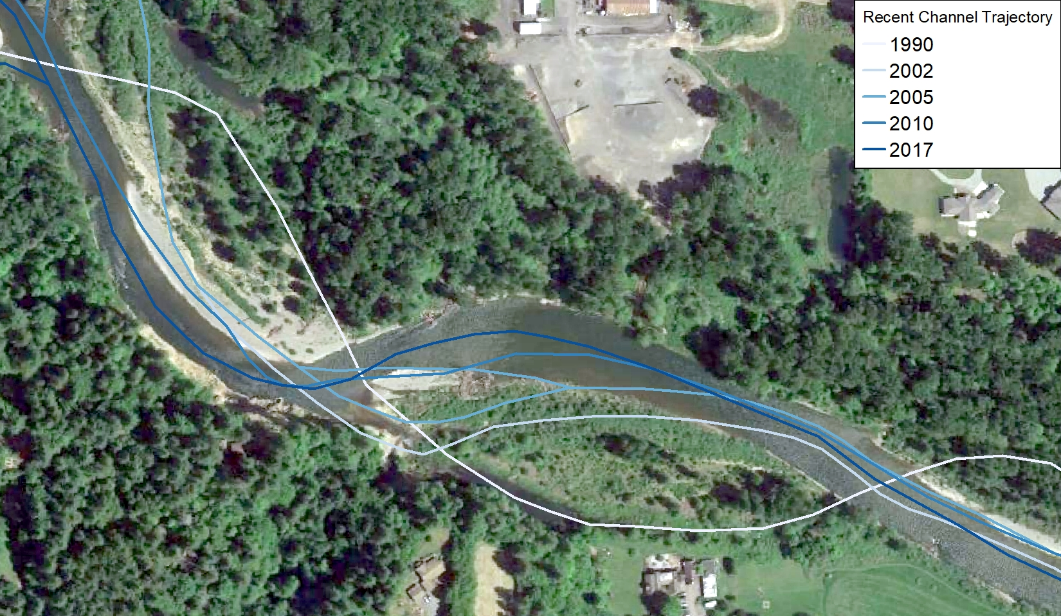
Mill-Manley Confluence
Geomorphic Trajectory and Risk
Channel migrating to the north over the last 30 years
Continued migration will lengthen back-bar channel fed by Mill and Manley
Creating a scour channel has uncertain outcome especially given continued channel migration
Existing house on top of bluff currently being undermined
Effects on bluff erosion uncertain as channel migrates

Slide 22
END

Slide 23
Restoration Alt.’s- Voting From Last Year Meeting
Alt. 1- No action/passive recovery
Alt. 2- Relocate main channel back to pre-1996 avulsion
Alt. 2a- Relocate river into a portion of its pre-avulsion flow path
Alt. 3- Full Floodplain & Pits Re-Grade
Alt. 3a- Select Floodplain & Pits Regrade
Notes:
Restoration Alternatives Prioritized- Alt 3 (multi-thread channel)
- TOG to comment on refinement March 30
Channel migration zone
Allowing riverine processes
Cold water

