Slide 1

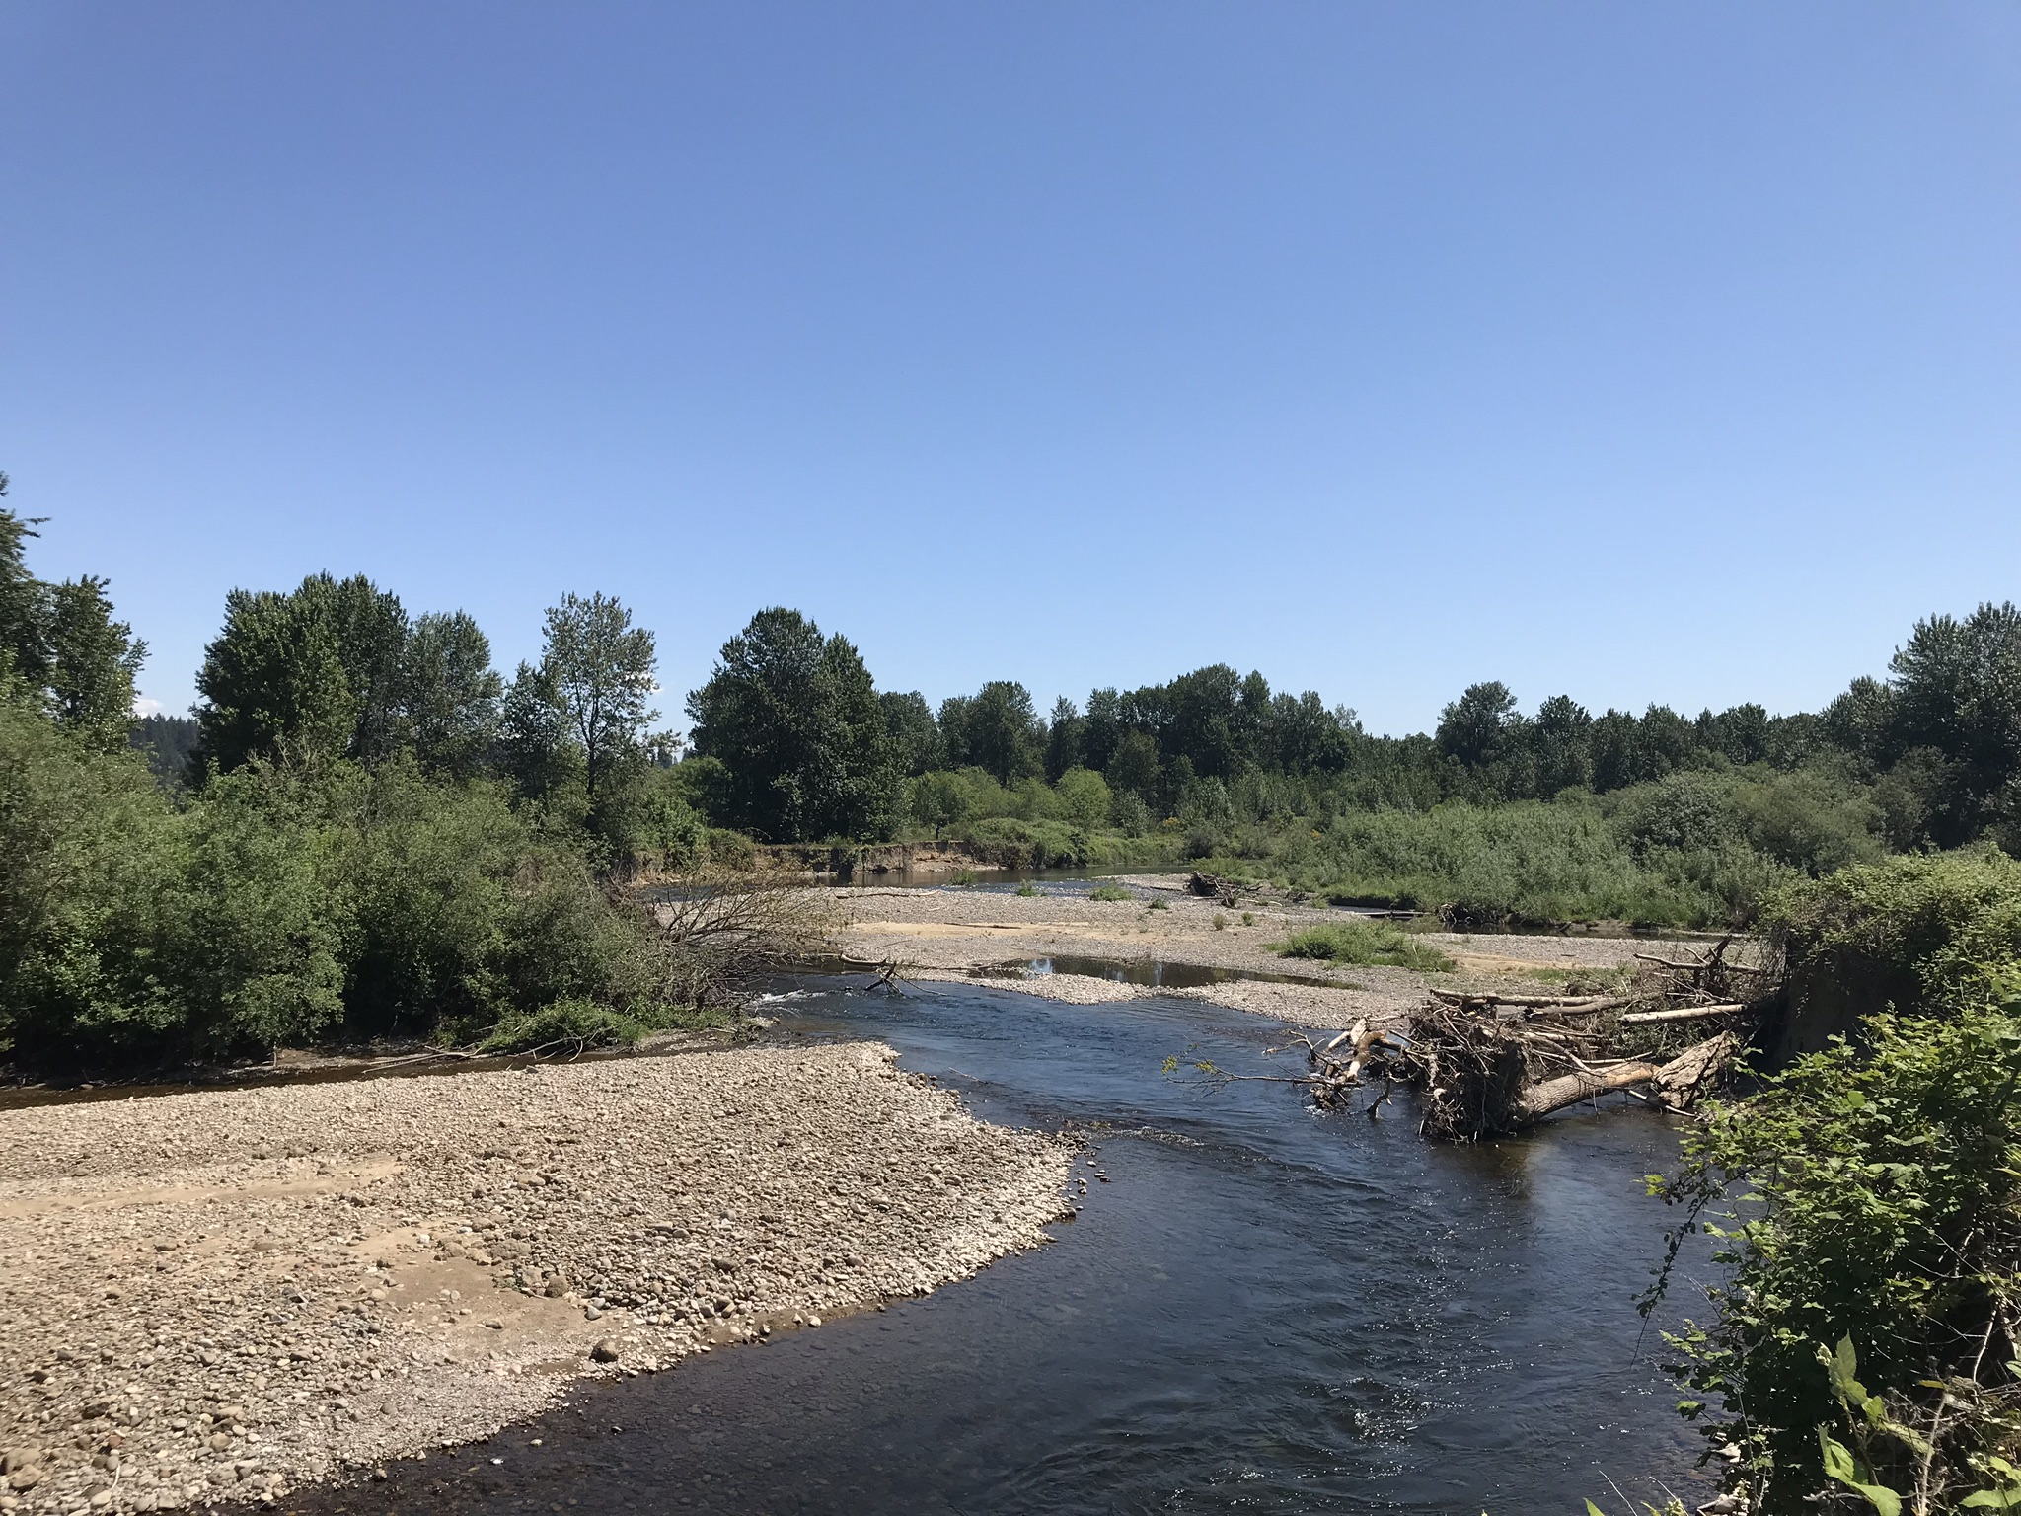


East Fork Lewis River Ridgefield Pits Restoration Design Study, Technical Oversight Group Meeting 5: Project Summary and Restoration Alternatives Discussion

Slide 2
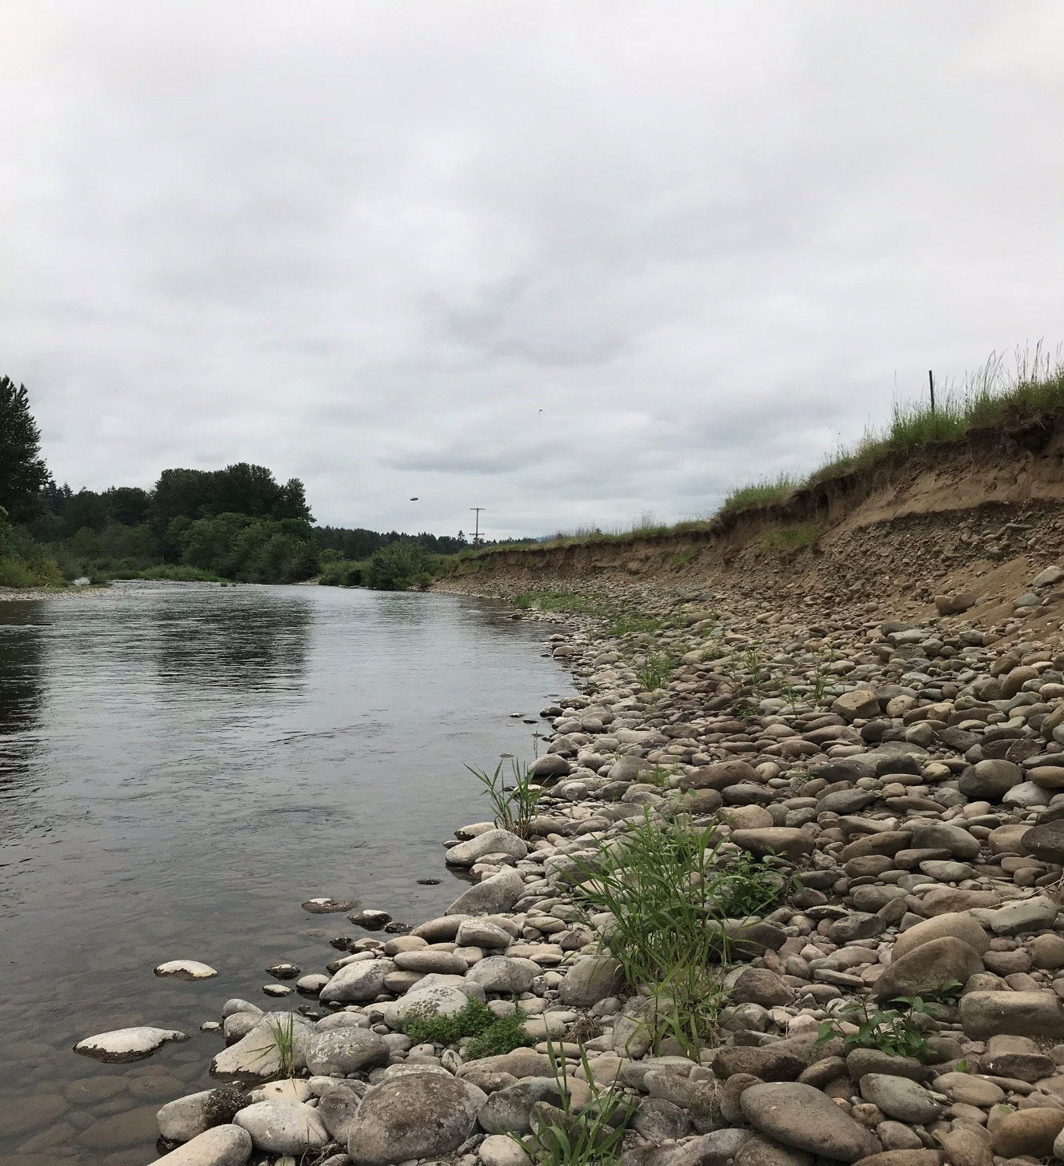
Technical Oversight Group Meeting 5 Objectives
Recap Prior Meetings
Summarize Physical Conditions & Stakeholder Concerns
Introduce Initial Restoration Concepts
Discuss Restoration Alternatives

Slide 3




Technical Oversight Group Meeting Recap
Meeting 1. September 10, 2018
- Site History & Stakeholder Perspectives
fish use
channel and geomorphic conditions
flows and water temperature
mining
stakeholder concerns
ownership
restoration approach
Meeting 2. November 20, 2018
- Fish Use and Available Data
WDFW Spawning Ground Surveys (SGS)
LCEP observations, summer 2018
other

Slide 4
Technical Oversight Group Meeting Recap
Meeting 3. April 23, 2019
- Storedahl HCP for Daybreak Mine Expansion (Tim Romanski, USFWS)
- Related Stakeholder Interests & Concerns
Meeting 4. June 27, 2019
- Geomorphic Conditions and Ridgefield Pit Fill Assessment (Inter-Fluve)
- 2018 Water Temperature Sampling Results (LCEP)
TOG meeting materials and related project documents are available for download:
http://s458607291.onlinehome.us/FTP/Ridgfield Pits_Working_Group/

Slide 5
Key Considerations From TOG Meetings - Geomorphic
Bank erosion in Daybreak Reach (L bank US of Pit 1 & along West Daybreak Park).
Bluff erosion in Daybreak Reach (L bank immediately DS of Mill Creek).
Upstream issues potentially affecting sediment processes within Project Reach: head-cut, Daybreak bridge constriction.
Ridgefield Pits sediment trapping potentially affecting downstream processes.
Sediment deposition at tributary mouths (Mill/Manley Cr.). What is source?
Loss of anastomized system in RP reach. Decreased sinuousity in US/DS reaches.
Disconnected floodplain.
Loss of wood (forested areas and wood jams) > > decreased hydraulic roughness.
Revised estimates for Ridgefield Pits filling show considerably longer trajectories compared to WEST studies. 2075 vs. 2027.

Slide 6
Key Considerations From TOG Meetings - Hydrologic
Summer water temperature is already warm entering project reach. Mainstem temperature does not increase appreciably through project reach.
Some of the Ridgefield Pits have higher summer temperatures than mainstem.
EFLR system possibly has become more dynamic, more flashy.
Hyporheic flows are important sources of cold water in project reach above RPs. Project actions should not degrade what refuge already exists.
Have RP avulsions impacted sub-surface flows?
Are channel geometries influencing water temperatures? Too wide and shallow?
EFLR summer flows have potentially decreased historically in project reach. Heisson data does not point to this, but water withdrawals downstream may have increased. More study needed.

Slide 7
Key Considerations From TOG Meetings – Fish Use
Water temperature is the primary concern, followed by lack of spawning habitat.
Fall Chinook (FC), Summer steelhead (SS) and chum (C) have historically used project reach for spawning (Mason Cr. confluence upstream to Daybreak).
FC currently have the most spawning activity, but this has declined significantly. C,SS – little to no spawning currently.
C spawn in side channels. FC/SS primarily in mainstem, some side channel.
1996 avulsion into Ridgefield Pits resulted in loss of quality spawning habitat.
LCEP 2018 snorkel surveys observed several juvenile chinook using mainstem near wood cover and in warmer water. Also in cold water refuge areas.
General reach observations: decent spawning conditions, poor summer rearing, ok winter rearing.

Slide 8
Key Considerations From TOG Meetings – Mining
Storedahl Daybreak HCP is 25-year plan. Mining is ‘supposed’ to cease in 2027.
Long-term plans for the Daybreak site are unknown.
No provisions in HCP requiring specific management or restoration measures for Ridgefield Pits. Monitoring is the only requirement.
Several stakeholders have expressed concern over enforcement of, and Storedahl’s compliance with the HCP terms, and the effectiveness of some of the conservation measures.
HCP monitoring reports have been made available online.
Potential avulsion into Daybreak is a significant concern. Has Storedahl adequately addressed this for the existing conditions? Restoration plans must not increase risk.

Slide 9
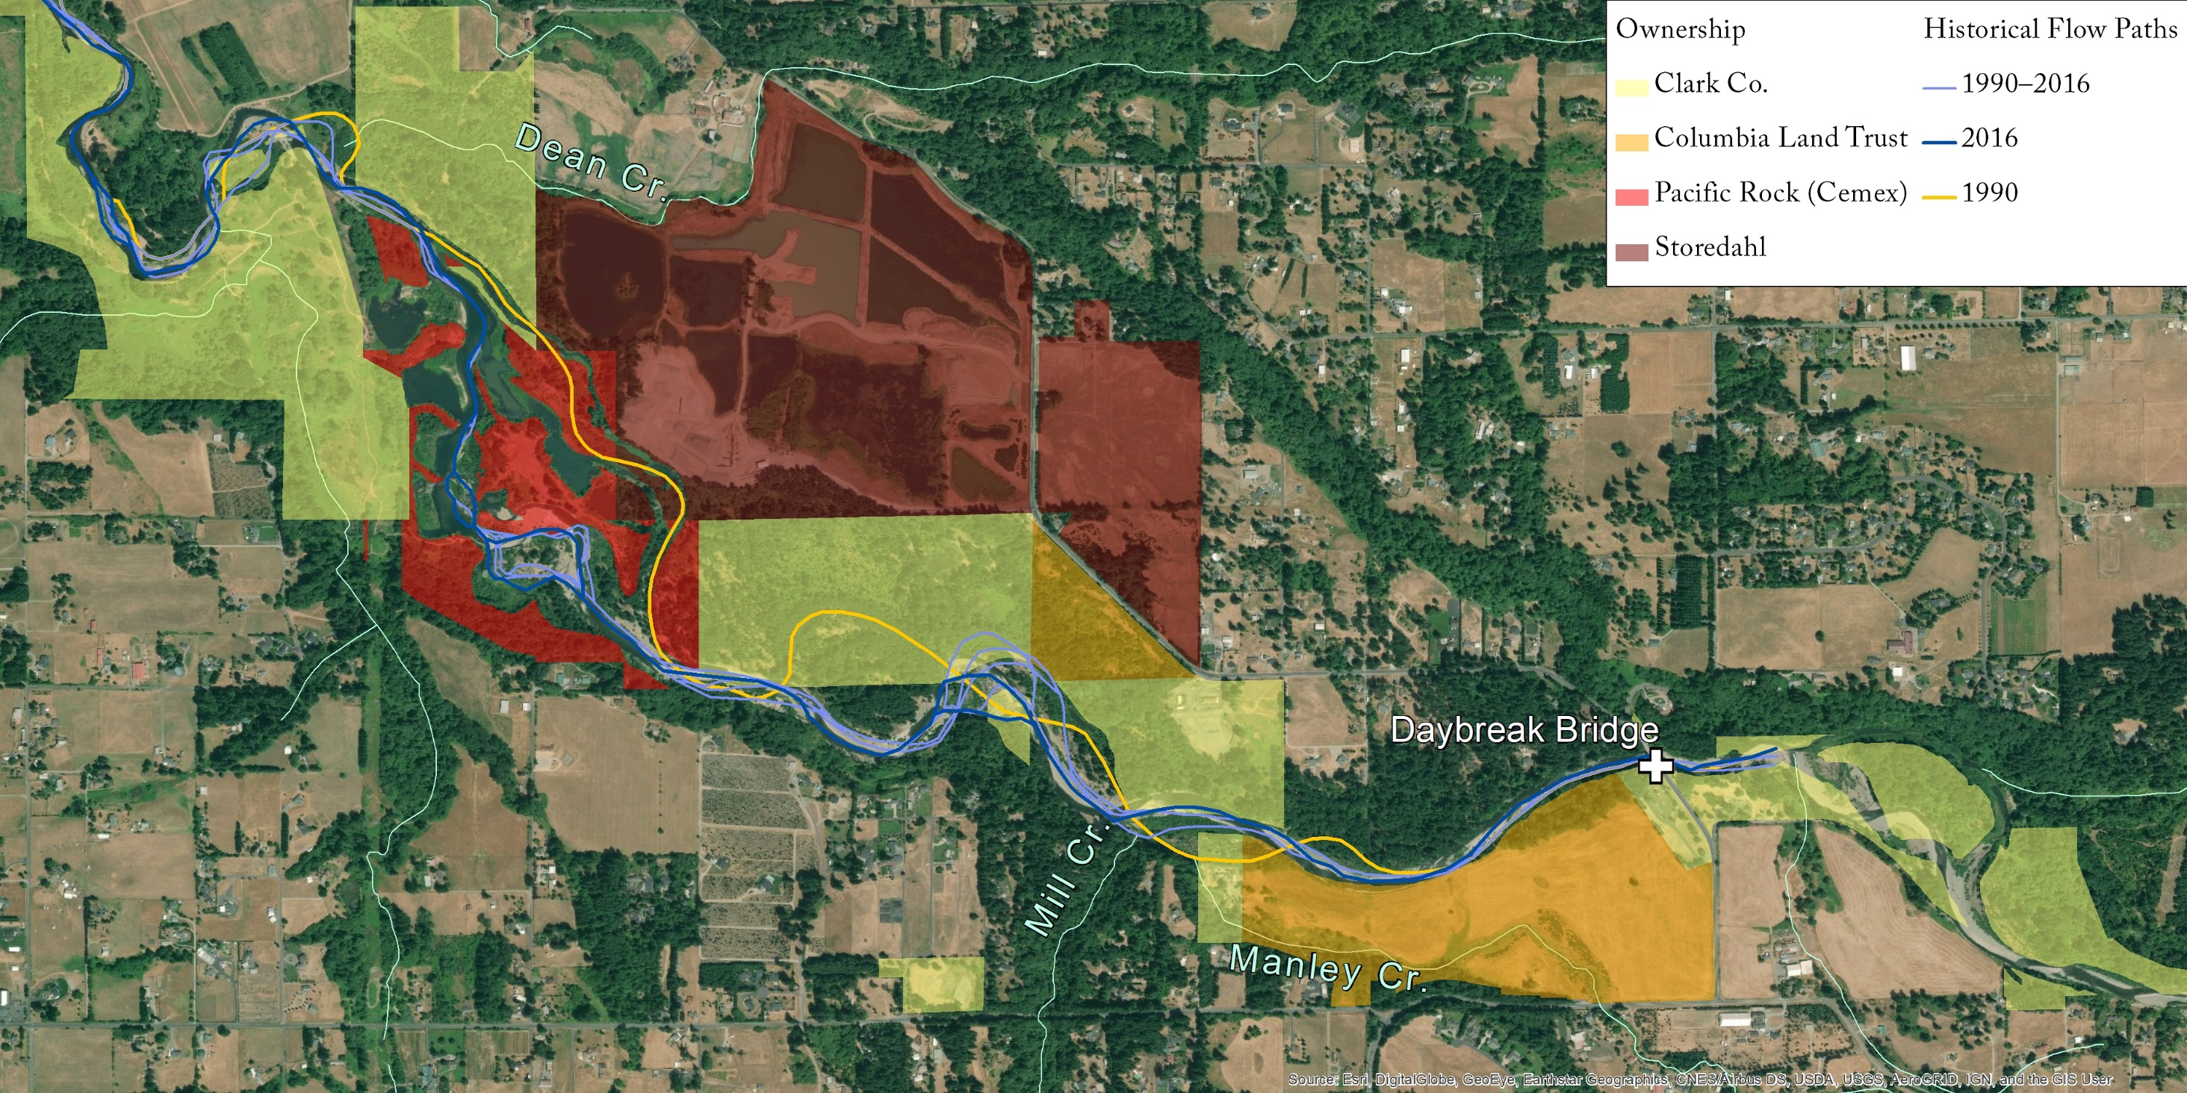
Water Elevation and Temperature (2018)
Long term site (2012 – 2018)
- Head-cut
- Water Temp.
- Sediment inputs (unknown ?)

Slide 10
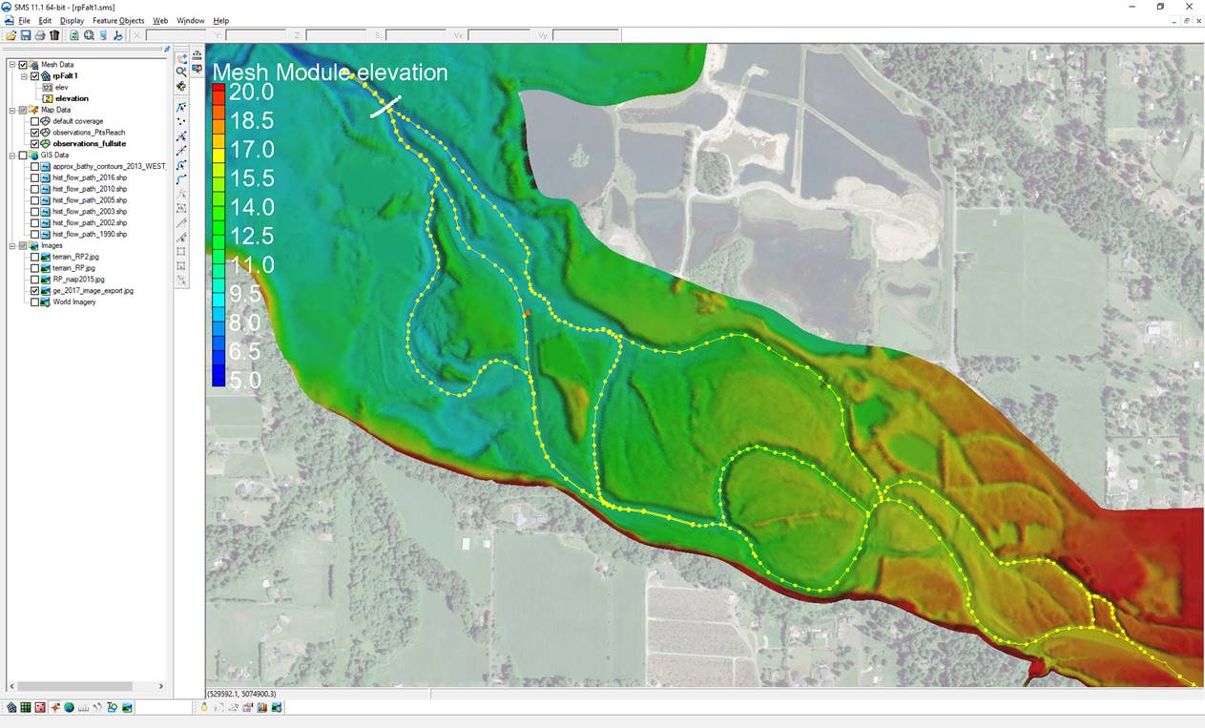
Water Elevation and Temperature (2018)

Slide 11
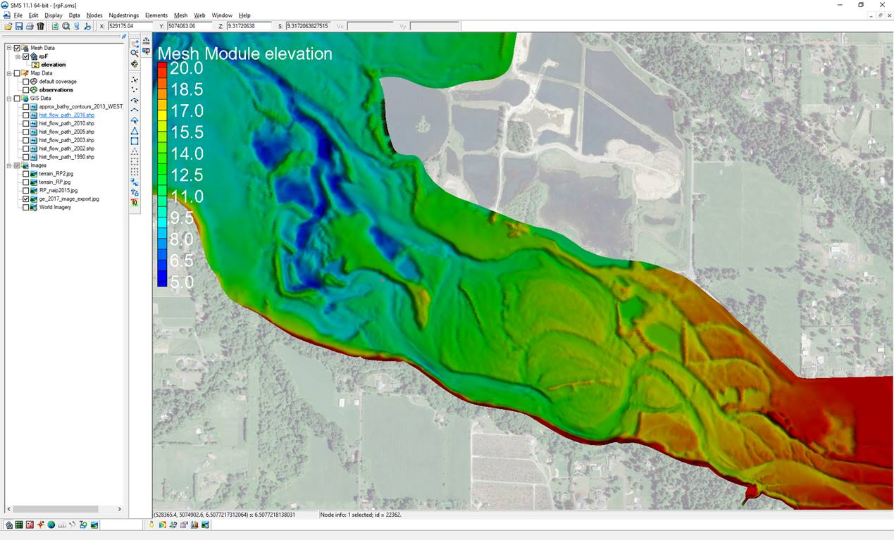
Water Elevation and Temperature (2018)

Slide 12
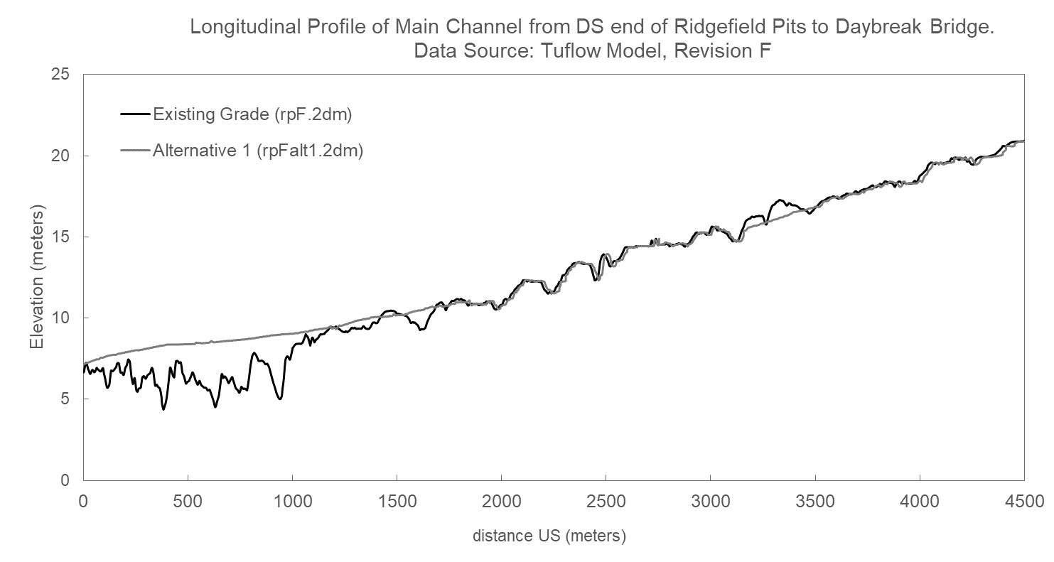
Water Elevation and Temperature (2018)

Slide 13
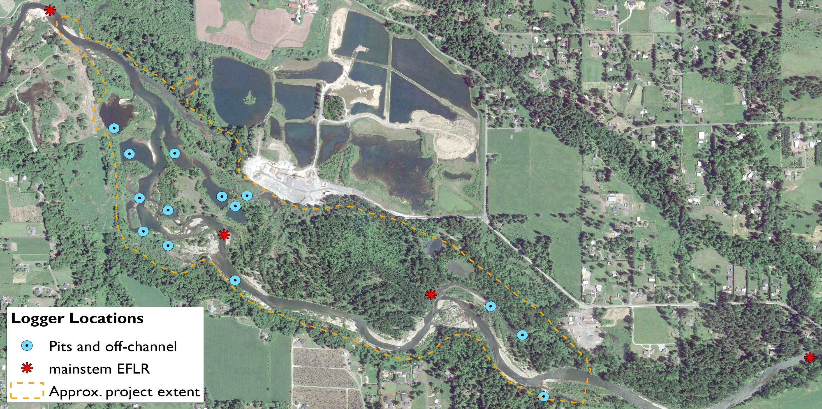
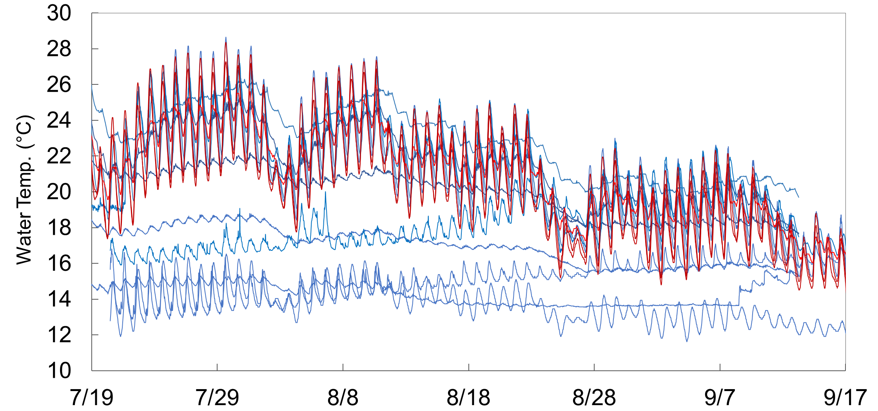
Water Temperature (2018)

Slide 14
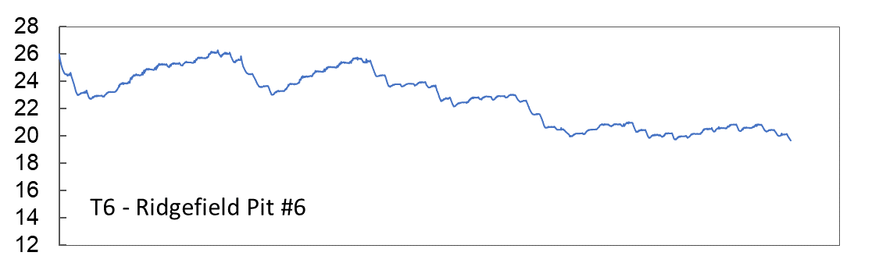
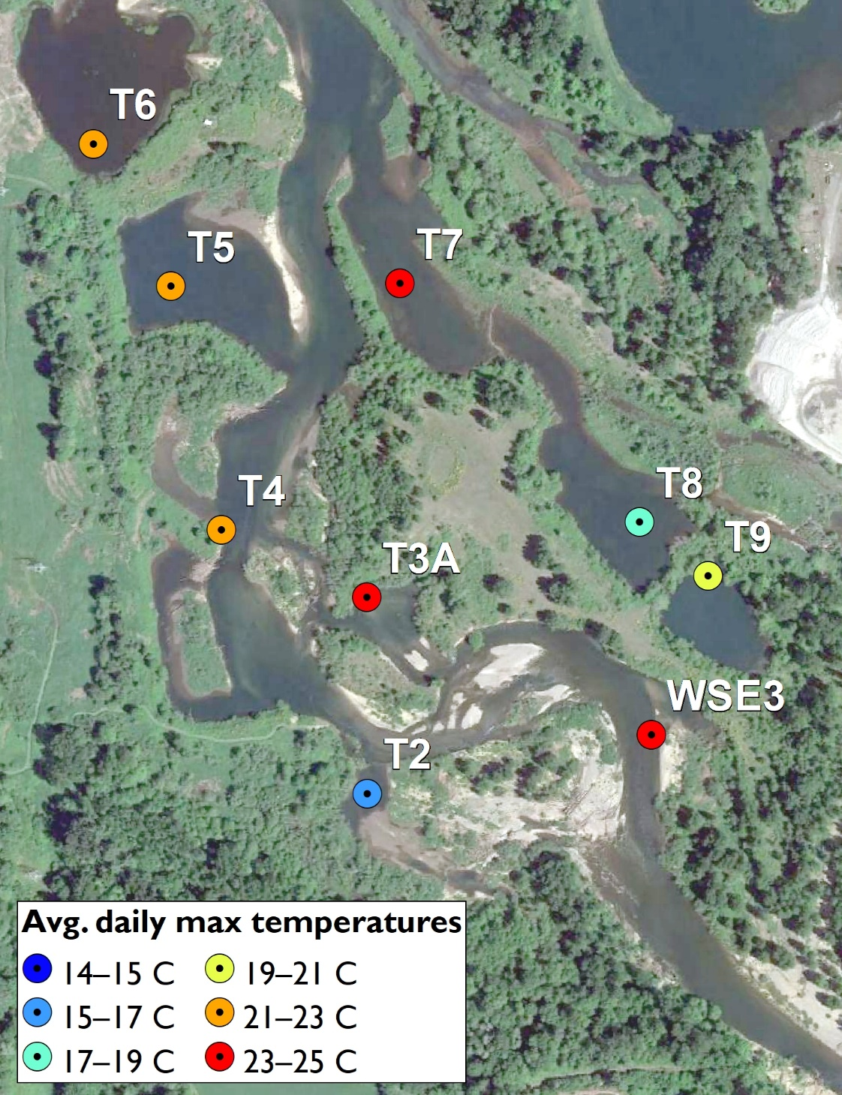
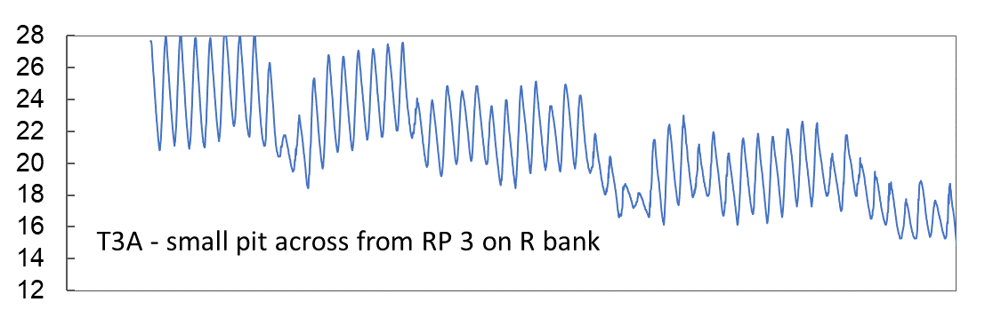
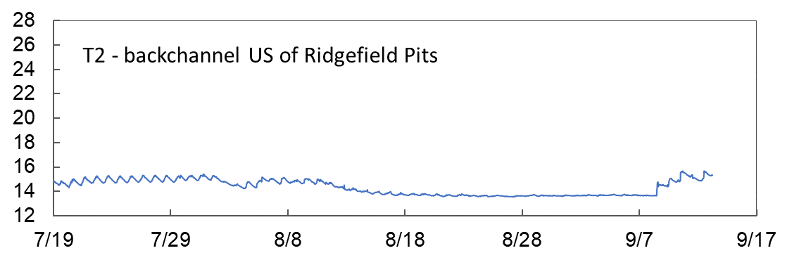
Water Temperature (2018)

Slide 15
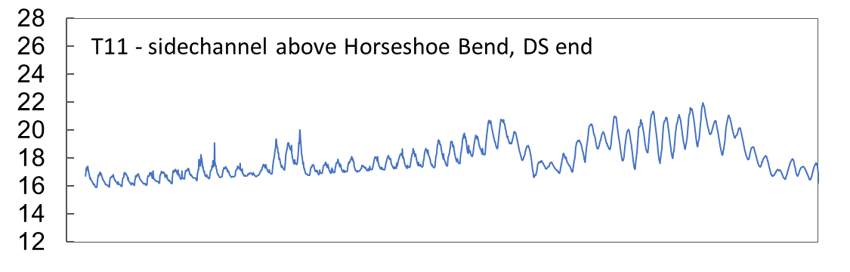
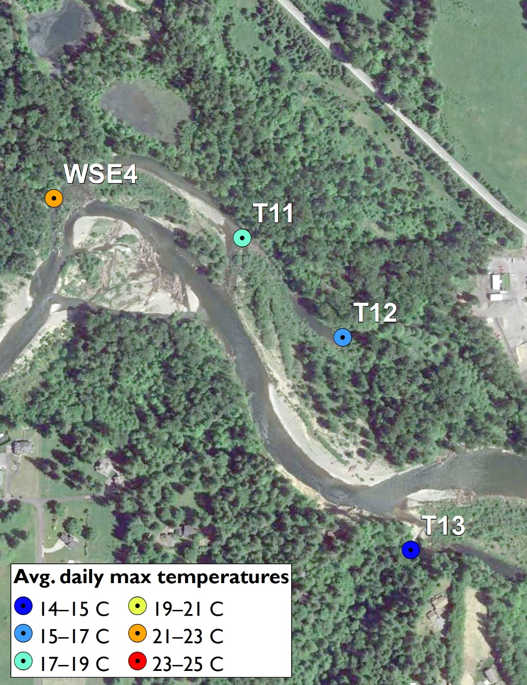
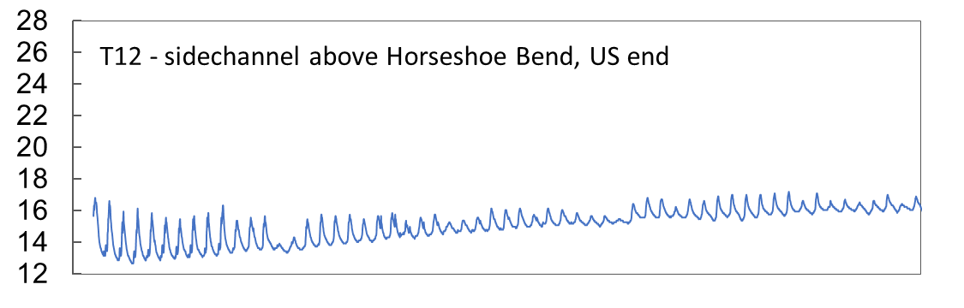
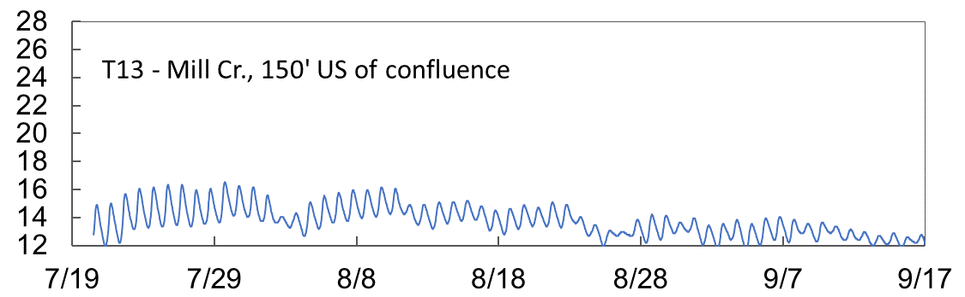
Water Elevation and Temperature (2018)

Slide 16
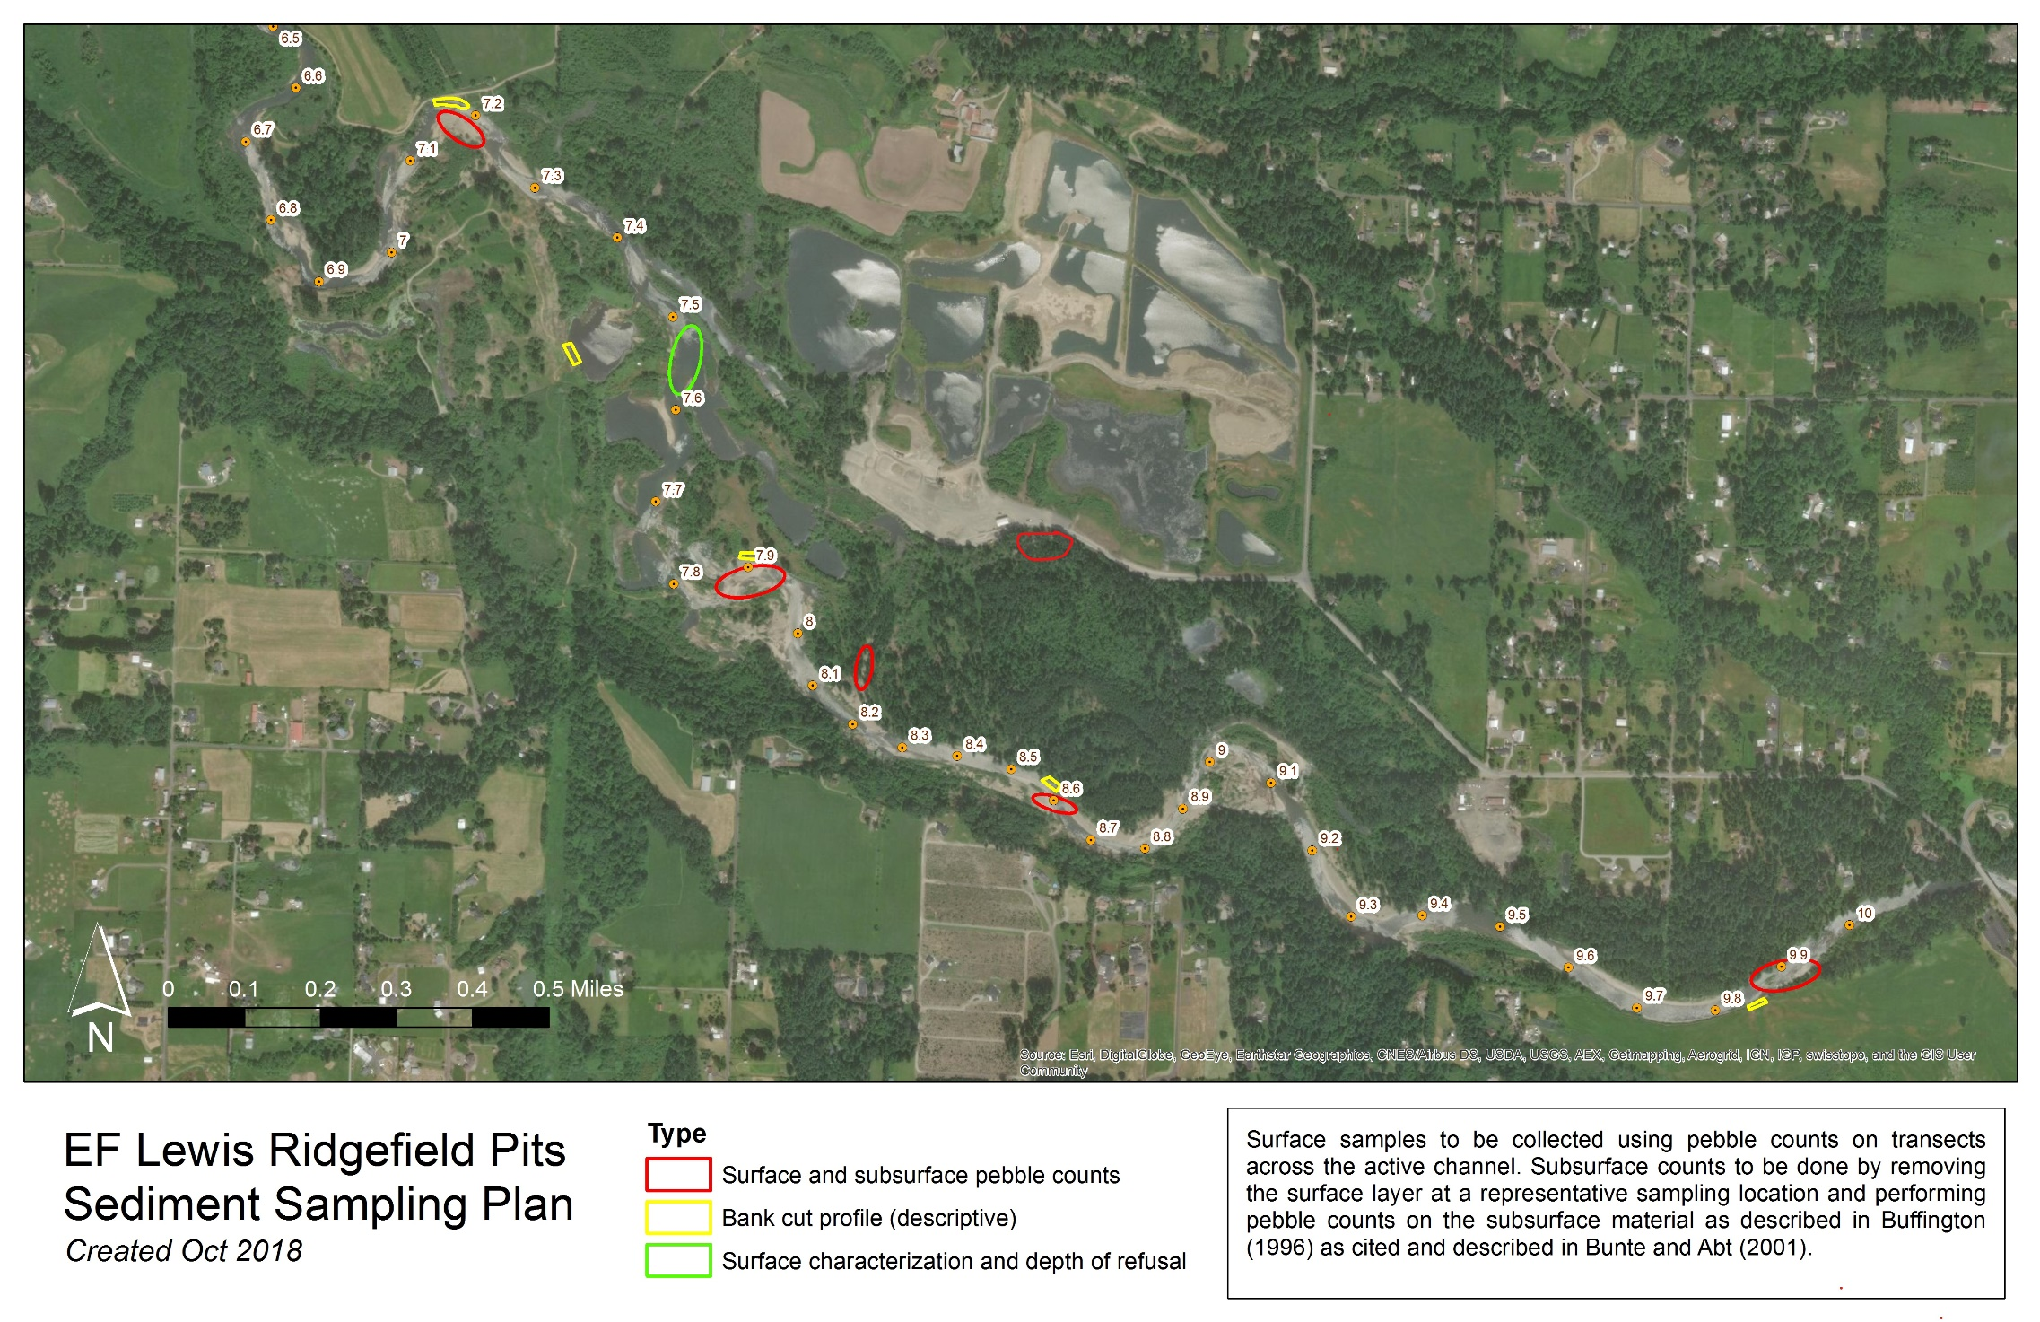
Sediment Sampling Plan (2018)
surface/subsurface pebble counts
bank cut profile
depth of refusal

Slide 17
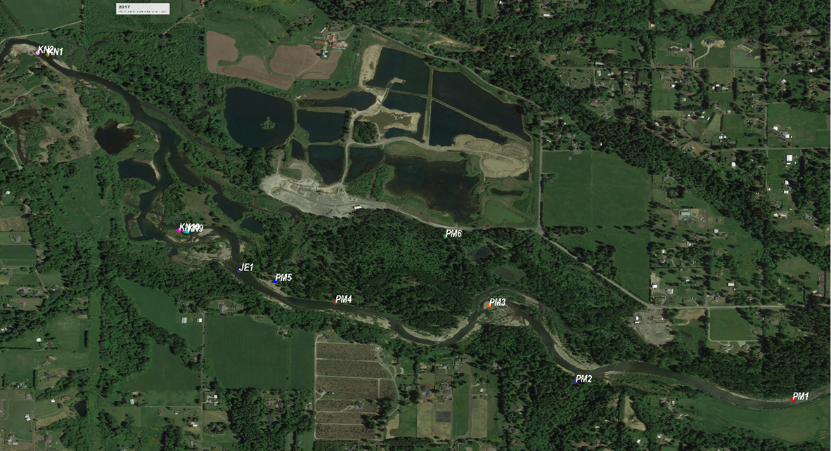
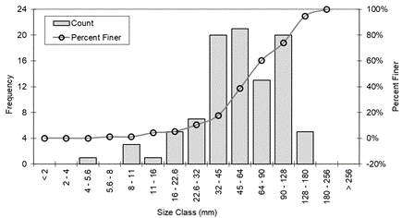
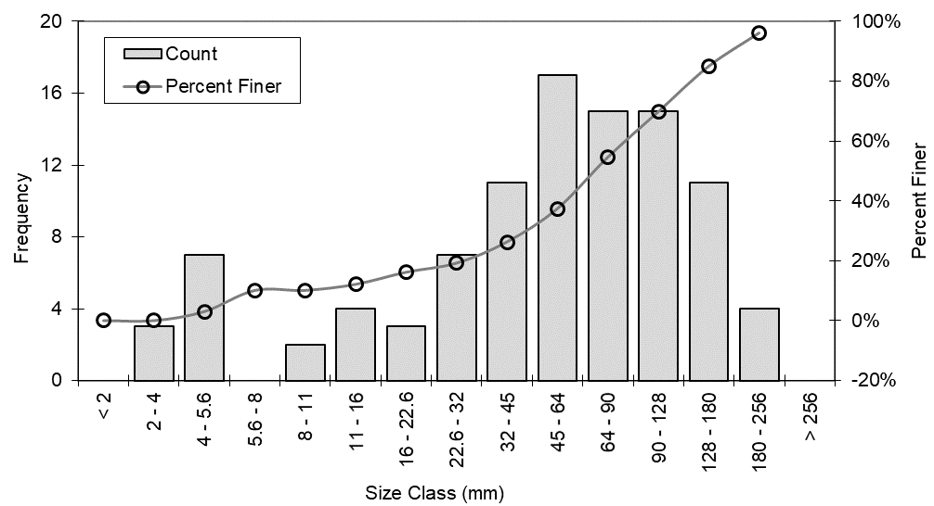
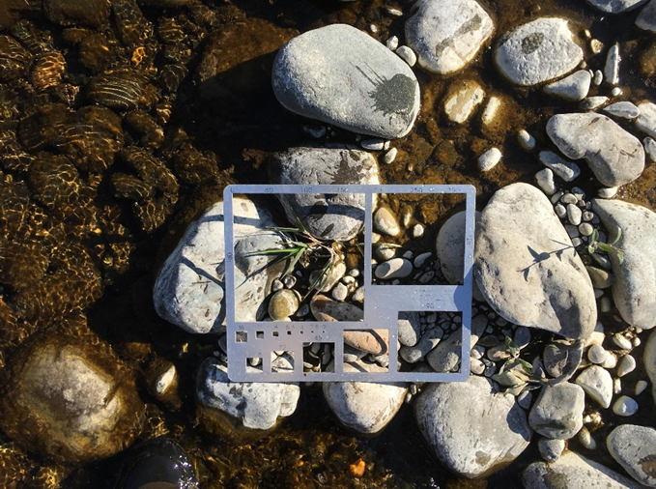
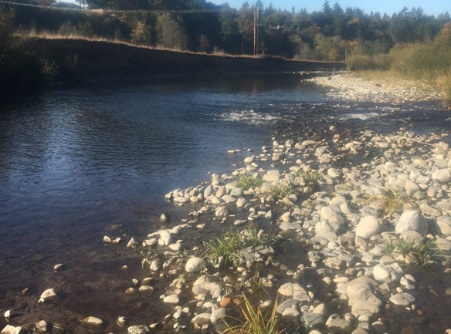
Sediment Sampling – Bed Material (Surface/Armoring)

Slide 18
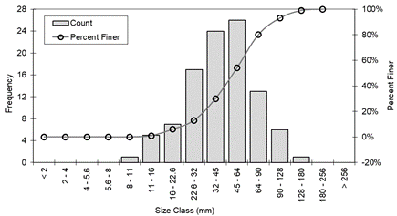
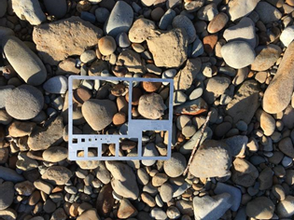
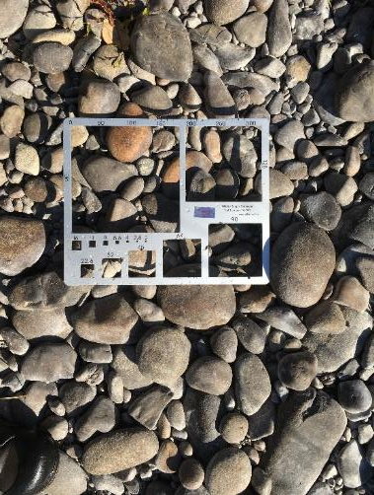
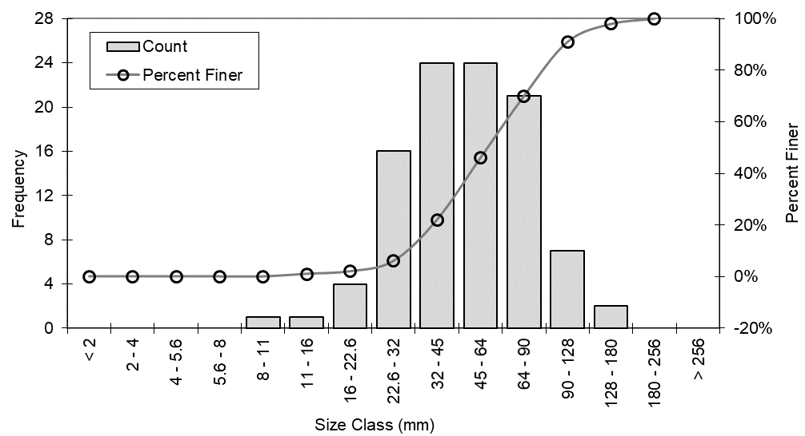
Sediment Sampling – Bed Material (Surface/Armoring)

Slide 19

Sediment Sampling – Bed Material (Surface/Armoring)
Relatively consistent size distribution throughout the study area
D10 ≈ 20mm Coarse Gravel
D50 ≈ 50mm Very Coarse Gravel
D84 ≈ 100mm Cobble

Slide 20
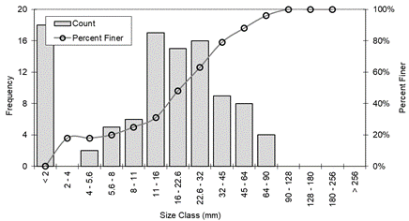
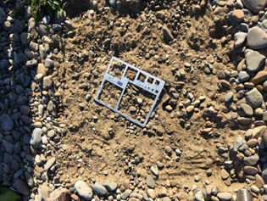
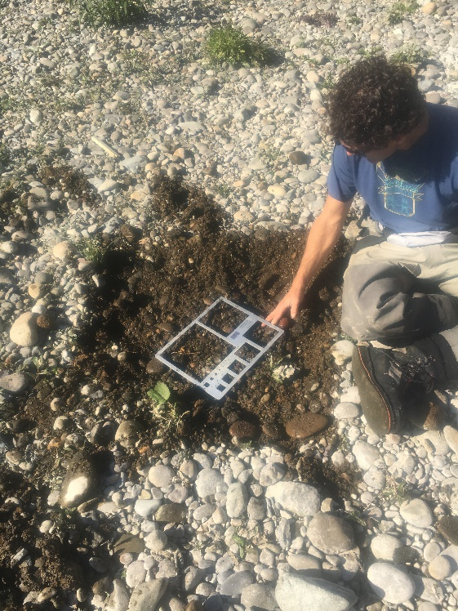
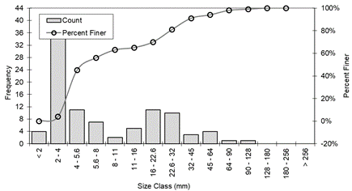
Sediment Sampling – Bed Material (Subsurface)

Slide 21

Sediment Sampling – Bed Material (Subsurface)
Two peaks in grain size, i.e. mixture of:
Coarse components: Gravel/Cobble, ~ same as river bed
Fine components: Sands, even silts (2mm and less)

Slide 22
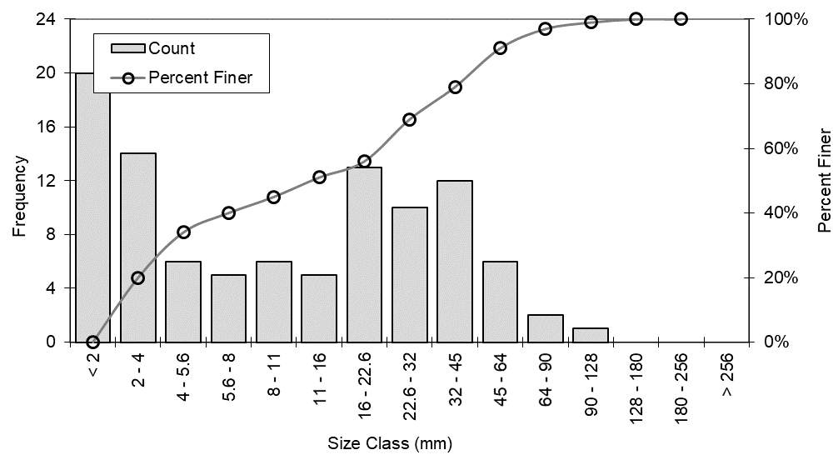
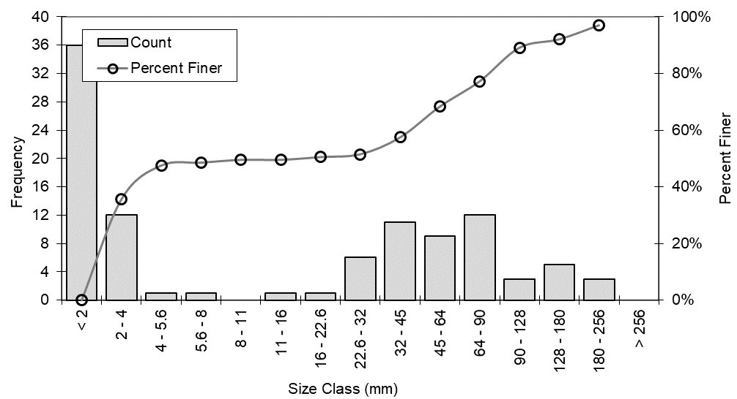
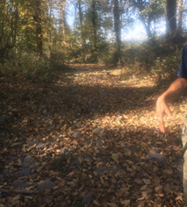
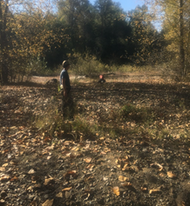
Sediment Sampling – Floodplain Material

Slide 23
Sediment Sampling – Floodplain Material
Also has two peaks in grain size. Similar profiles to riverbed subsurface.

Slide 24
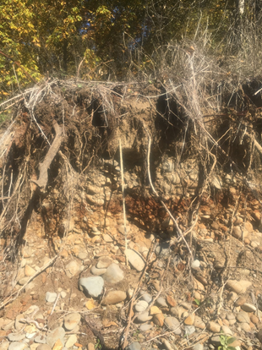
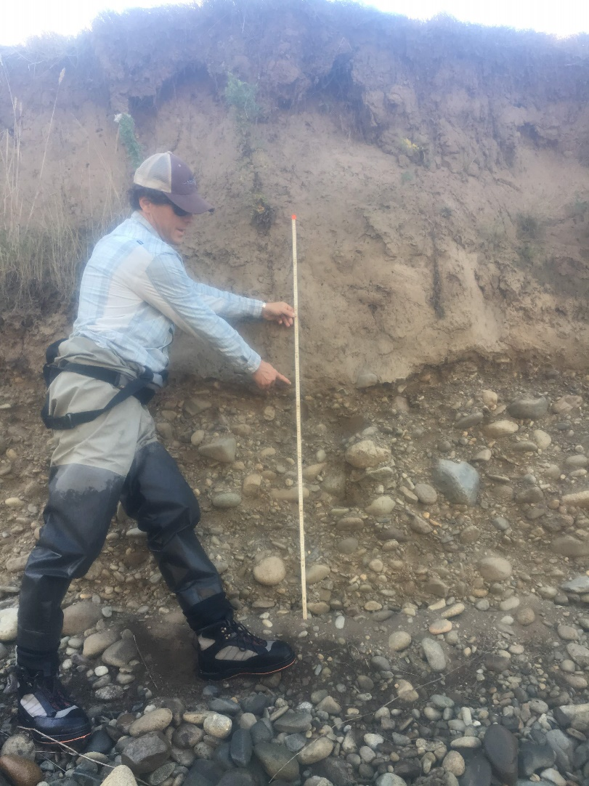
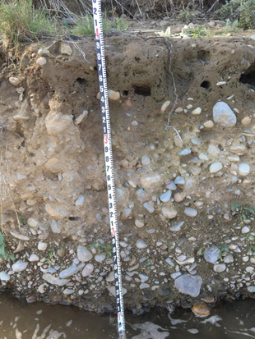
Sediment Sampling – Vertical Bank Profile

Slide 25
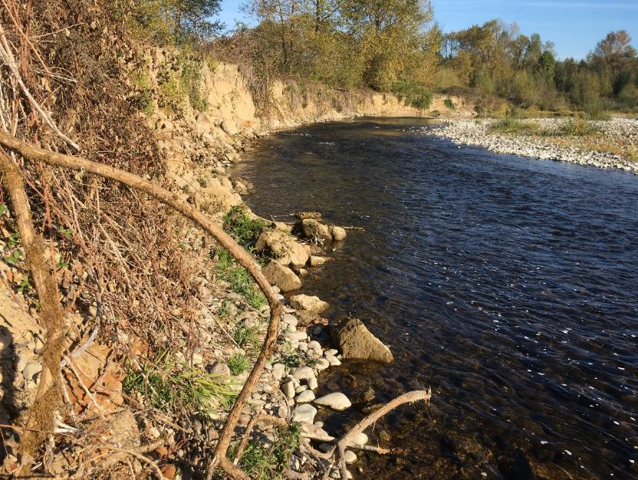
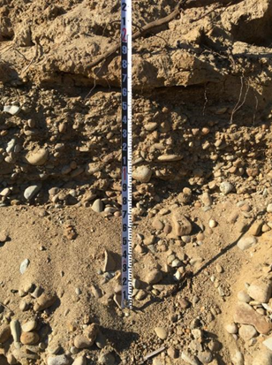
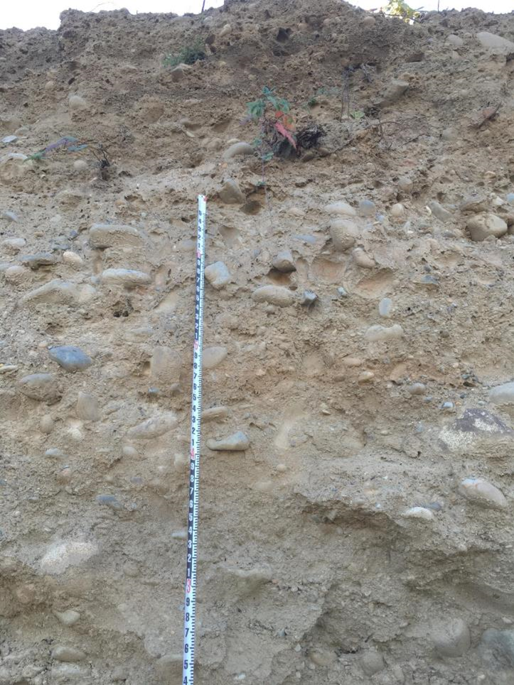
Sediment Sampling – Vertical Bank Profile

Slide 26
Sediment Sampling – Vertical Bank Profile
Type 1: Single layer of mixed sand, gravel, cobble. Forested floodplains.
Type 2: Two layer structure with thick sand/silt layer over the Type 1 layer. More dominant.

Slide 27


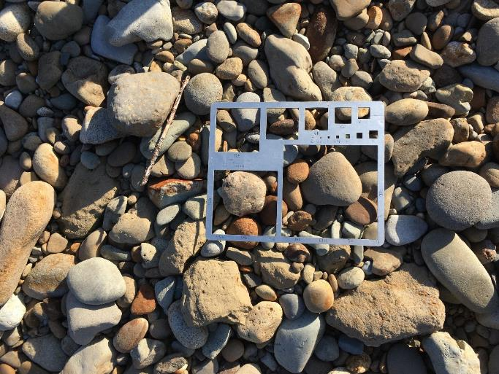
Proposed Sediment Parameters for Modeling
Sediment Type A:
bed surface layer
Sediment Type B:
bed sublayer, forested floodplain
Sediment Type C:
Bank top layer,
uniform size of
1 or 2 mm

Slide 28
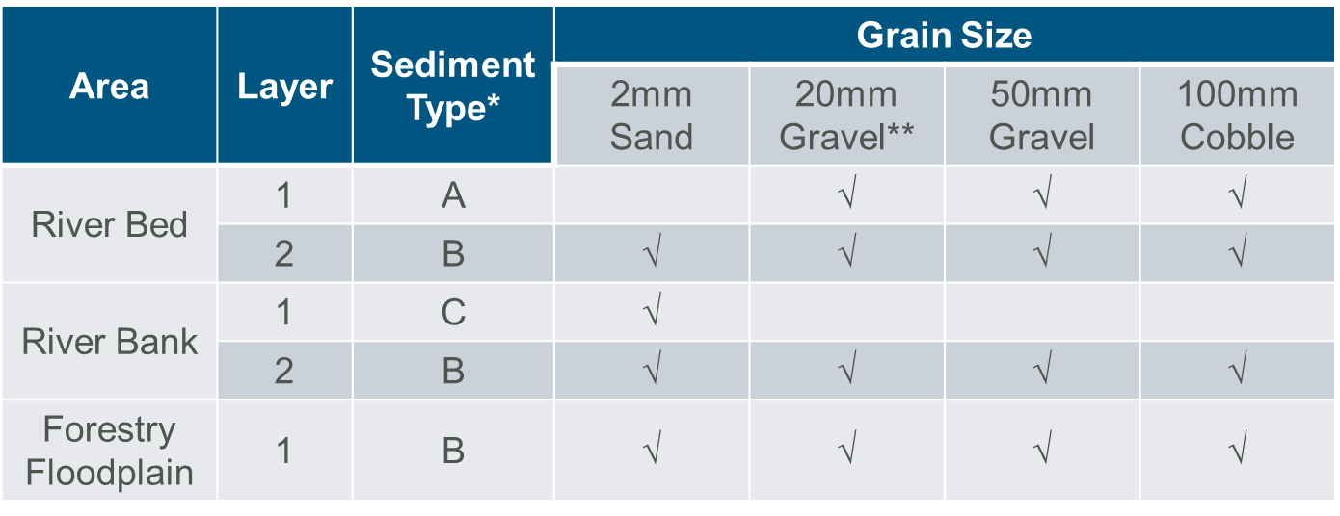
Proposed Sediment Parameters for Modeling

Slide 29
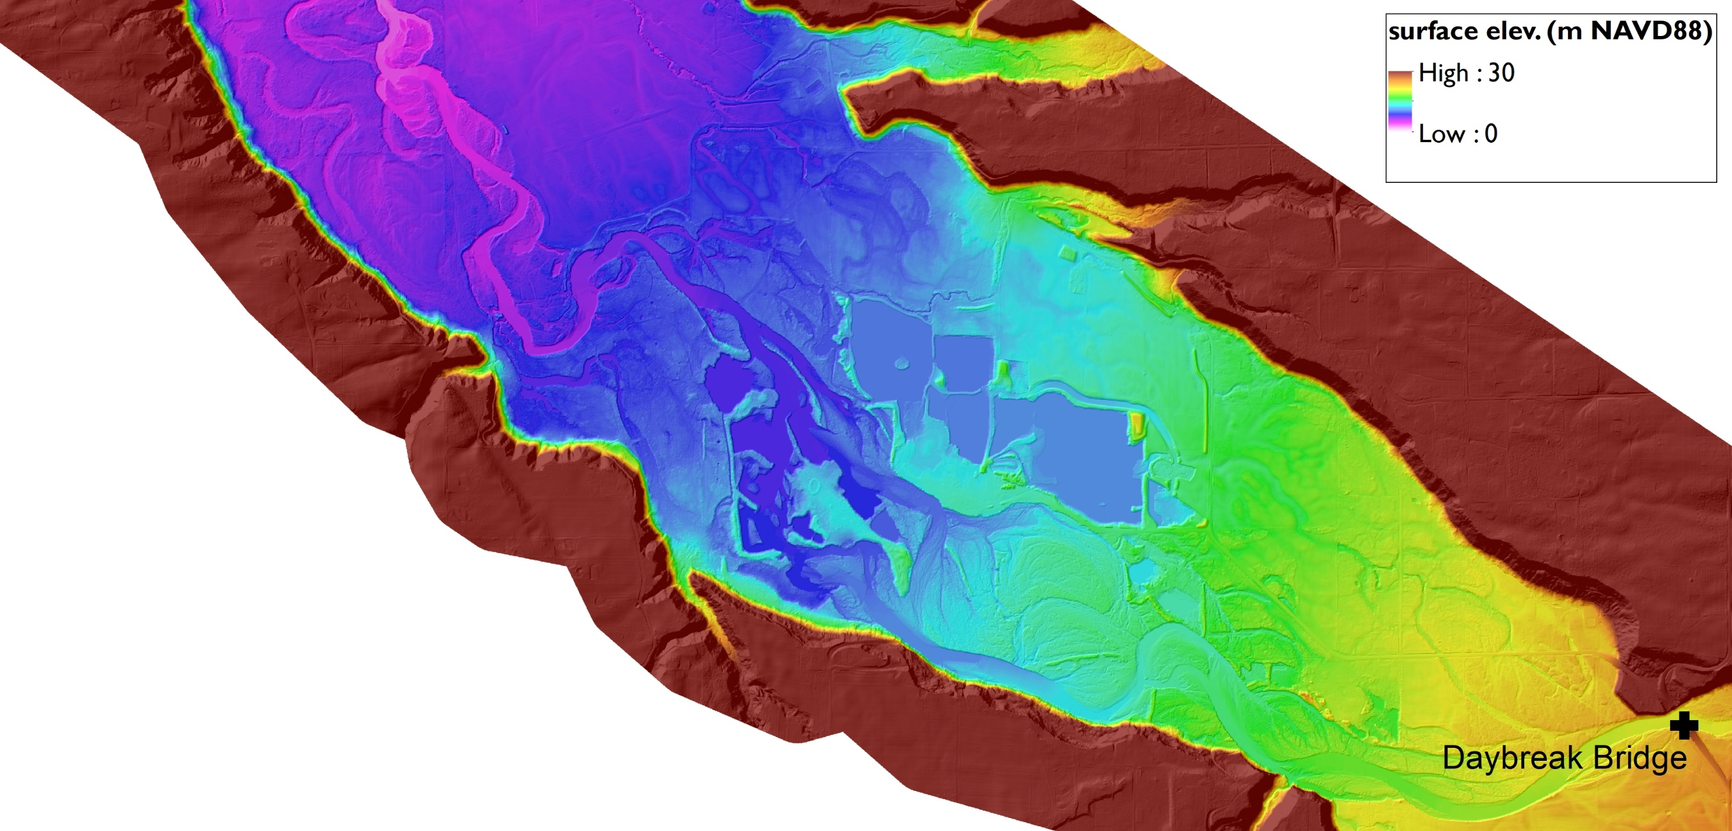
Elevation Model: Primary Source Data
Long term site (2012 – 2018)
2010 Lower Columbia LiDAR (Corps of Engineers)

Slide 30
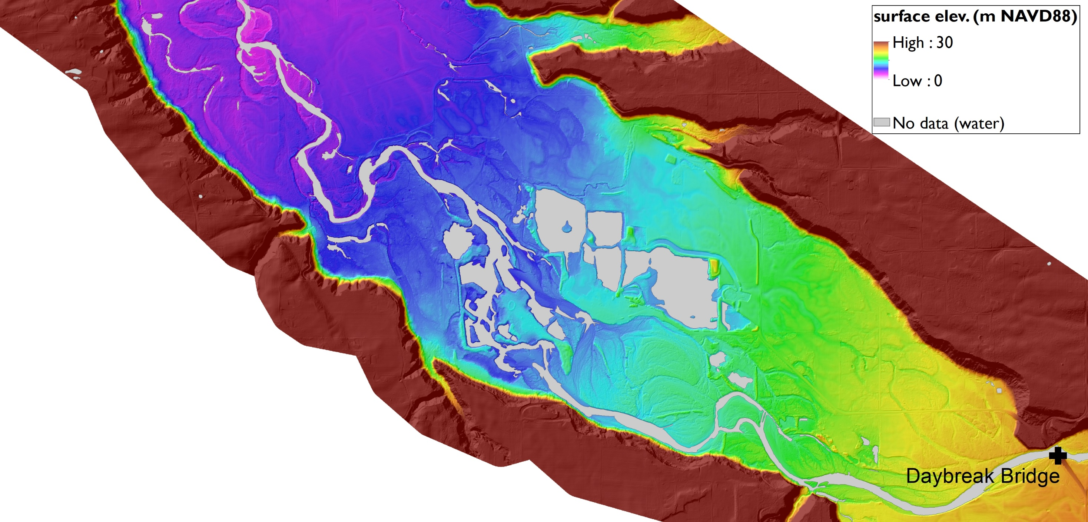
Elevation Model: Primary Data Source
Long term site (2012 – 2018)
Data gaps due to standing water

Slide 31
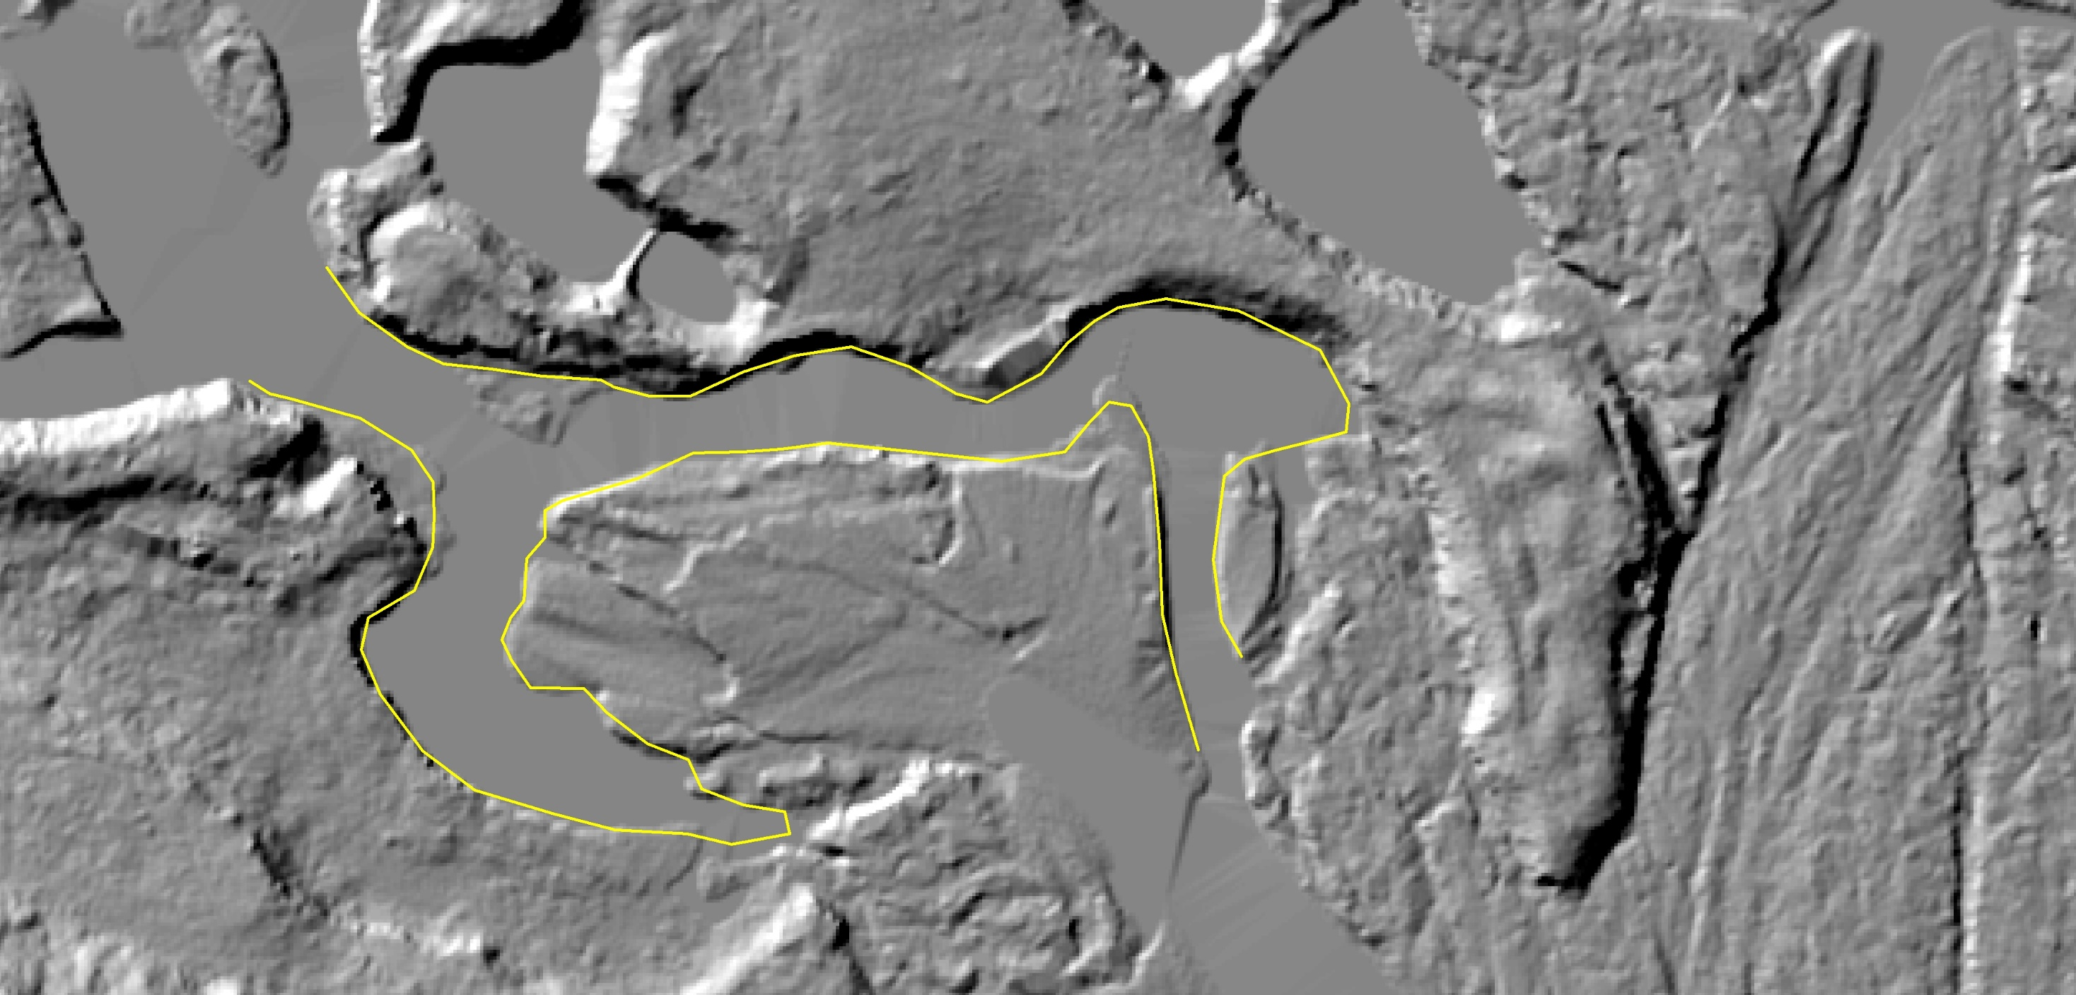
Elevation Model: Primary Data Source
Long term site (2012 – 2018)
2010 elevation model
Channel form 2010
Data gaps due to changes in planform over time

Slide 32
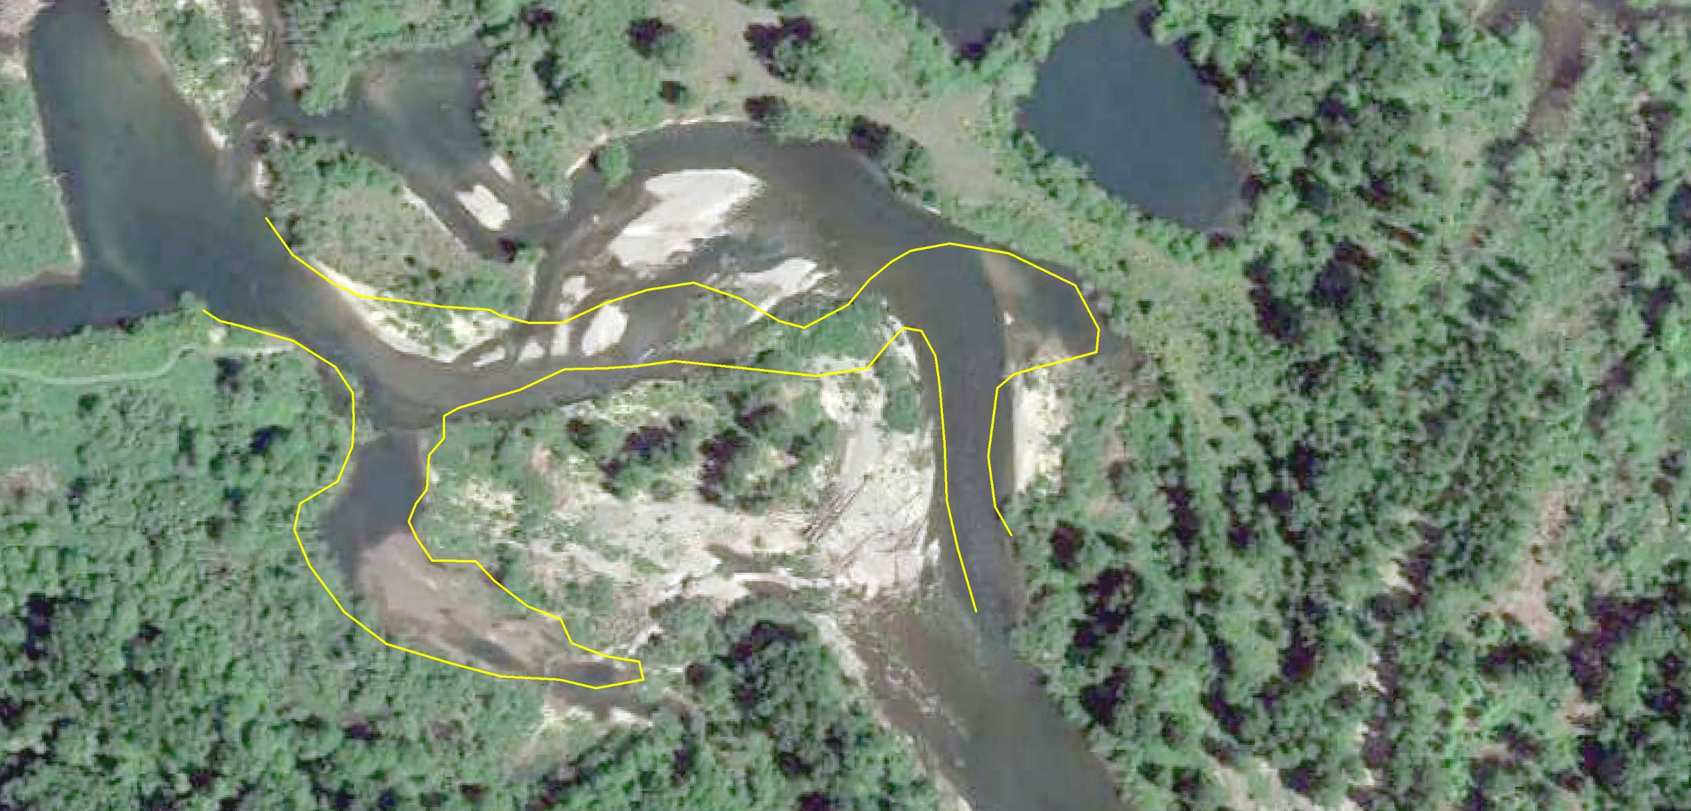
Elevation Model: Primary Data Source
Long term site (2012 – 2018)
2017 Image
Channel form 2010
Data gaps due to changes in planform over time

Slide 33
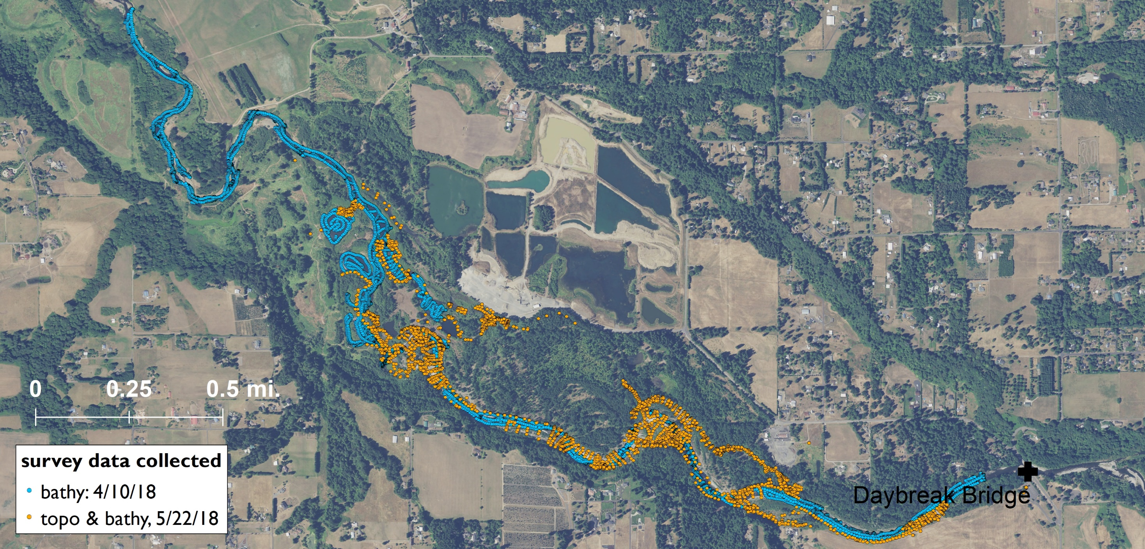
Bathymetric and Topographic Survey (2018)
Long term site (2012 – 2018)
Topo-bathy: 3600 points, RTK and total station
Bathy: 4 miles, single beam sonar

Slide 34
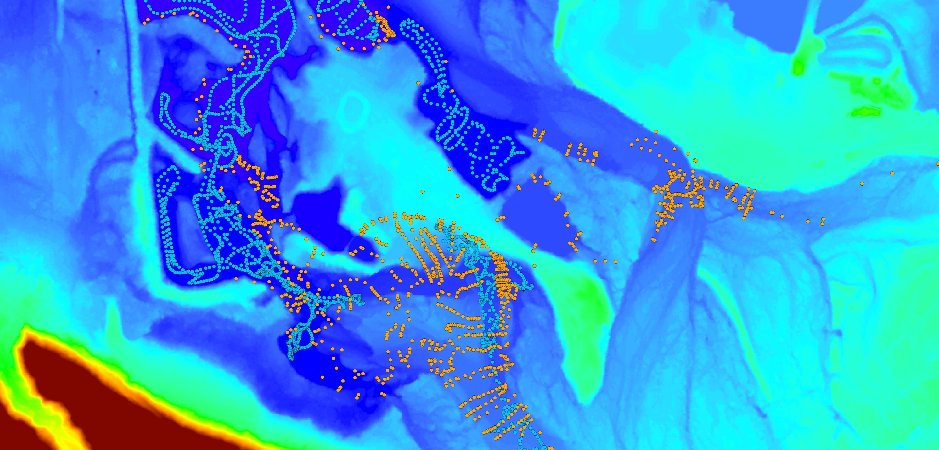
Bathymetric and Topographic Survey (2018)
Long term site (2012 – 2018)
Topo-bathy: 3600 points, RTK and total station
Bathy: 4 miles, single beam sonar

Slide 35
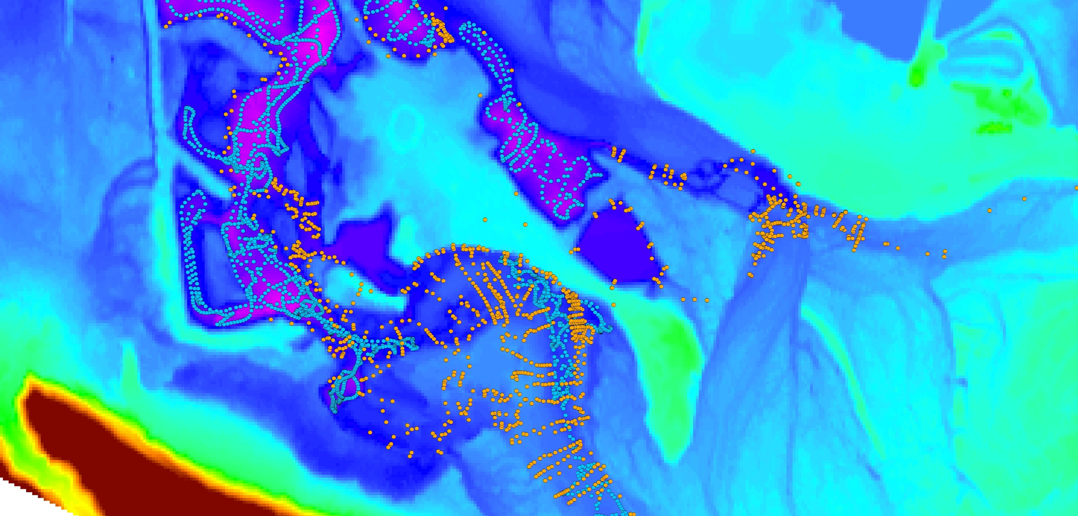
Bathymetric and Topographic Survey (2018)
Long term site (2012 – 2018)
Topo-bathy: 3600 points, RTK and total station
Bathy: 4 miles, single beam sonar

Slide 36
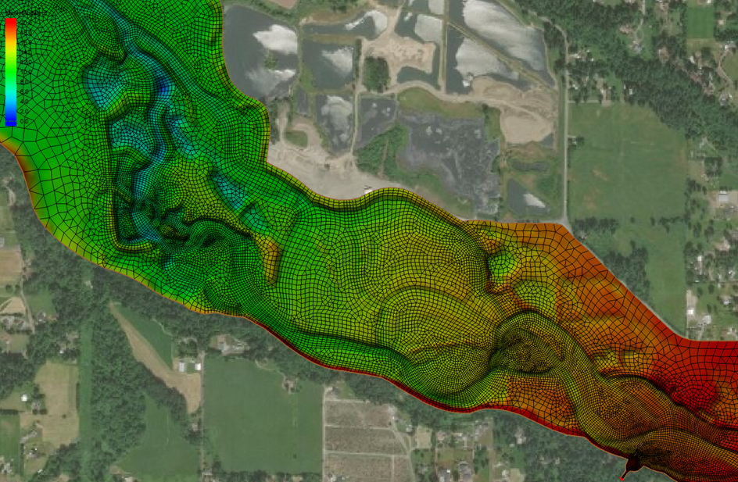
Hydro/Morpho-dynamic 2D Model: surface
Long term site (2012 – 2018)

Slide 37

Hydro/Morpho-dynamic 2D Model: model extent & drivers
WSE
Model Inputs:
Downstream water surface elevation (LCEP sensor)
Upstream flow (Heisson gage)
Optional upstream sediment supply (best estimate)
Q
SED

Slide 38




Model hydraulic inputs: H-Q rating curve
Established relationship between upstream flow (Q) and downstream water level based on available data:
C_{r}, β: rating curve
constants
a: constant which
represents the
gauge reading
corresponding
to zero discharge.
$$Q=C_{r}{\left(H−a\right)}^{β}$$
Over bank flow:
$$Q=20{\left(H−4.3\right)}^{0.35}$$
In bank flow:
$$Q=20{\left(H−2.5\right)}^{0.64}$$

Slide 39


Flood Frequency Analysis, EFLR

Slide 40

Tuflow FV Sediment/Morpho-dynamic Model Key Features
Suspended load
Hydraulic module → advection / dispersion
Sedimentation / Erosion (Mehta Model)
Bedload (Meyer-Peter Mueller Model)
Morphology (adjusts bed elevation in response to sediment transport)
Multiple sediment fraction
Multiple bed layer
Armouring
2D/3D
Slide source: BWT-WBM (Tuflow FV)

Slide 41

Tuflow FV Sediment Module: Armouring Feature
Slide source: BWT-WBM (Tuflow FV)

Slide 42



Transport Mode Governing Equations
Suspended Load Erosion Model == Mehta
Mehta’s erosion model
Bedload Model == MPM
Meyer-Peter Müller’s equation
$$E=E_{r}{\left(τ_{b}/τ_{b,c}−1\right)}^{α}$$
$$\frac{q_{bv}}{\sqrt{\left(G−1\right)gd_{50}^{3}}}=8{\left(τ_{b∗}−0.047\right)}^{3/2}$$
- Condition for sediment transport: Bed shear stress ($τ_{b}$) > critical shear stress ($τ_{c})$
Look at $τ_{b}$ values output by hydrodynamic (or sediment) model to get a sense of where sediment is predicted to move under different flow conditions.
Compare to known sources (imagery) to see if model is making sense

Slide 43

Grain Size and Critical Shear Stress
Description | Grain Size (mm) | Tau,c Shields’ (1936) (N/m2) | Tau,c Soulsby’s (1997) (N/m2)
Fine Sand | 1 | 0.50 | 0.50
Gravel | 10 | 9.0 | 9.0
Coarse Gravel | 25 | 22.4 | 22.4
Cobble | 100 | 89.1 | 89.1
Slide source: BWT-WBM (Tuflow FV)

Slide 44


Model Results: Bed Shear Stress, Q = 1000 cfs (base flow)
$τ_{b}$ > $τ_{c}$ for:
cobble
gravel
sand
none

Slide 45

Model Results: Bed Shear Stress, Q = 3000 cfs (~Q1)
$τ_{b}$ > $τ_{c}$ for:
cobble
gravel
sand
none

Slide 46

Model Results: Bed Shear Stress, Q = 15,000 cfs (~Q20)
$τ_{b}$ > $τ_{c}$ for:
cobble
gravel
sand
none

Slide 47

Model Results: Bed Shear Stress, Q = 28,600 cfs (~Q100)
$τ_{b}$ > $τ_{c}$ for:
cobble
gravel
sand
none

Slide 48


Model Results: Bed Elevation Change, post 5-yr event
$$elev. change (m)$$
1.0
0
-1.0

Slide 49

Preliminary Model Observations
Even at base flow condition, $τ_{b}$ can reach 50N/m² in some areas, which is strong enough to move bed material smaller than “coarse gravel”.
At a 1-yr flood event, $τ_{b}$ can reach 100N/m2 in limited areas. The majority of bed material ‘can’ move, but cobble forms an armouring layer in most areas. This is a high frequency event and the bank erosion may shift the stream banks over time.
Under the 5-yr flood event, water can get almost everywhere. $τ_{b}$ can reach 150N/m2 even in the potential river course at the south side of the domain.
Much more to come!

Slide 50

Preliminary Model Observations
Questions?

