Slide 1
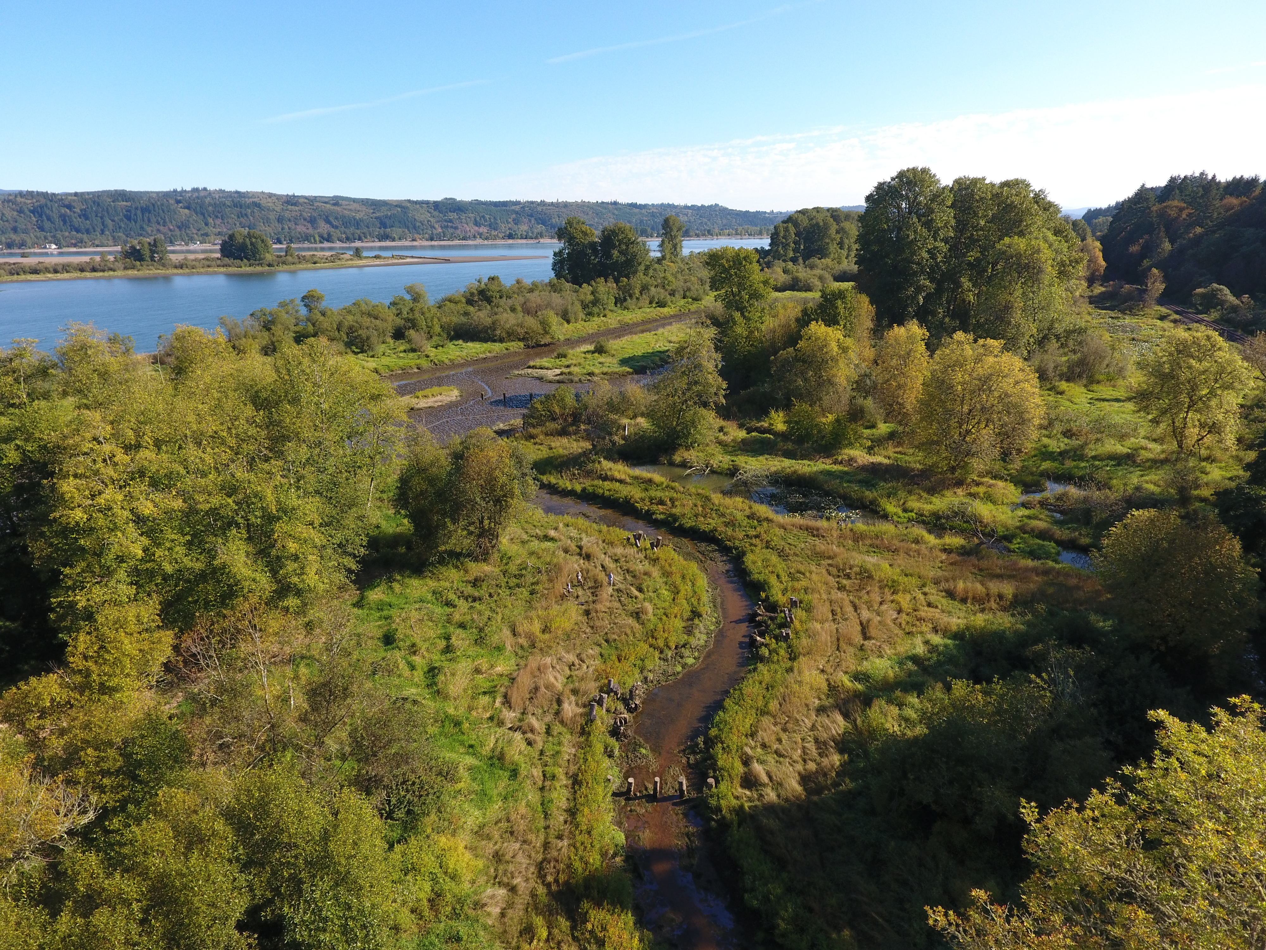

Estuary Partnership Monitoring Overview
Matthew Schwartz - mschwartz@estuarypartnership.org
Catherine Corbett – ccorbett@estuarypartnership.org

Slide 2
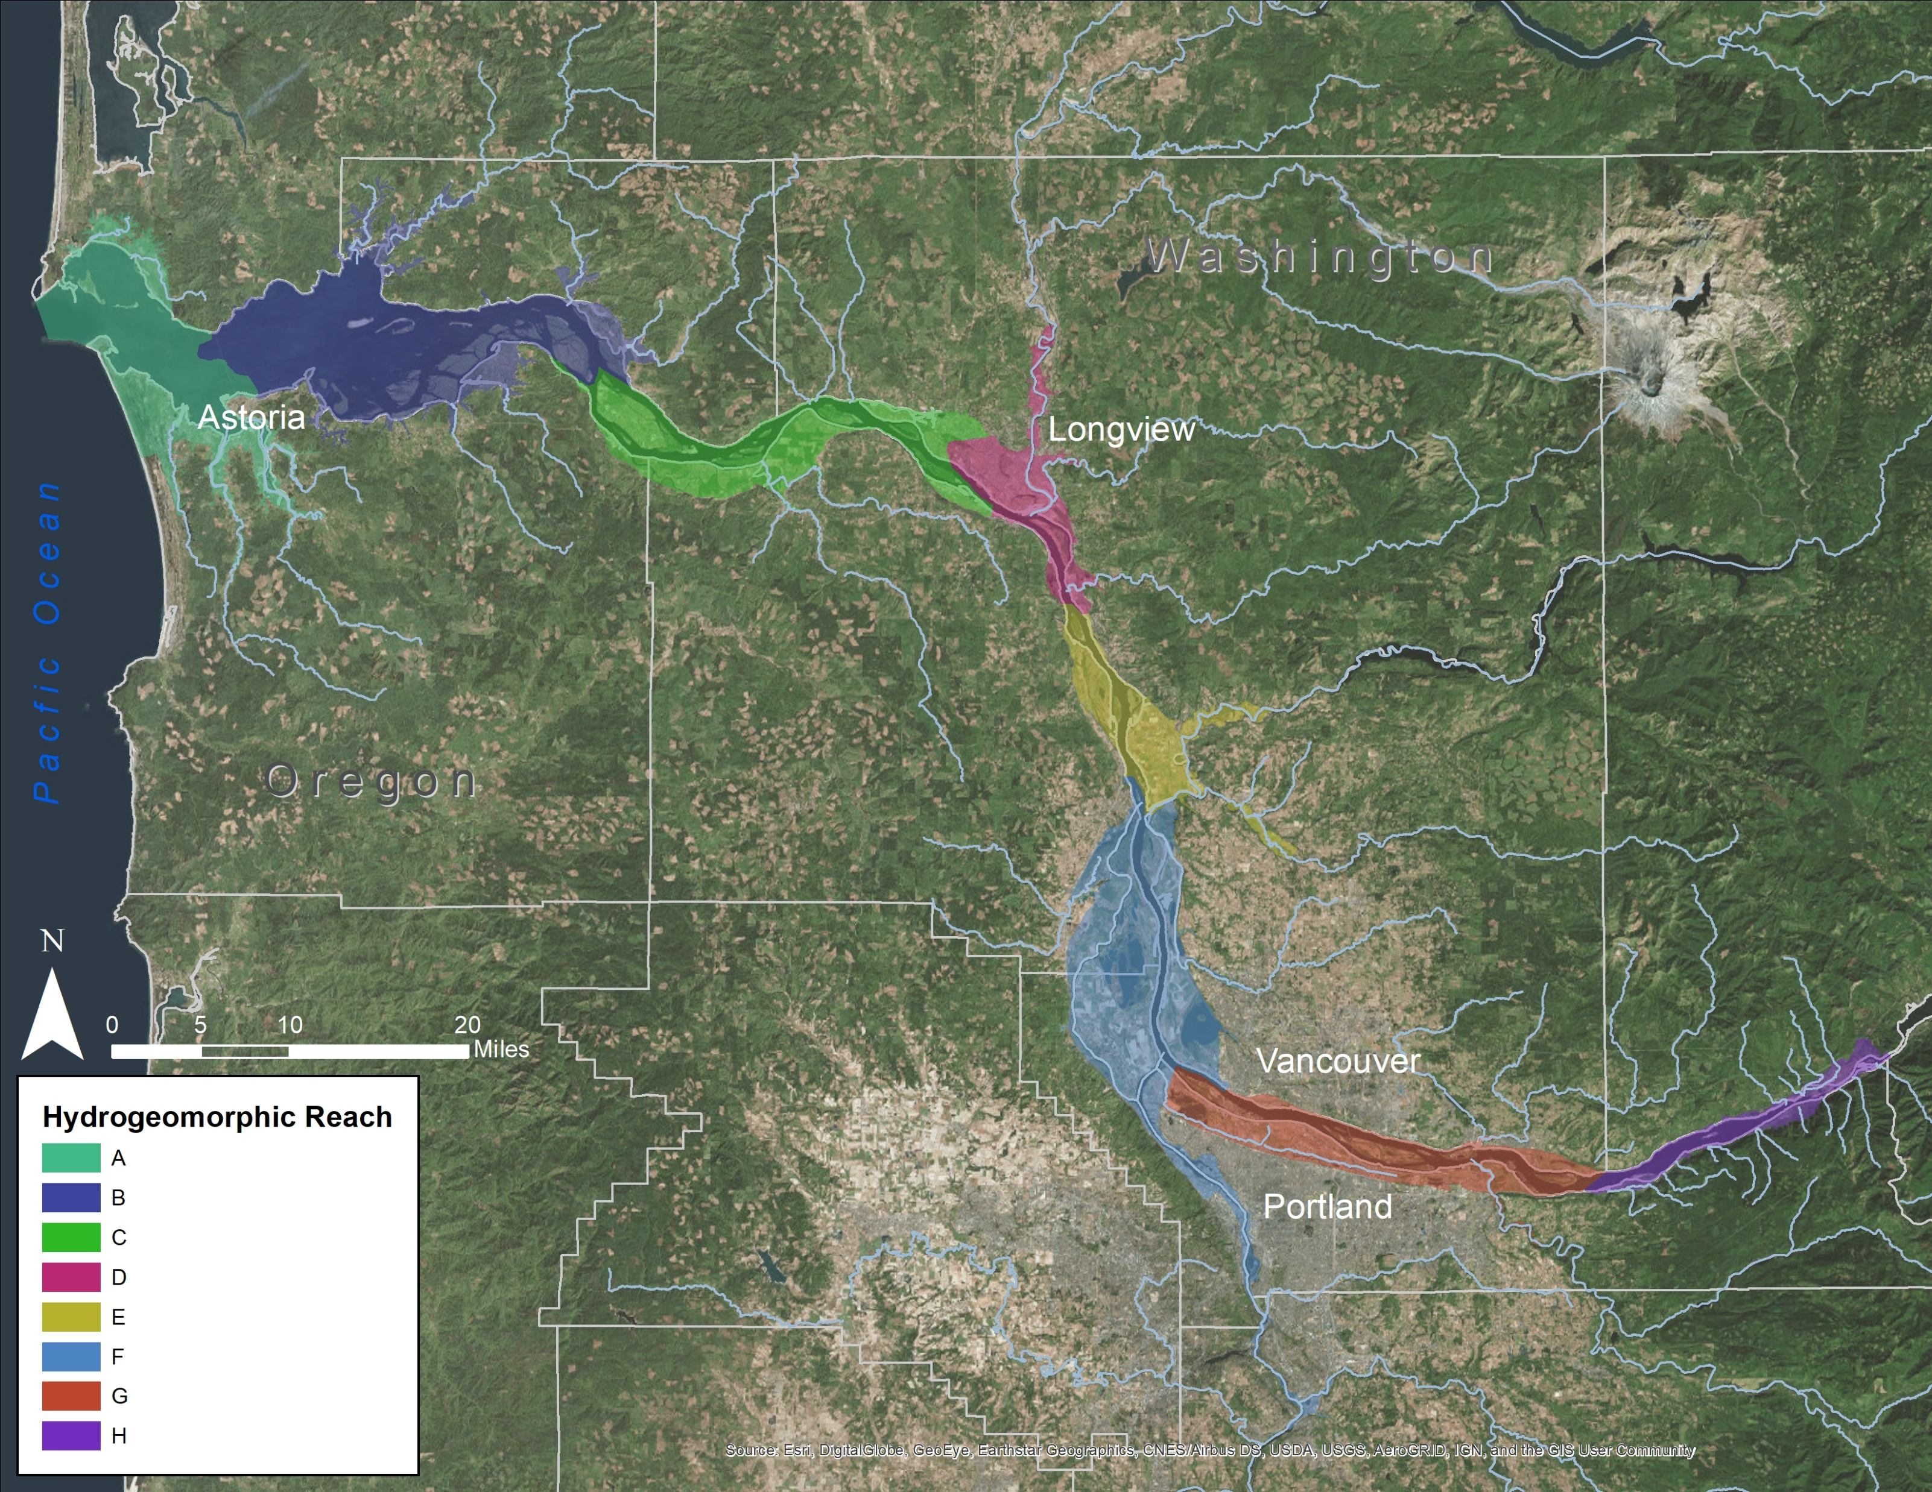
Estuary Partnership Monitoring Program Assessment Area
Notes:
Application Assessment: Assessment Area – Lower Columbia River, Bonneville Dam to mouth 146 Miles
Emergent tidal freshwater wetlands

Slide 3
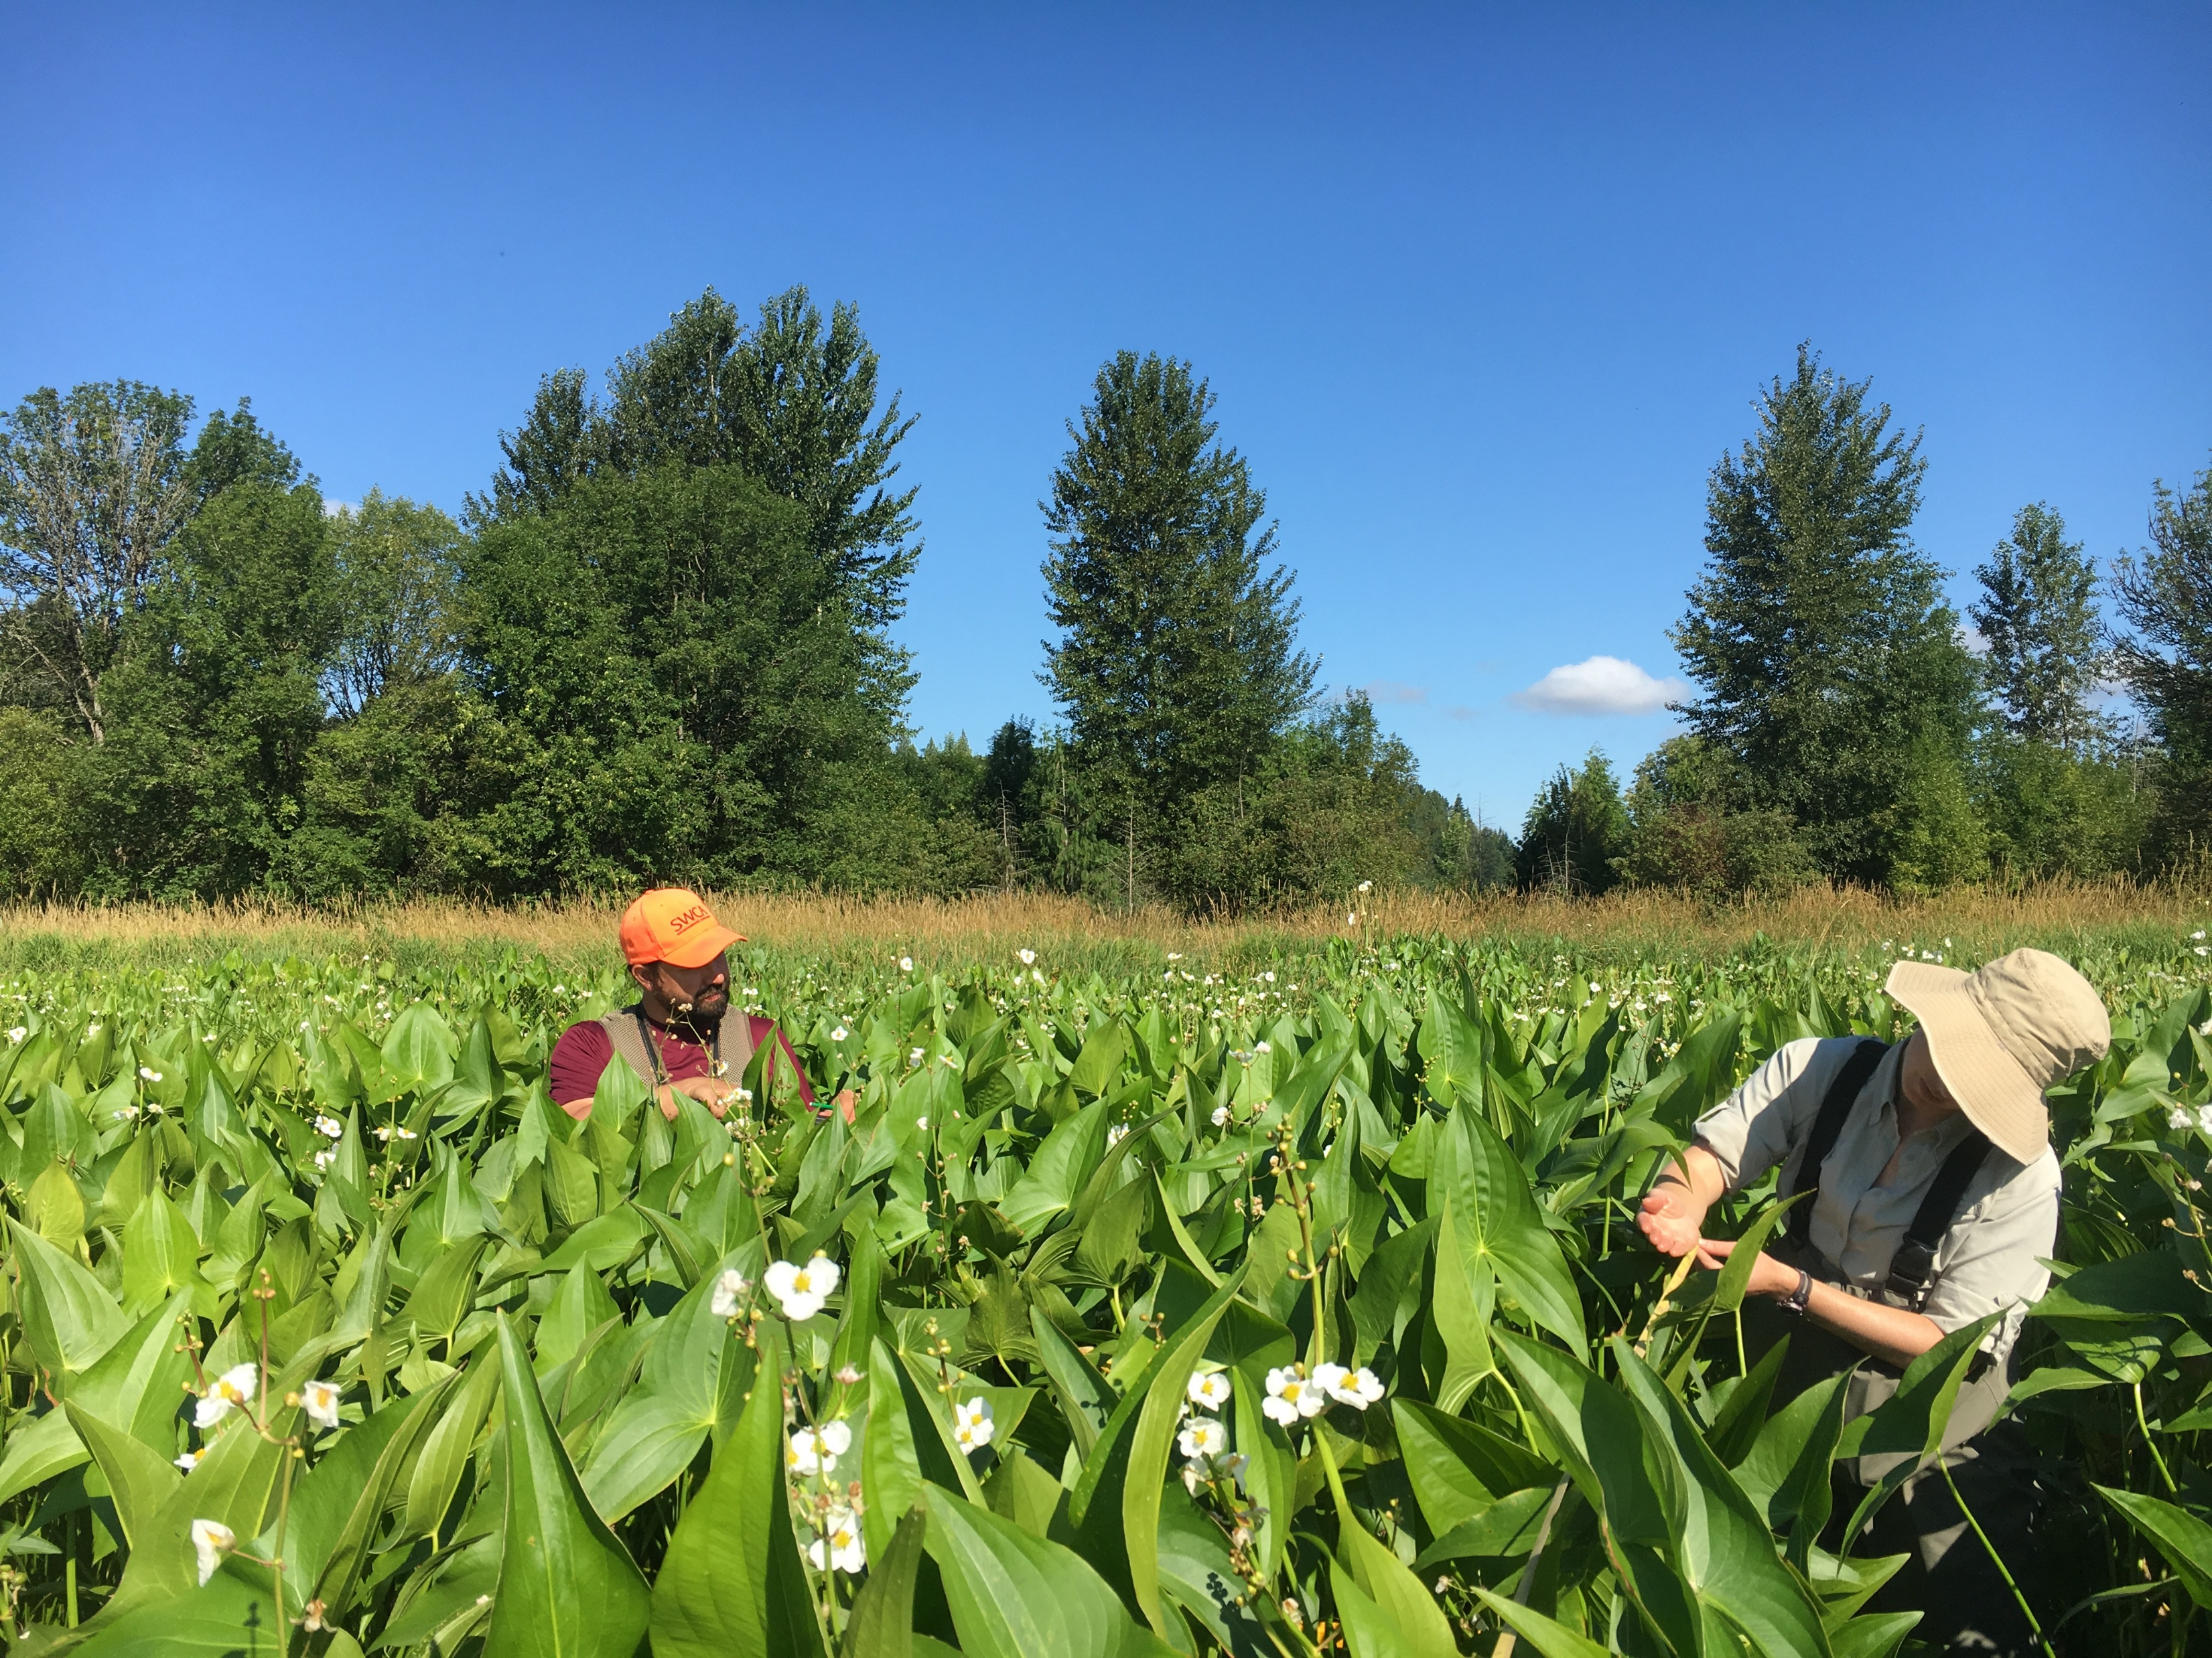
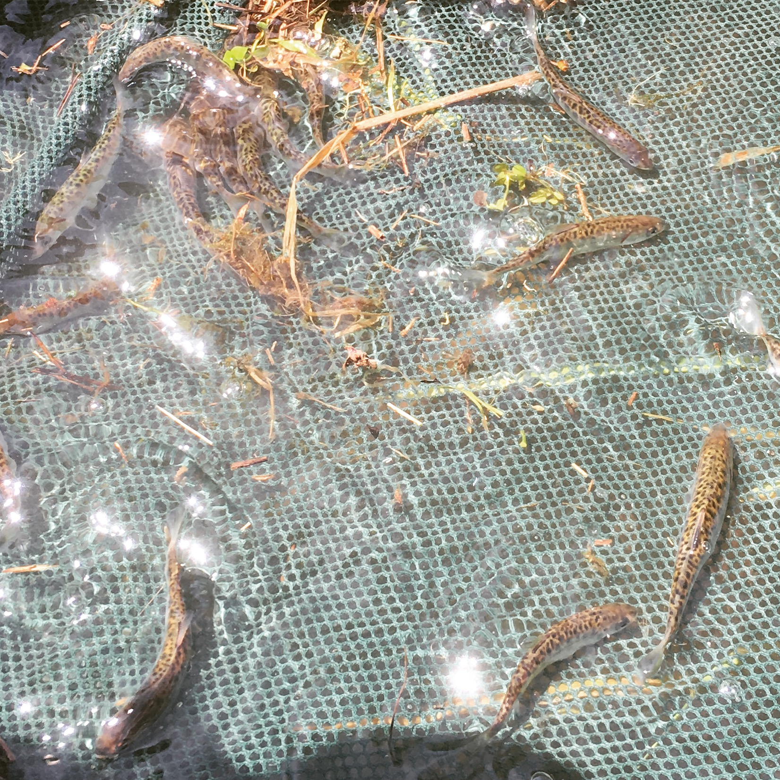
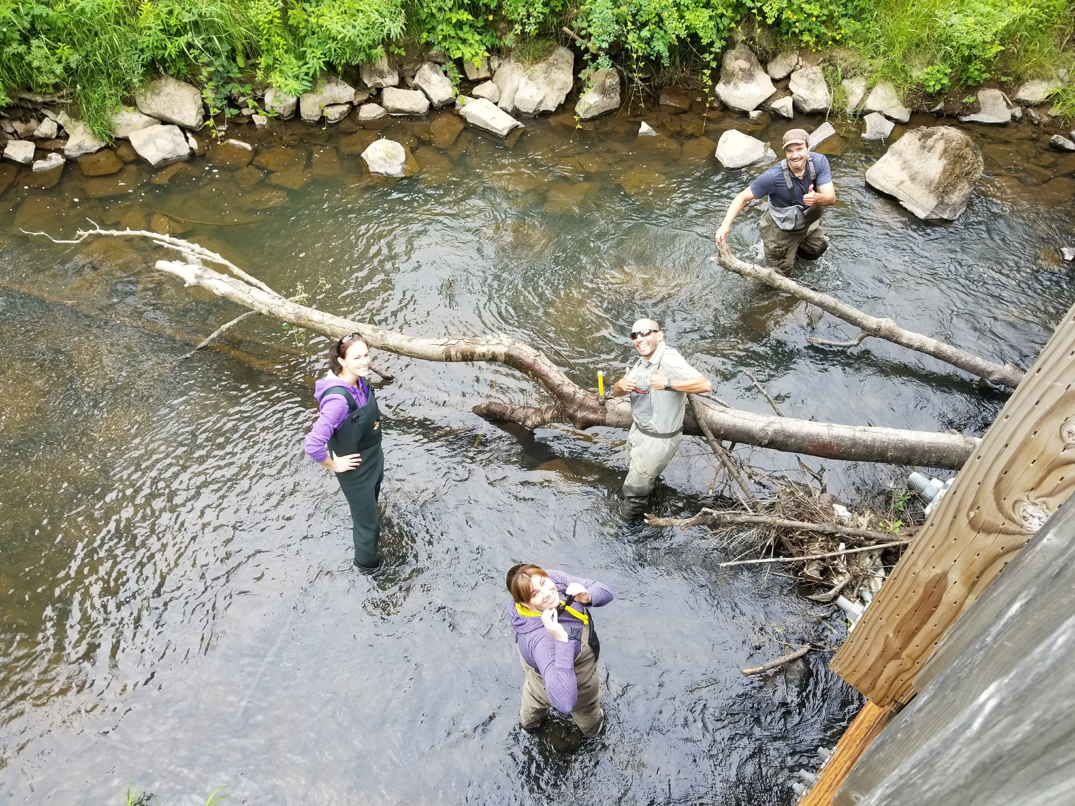
Estuary Partnership Monitoring Program Overview
Ecosystem Monitoring Program (EMP)
Status and trends monitoring of ecosystem condition
Provides basic information, fill knowledge gaps on tidal freshwater section of lower river
Action Effectiveness Monitoring Program (AEMR)
Evaluates whether restoration actions achieved the stated goals of the project
Evaluates if restoration sites become similar to reference sites
Notes:
Goals and Objectives: Two programs

Slide 4
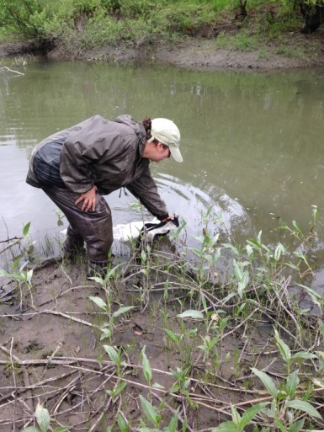
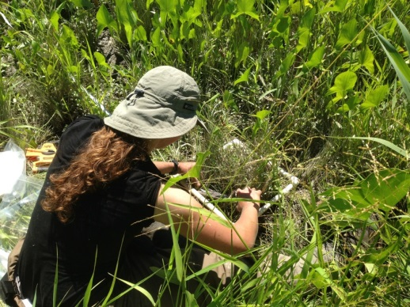
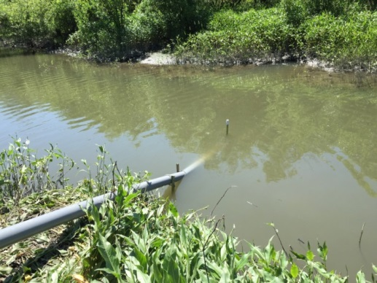
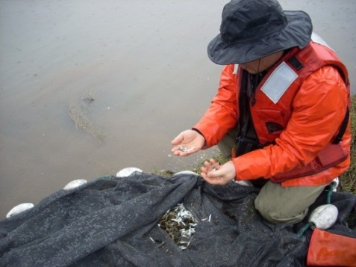
Ecosystem Monitoring Program Components
Habitat and Hydrology - Habitat accessibility/quality for fish, macrodetritus production and flux offsite
Mainstem and Abiotic Site Conditions – water quality, organic matter and nutrient flux; factors affecting primary productivity and food-web resources during peak salmon outmigration period
Food Web - Role of different food web components in supporting juvenile salmon (primary/secondary production)
Fish and Fish Prey - Assessment of salmonid habitat use, prey availability, and diet preference

Slide 5
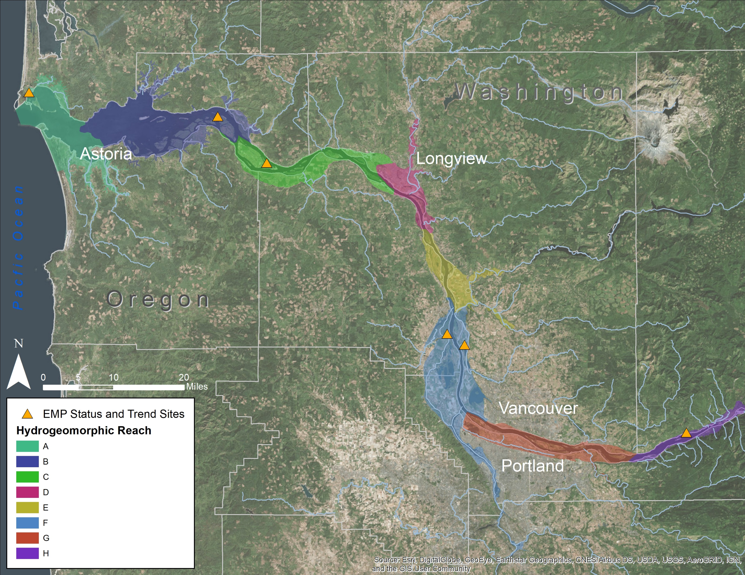
Estuary Partnership EMP Sites
Notes:
Application Assessment: Assessment Area – Lower Columbia River, Bonneville Dam to mouth 146 Miles
Emergent tidal freshwater wetlands

Slide 6
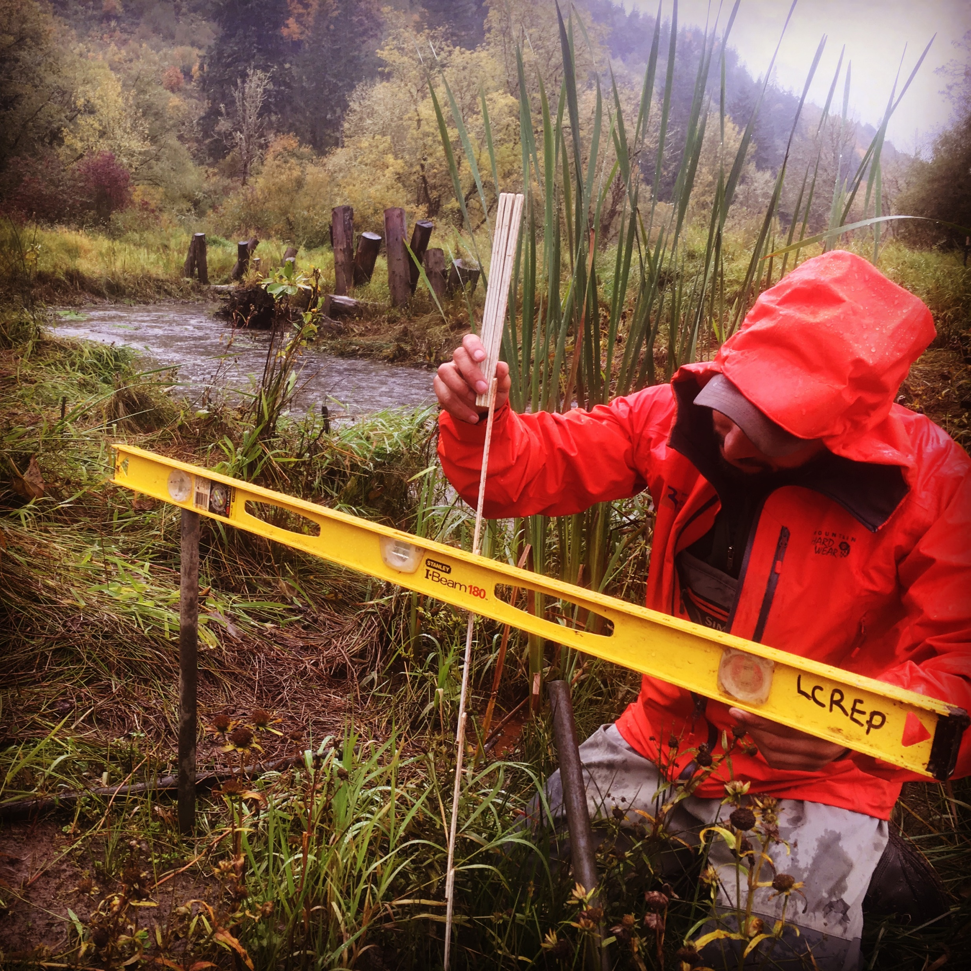
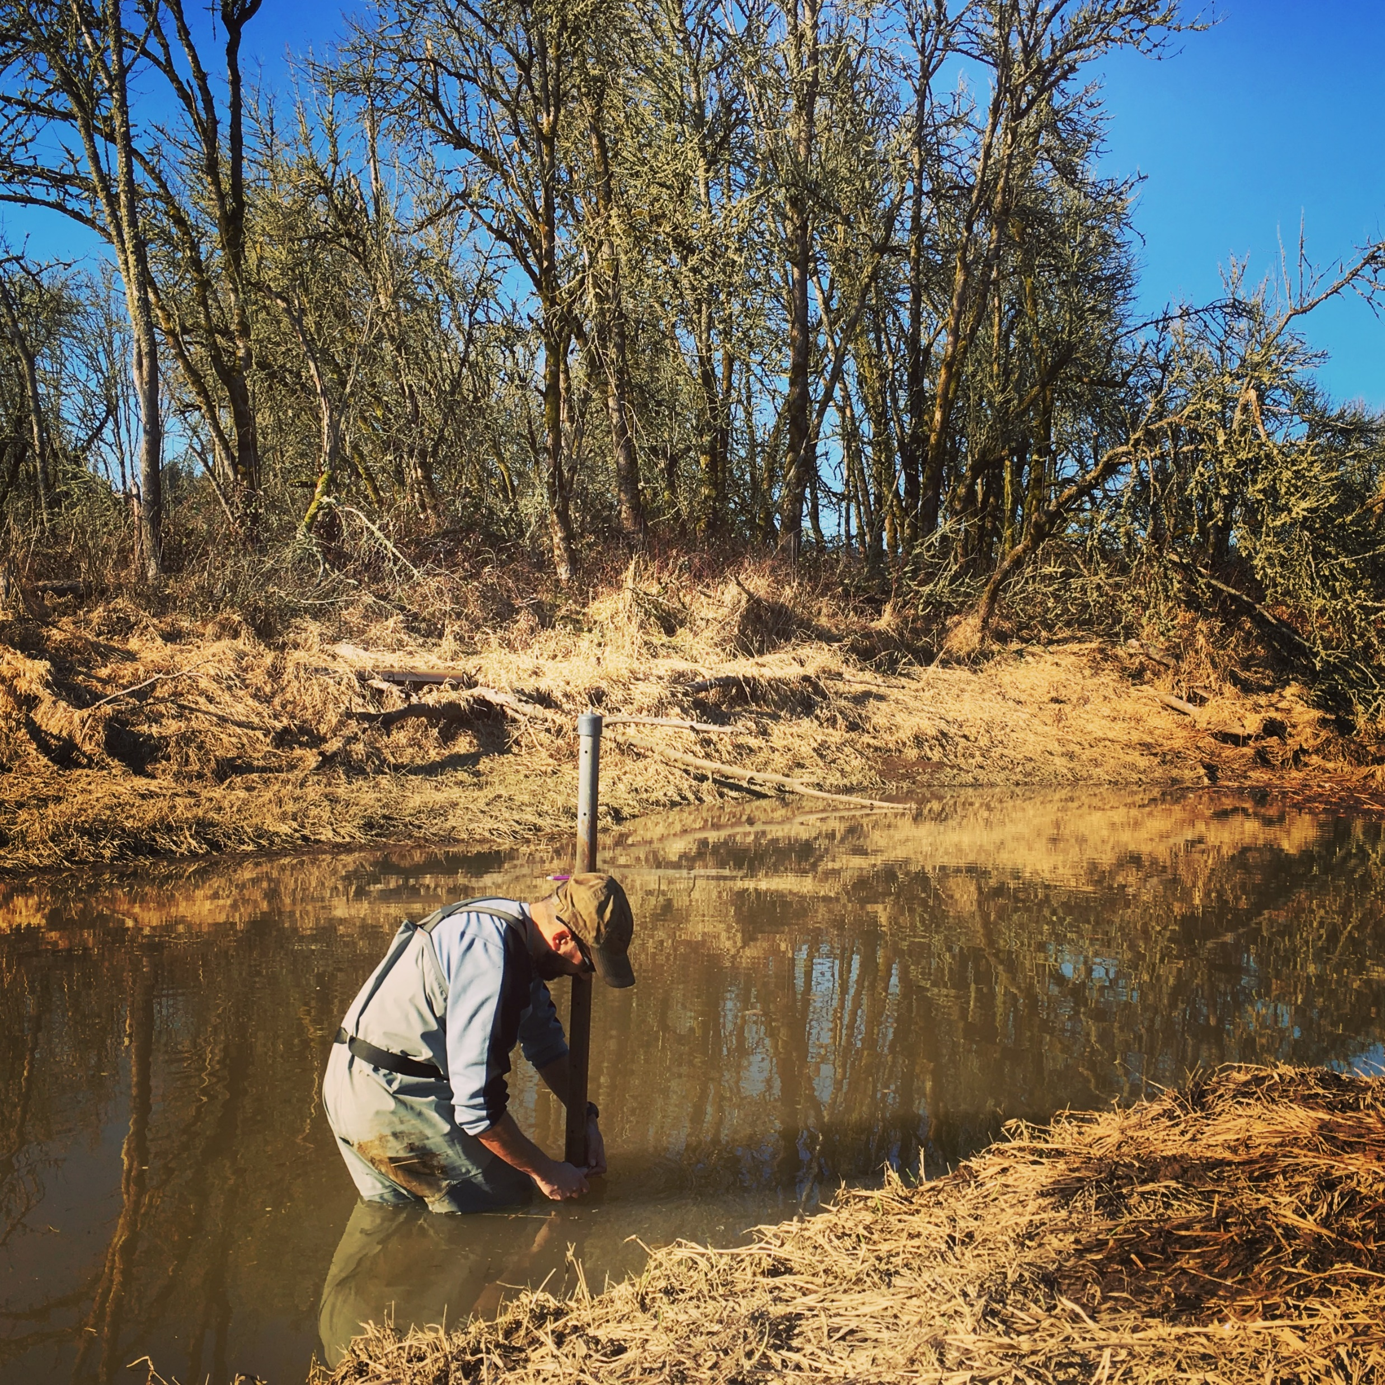
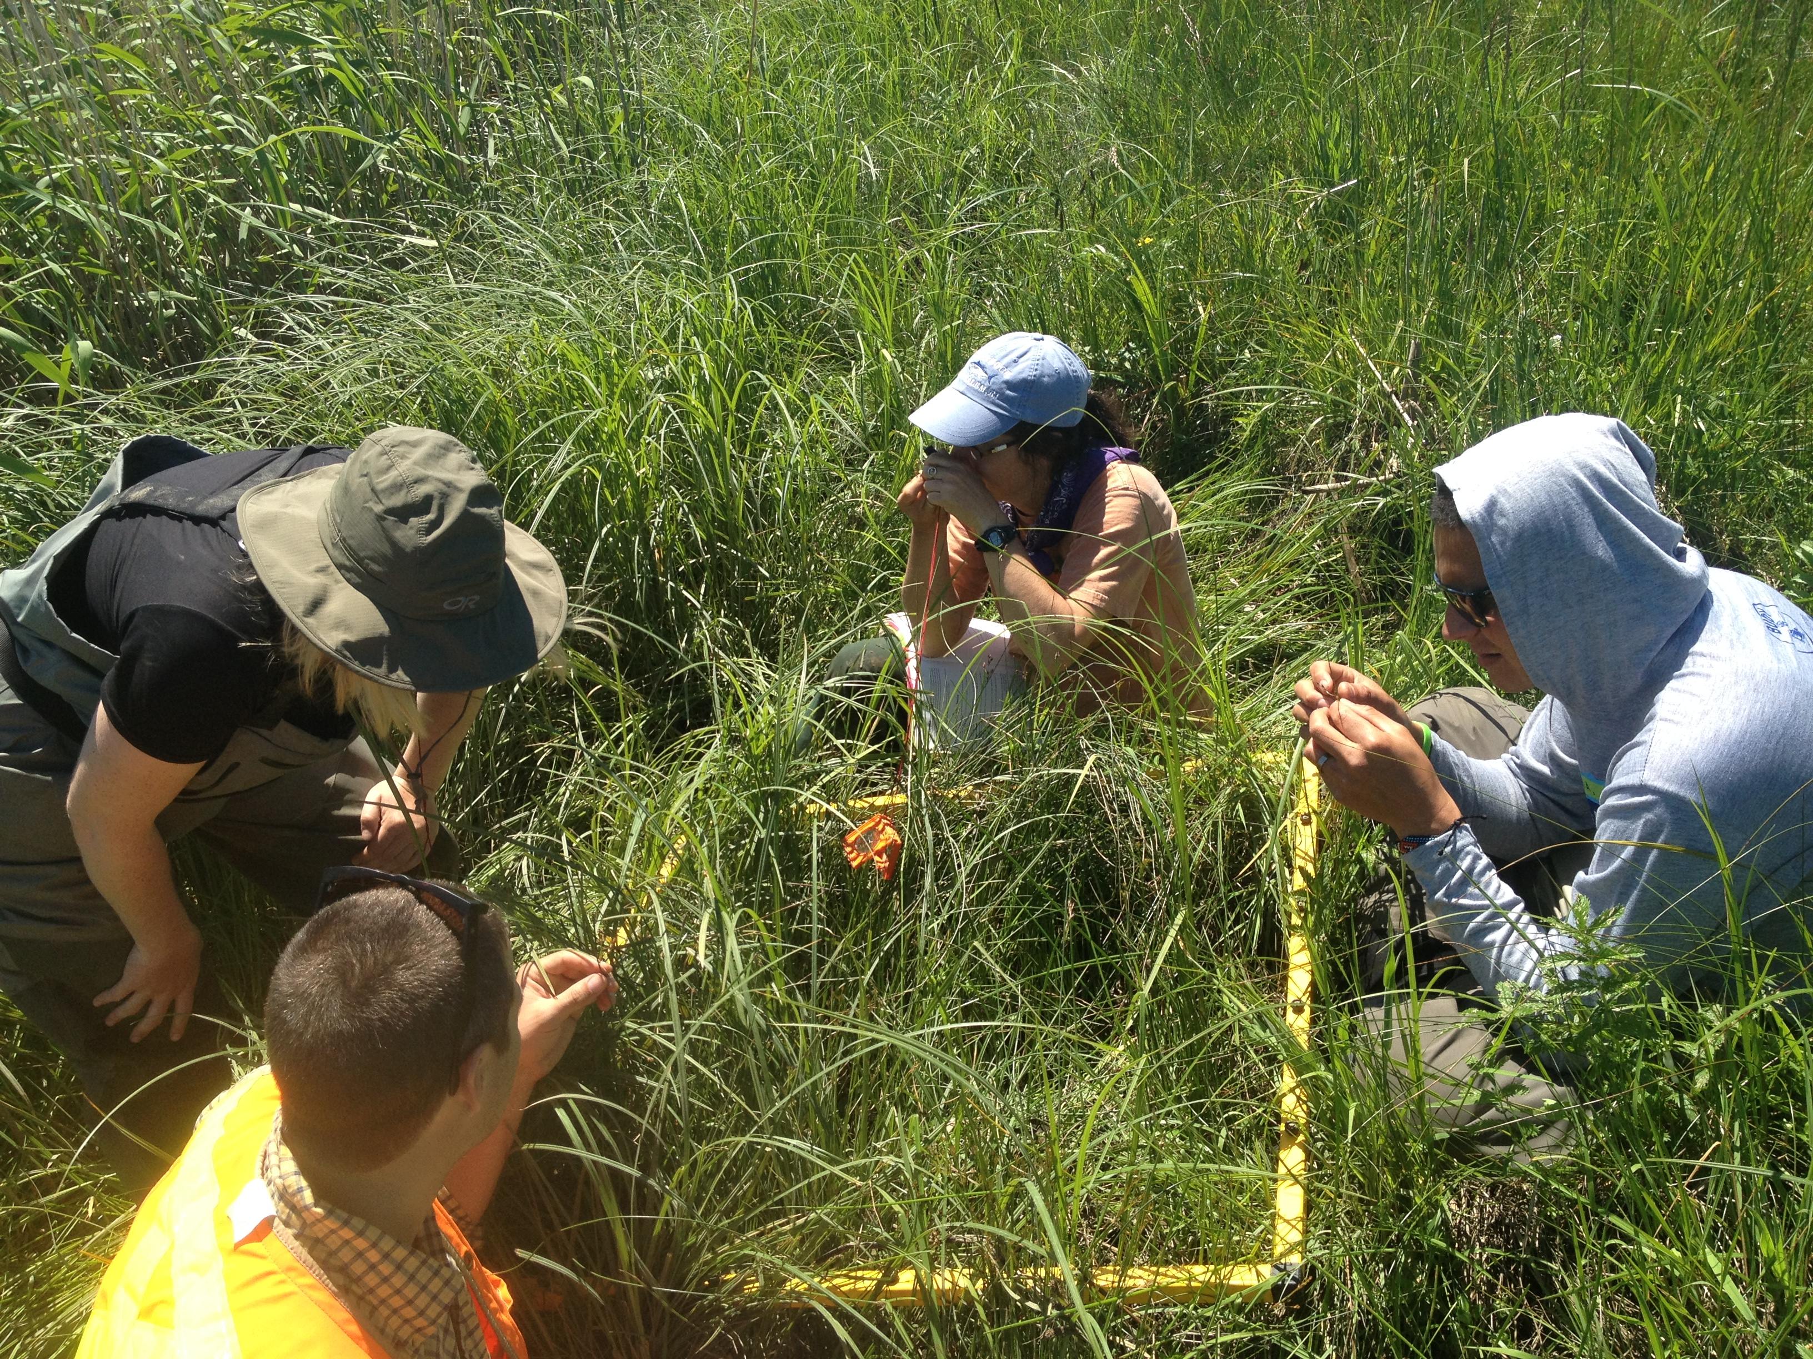
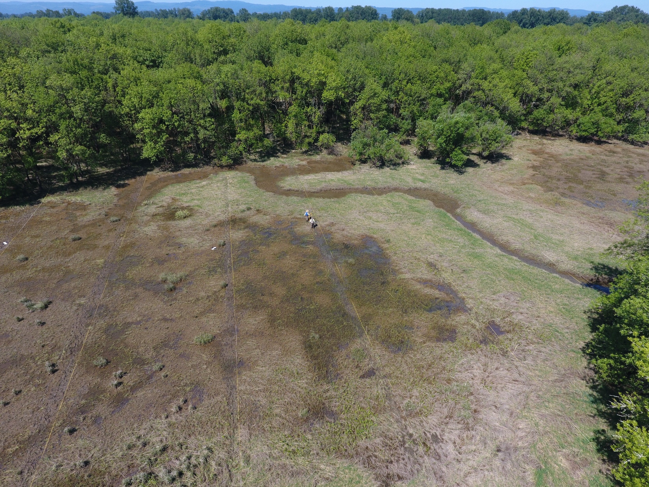
Action Effectiveness Monitoring Components
Hydrology and Water Quality - Habitat accessibility/quality for fish
Sediment Accretion and Topography – Sustaining wetlands
Photo Points – Qualitative ocular monitoring
Habitat – Vegetation composition and cover, macrodetritus production
Fish Prey - Prey availability
Fish – Presences/Absence
Basic data collected at all Sites
Extensive Data collected at a subset of sites

Slide 7
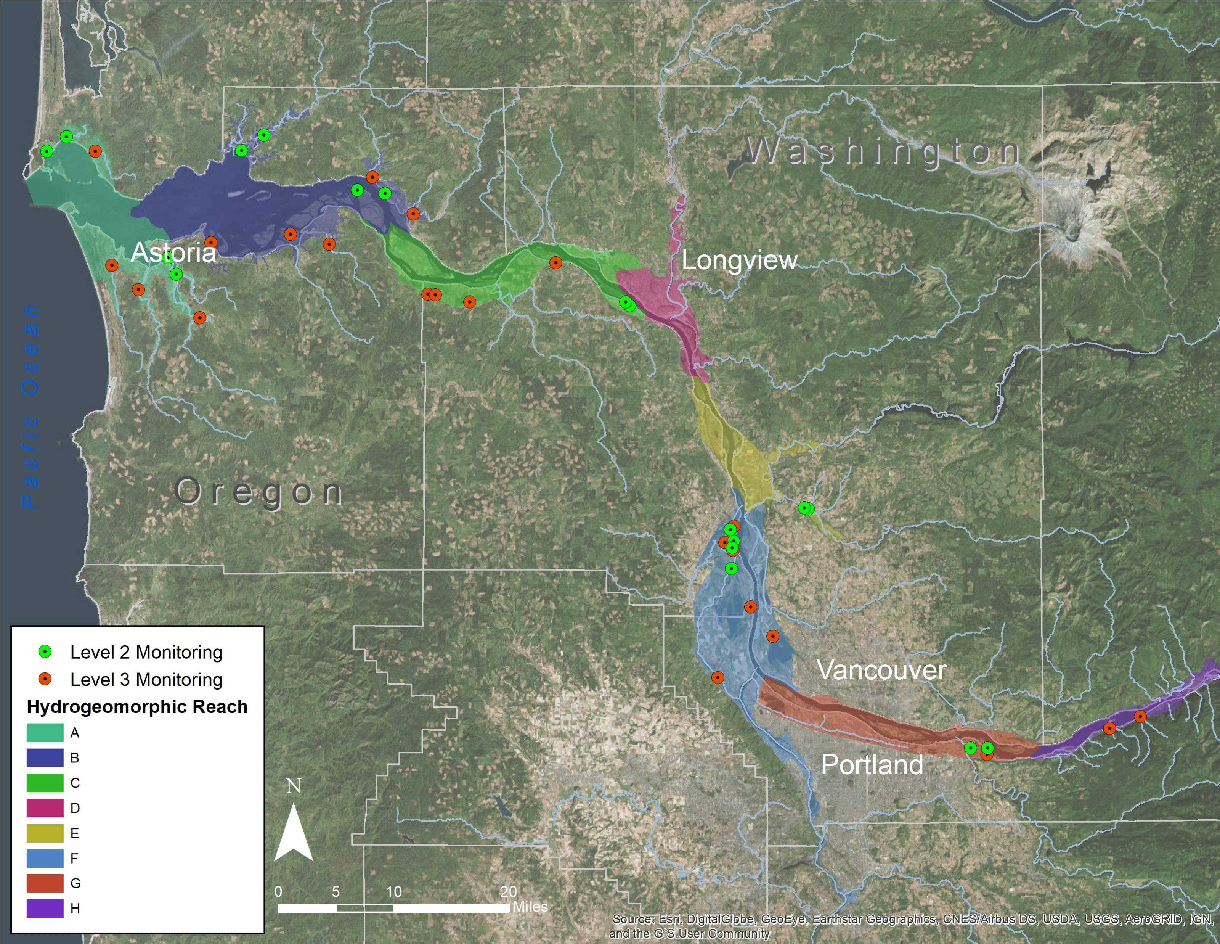
Estuary Partnership AEMR Sites

Slide 8
Documentation and Data
Protocols and Methods – “Protocols for Monitoring Habitat Restoration Projects in the Lower Columbia River and Estuary” (Roegner et al. 2009)
Documented at Monitoringresources.org
Data Results and Summaries – Annual Reports, Synthesis Reports, and Presentations
Data Sharing– Oncor Regional Database
Data Reduction Protocols
Digital Exchange Templates (DETs)

Slide 9
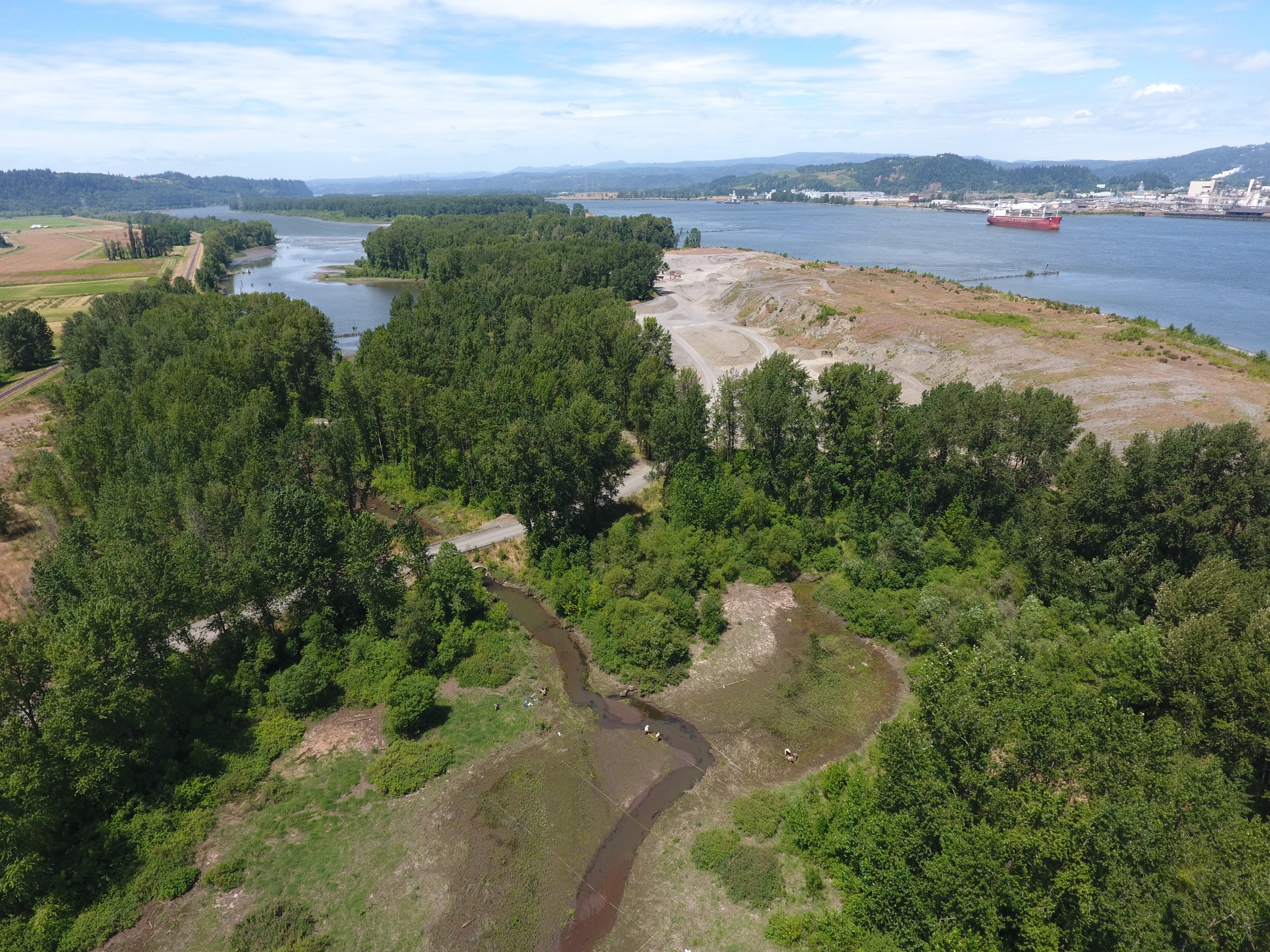
Coordination and Collaboration
Site Sampling Plans – Project sponsors develop restoration hypotheses/objectives for restoration actions
Basic Data Collection – conducted by project sponsors
Ecosystem Monitoring and Extensive AEMR Data Collection – conducted by regional partners NOAA, OHSU, UW, and Estuary Technical Group
Science Work Group – includes Federal, State, Municipal, and regional partners

Slide 10
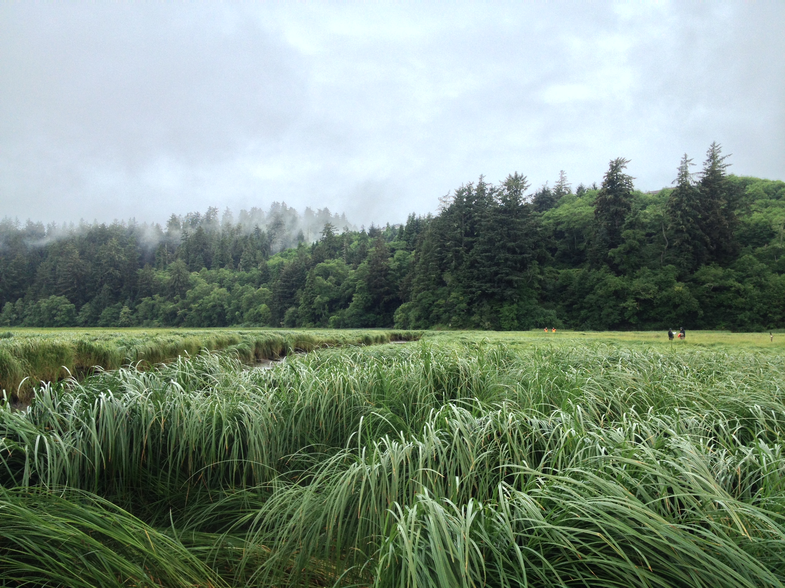
Questions?

