Slide 1
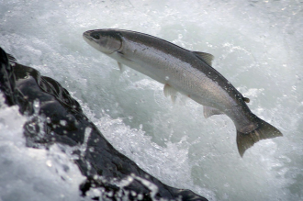
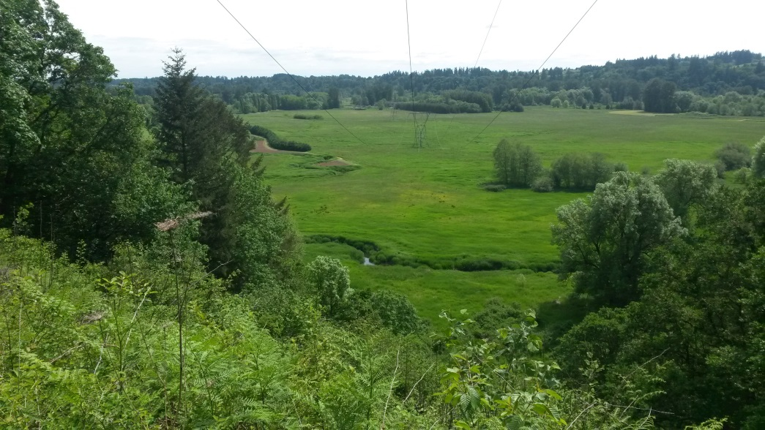
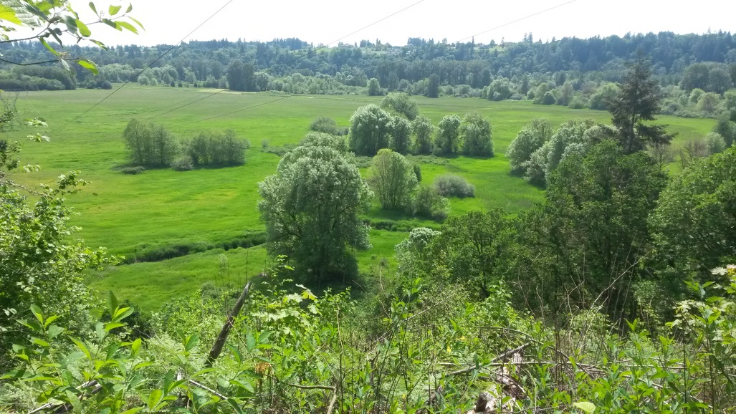
18-1412 Mason Creek Planning & Acquisition
Patrick Lee, Clark County, and Paul Kolp, Lower Columbia Estuary Partnership
LCFRB Draft Application Review: May 15, 2018

Slide 2
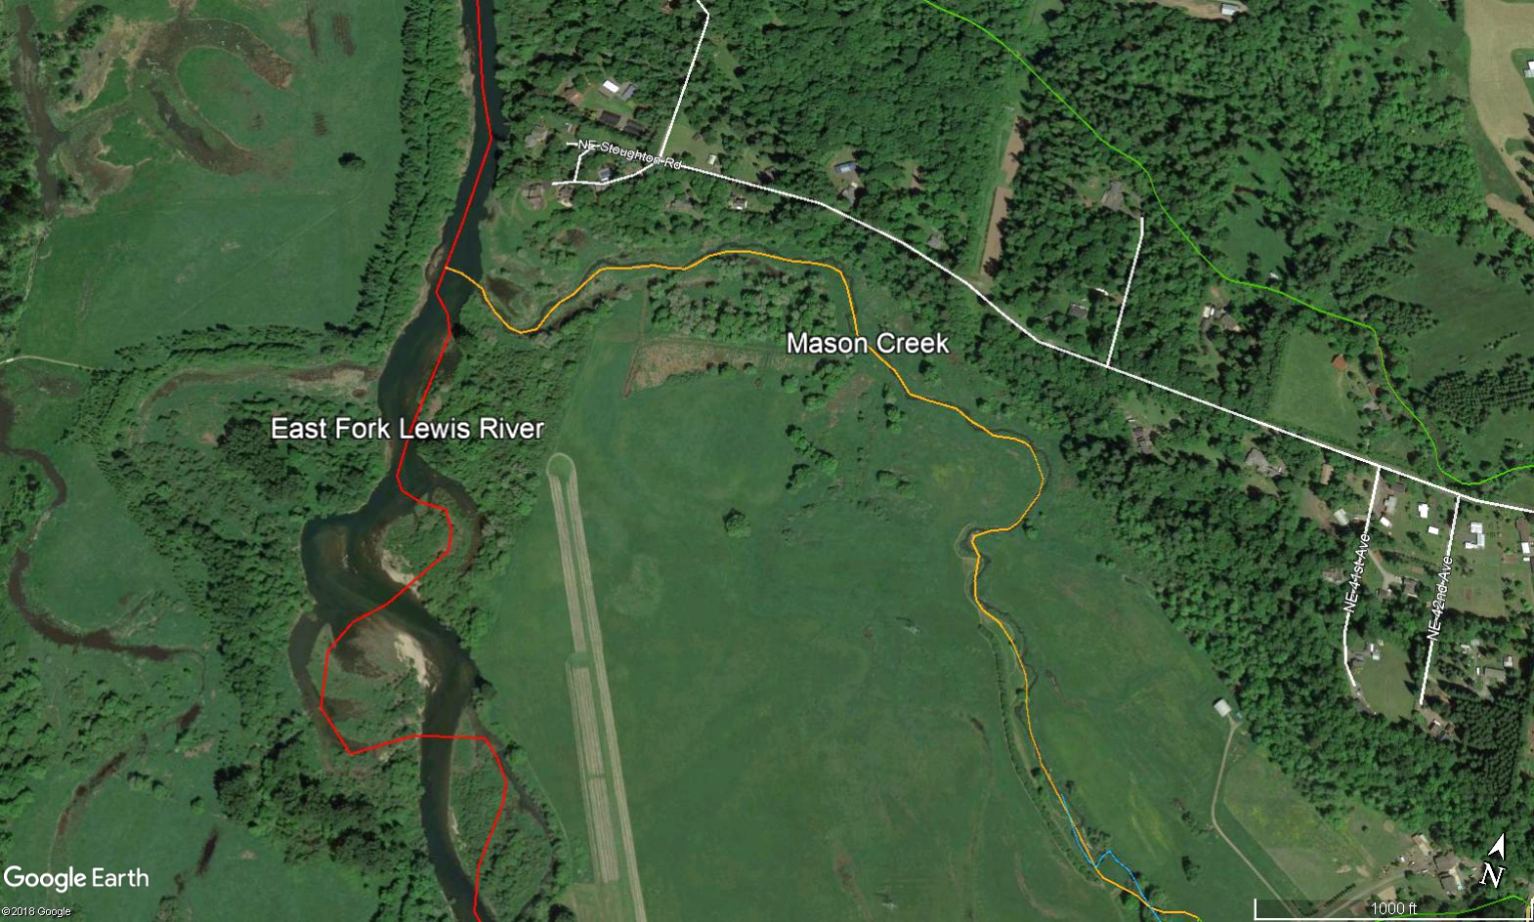
Acquire 60 acres & Develop Designs: 1 mile- Mason Cr. & E. Fork
Restoration actions : EF Lewis 4C, 5A & Mason Cr1
Benefiting reaches: Swanson Creek & Mason Cr2
Primary limiting life stages: pre-spawn holding, spawning, rearing, egg & fry
Primary limiting factors: temperature, habitat quantity/quality & sediment
Species: chum, Chinook, steelhead, coho and cutthroat

Slide 3
Goals
1. Acquire Parcels to achieve 2 high priority projects as part
of the Lower East Fork Habitat Restoration Plan (LCFRB
2009) & may be our last chance current landowners
2. Watershed Approach to connect with other projects and
address identified limiting factors in the basin
3. Restore juvenile rearing and spawning habitats &
riparian buffers along 1 mile of the E. Fork & Mason Cr.
4. Continue county stewardship and high community
support for this project.
5. Support East Fork designation of wild steelhead gene
bank
6. Expand cold water refuge potential
Notes:
Paraphrase your objective list from your Appendix C Project Proposal document to remind the TAC of what you aim to accomplish with your project.
Please tie objectives into habitat limitations identified for species-life stages that are present in your project area.

Slide 4
Objectives
Acquire 62 Acres along Mason Creek through acquisition and easements
Provide access to off-channel refugia- habitat diversity and quantity & key habitat
Age 0, Age 1- rearing (all species)
Restore alluvial functions to Mason Cr. including increasing pools and large woody debris and sediment retention- habitat diversity and quantity & key habitat
Fry Colonization, egg incubation, Age 1 active rearing (all species)
Increase gravel retention and reduce fines- sediment
Spawning- Chinook
Reduce instream temperatures and capture cold water- temperature
Age 0 rearing, spawning, fry colonization (all species)
Improve riparian habitat conditions- key habitat (all species)

Slide 5
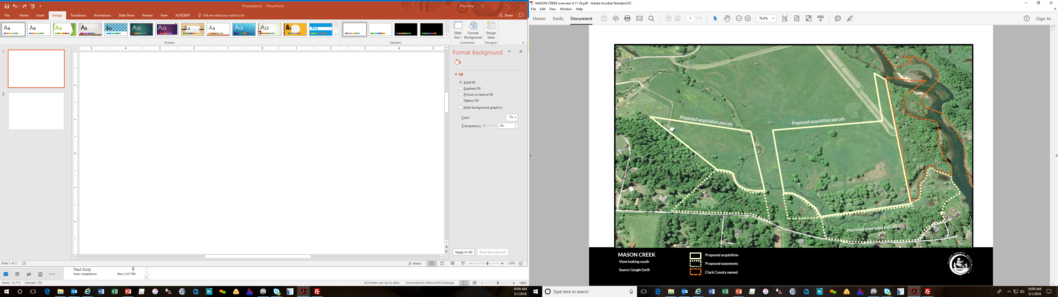
Acquisition & Landowners
Swanson
Swanson
Davis & Swanson
Wetland creation
49 acres- Fee
12 acres- Easement

Slide 6
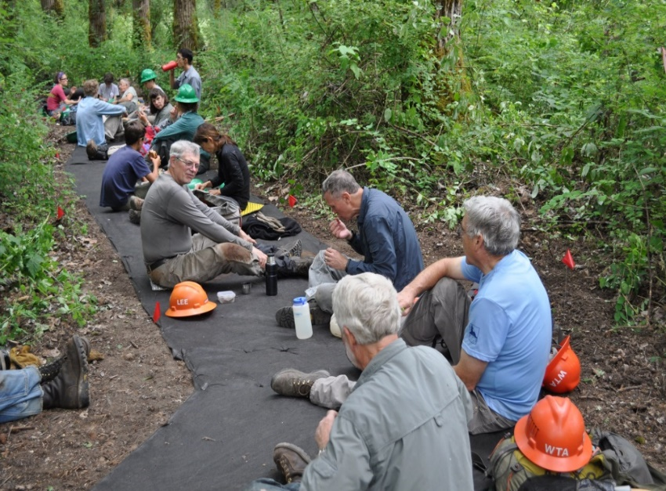
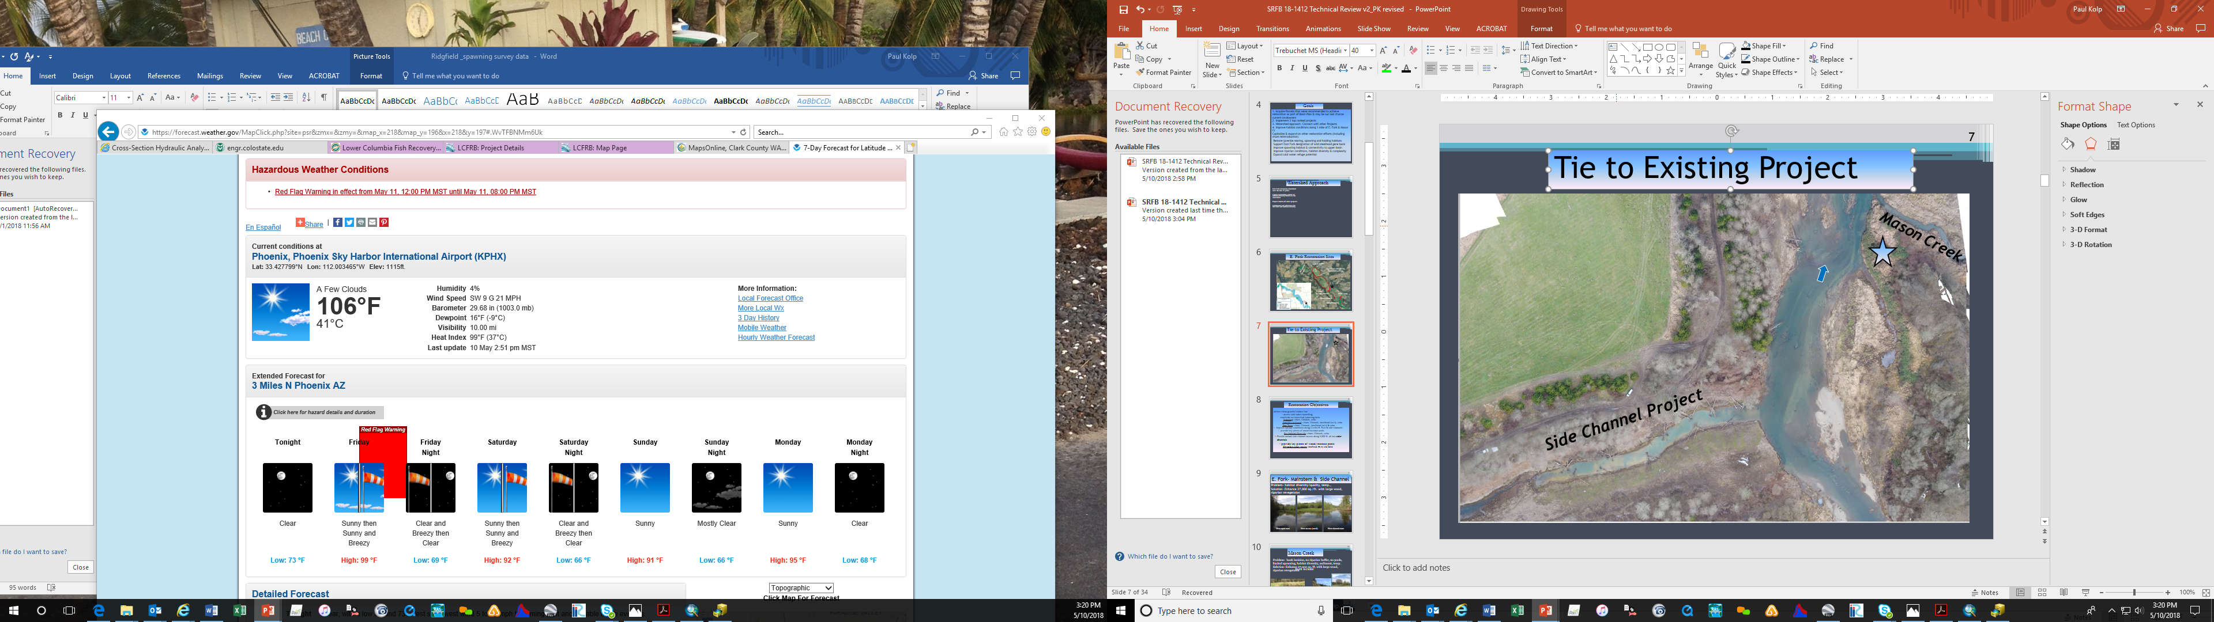
Watershed Approach & Stewardship
East Fork Greenway assembled over the last 35 years.
Over ten restoration projects have been competed on County-owned land
County and partners have assembled 2,200 acres along the East Fork Lewis River Greenway
This Project builds off other projects!!

Slide 7
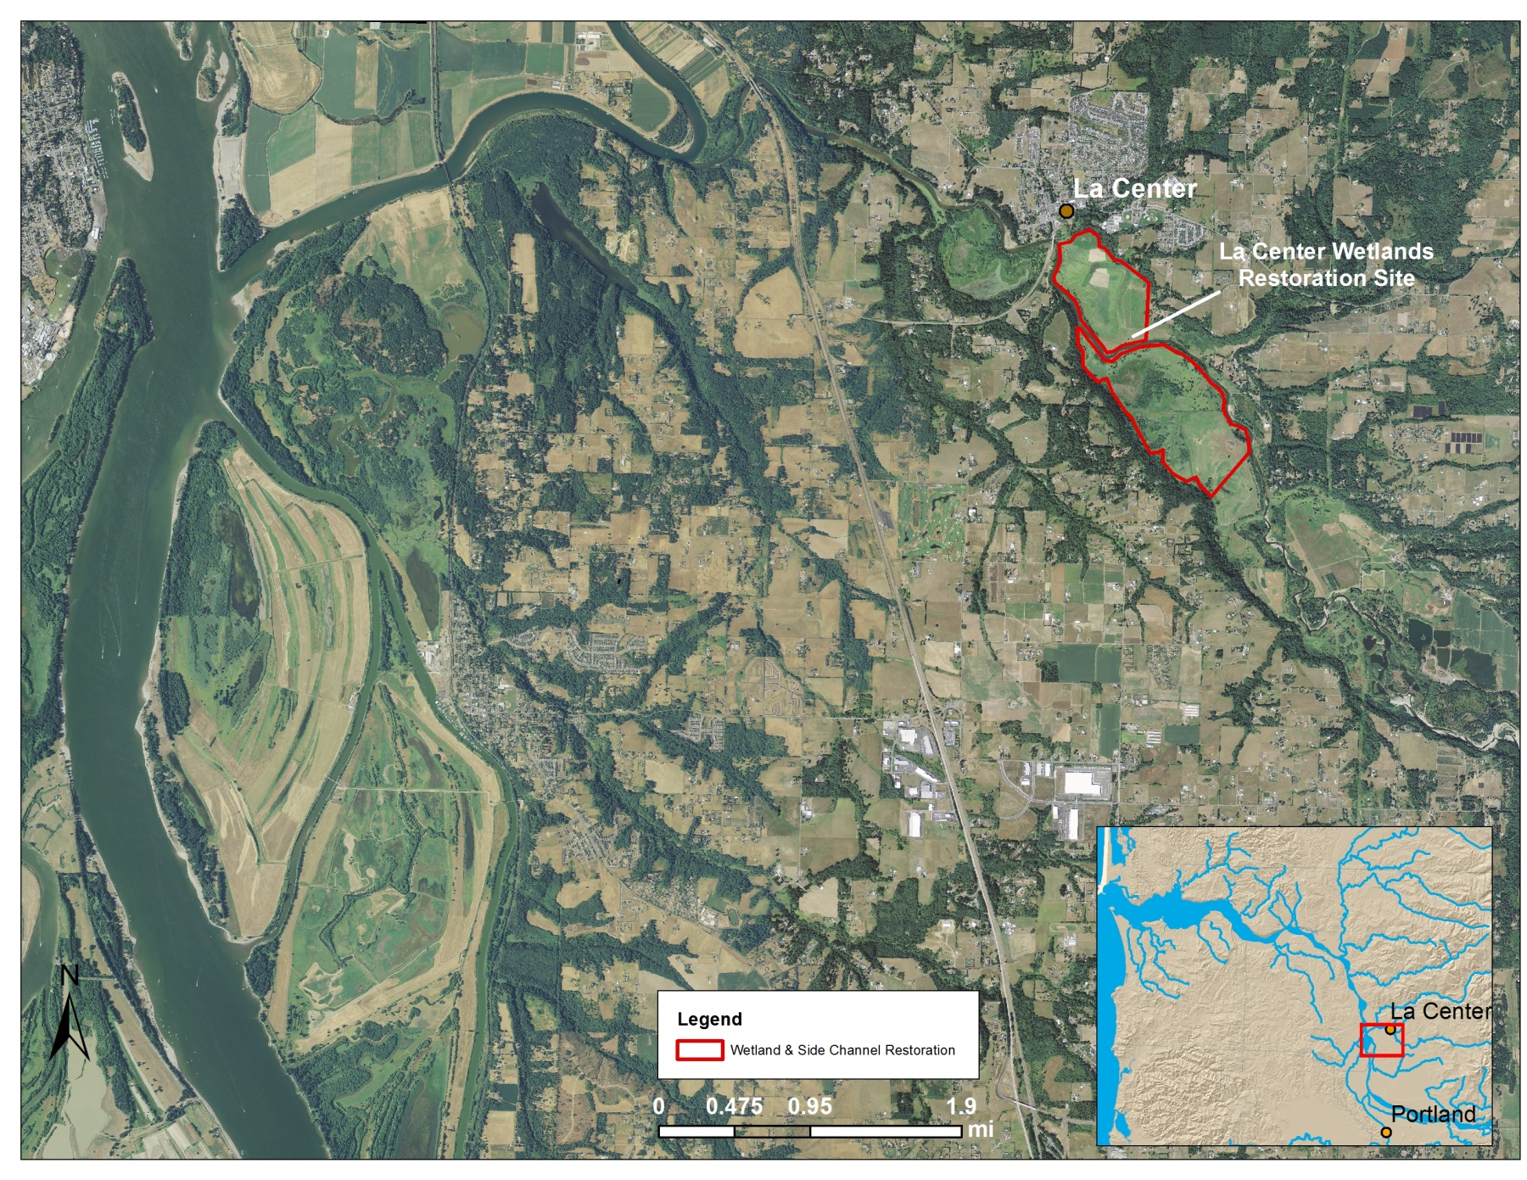
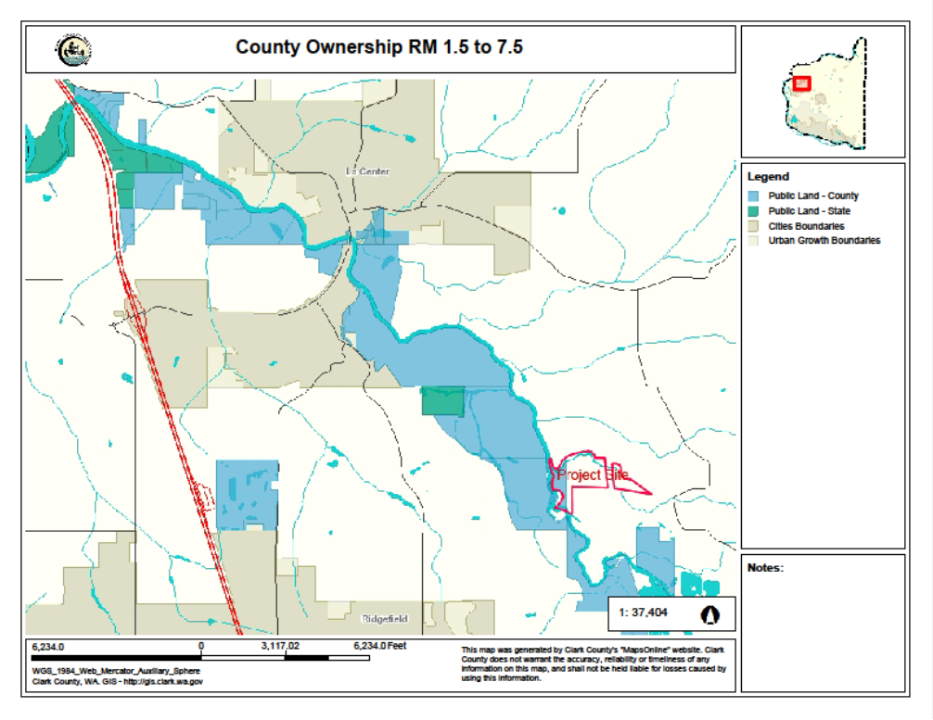
Watershed Approach
St Helens
McCormick Creek
E. Fork
& Side-Channel
Dean Creek
County Ownership RM
1.5 to 7.5
Chum Channel
Columbia River
Ridgefield Pits

Slide 8
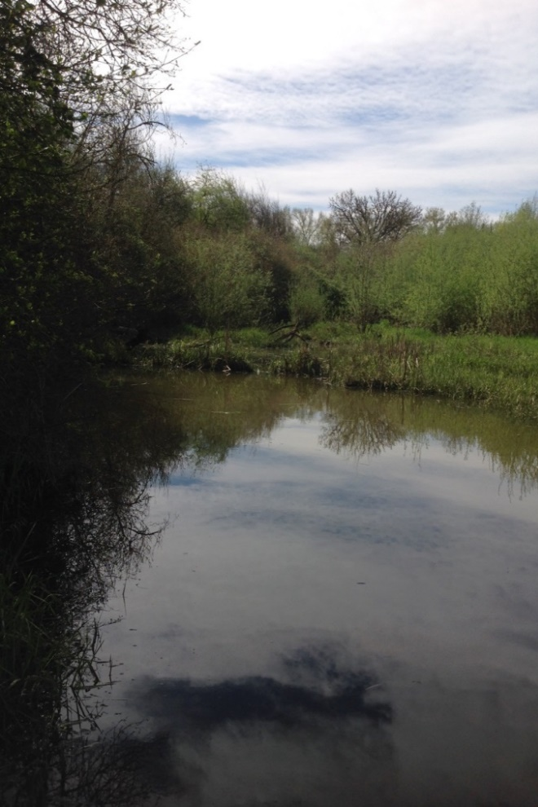
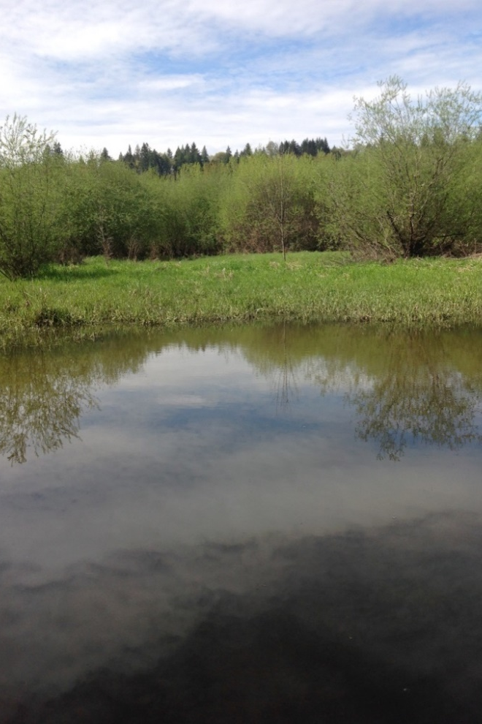
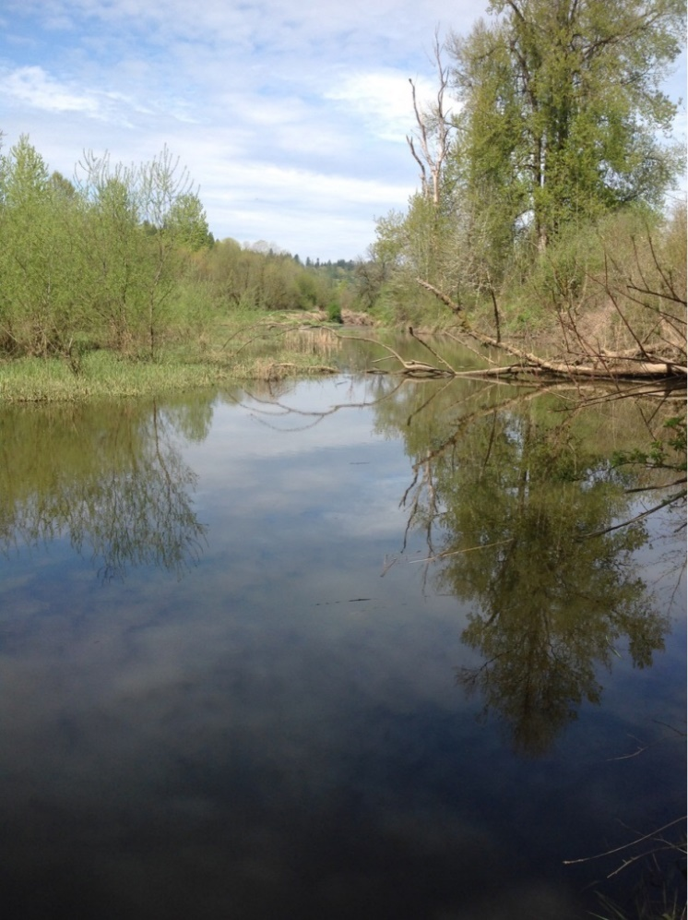
E. Fork- Mainstem & Side Channel
Problem- habitat diversity/quality, temp
Solution- Enhance with habitat features & riparian revegetation
Very limited instream or riparian habitat
upstream
across (west)
downstream

Slide 9
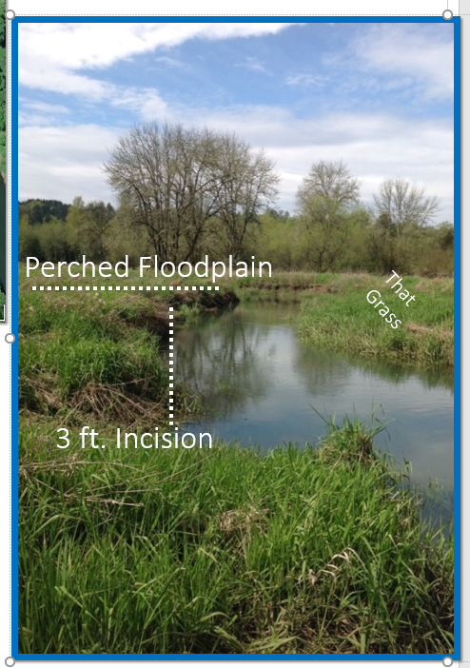
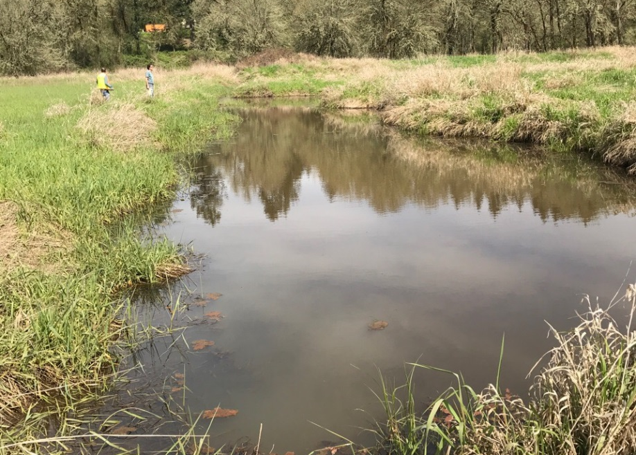
Mason Creek
Problems
Incision
limited floodplain access
no riparian buffer
limited pools
limited spawning
no habitat diversity
sediment & temperature
Solution(s)
-connect floodplain & create
wetland
-riparian revegetation
-create pools
- trap gravels
- incorporate cold water
No instream or riparian habitat

Slide 10
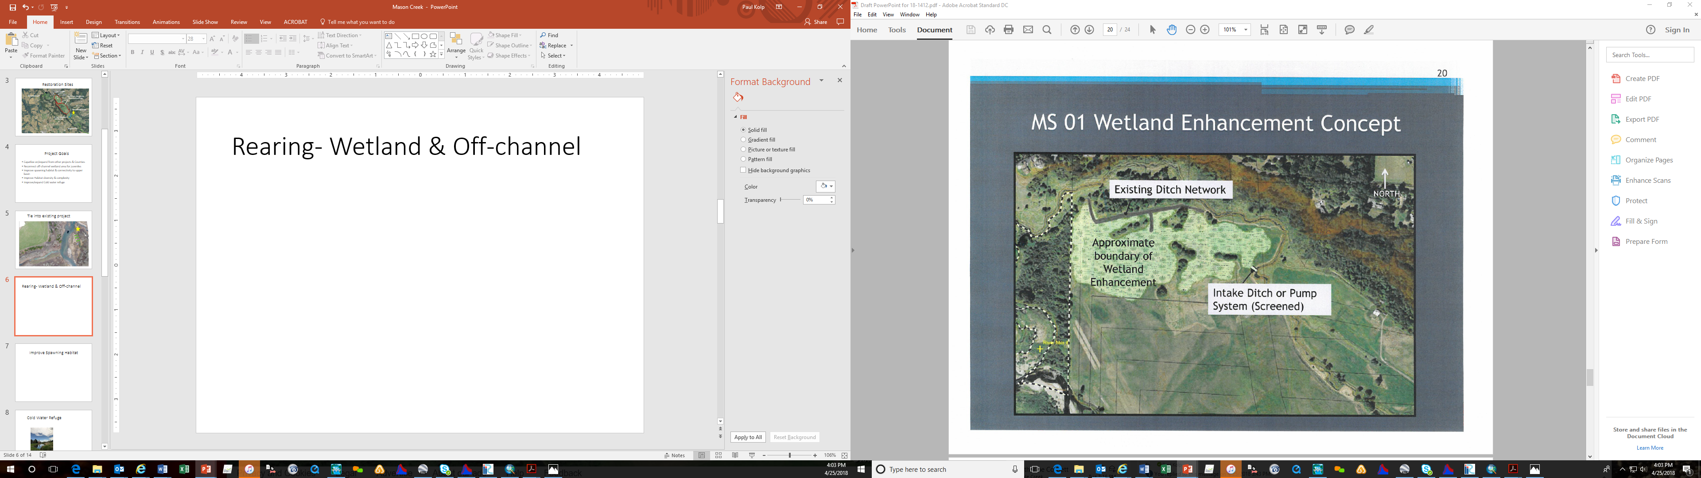

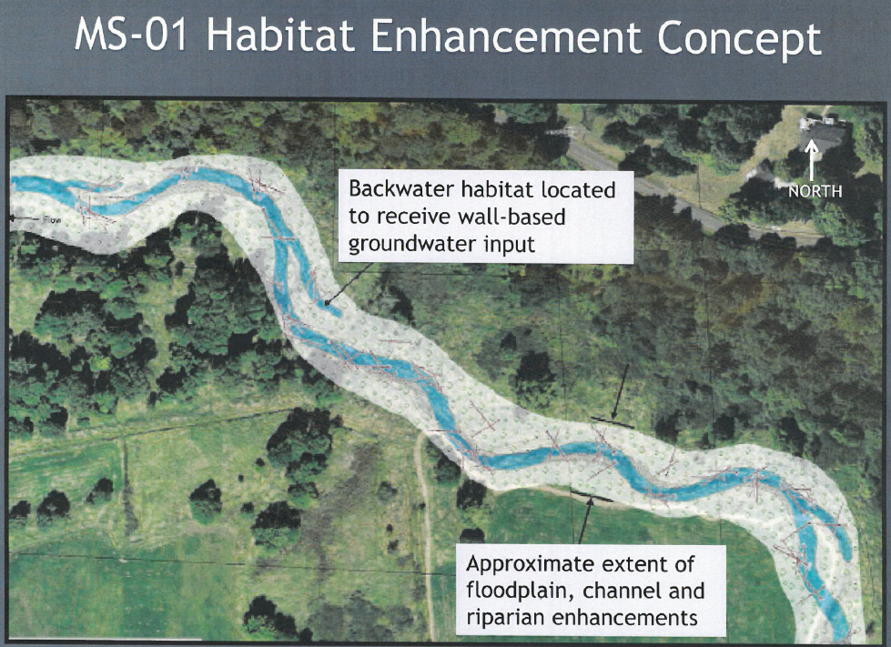
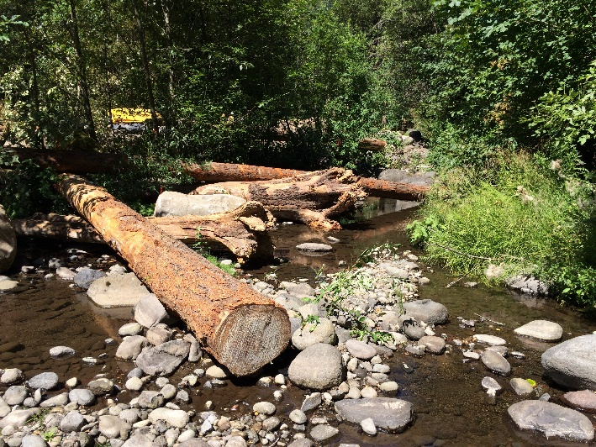
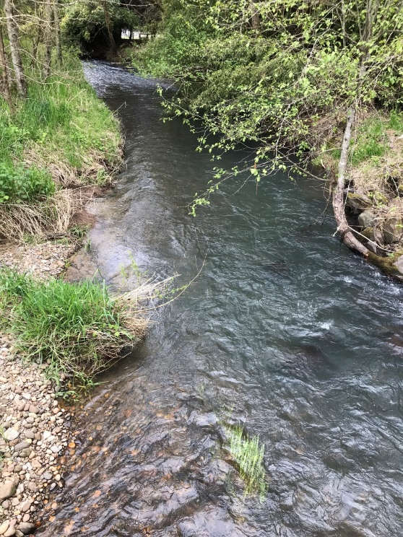
Designs- Mason Cr.
Wetland/Off-channel- regrade, remove ditches and bring up channel elevations
Improve habitat- sediment seed?, install wood (low profile) & beaver?
Riparian- high density planting
Cold water- excavate/capture
Design Considerations
- Power line
- Alluvial- gravel recruitment
- Fish use timing (October May)
- Alternatives Analysis to inform designs
- Adjacent restoration projects

Slide 11
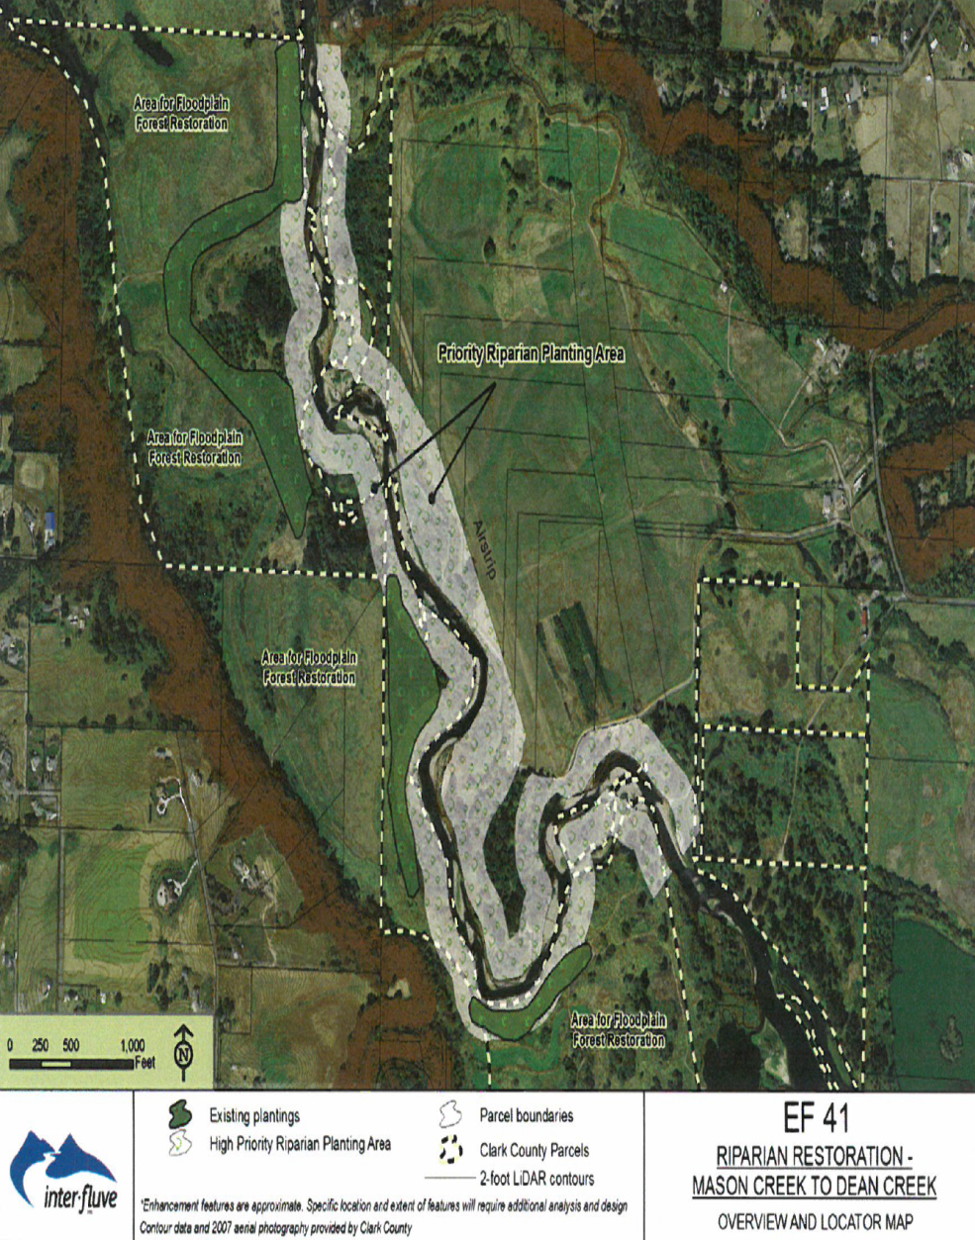
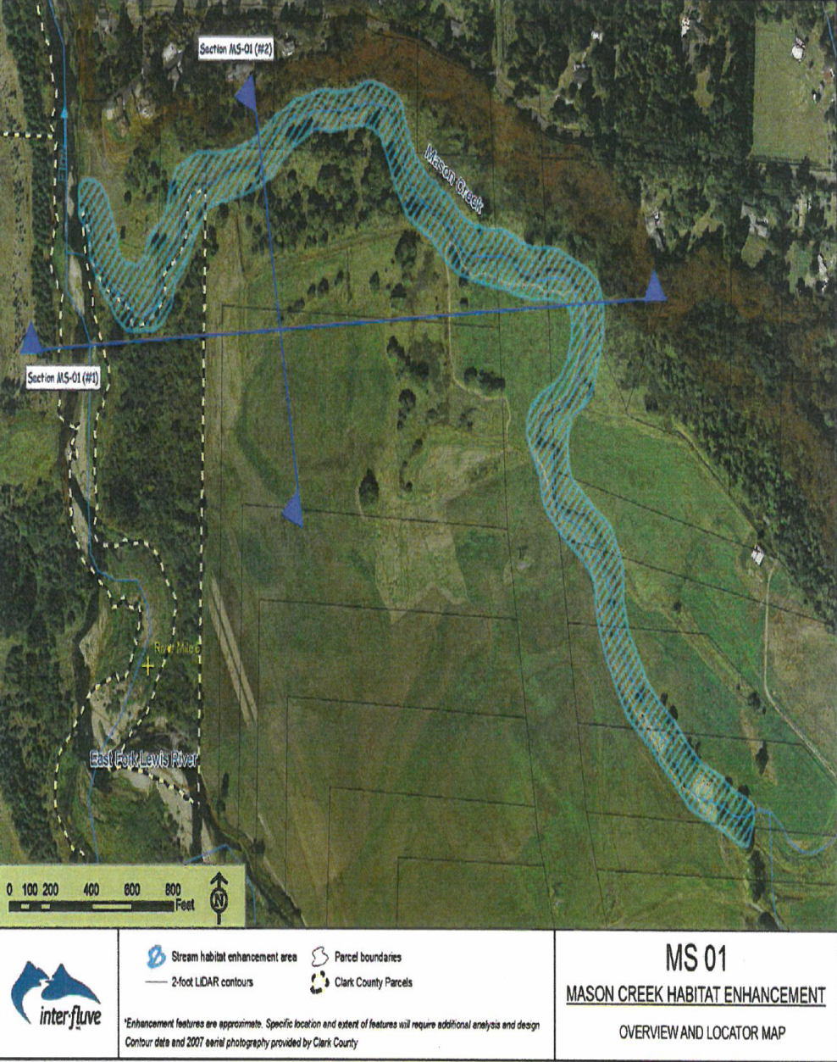
Designs Riparian- Mason Cr. & . Fork
NORTH

Slide 12
Salmon Use & Climate Change *
Temp. threshold- 17.5 C
(drier & warmer scenario)
* Based on data from WDFW (1999) & Cindy Baker (2008)

Slide 13
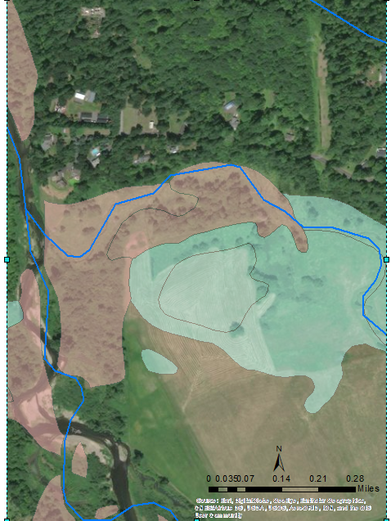
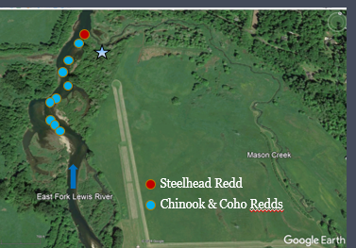
Certainty of Success
Incorporate lessons from adjacent restoration projects
Off-channel rearing and spawning documented (C. Baker & WDFW)
Don’t “reinvent the wheel”…… use existing information & data
Wetland potential exists (NWI)

Slide 14
Predicted Uplift- Mason Cr.
 | Current (per/mile) | With project (per/mile) | Predicted increase (%)
Pools | 5 | 20 | 300%
LWD | 1 | 175 | A LOT
Spawning Gravels (Redds) | 2 | 8 | 300%
Willows/ Shrubs | 0 | A LOT | A LOT

Slide 15
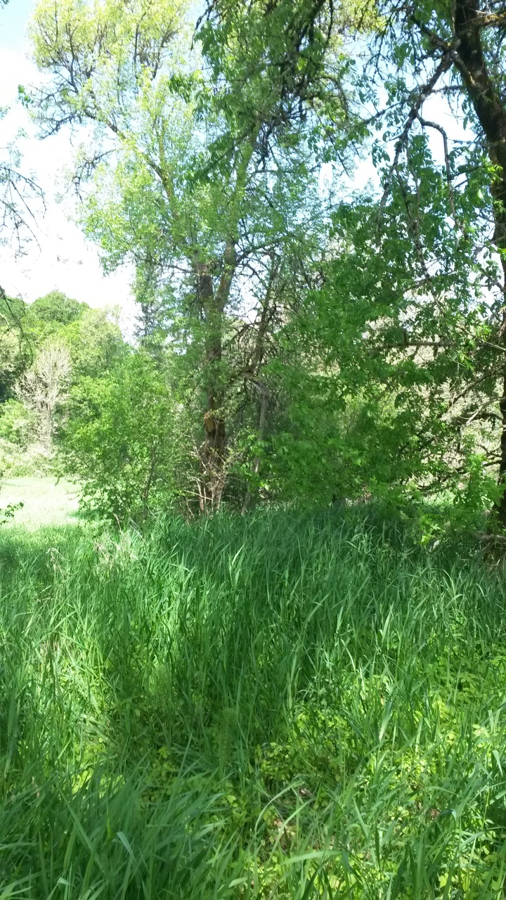
Cost Considerations
Total: $748,110
SRFB Request: $561,092 (75%)
Design Costs for MS 01 & EF 41 were $130k (2009) & ask today is $150k
Local Match: $187,018 (25%)

Slide 16
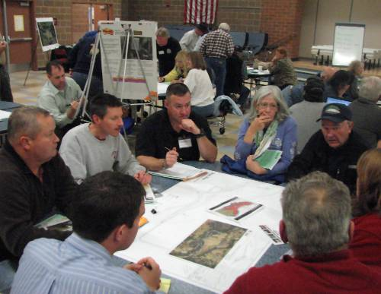
Project Support
Project identified as a high priority in the East Fork Habitat Restoration Plan
Project included in Clark County Comprehensive Parks Recreation and Open Space Plan & Conservation Areas Acquisition Plan 6-year capital project list
County Council has approved funding for the project

Slide 17
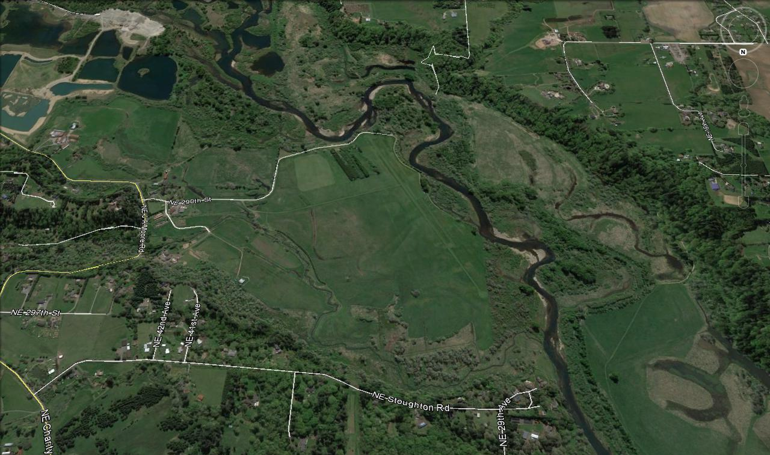
Questions ?
NORTH
Thank you!

Slide 19
Project Regional Location Map
Mason Creek Acquisition (18-1412)
Clark County, WA

Slide 20
Project Location Map
East Fork Lewis River Greenway
County Ownership RM
1.5 to 7.5
NORTH

Slide 21
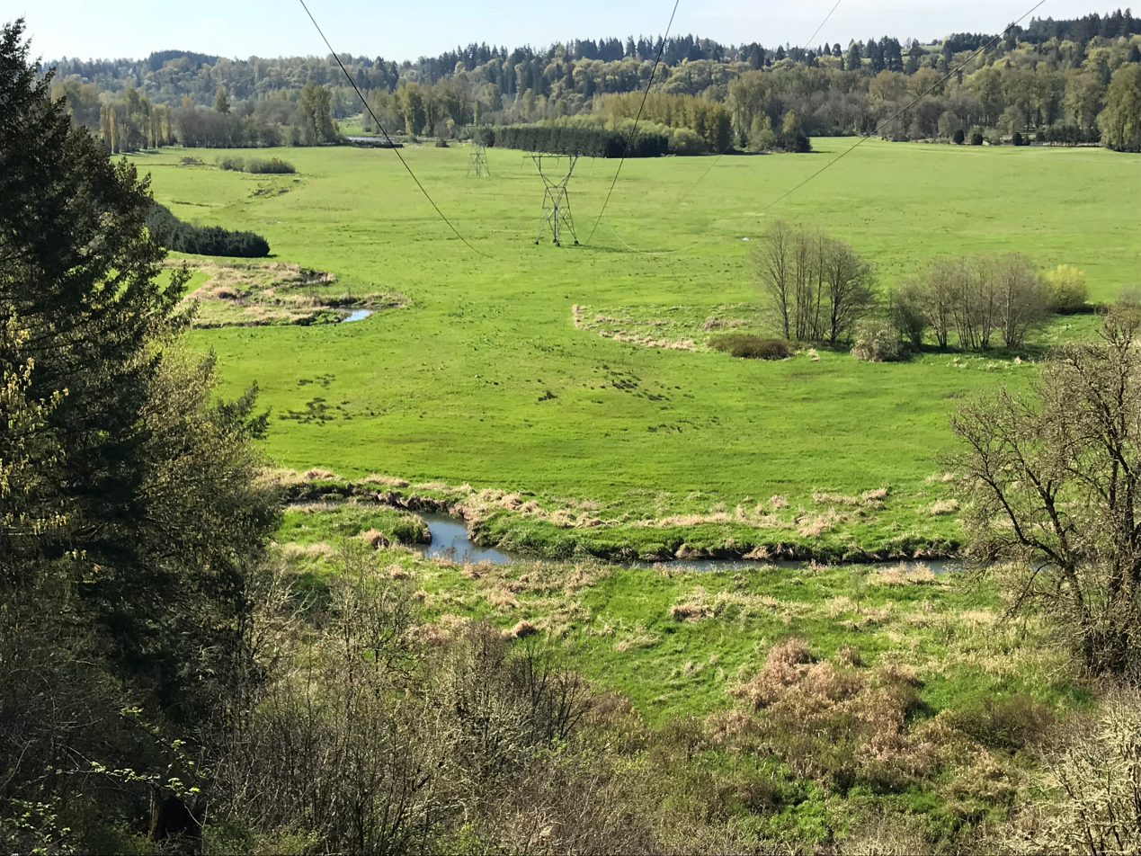
Project Scope
Acquire 49.8 acres in fee and 12 acres in easement
Develop preliminary restoration design for the acquired
parcels and an adjacent 19.25 acre county-owned parcel
Site Overlook from Stoughton Road (looking south)

Slide 22
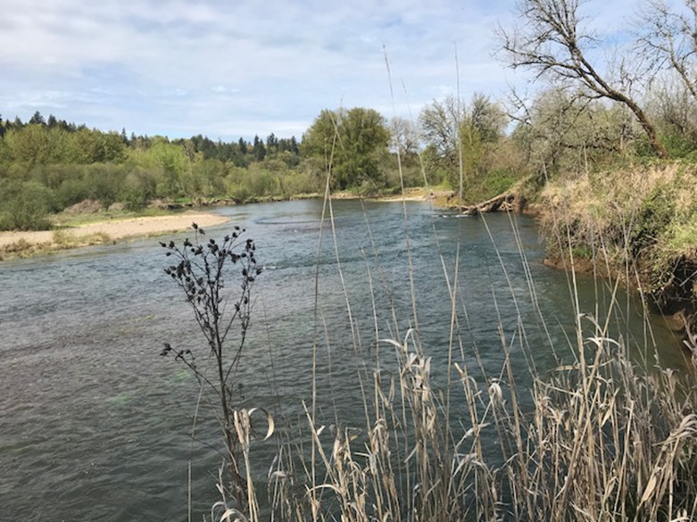
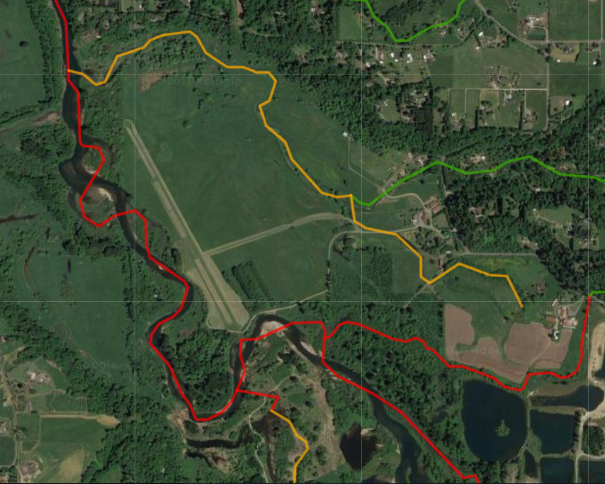
Key Restoration Location
Upstream end of existing
County Parcel looking downstream
Red – Tier 1
Yellow – Tier 2

Slide 23
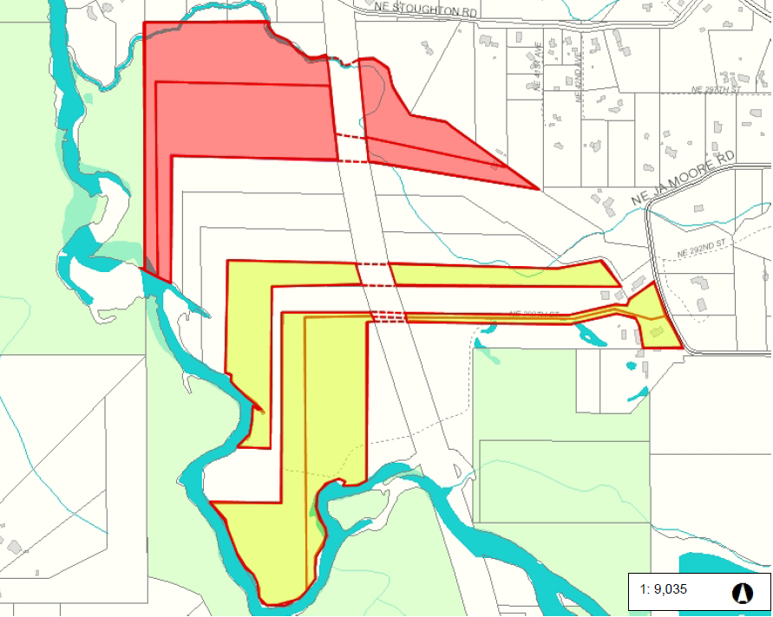
Acquisition Objectives
County-Owned Land
Fee Acquisition Parcels
Other Parcels For Sale
Key restoration location
County owns mouth and 1,049 lineal feet of Mason Creek
County owns 2,600 lineal feet of EFL right bank
County also owns left bank of East Fork Lewis River
Parcels for Sale

Slide 24
Limiting Factors
East Fork Lewis River EDT Reaches 4C and 5A
Species | Primary limiting life stages | Primary limiting factors | Relevant Months
Chum | Prespawn holding; Egg incubation | Habitat diversity/quantity; Sediment | Oct-Jan; Oct-Apr
Fall Chinook | Egg incubation; Spawning | Sediment; Temperature | Nov-May; Oct-Nov
Coho | Age-0 inactive; Age-0 active rearing | Key habitat quantity; Temperature & key habitat | Oct-Mar; Mar-Oct
Mason Creek EDT 01
Species | Primary limiting life stages | Primary limiting factors | Relevant Months
Coho | Age-0 active rearing; Egg incubation; Fry colonization | Temperature, key habitat quantity Sediment, channel stability Key habitat quantity/quality | Mar-Oct Oct – May Mar-May
Winter Steelhead | Age-0,1 inactive rearing; Age-1 active rearing; Fry colonization | Habitat diversity Habitat diversity Habitat diversity, temperature , flow | Oct-Mar Mar-Oct May-Jul

Slide 25
Surrounding County Land Ownership
East Fork Lewis River
County Ownership RM
1.5 to 7.5
NORTH

Slide 26
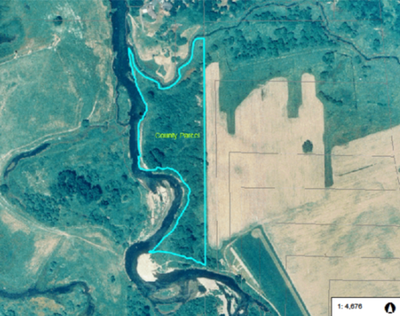
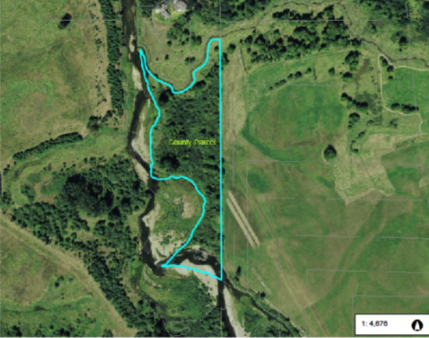
Improve Off Channel Habitat
East Fork Lewis Channel Shift1996 and 2007
N
East Fork Lewis 1996
East Fork Lewis 2007

Slide 27
Climate Change
Drier & Warmer Scenario
Mason Creek Depth (ft.)

Slide 28
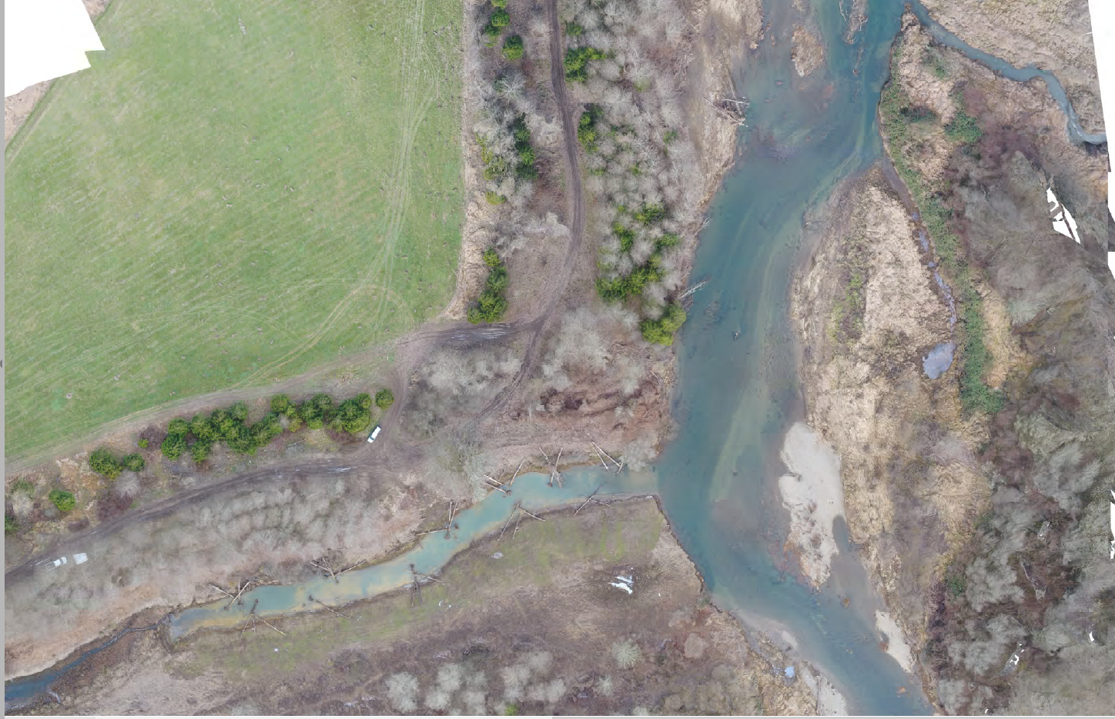
Tie to Existing Project
Mason Creek
Side Channel Project

Slide 29
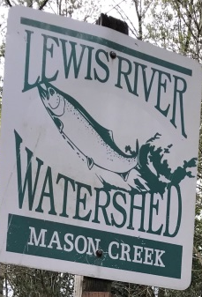

Improve Spawning Habitat
Acquisition & Landowners
Diversify 4,000 lineal feet with wood
Create 20 pools
Reconnect 19 acres of floodplain

Slide 30
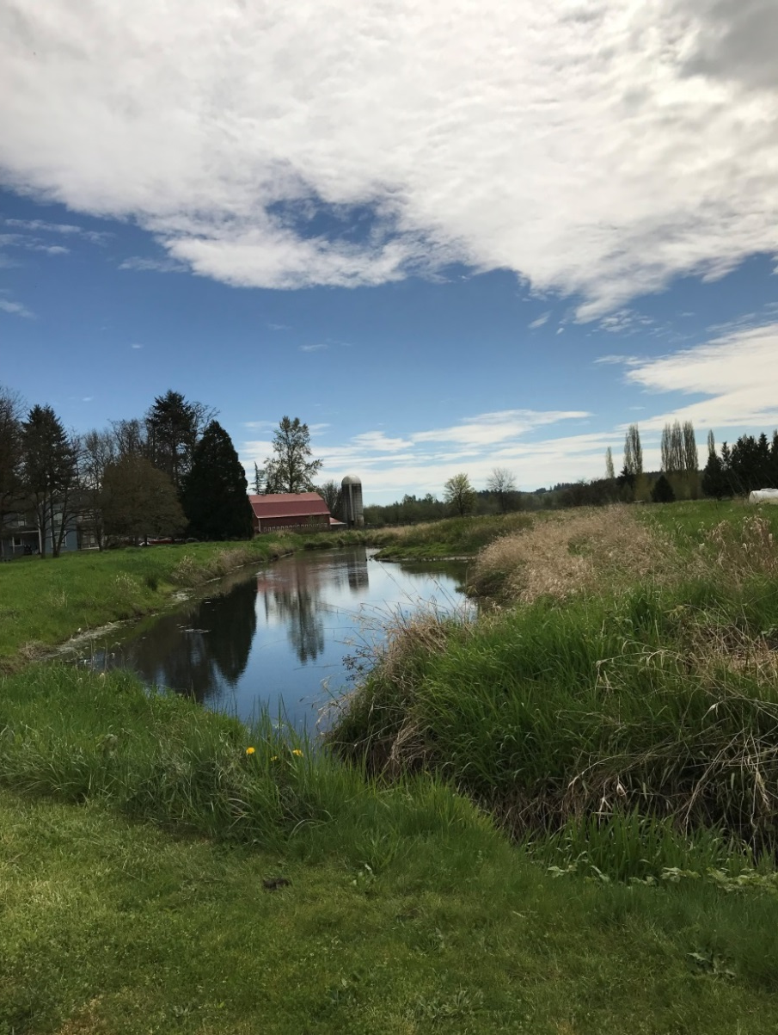
Cold Water Refuge
Acquisition & Landowners
Excavate backwater channels to the north of the main channel to provide off-channel habitat and capture cool groundwater originating from the valley wall
Restore riparian vegetation to provide shading
Wetland enhancement
Hiteon Creek

Slide 31

Stewardship
County and partners have assembled 2,200 acres along the East Fork Lewis River Greenway
Over ten restoration projects have been competed on County-owned land
County has a variety of function-based divisions including Parks Maintenance, Vegetation Management, Engineering and Construction to address stewardship and maintenance issues

Slide 32
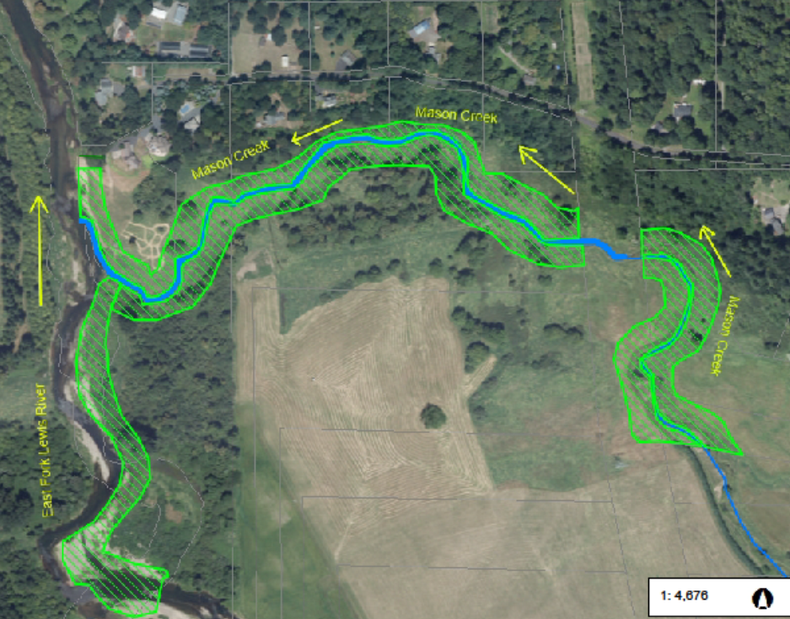
18-1412 Riparian Restoration
Acquisition & Landowners
Reach Width Length
EFL 4C 100 300
EFL 5A 100 500
MS 01 200 4,000
Total 20 acres

Slide 33
Designs
Build on Concept Designs (2009)
Reconnect mainstem- 3 options (Prelim. Designs)
Install mainstem wood (Prelim. Designs)
Regrade entrances to side-channels
(Final Designs)
Install habitat features/wood in side-channels (Final Designs)
Notes:
Walk the TAC through your proposed design. Drawings can be added to the slide or staff can load materials from your draft application. Relate design elements to functional habitat goals and fish benefits.

Slide 34
Design Development Review Process
Technical Work Group to meet quarterly (or more) over project duration
Review & guide designs
Represent stakeholder diversity/interests
-Columbia Land Trust
- Clark County
- NOAA
- Cowlitz Tribe
- WDFW
- Pac. Rock Environmental/CEMEX
- private landowners
- Friends of the East Fork
- Storedahl
Notes:
Will you have a work group? Who are the key members? How often will the group meet? Will you have a technical design team? What expertise do you expect the technical team to have? How will you incorporate feedback from the LCFRB TAC?

Slide 35
Project Milestones
Conduct physical/biological surveys & modeling, Technical Report, Dec. 2018
Present Preliminary Restoration Alternatives to Technical Work Group, Dec. 2018
Draft Preliminary Designs, March 2019
Complete Preliminary Designs, June 2019
Notes:
List your deliverables and due dates if funded. This should be a coarse-scale version of what you submitted in SalmonPORT and in your Appendix C Project Proposal document (Scope of Work). Example: "1. Site survey (Month, Year), 2. Present conceptual alternatives to stakeholder group (Month, Year), 3. Present draft preliminary designs to stakeholder group (Months, Year), 4. Present draft preliminary designs to TAC (Months, Year), 5. Complete preliminary designs (Month, Year), 6. Public workshop (if needed, Month, Year).

Slide 36
Design Considerations
Power line-
Alluvial- gravel recruitment
Fish use timing – October to April is
Compatable with Ag../ other land uses
Alternatives Analysis to inform Prelimn. Designs

