Slide 1
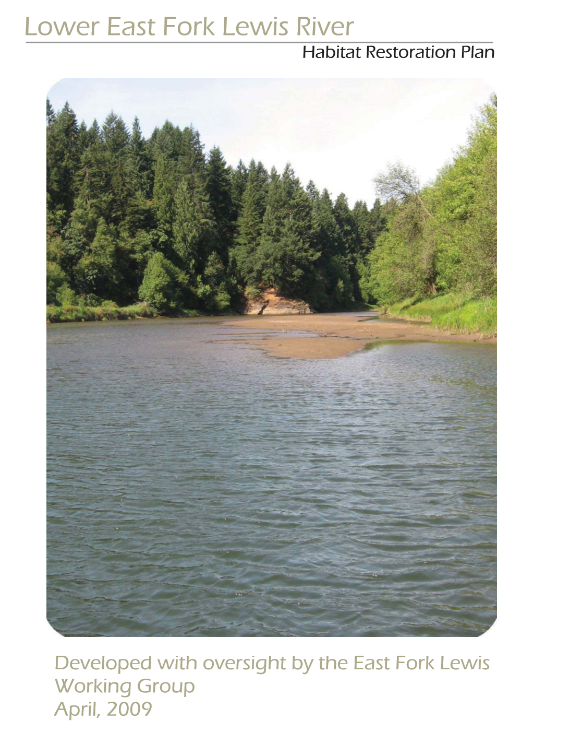
Goals- E. Fork & Mason Creek
Capitalize & expand on other restoration efforts (including chum reintroduction)
Restore juvenile rearing, spawning and holding habitats
  - chum, coho, steelhead & Chinook
Support East Fork designation of
wild steelhead gene bank
Address basin limiting factors:
  habitat diversity & complexity
  temperature
  off-channel/floodplain
  riparian

Slide 2
Habitat Improvement Metrics
Pat, can you add some salmonport metrics in here?
Maybe using same google earth image in slide 4 and putting metrics on top of it.

Slide 3
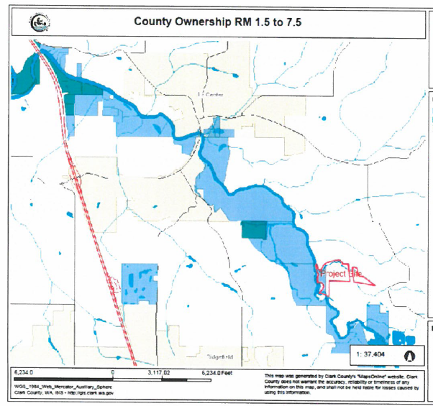
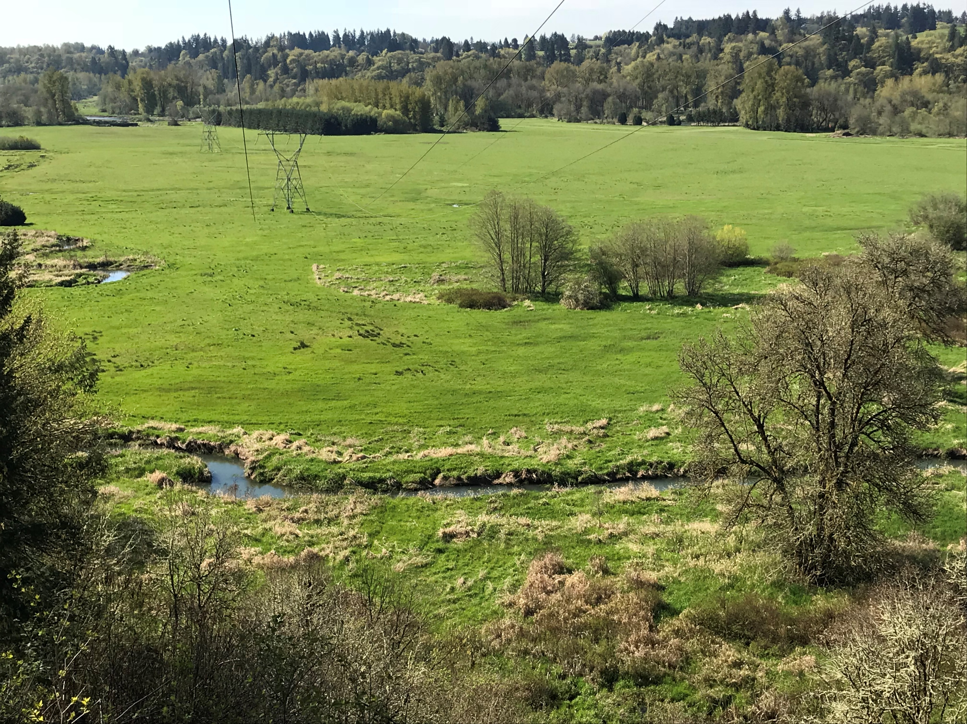
Watershed Approach
Clark County has protected more than 1,000 acres on E. Fork

Slide 4
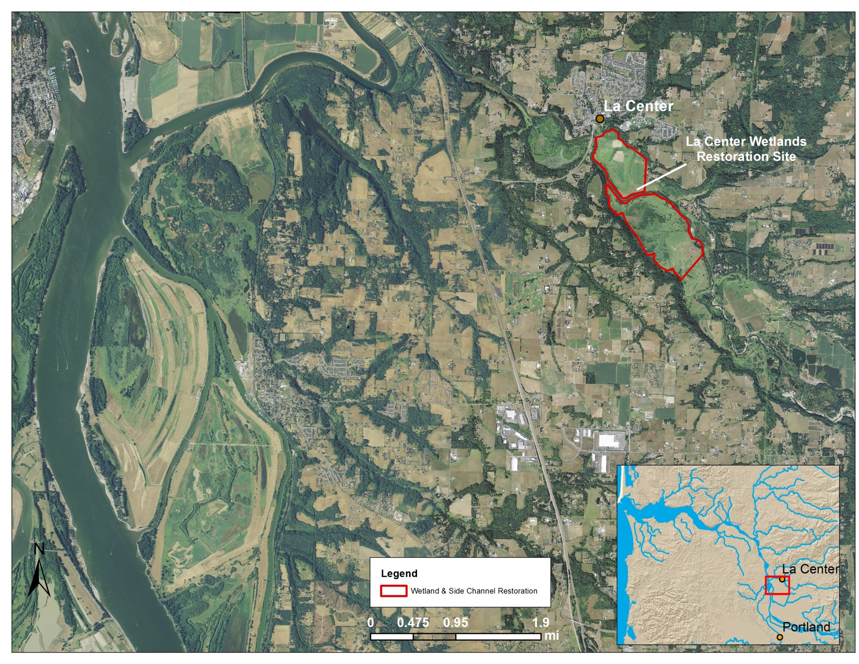
Watershed Approach
St Helens
McCormick Creek
Mason Creek
E. Fork Mainstem & Side-Channel
Chum Channel
Columbia River
Ridgefield Pits

Slide 5
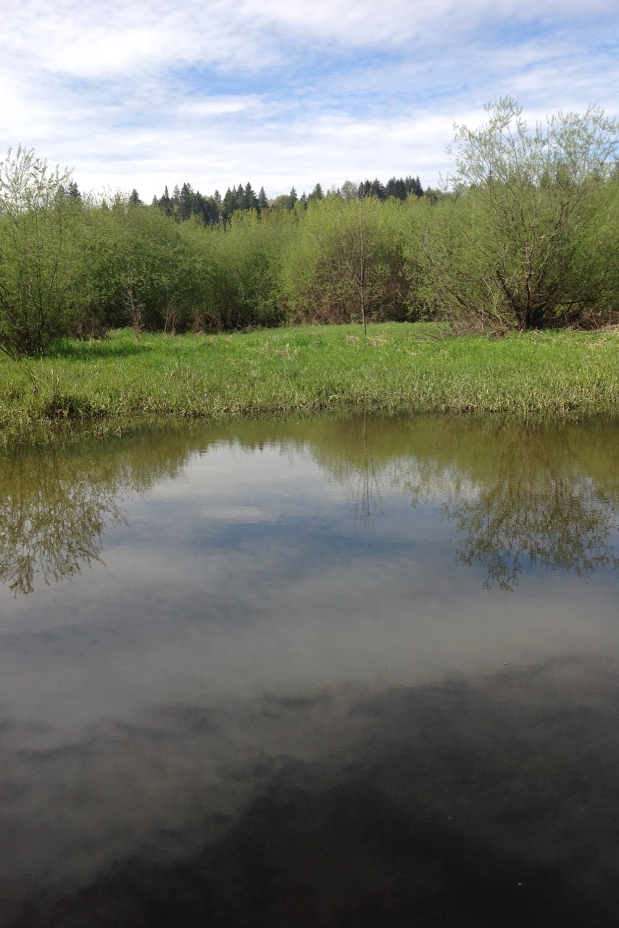
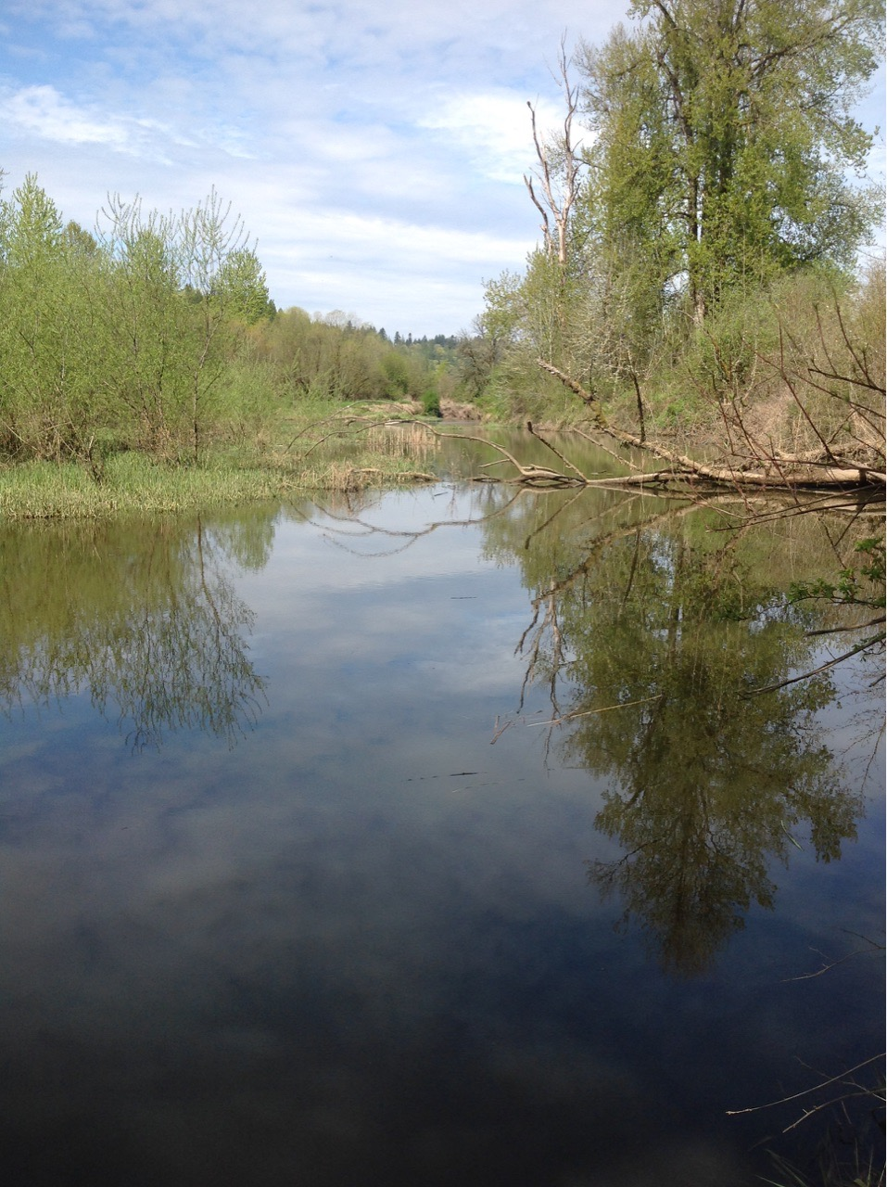
East Fork Side Channel
RCG…if only…..
Extremely limited habitat complexity and quantity

Slide 6
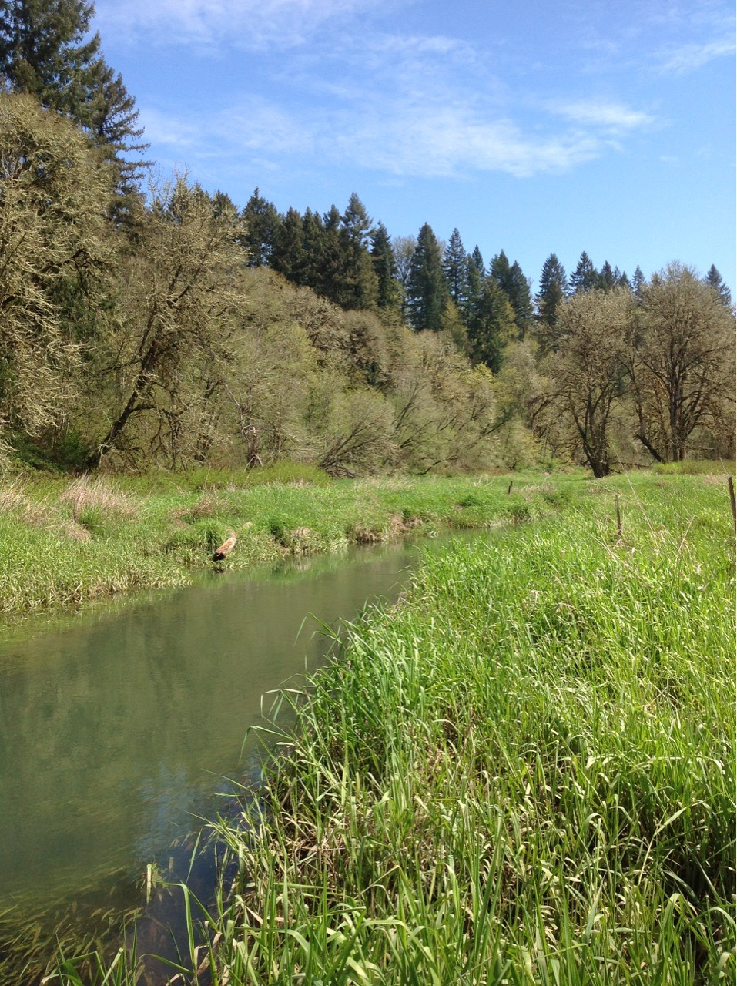
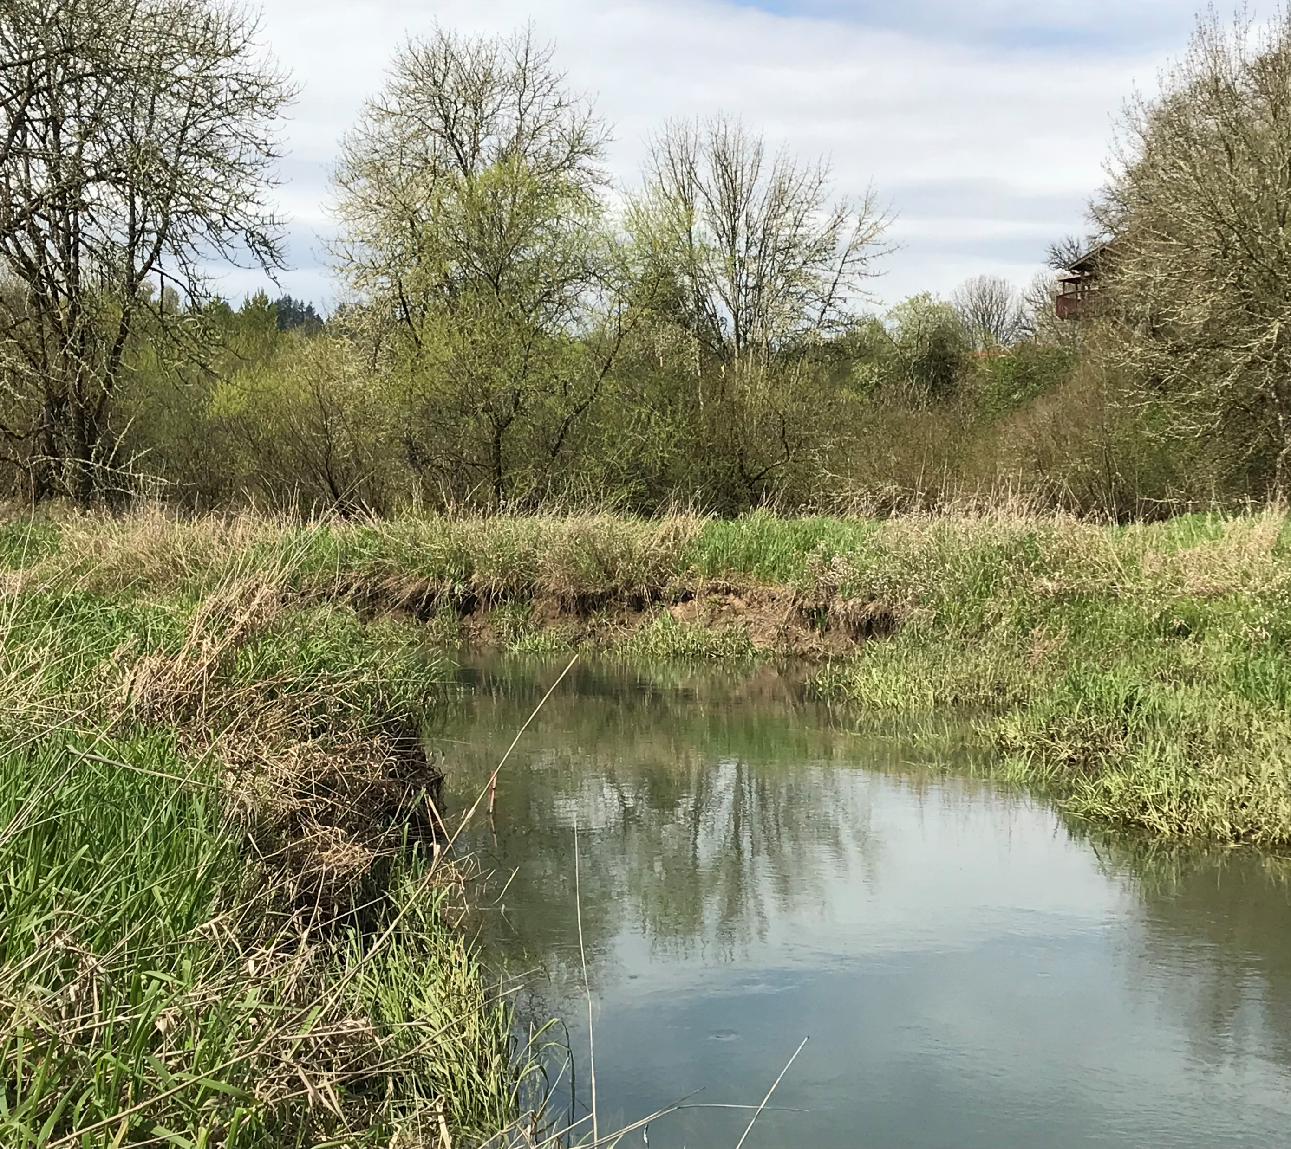
Mason Creek
3 Ft. Incision
No willows
No Wood
Legacy floodplain

Slide 7
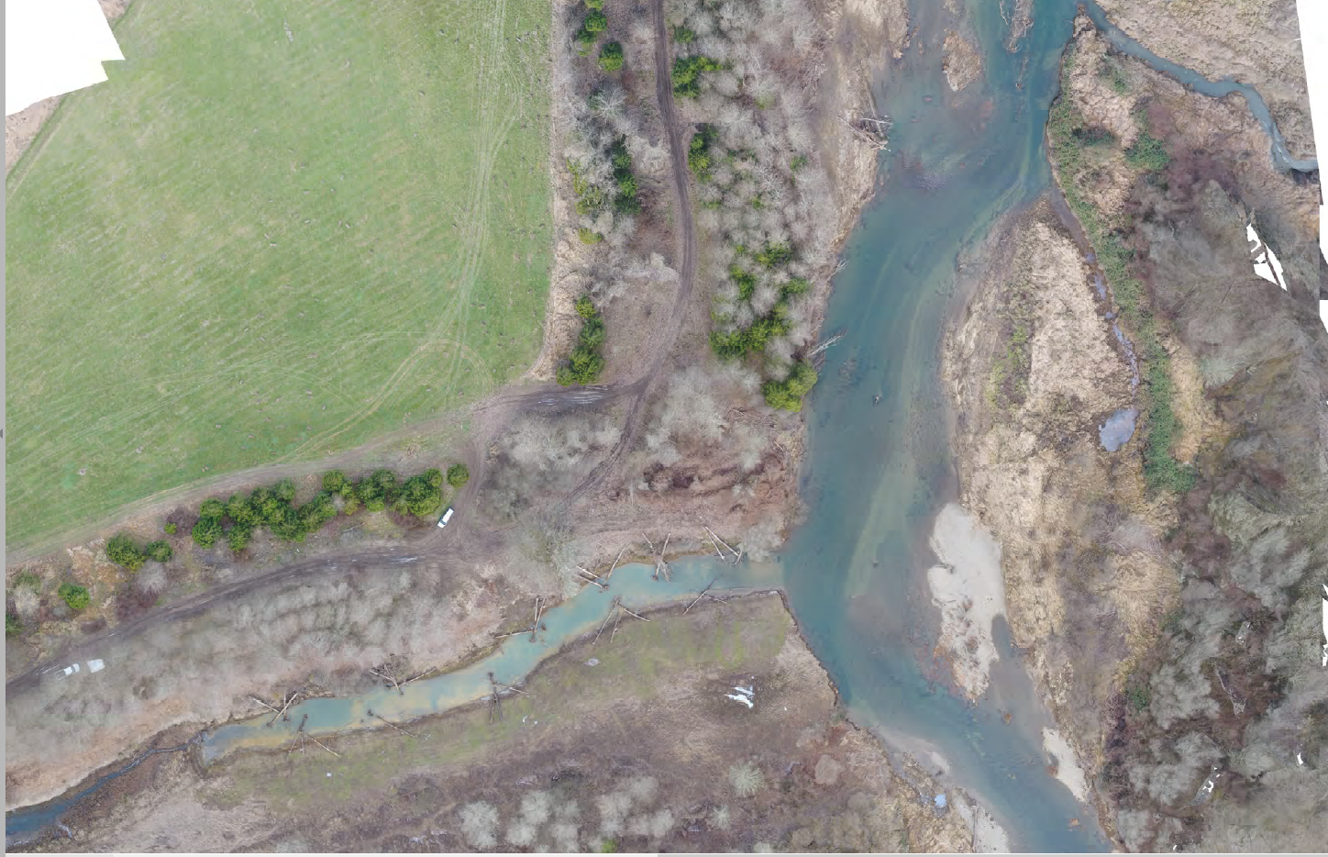
Connect Project Sites
Side Channel Project

Slide 8
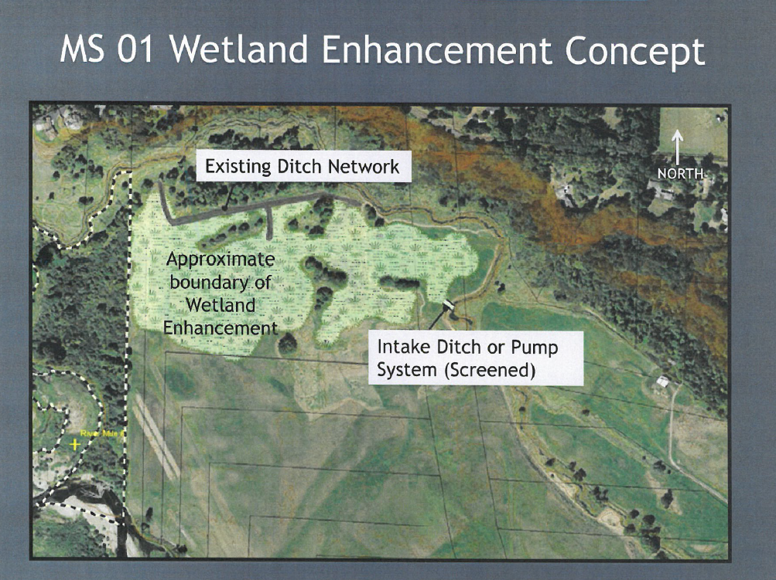
Improve Rearing
Install LWD
Connect wetlands
Remove ditches

Slide 9
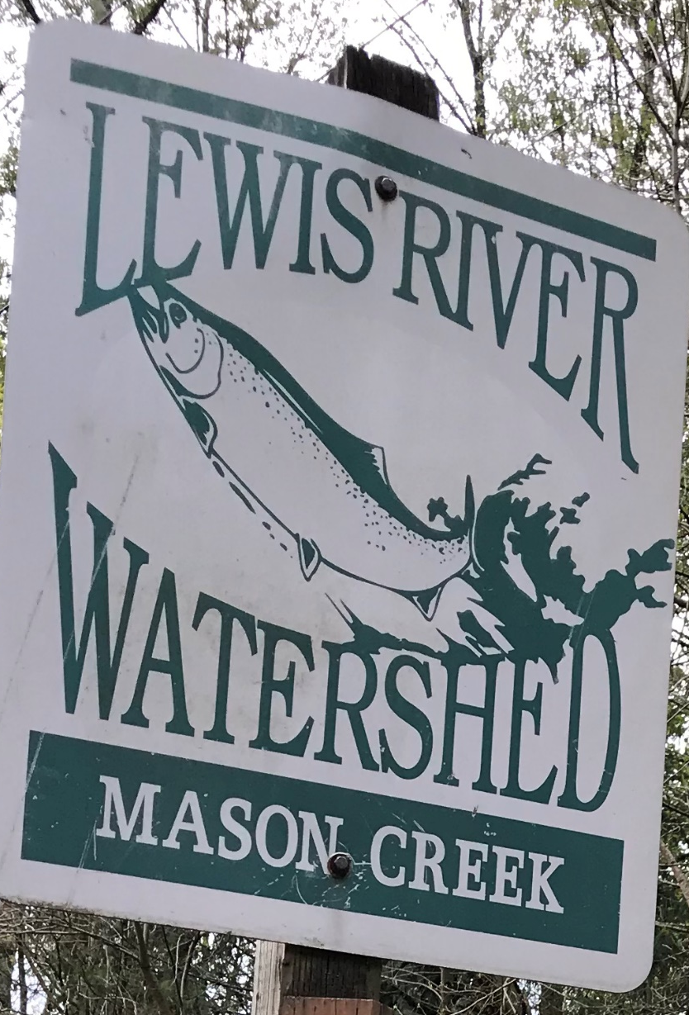
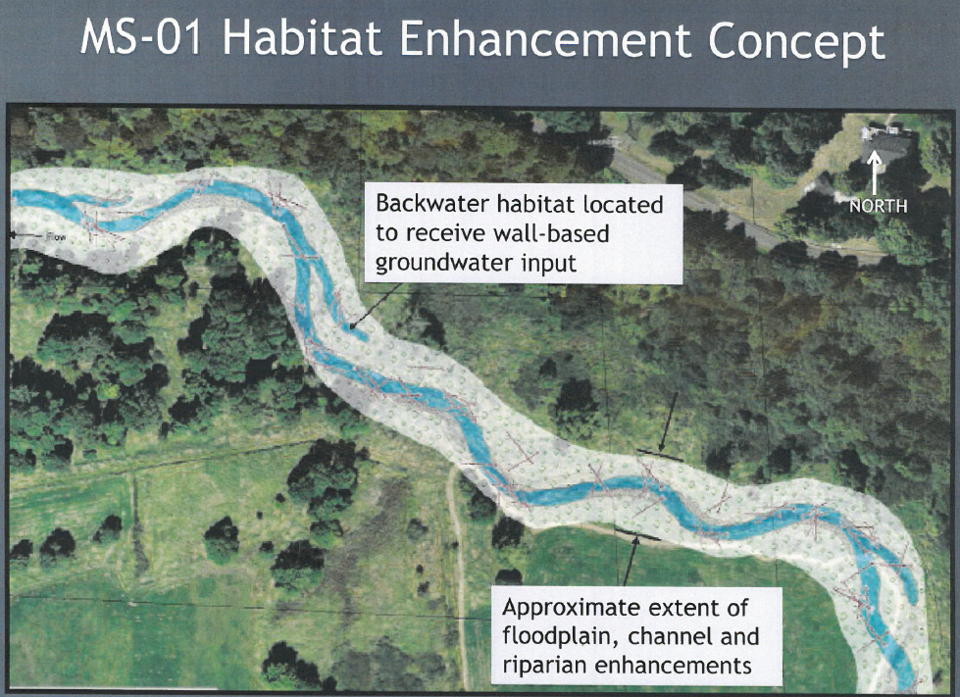
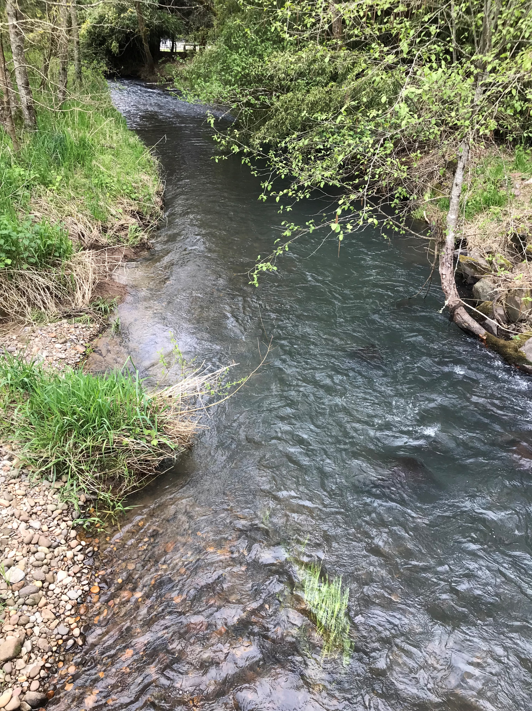
Improve Spawning Habitat
Install LWD
Gravel retention
Narrow channel

Slide 10
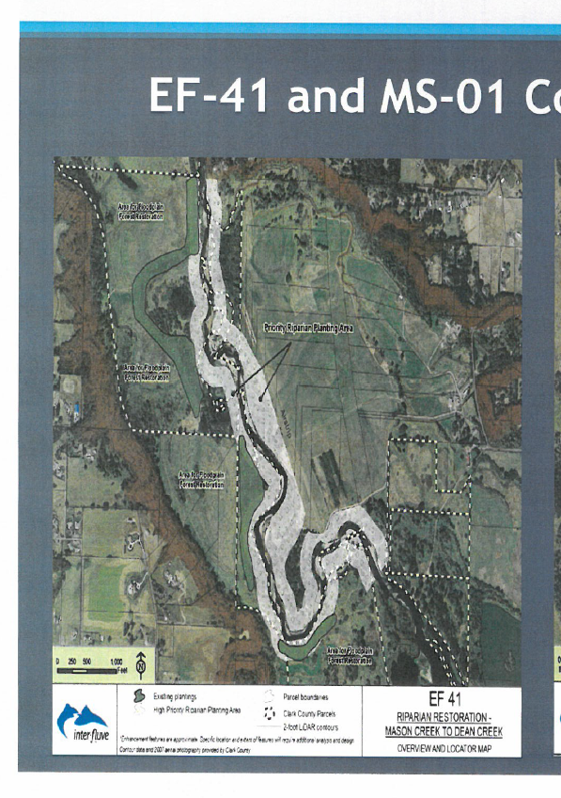
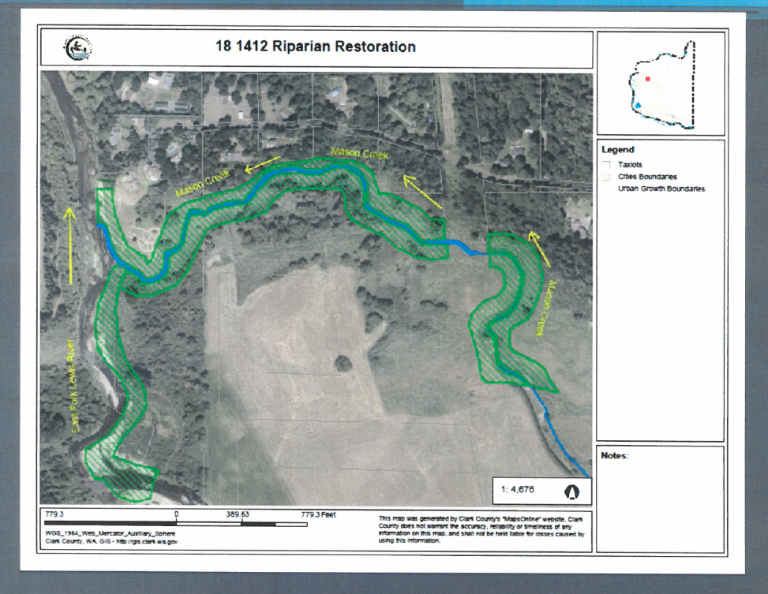
Improve Riparian Conditions

Slide 11
Expected Salmonid Use*
Temp. threshold- 17.5 C
(drier & warmer scenario)
* Based on data from WDFW (1999) & Cindy Baker (2008)

Slide 12
Climate Change
Design Drier & Warmer Scenario
Mason Creek Depth (ft.)

Slide 13
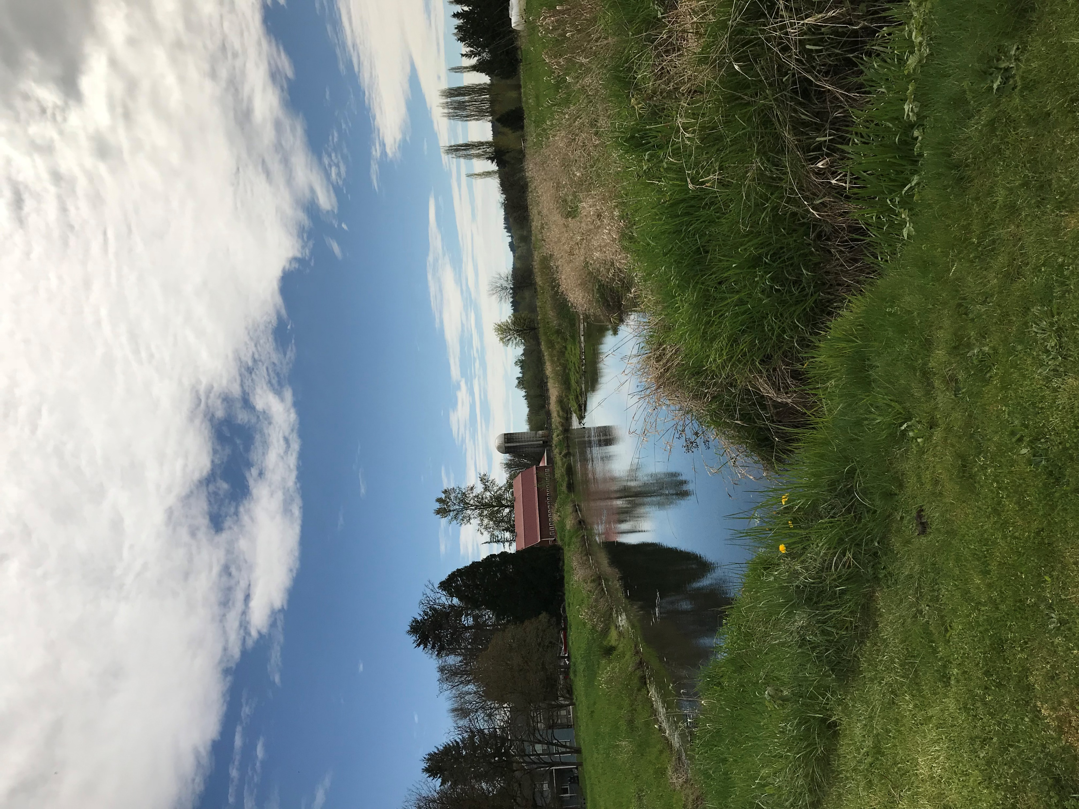
Cold Water Refuge- Upstream

