Slide 1
Restoration Goals
Capitalize & expand on other restoration efforts (including chum reintroduction)
Restore juvenile rearing, spawning and holding habitats
Support East Fork designation of wild steelhead gene bank
Improve spawning habitat & connectivity to upper basin
Improve Habitat diversity & complexity
Expand cold water refuge potential

Slide 2
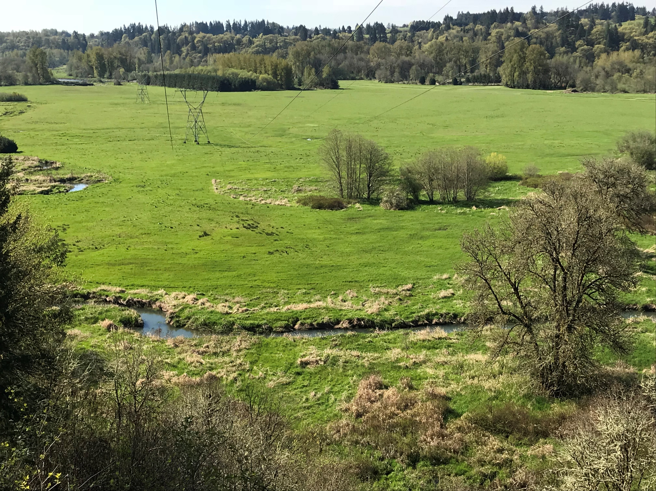
Watershed Approach
County has been protecting E. Fork
Build off other projects
Landowners are advocates for the river

Slide 3
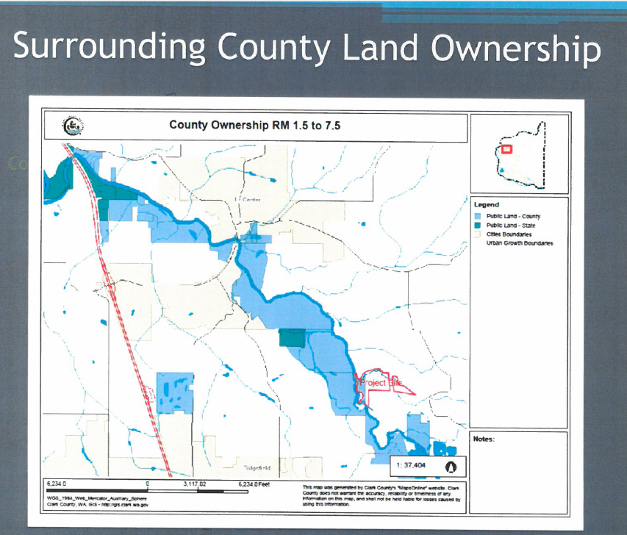
County Ownership- Critical Driver

Slide 4
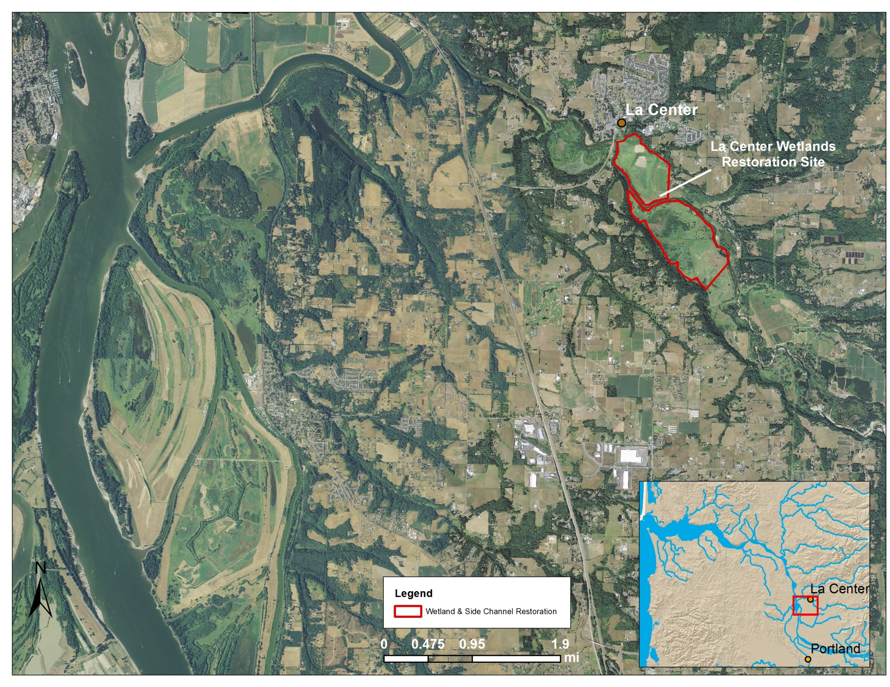
Restoration Sites
St Helens
McCormick Creek
Mason Creek
E. Fork Mainstem & Side-Channel
Columbia River
Ridgefield Pits

Slide 5
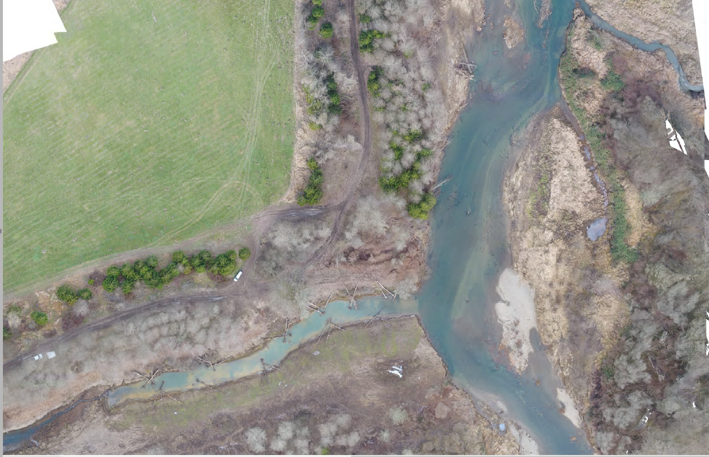
Tie into existing project
Mason Creek
Side Channel Project

Slide 6
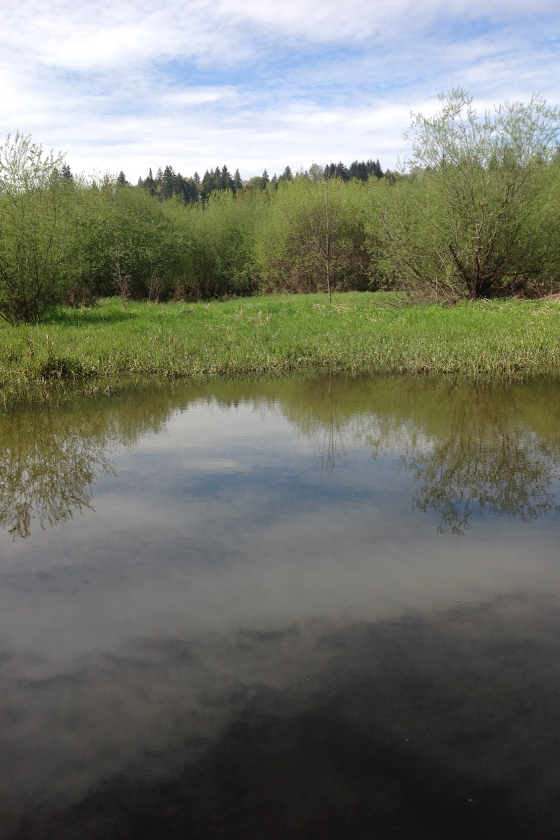
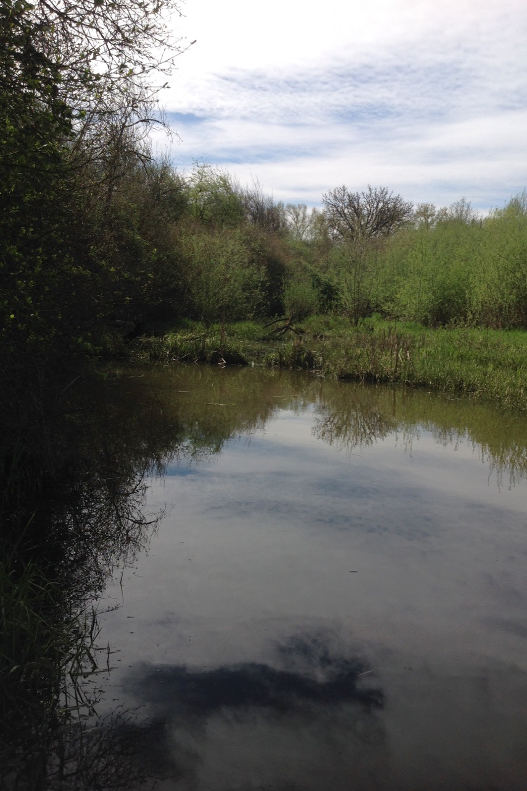
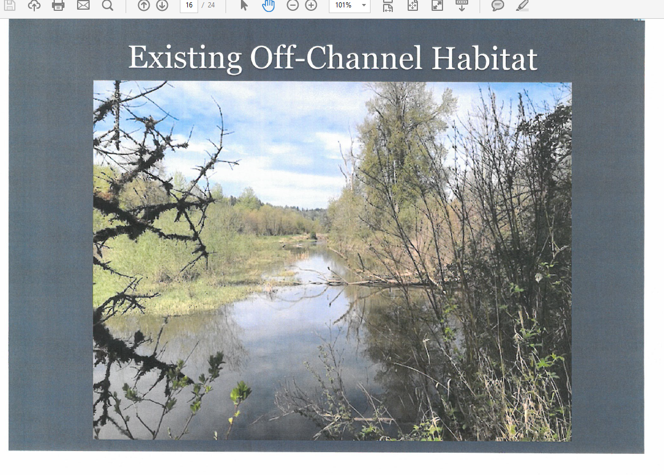
East Fork Side Channel

Slide 7
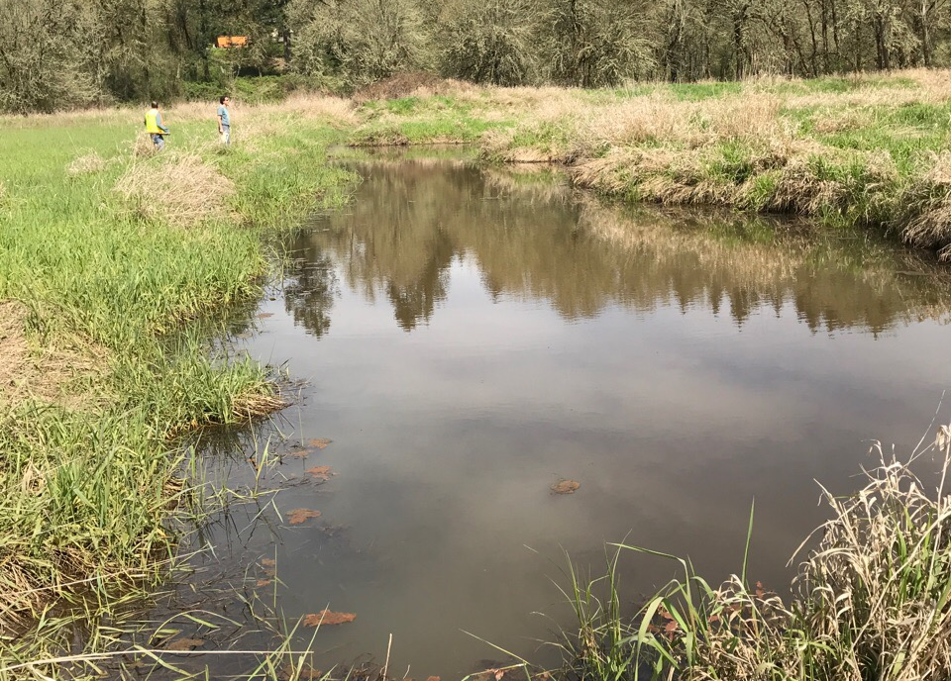
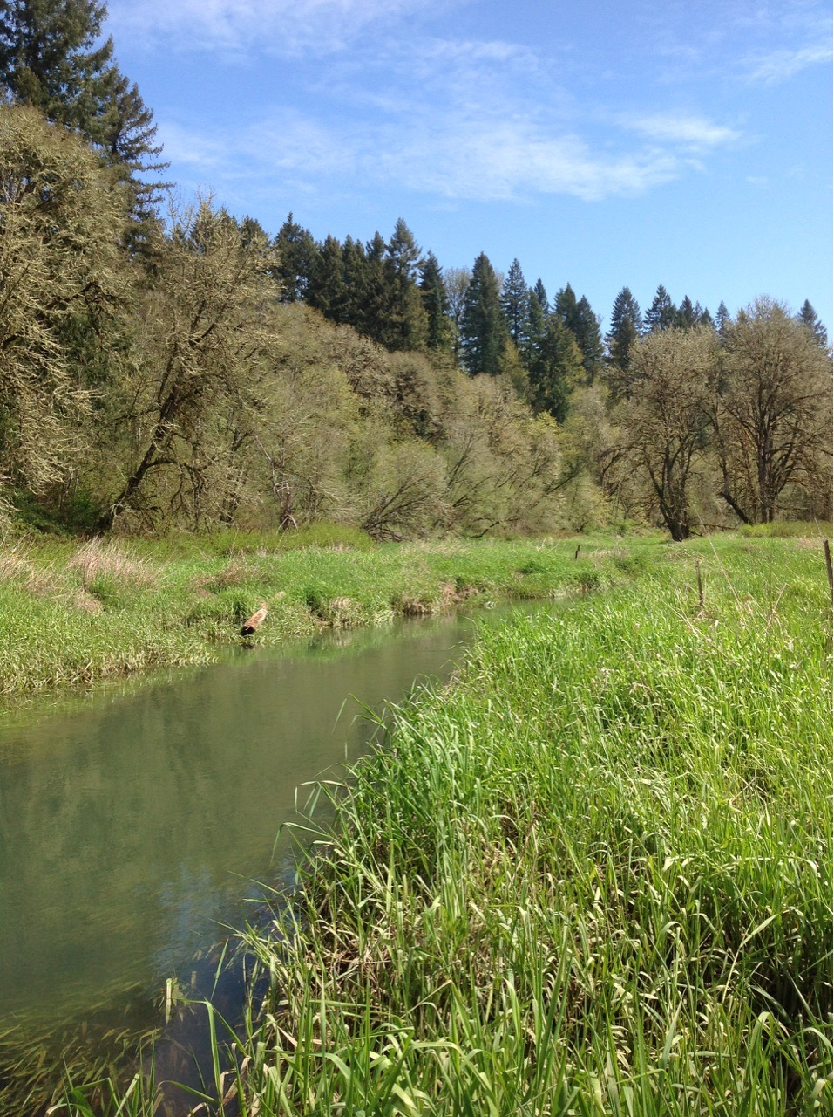
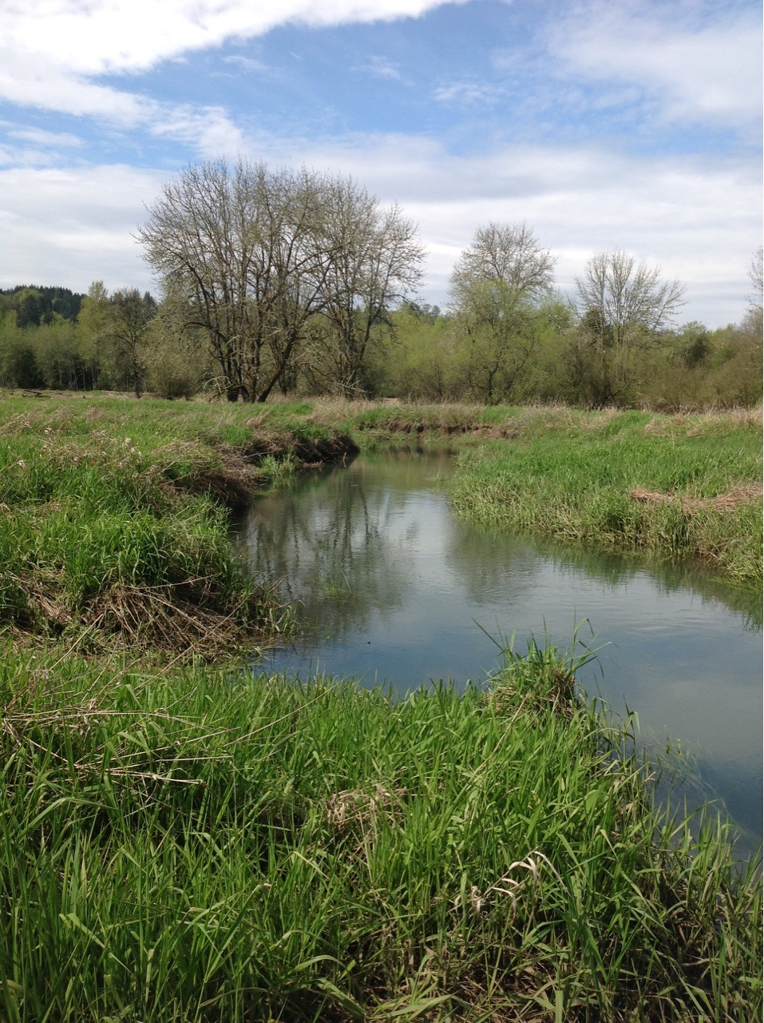
Mason Creek

Slide 8
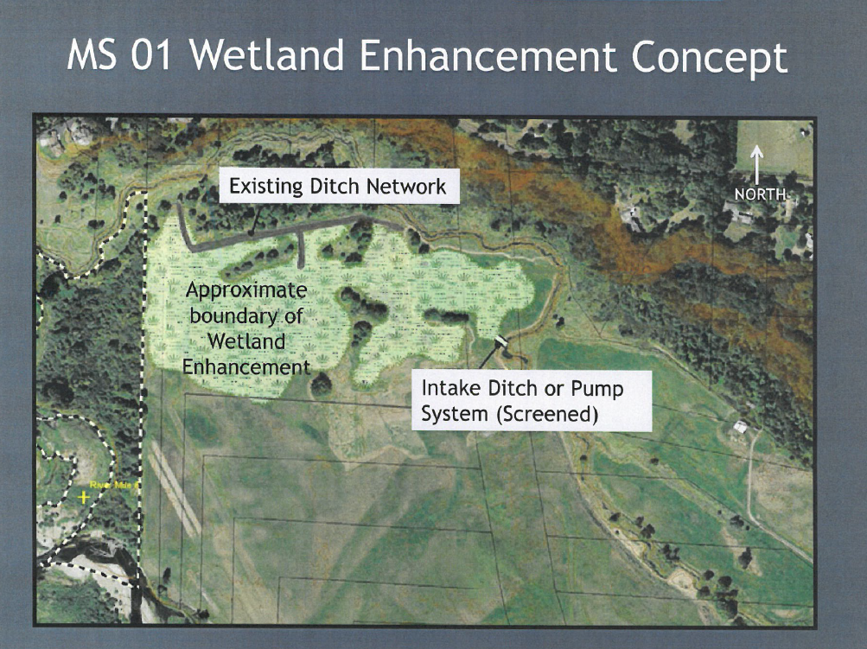
Improve Rearing
Need Metrics

Slide 9
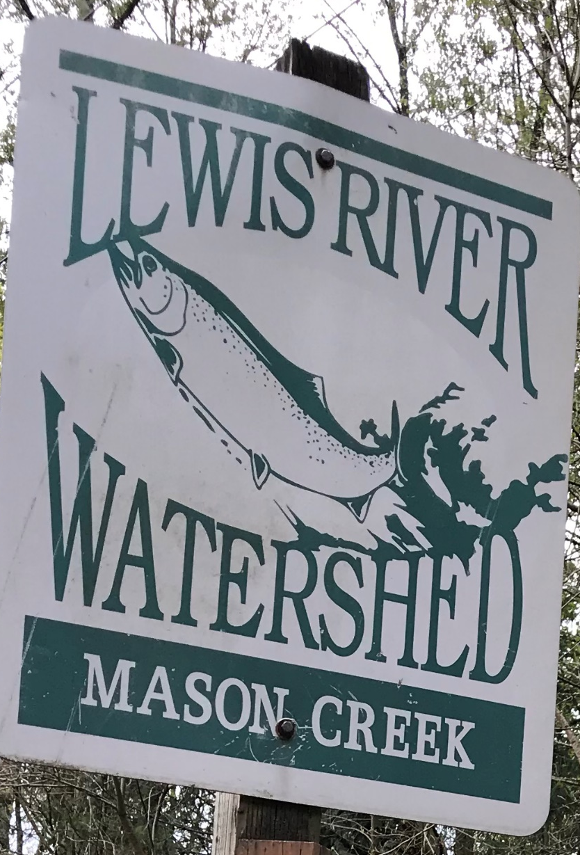
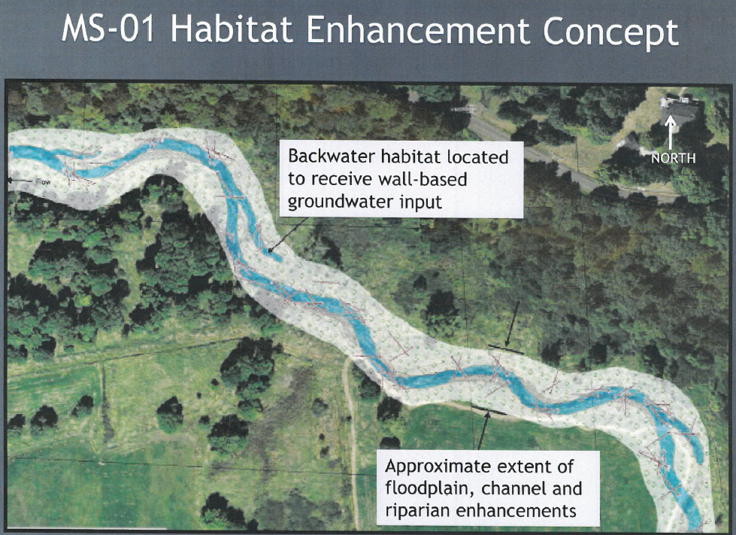
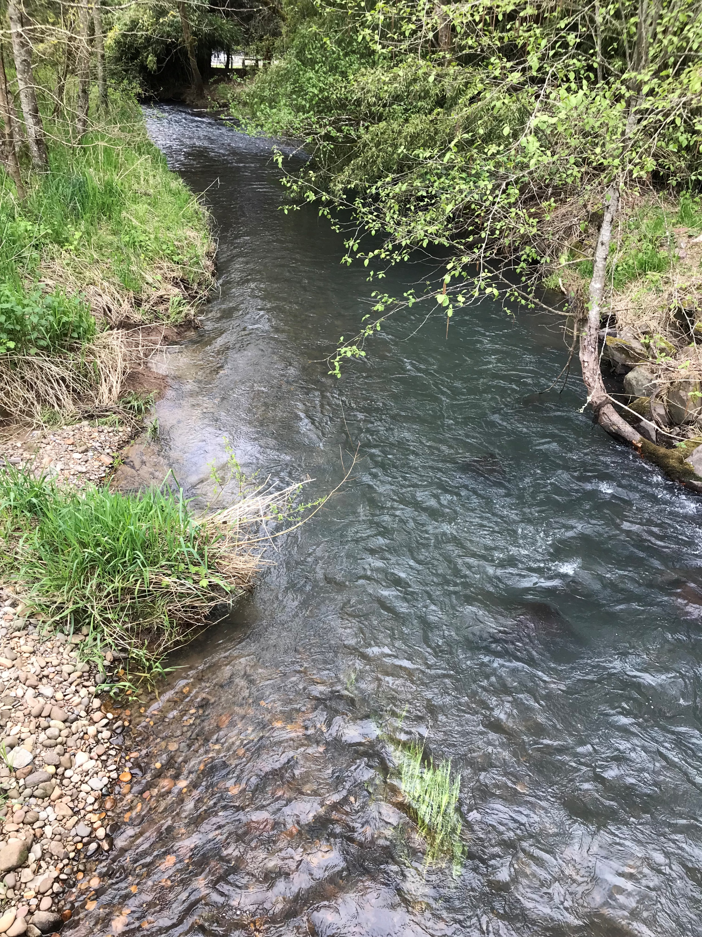
Improve Spawning Habitat
Need Metrics

Slide 10
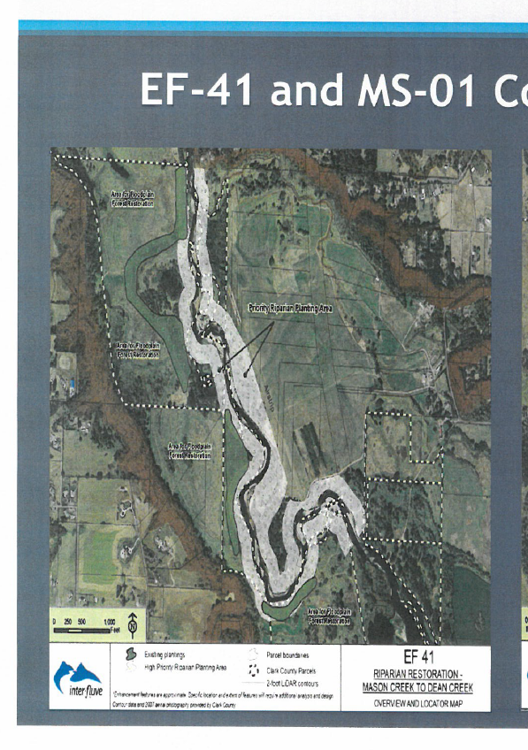
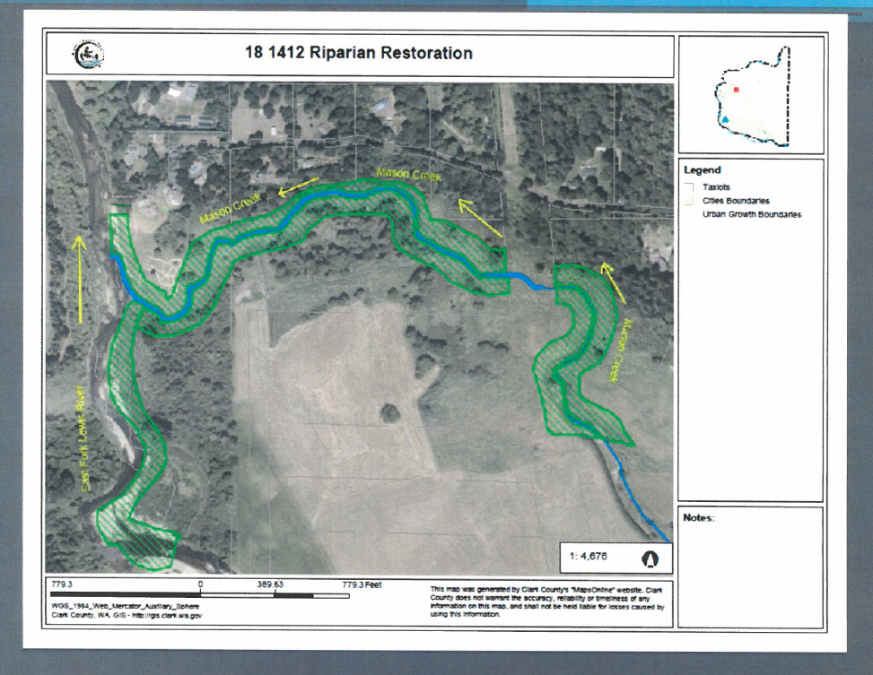
Improve Riparian Plantings
Acres
100 foot buffers

Slide 11
Expected Salmonid Use*
Temp. threshold- 17.5 C
(drier & warmer scenario)
* Based on data from WDFW (1999) & Cindy Baker (2008)

Slide 12
Climate Change
Design Drier & Warmer Scenario
Mason Creek Depth (ft.)

Slide 13
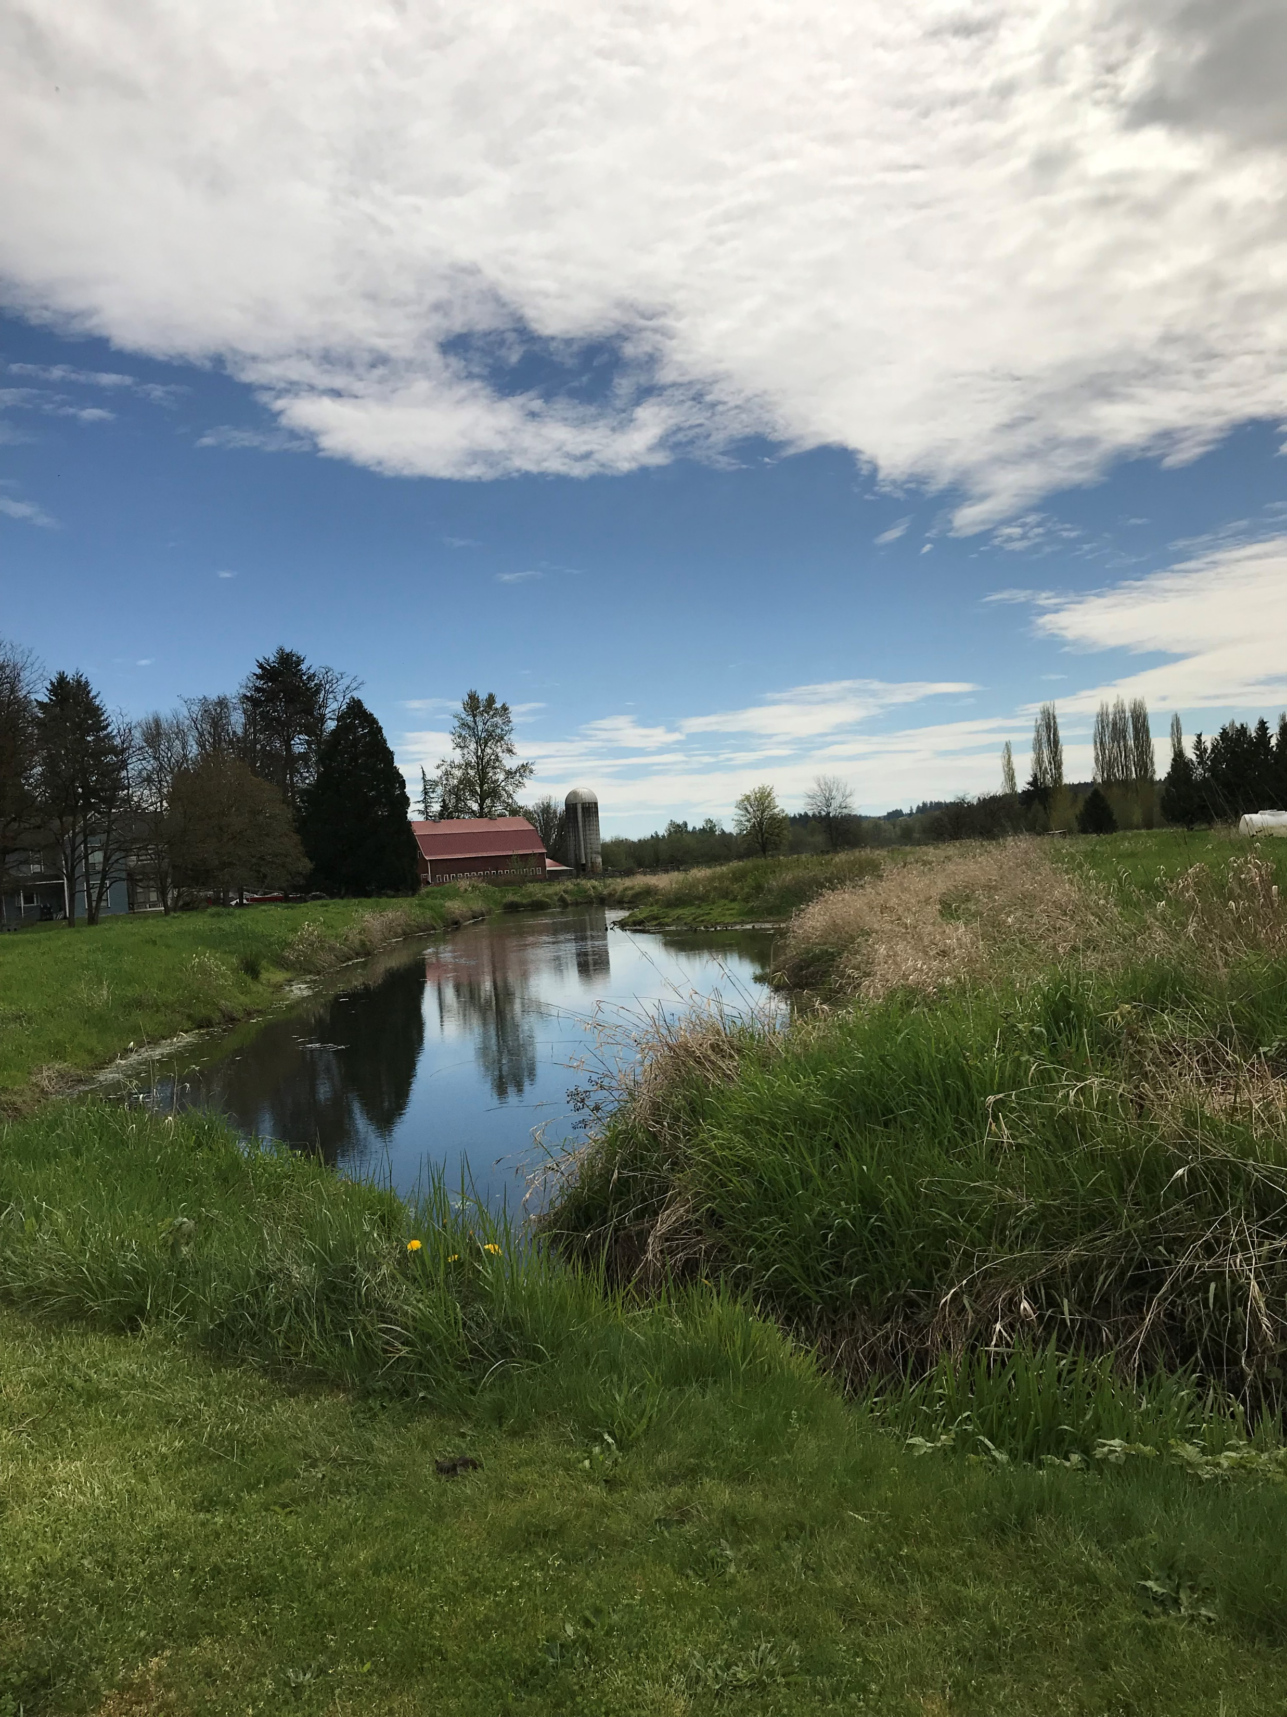
Cold Water Refuge- Upstream

