Slide 1
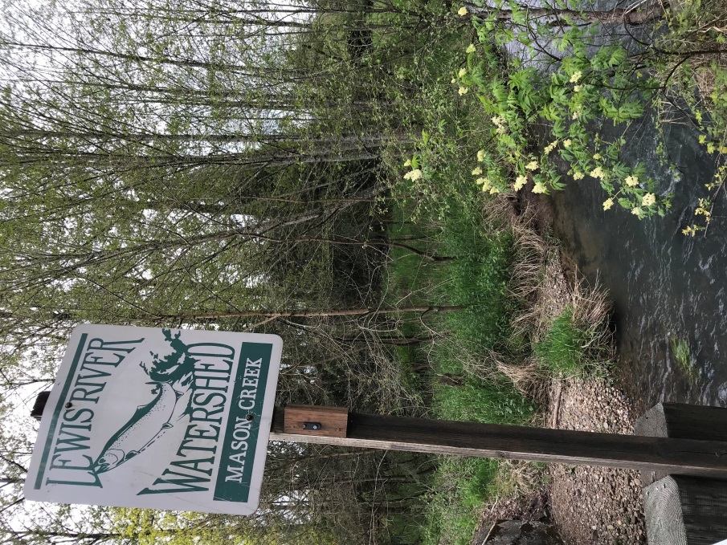
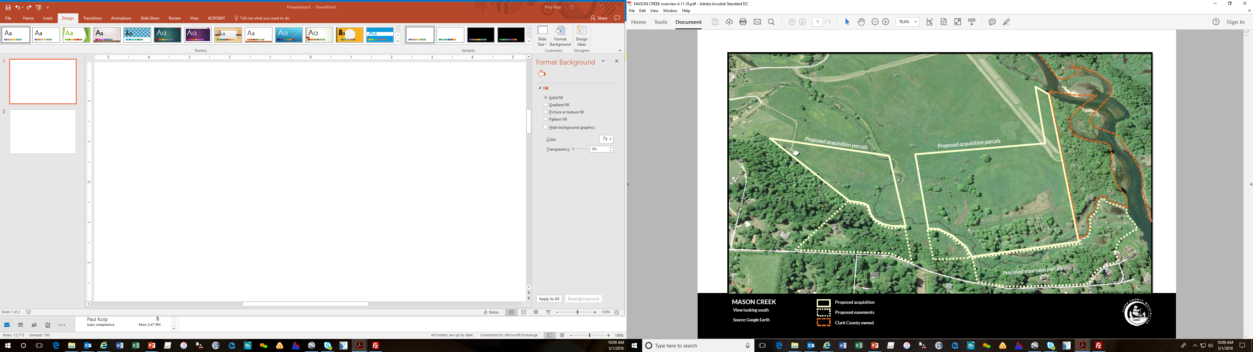
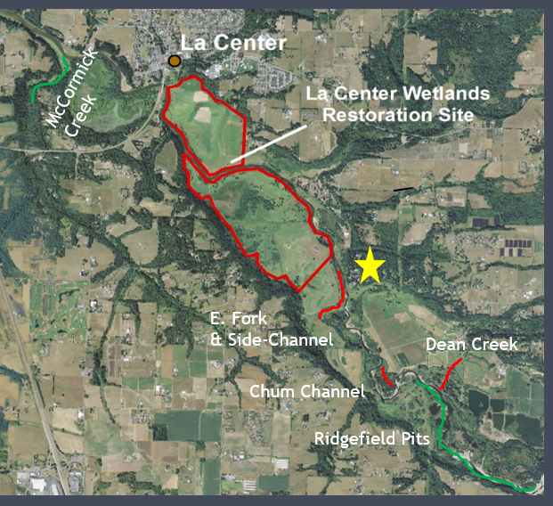
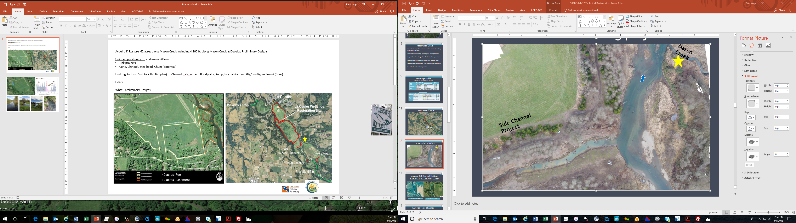


Acquisition
62 acres & 4,200 ft. Mason Creek & Develop Preliminary Designs
Unique Opportunity
Landowners (Dean S.)
Watershed Approach + Link projects
Combine two highly ranked projects (East Fork Habitat Plan (LCFRB) including Riparian &
Restoration
Multiple Species & Life Histories: Coho, Chinook, Steelhead, Chum (potential),
Existing Conditions Channel incison has….floodplains, temp, key habitat quantity/quality, sediment (fines)
Potential Solutions- Enhance Habitat complexity/quantity, create off-channel wetlands
49 acres- Fee
12 acres- Easement

Slide 2
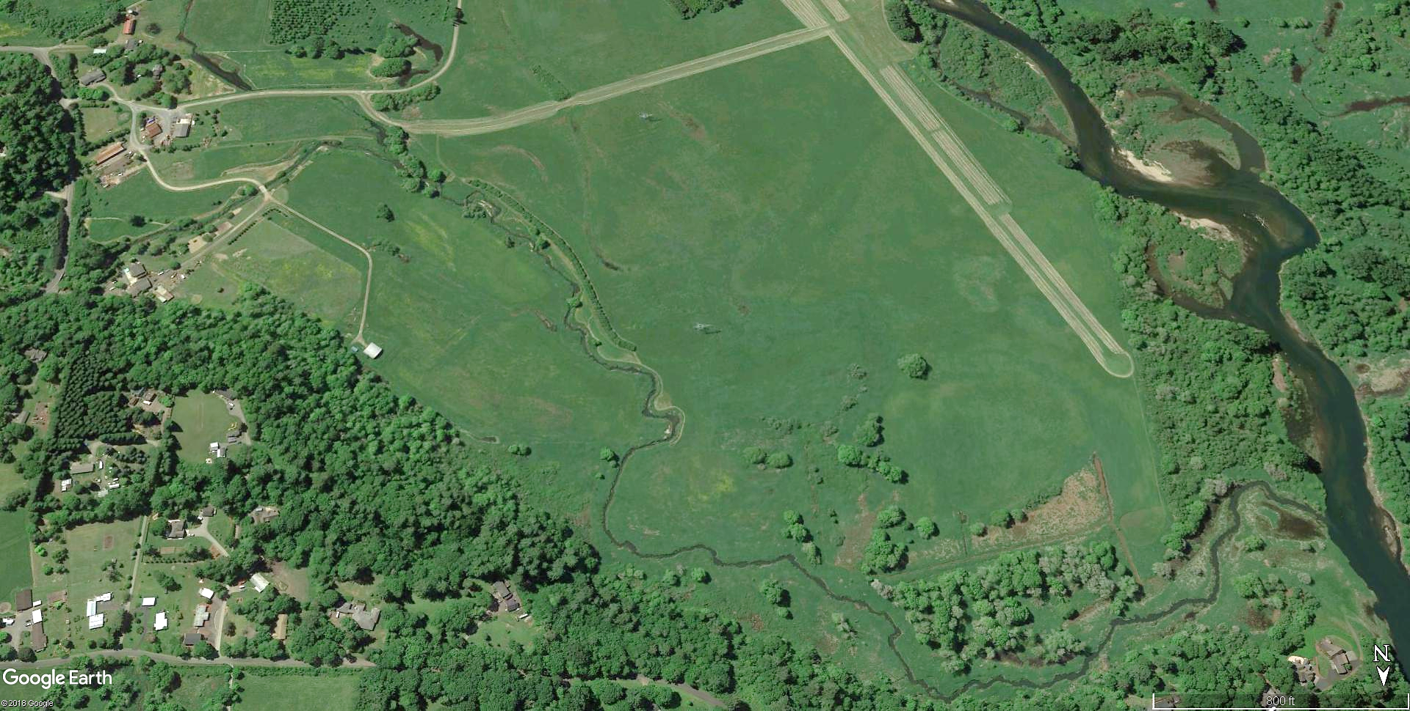
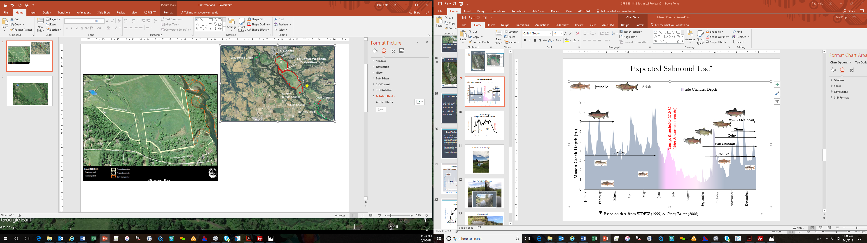


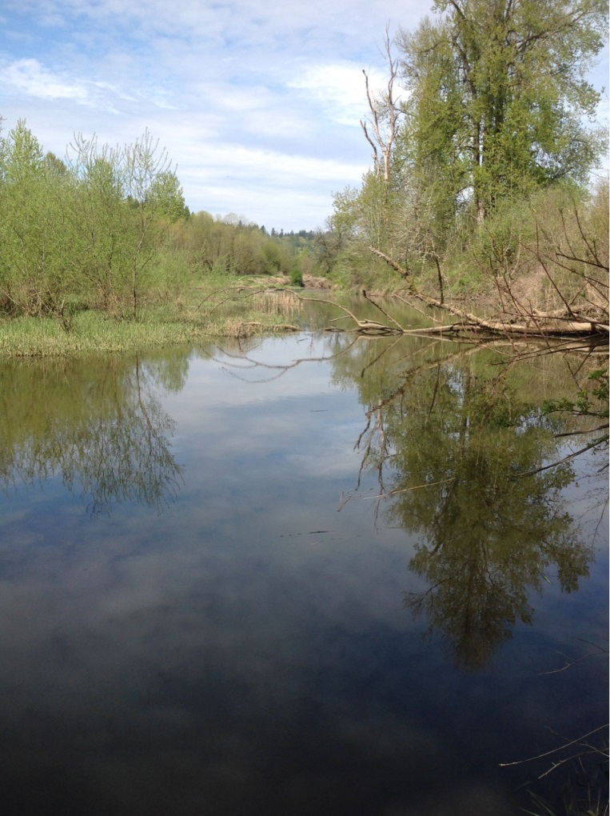
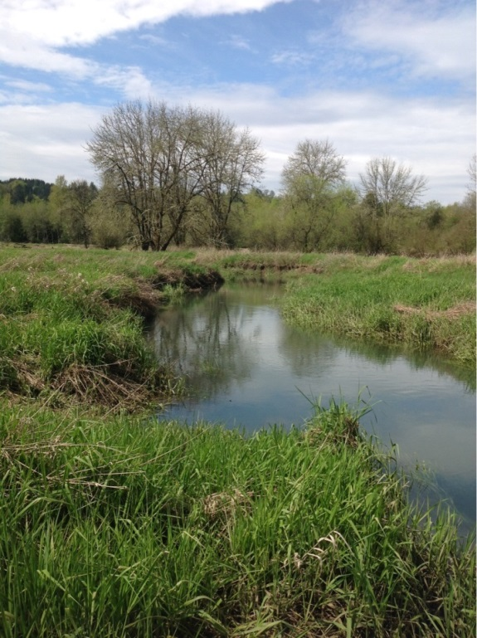
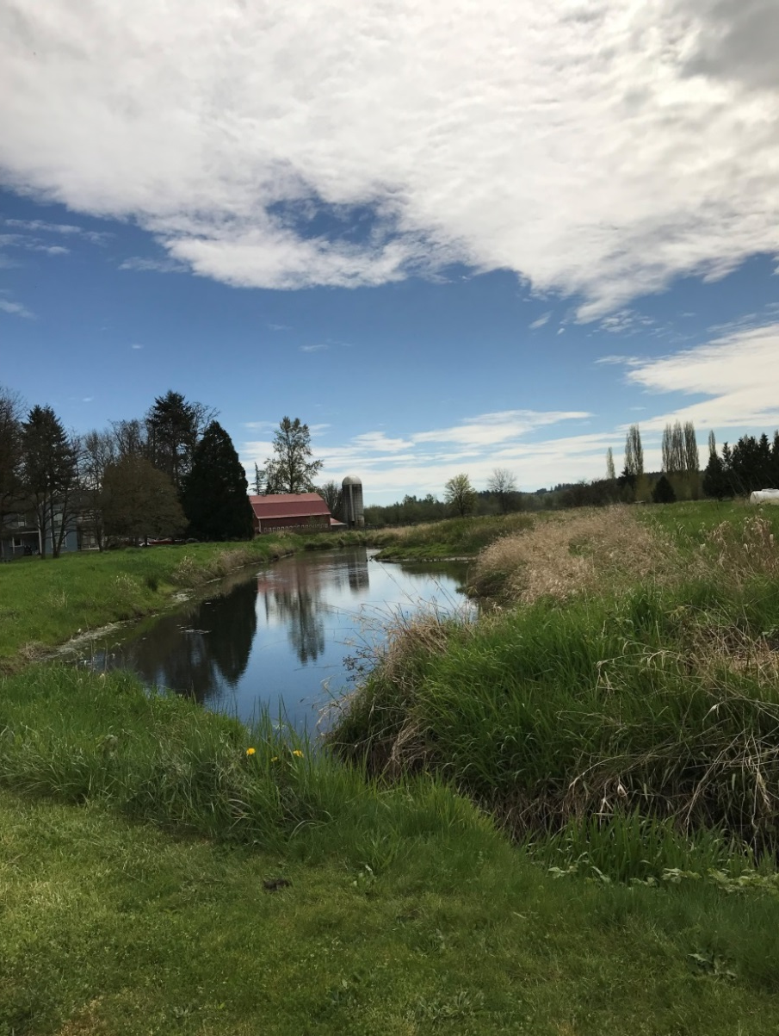
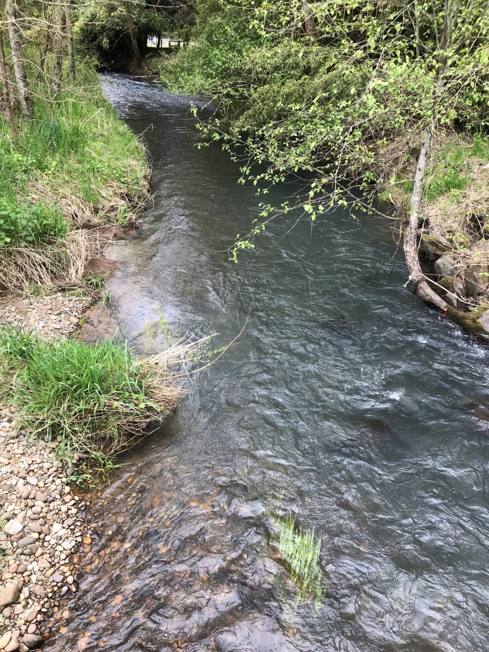
4
1
3
2
3 ft. Incision
No wood
No wood
That Grass
1
2
3
4

