Slide 1

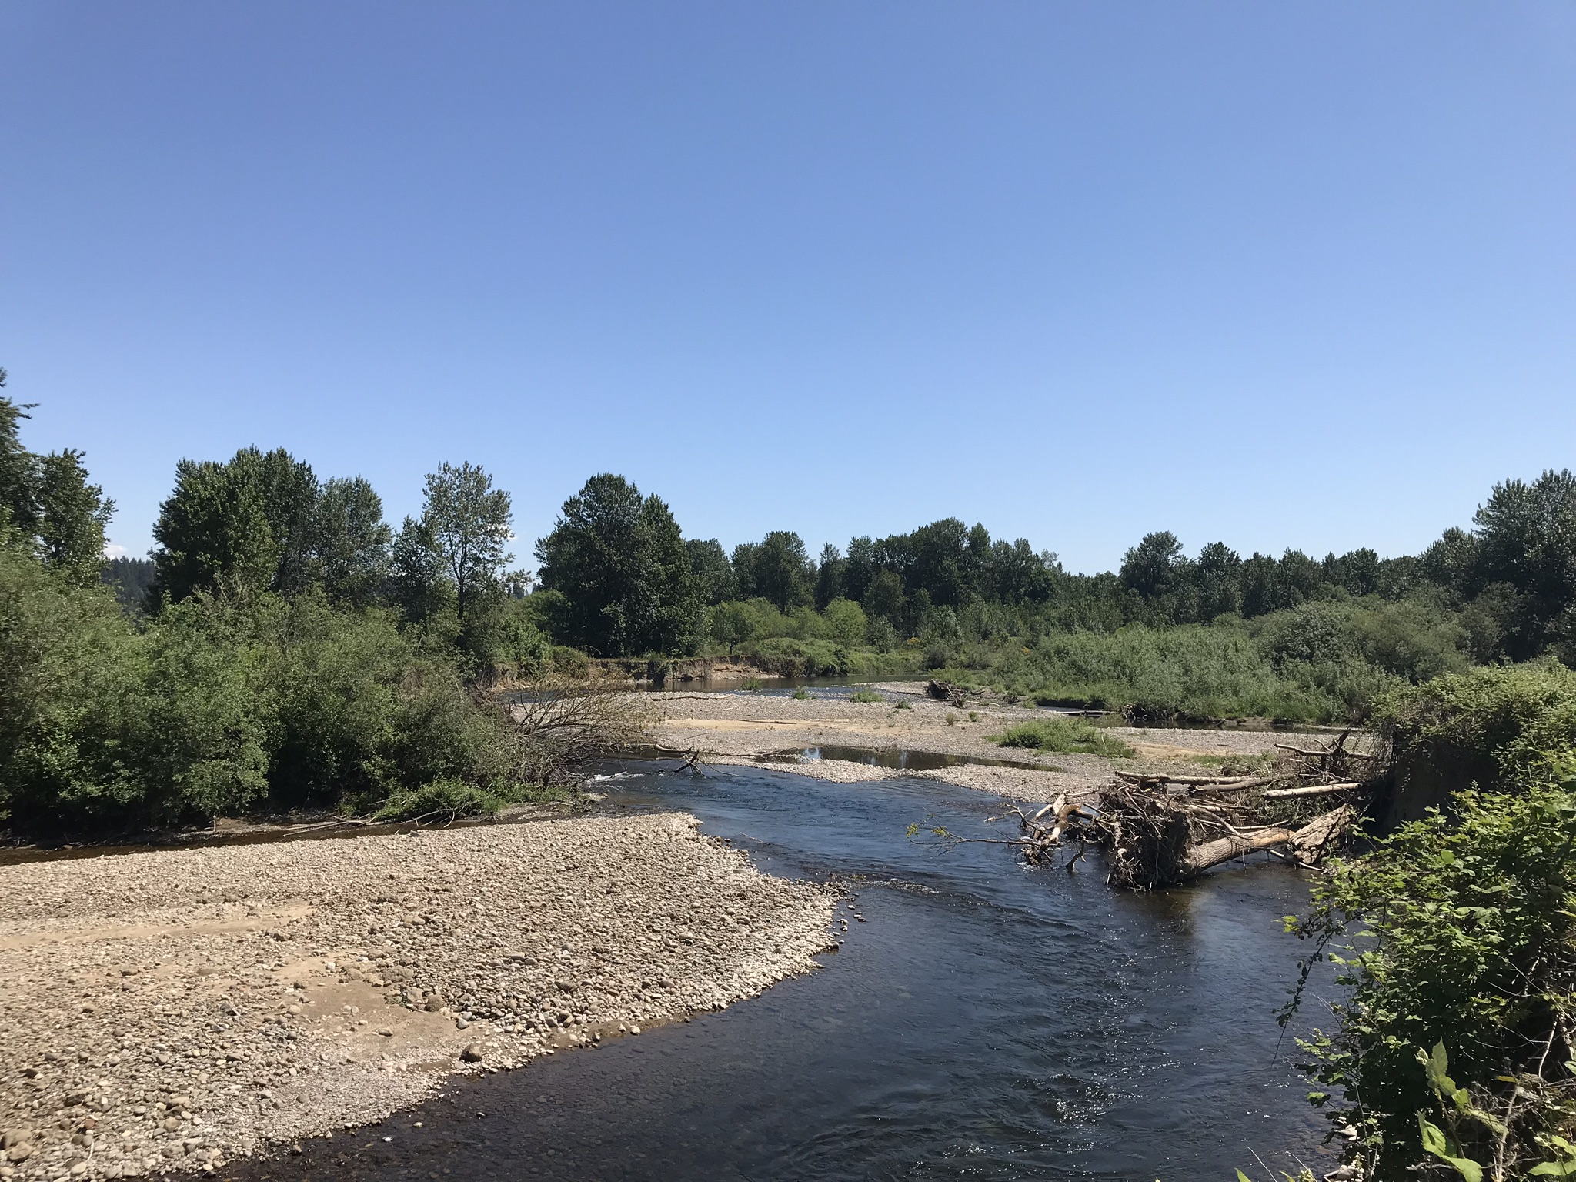

East Fork Lewis River Thermal Study Kickoff Meeting: Field Data Results Presentation & Review
Keith Marcoe, Jenny Dezso, Paul Kolp (LCEP)
October 27, 2021

Slide 2
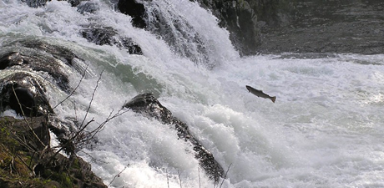
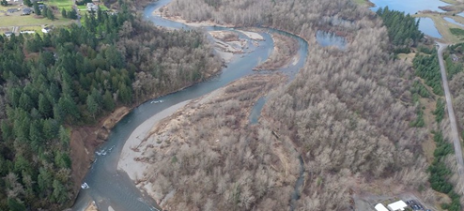
Big Picture
Warming river temperatures negatively affect 5 salmon & steelhead species across all life history stages
Documented need on the E. Fork to address water temperature (LCRFB, 2009; Ecology 2018)
A greater understanding of the spatial extent of cold water and overlapping habitat conditions is needed in light of current conditions & future climatic prognosis

Slide 3




Thermal Assessment Project
Approach
Compile & collect thermal imaging temperature information from ~ RM 5 to RM 25 (Lockwood Cr. to Moulton Falls)
Compile & collect temperature information from Lockwood Cr., Mason Cr., Dean Cr., Rock Cr.
Remote sensing, ground based, desk top analysis
Validate thermal imaging
Identify and rank sites and select restoration opportunities using Technical Group.
Deliverables
Thermal imaging and logger temp data
Feasibility & Alternatives Assessment
Produce 3 Conceptual Designs
Revise LCFRB LEF Plan (2009) based on findings

Slide 4
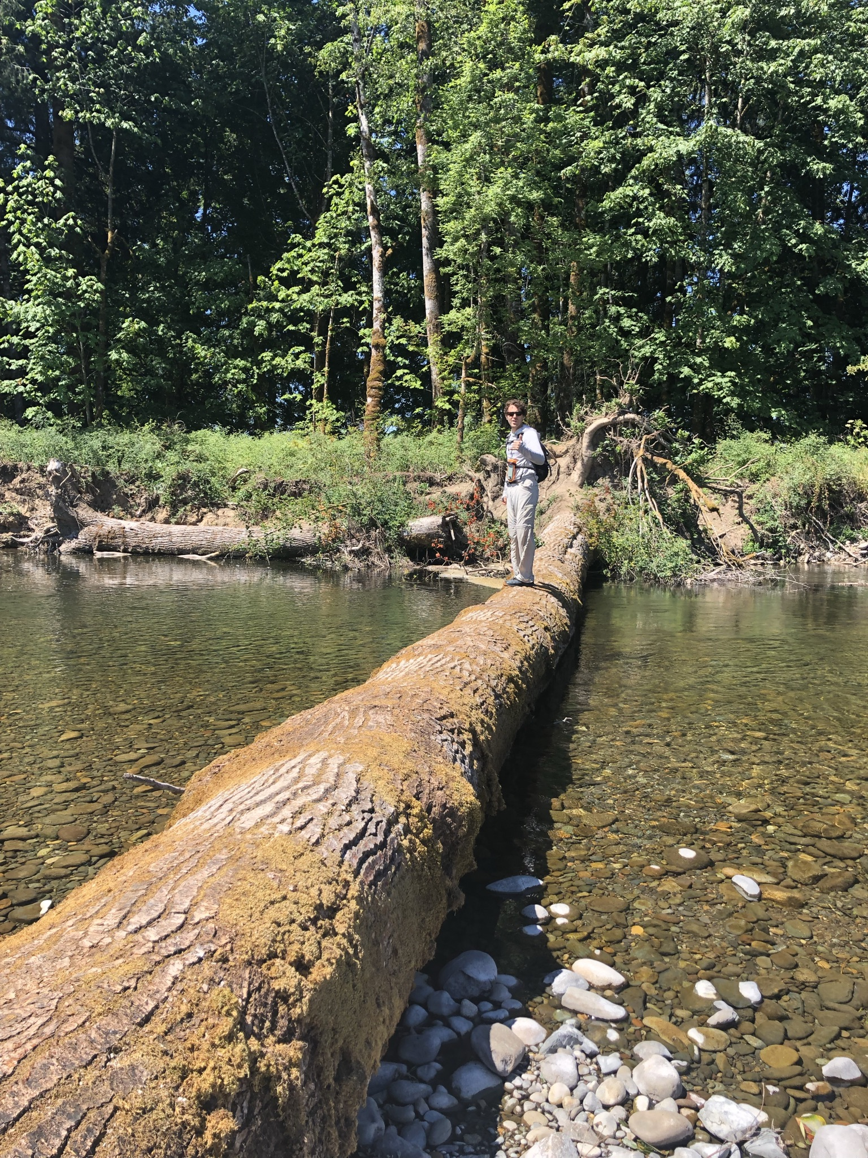
Thermal Assessment Data Needs
Goals:
To map the existing thermal profile of the EFLR mainstem, off channel areas and tributaries
Identify potential opportunities to protect, restore, and create cold-water refuge zones
These goals require high resolution temperature data that covers a large spatial extent
To meet this need LCEP hired Quantum Spatial to collect remotely sensed thermal infrared (TIR) temperature data in 2020

Slide 5
East Fork Lewis River Historical Temperature Data Inventory
Org. | Collection Yrs. | Format | Monitoring Loc. | Raw Data Avail.? | Notes
WA DOE | 2005 | Report | EFLR, tribs | ? | McCarthy 2018
WA DOE | 2005 | Report | EFLR, tribs | ? | Carey & Bilheimer 2009
Clark Co. | various | Logger | Selected tribs | Y | Rotating basis
LCEP | 2018 | Logger | EFLR Pits reach | Y | Mainstem and side channels
LCEP | 2020 | Logger | EFLR, tribs | Y | Calibration for thermal-IR
LCEP/ Quantum | 2020 | Thermal-IR | EFLR, tribs | Y | Thermal-IR surface temperature
LCEP | 2021 | Spot checks | EFLR, limited tribs | Y | Verification for thermal-IR
Friends of EF | 2021 (various) | Logger
LCFEG
Dave Brown (Mill Cr.)
WDFW |  |  | Mason Cr, mainstem |  | We have 2016 data
Other?

Slide 6
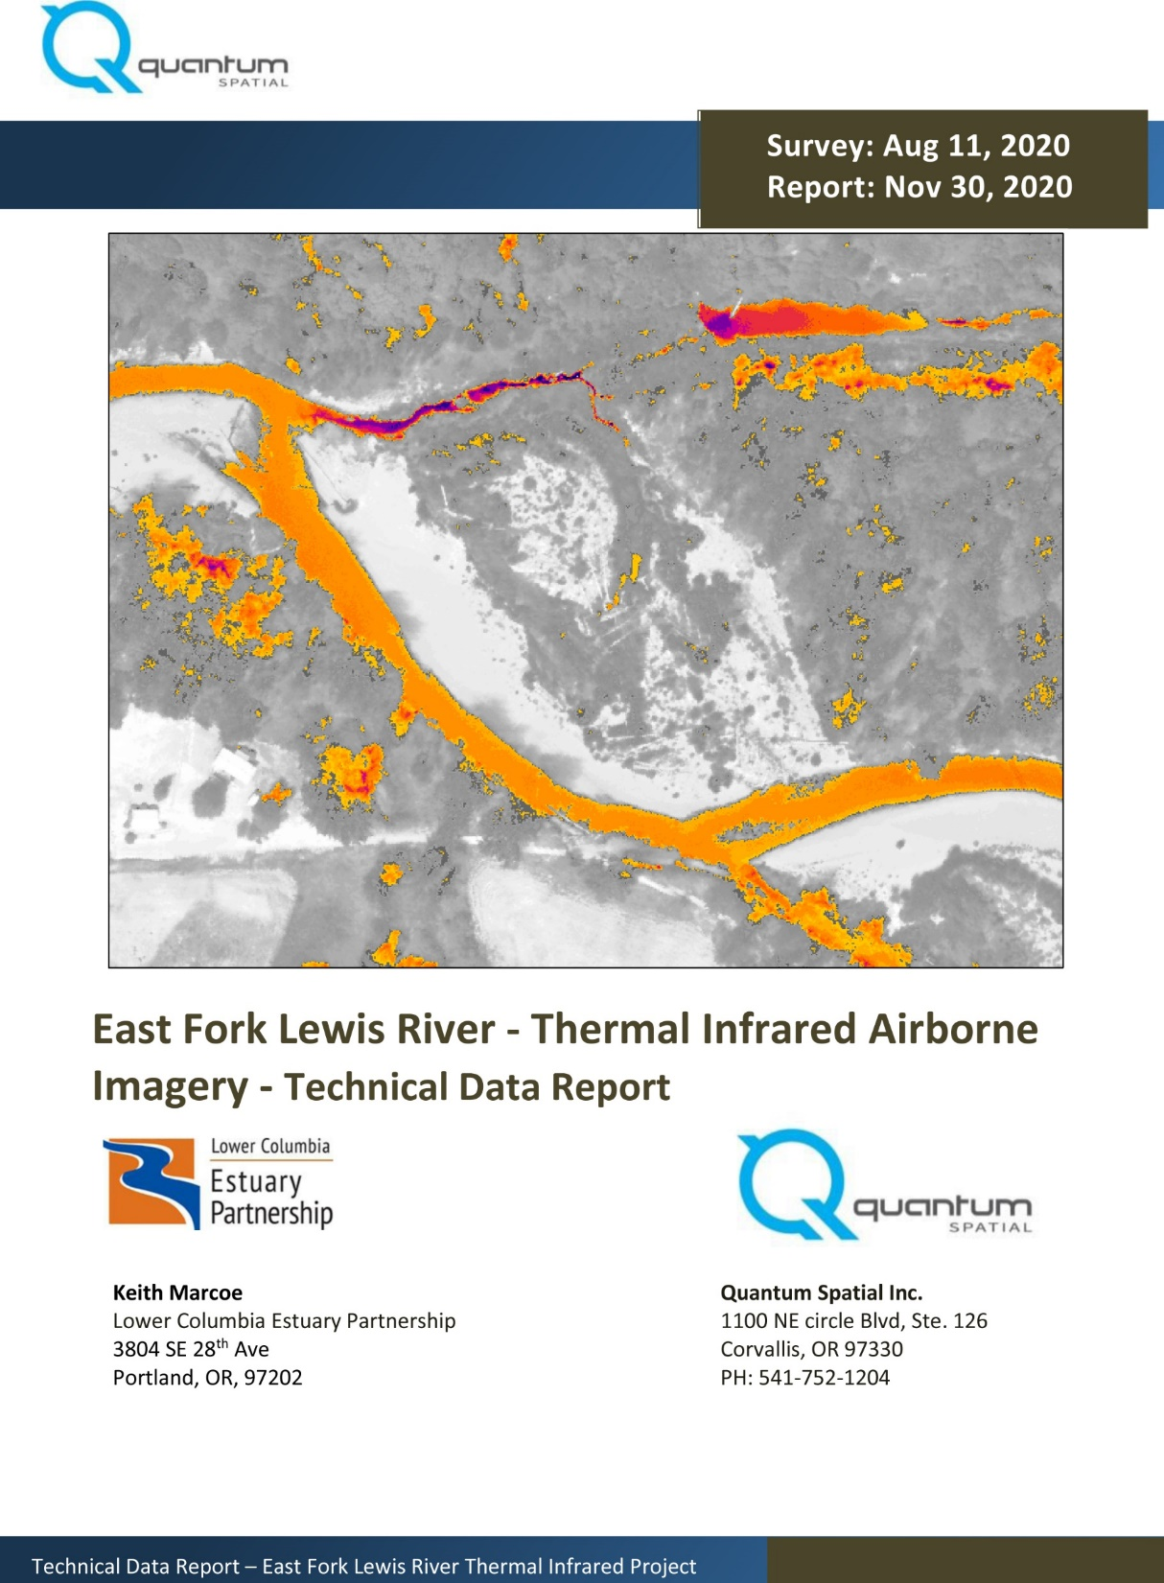
Thermal Infrared Survey Overview
Single acquisition from helicopter – ‘instantaneous’ snapshot covering a large area.
Sensor captures radiation from surface (air or water)
High spatial resolution (< 0.5 meter)
Acquired on August 11 2020, from approx. 2:30–3:30 pm
- air temperature at TOA: ~ 76°C
- Heisson flow at TOA: ~ 82 cfs
Report, GIS files, and maps available from LCEP
Viewable online map

Slide 7
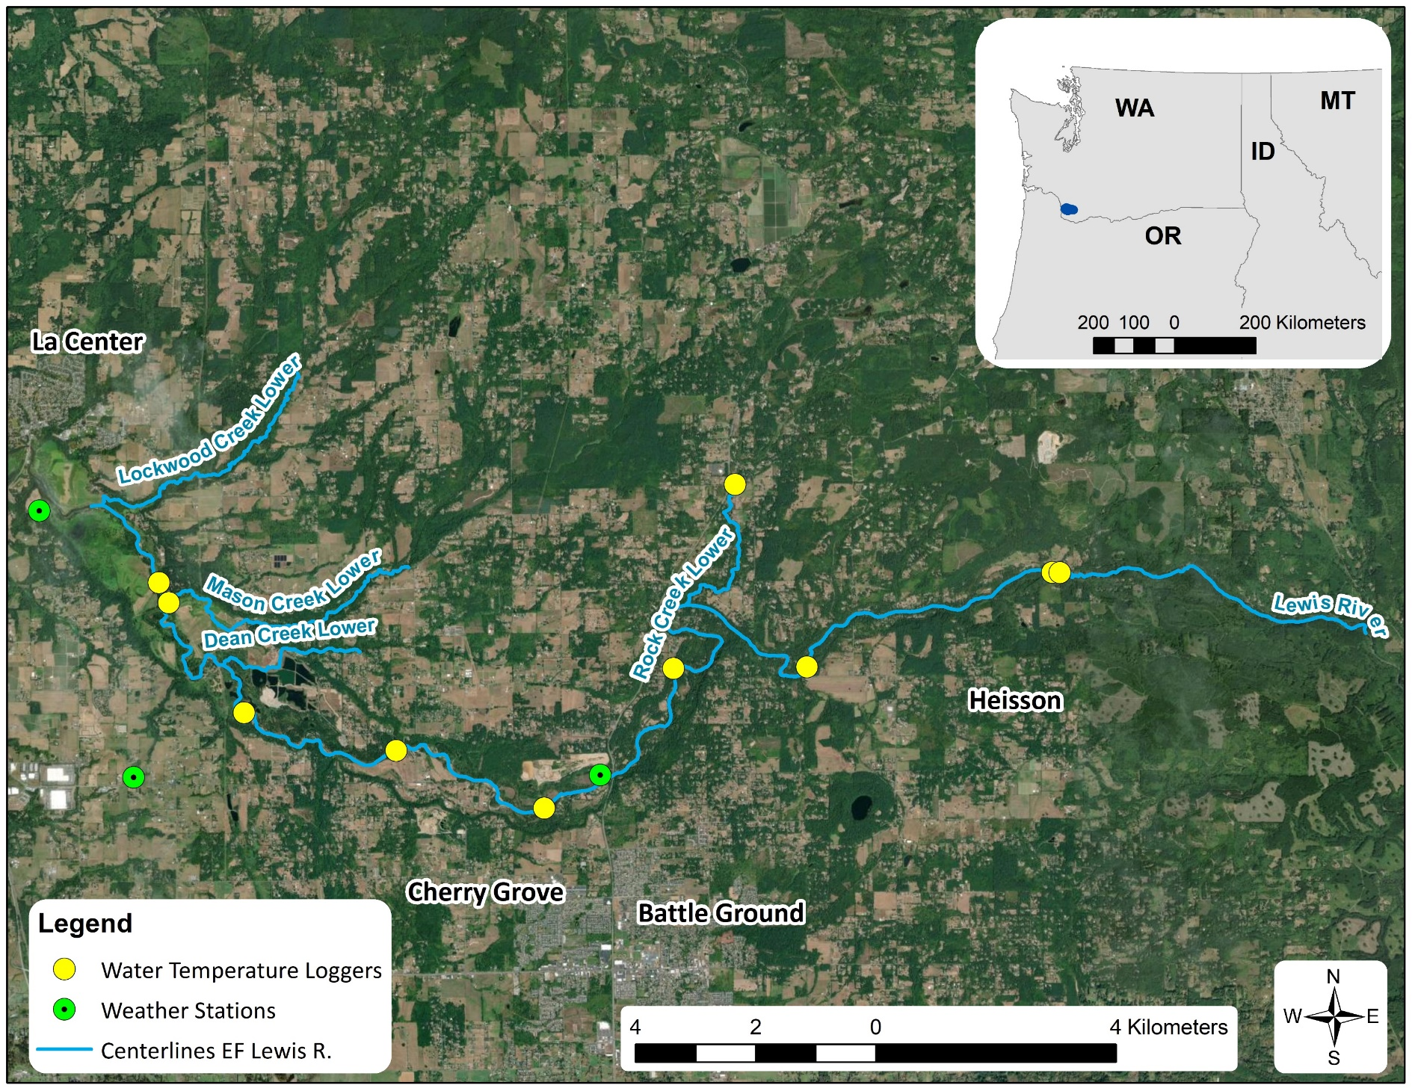
Thermal Infrared Survey Overview
Calibration data collected by LCEP with instream HOBO loggers at locations shown
Coverage includes:
- EFLR and off channel areas from
RM 5–25 (Moulton Falls)
- Lower Lockwood Cr.
- Lower Mason Cr.
- Lower Dean Cr.
- Lower Rock Cr.

Slide 8
Thermal Infrared Results: Obvious Locations
Pit 8
Near RM 8 above Ridgefield Pits
(Pit 8 not detected due to surface water?)
Off-channel near RM 10.5 above Daybreak Park
Pit 9
Mill/Manley confluence (RM 9.3)
All show strong thermal signatures

Slide 9
Thermal Infrared Results Q/A: Ambiguous locations
Several cold areas were indicated in off-channel areas and along EFLR banks
LCEP field verified these areas in 2021
Conclusion: Most are shading effects from tall trees and/or steep banks and are not representing true water temperature
Can likely disregarded areas where above features are present
RM 16 below Rock Cr.
RM 14 ( Lewisville Park)
Appearance only of cool off-channel area
Obvious shading effect
RM 9.3 Mill/Manley confluence
Extent of verified cold water
Appearance only of cool off-channel area

Slide 10
Thermal Infrared Results Q/A: Ambiguous locations
Mixed result for all tributaries
Some areas show up, but many are too narrow to get continuous streamline
Outside of floodplain – no access to verify
High uncertainty provides limited info about restoration potential
Upper Mason & Dean creeks
Lower Lockwood Cr.

Slide 11
Thermal Infrared Results Q/A: Ambiguous locations
Mixed result for all tributaries
Some areas show up, but many are too narrow to get continuous streamline
Outside of floodplain – no access to verify
High uncertainty provides limited info about restoration potential
Upper Mason & Dean creeks
Lower Lockwood Cr.

Slide 12
Thermal Infrared Results Q/A: Ambiguous locations
Lower floodplains of tributaries
Less canopy in Mason – slightly better results
Mason Cr. lower floodplain
Lockwood Cr. lower floodplain

Slide 13
Thermal Infrared Results Q/A: Ambiguous locations
Lower floodplains of tributaries
Less canopy in Mason – slightly better results
Mason Cr. lower floodplain
Lockwood Cr. lower floodplain

Slide 14
Thermal Infrared Results Q/A: Ambiguous locations
Lower floodplains of tributaries
Less canopy in Mason – slightly better results
Mason Cr. lower floodplain
Lockwood Cr. lower floodplain

Slide 15
Thermal Infrared Results Q/A: Mainstem Trends
Visual trends can be deceiving
Map symbology shows abrupt temperature change at Rock Cr. confluence

Slide 16
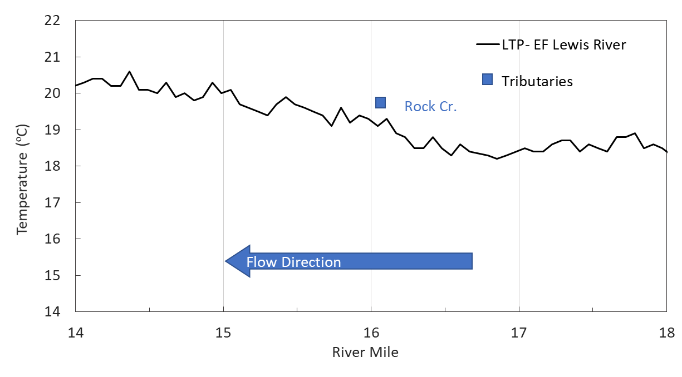
Thermal Infrared Results Q/A: EFLR trends
Longitudinal profile shows the trend to be more uniform

Slide 17
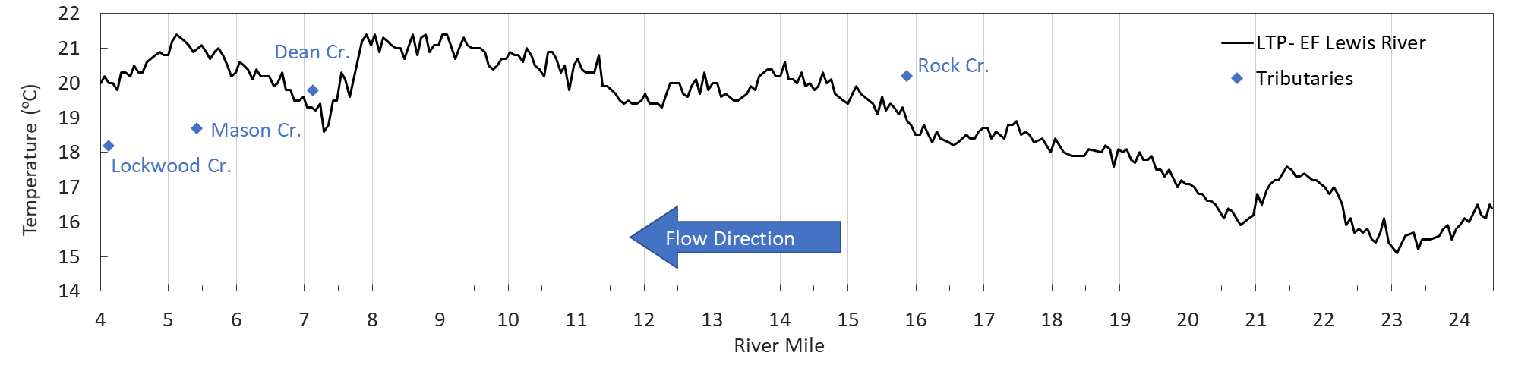
Thermal Infrared Results Q/A: Mainstem Trends
Above La Center
Below Lewisville Park
Ridgefield Pits
Lucia Falls
Lockwood Cr.
Rock Cr.
Mason Cr.
Dean Cr.

Slide 18
Thermal Infrared Results Q/A: EFLR trends
Lucia Falls reach
LCEP has not field verified results at this location
What kind of restoration opportunities exist here?

Slide 19
Thermal Infrared Results Q/A: EFLR trends
Ridgefield Pits
What is happening here?
Appears as if cold-water input is influencing mainstem temperatures
LCEP did not observe this trend during field verification in July 2021 - temps were similar above, below, and through the reach
Previously collected Hobo data from 2018 useful for analysis

Slide 20
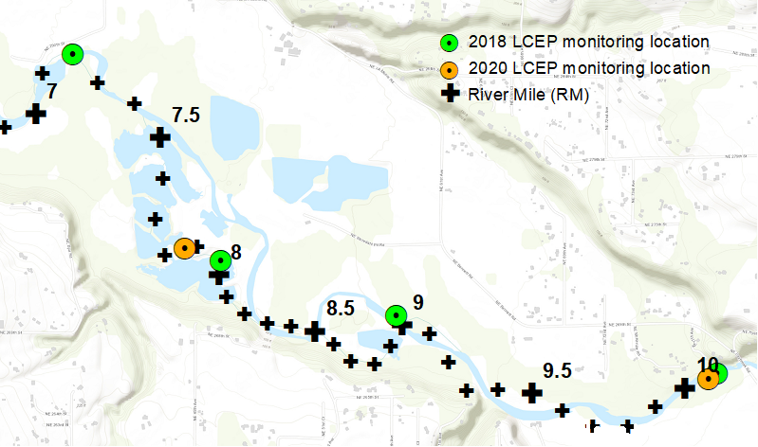
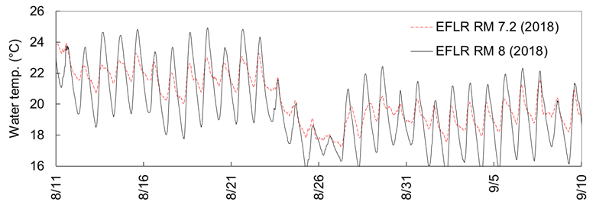
Thermal Infrared Results Q/A: EFLR trends
2018 Hobo locations
Increased depth and large volume of water in the Pits buffers atmospheric heating and cooling, reducing daily temperature fluctuation
Observed pattern reverses throughout day
7.2
Hobo temperature plots above and below Ridgefield Pits

Slide 21
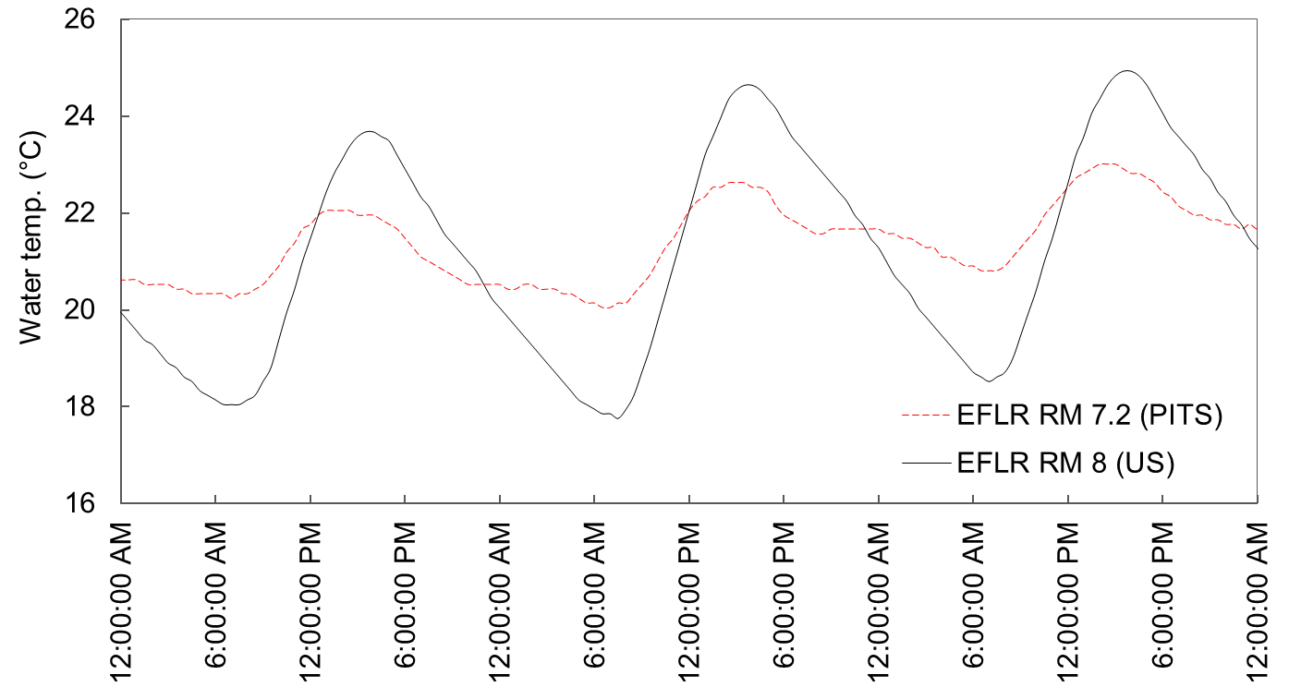
Thermal Infrared Results Q/A: EFLR trends
early morning:
T_{PITS} > T_{US}
late morning/noon:
T_{PITS} ~ T_{US}
LCEP field verif.:
10:30-1:00
mid/late afternoon:
T_{PITS} < T_{US}
TIR survey: 3:00-3:30
LCEP verif.
TIR survey
Pits may be warmer or cooler depending on measurement time
Pits have a moderating effect on temperatures: higher lows and cooler highs

Slide 22
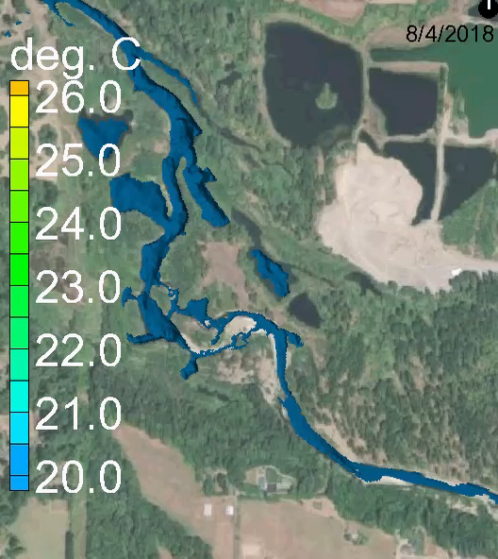
Ridgefield Pits Temperature Model Simulation
Model simulation with atmospheric heating and cooling applied shows similar performance to data

Slide 23
Thermal Infrared Results Q/A: EFLR trends
Downstream near La Center
Indicated cooling not related to Lockwood or Mason creeks inputs based on location
LCEP did not field verify
No calibration probes at this location for additional analysis
Previous studies showed opposite trend (Carey & Bilheimer 2009)
Could be similar effect as Ridgefield Pits? Tidal influence?

Slide 24
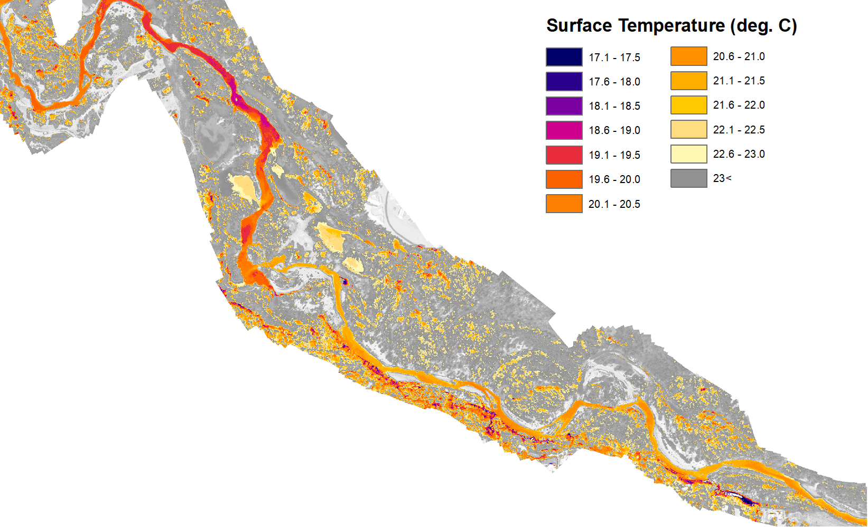
Thermal Infrared Results Summary
Useful for identifying temperature trends in the mainstem
Revealed some off-channel areas with restoration potential
Ineffective in areas obscured by shadows from trees and steep slopes - this includes many off-channel areas and most of the tributaries surveyed
Did not verify tributary results due to limited access to private lands
Must interpret carefully and verify results
Additional data sources needed to tell the complete story

Slide 25
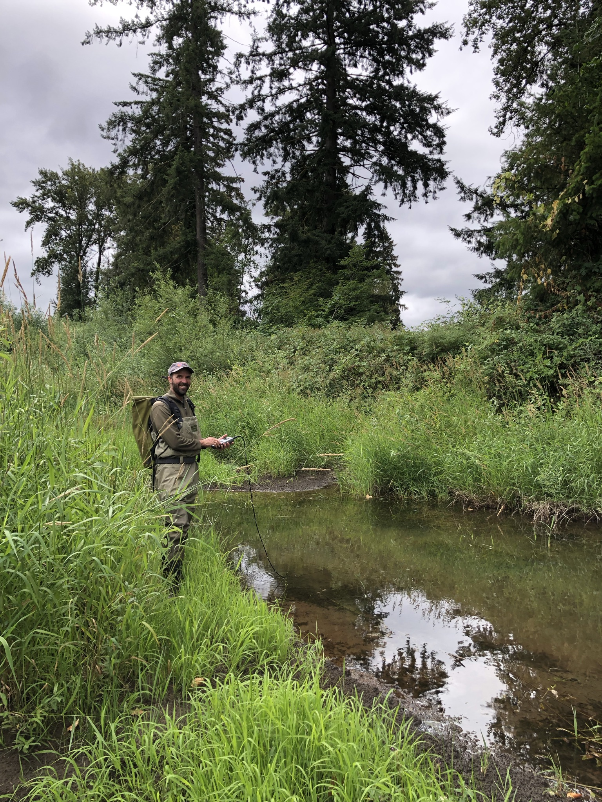
Thermal Infrared Verification – July 2021
Quantum Spatial identified 'Significant Features' as potential cold-water inputs/sources.
LCEP selected high priority areas to verify off channel and mainstem conditions.
Collected spatial water temperature and observed instream and riparian habitat conditions.
Focused primarily on Mainstem. Tributaries had very limited public access points.

Slide 26
Thermal Infrared Verification – July 2021
Spot checks with handheld thermometer in 5 key areas
Physical and climate conditions comparison:
- Similar flows (2020 TIR survey: 82 cfs. 2021 Verification: ~75 cfs)
- Different time of day (TIR: afternoon. Verification: late-morning)
- 2021 was much dryer
- Some of these may have influenced verification results
River Bend
Storedahl
Pits
Lewisville
Daybreak

Slide 27
Thermal Infrared Verification – July 2021
Areas of confirmed cold water after verification (outside of Ridgefield Pits)
Daybreak

Slide 28
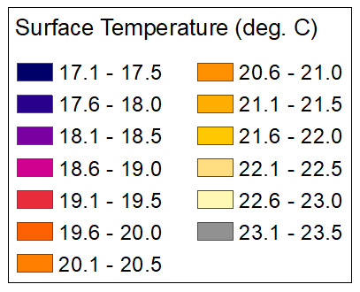
Thermal Infrared Verification – July 2021
Side channel above Daybreak Park (RM 10)
Potential area for restoration focus
Opportunity here may be limited (very small area)
Verification Results

Slide 29
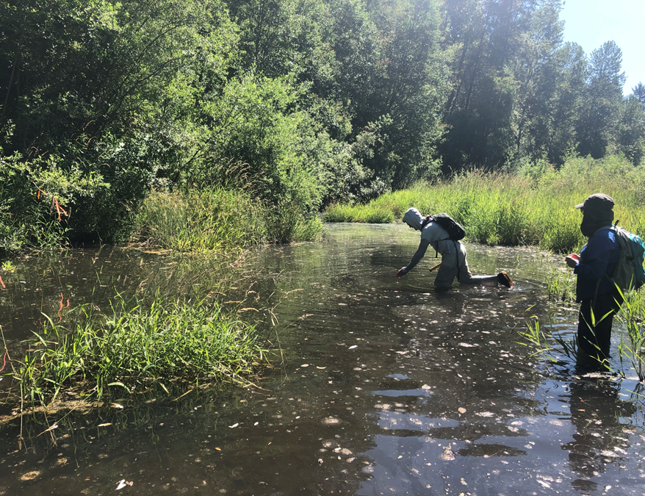
Thermal Infrared Verification – July 2021
Side channel above Daybreak Park (RM 10)
Potential area for restoration focus
Verification Results

Slide 30
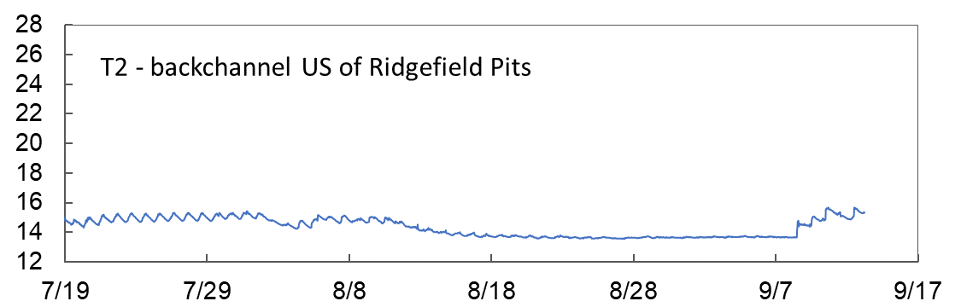
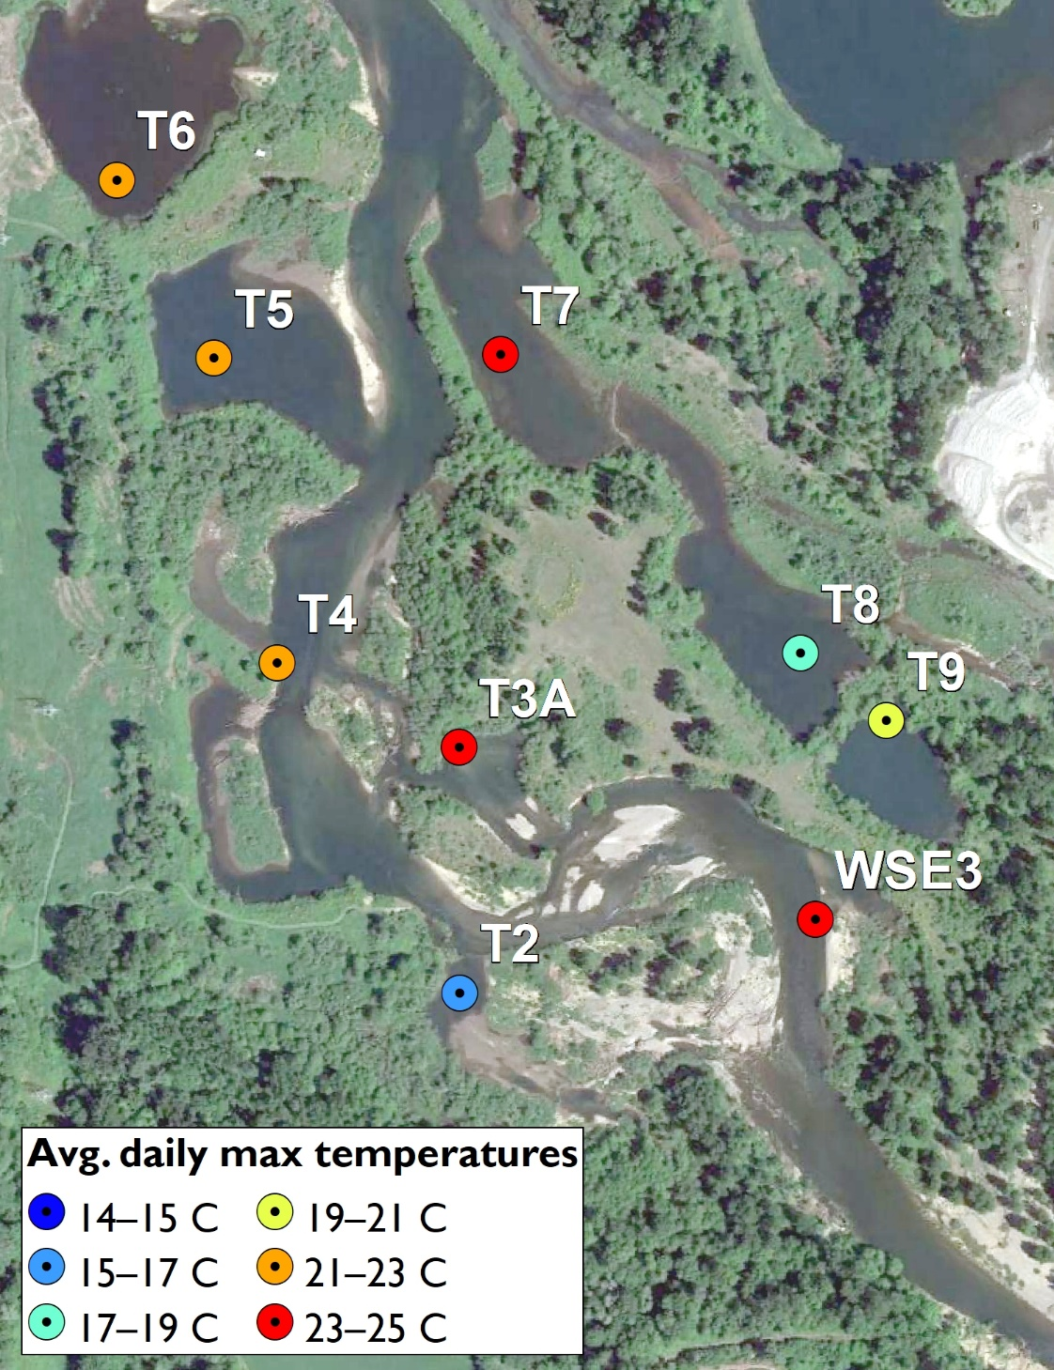
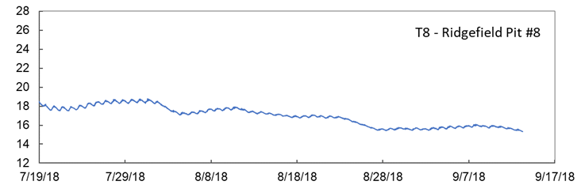
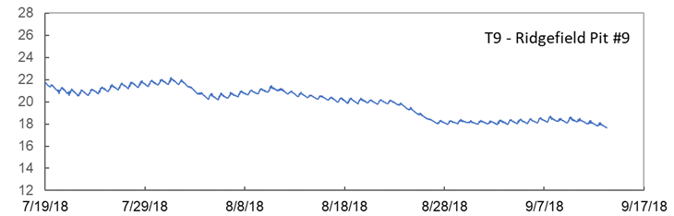
2018 Temperature Monitoring – Ridgefield Pits

Slide 31
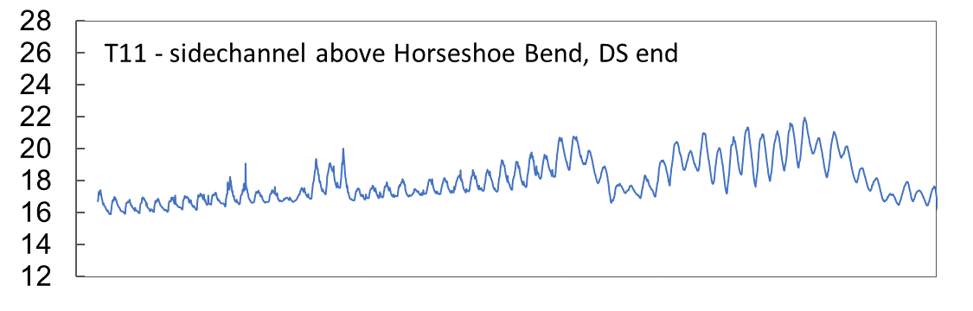
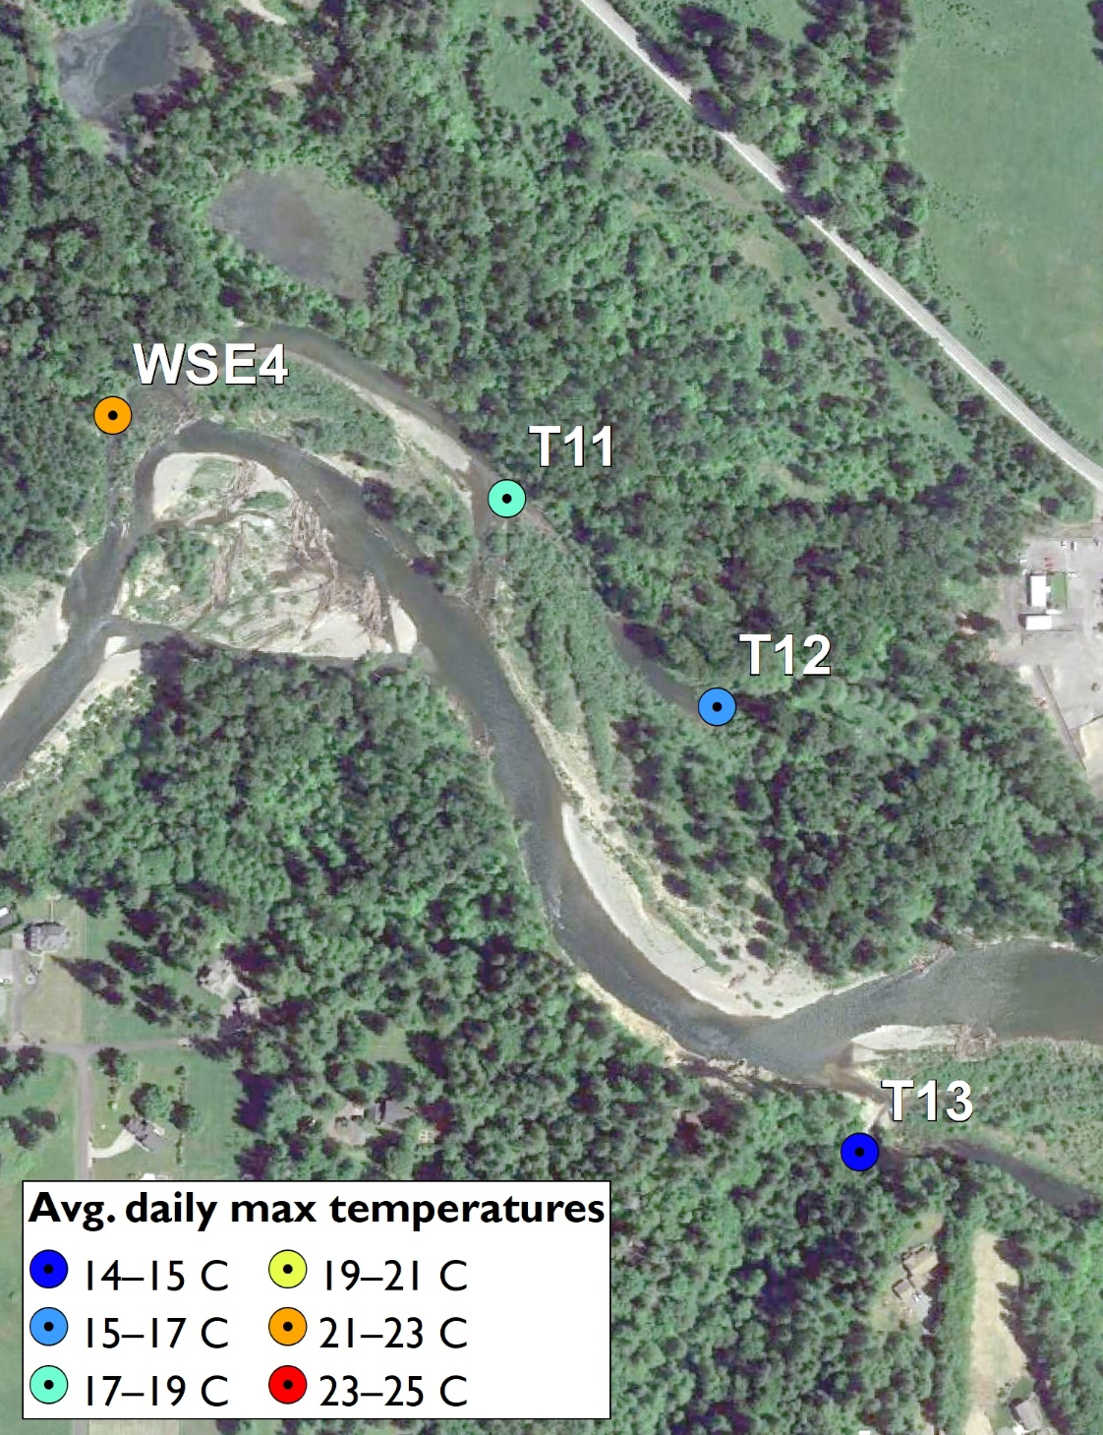
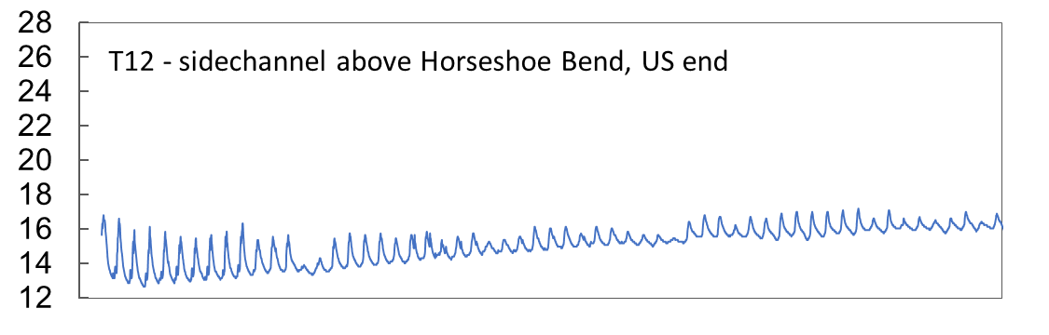
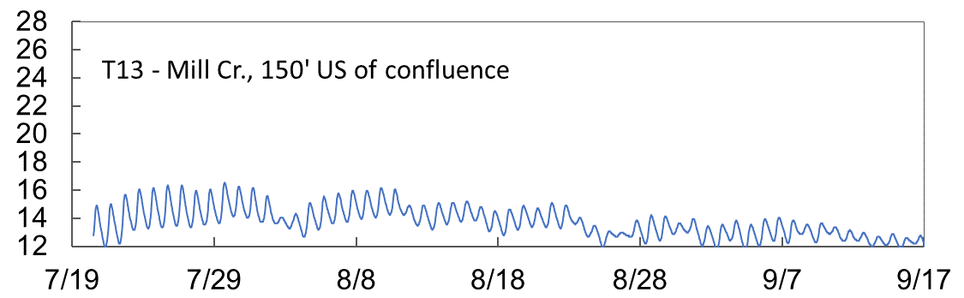
2018 Temperature Monitoring – Ridgefield Pits

Slide 32
TIR/2018 Hobo Comparison – Ridgefield Pits
?
?
?
Surface measurement of TIR missing some areas of interest

Slide 33
Ridgefield Pits Summary 2018/2021 (Cold Locations)
Have not looked here

Slide 34
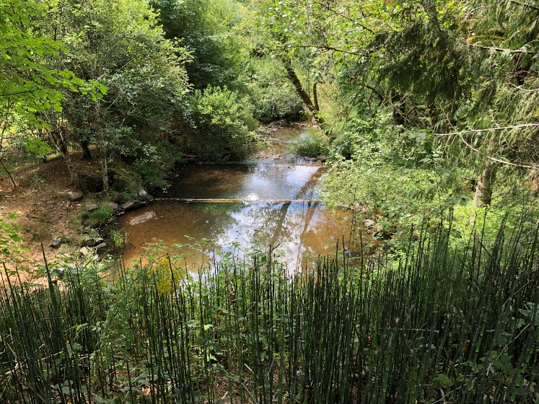
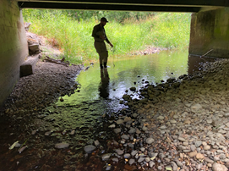
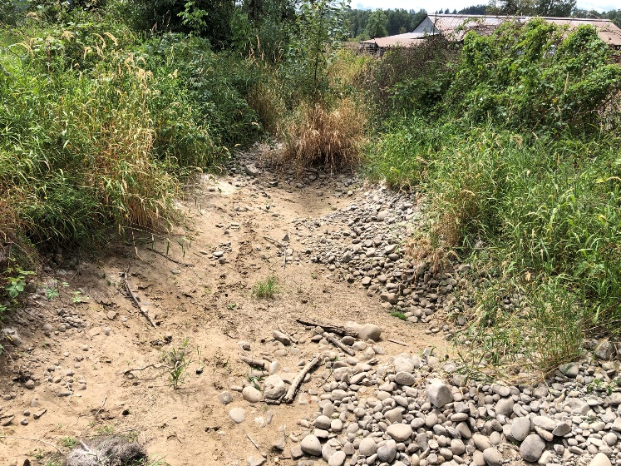
What about the Tributaries??
Need more investigation
Lockwood, Mason, Mill, Manley Creeks- Lower floodplain sections all run cooler than mainstem
Mill- part of Ridgefield pits /erosion issues
Manley- Potential fish passage barriers
Mason- Current habitat enhancement project in the floodplain section
Lockwood- potential for thermal/habitat improvements?
Dean Creek- not cold. Possibly impacted by Daybreak Pits
Potential for improvement?
Rock Creek – we know upstream is cold
Access is a barrier to evaluation and identifying opportunities
Lockwood Cr.
Mason Cr.
Dean Cr.

Slide 35
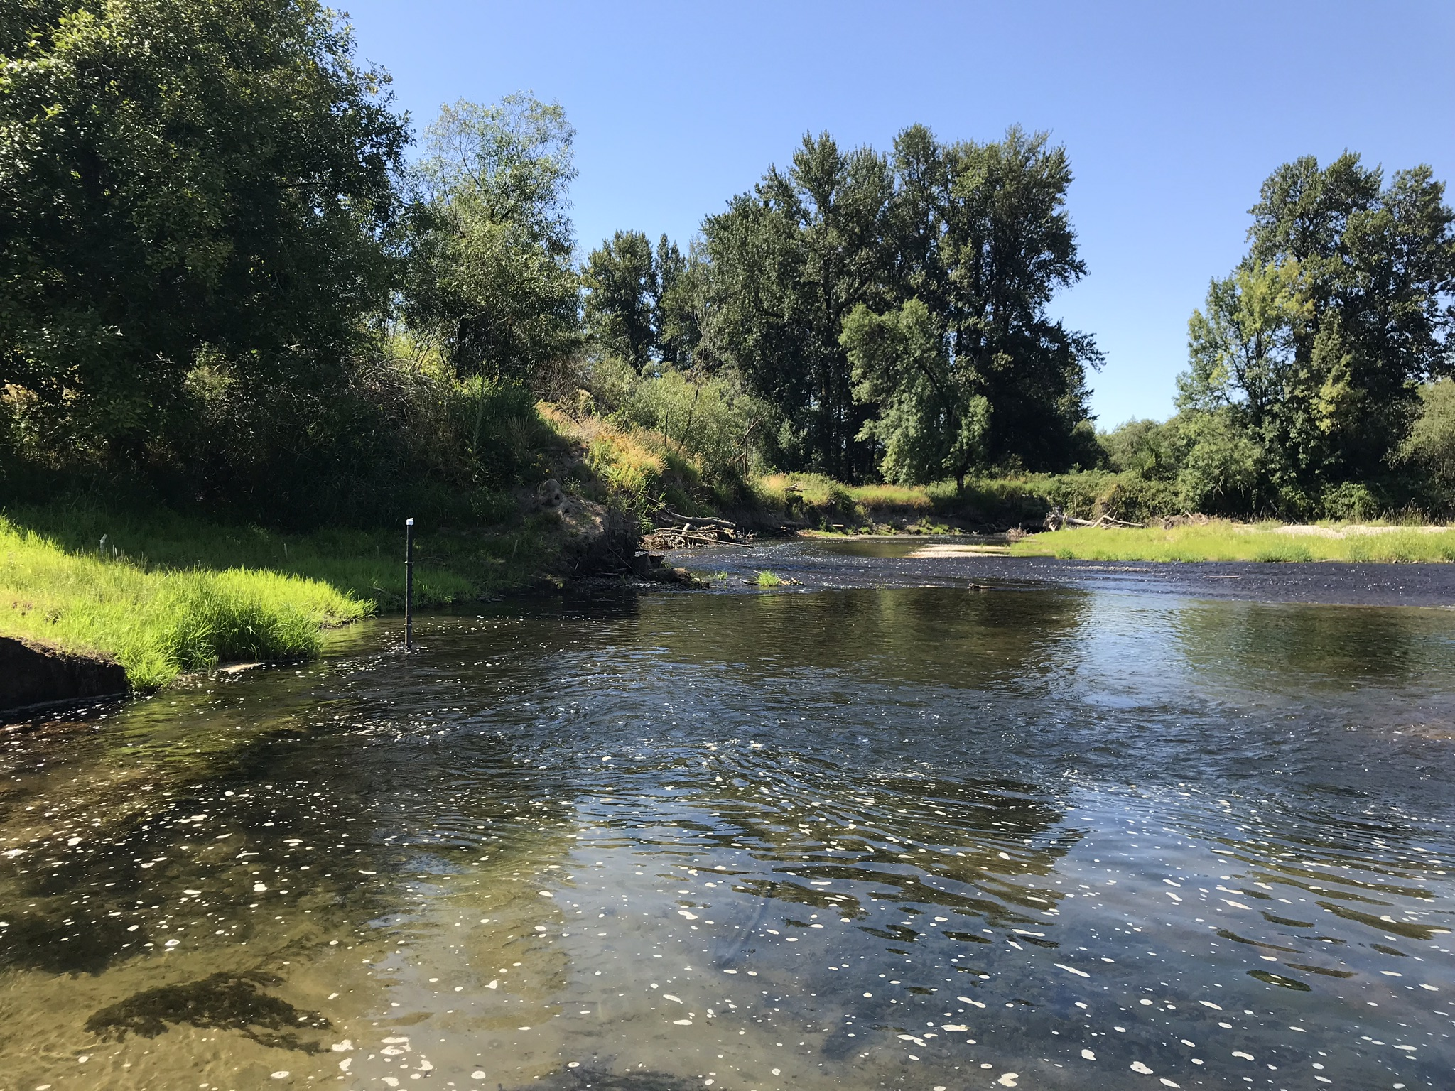

Preliminary Model Observations
Questions?

Slide 36
Summary of Sites for Discussion
Lockwood Cr.
La Center
Rock Cr.
Mason Cr.
Lucia Falls
Dean Cr.
Daybreak
Below Lewisville
Potential Area | Opportunities | Additional Assessment Needed
Lucia Falls Reach | Long cool reach, public ownership | Thermal verification, ID habitat opps.
Below Lewisville | Public ownership, mainstem habitat uplift | Thermal verification
Daybreak | Cool off-channel habitat uplift
La Center | Mainstem habitat uplift | Thermal verification
Mason- above floodplain reaches | Off-channel habitat uplift | Site access, thermal verification
Lockwood Creek- floodplain | Off-channel habitat uplift | Site access, thermal verification
OTHER AREAS???

Slide 37
Next Steps
Continue to investigate areas of need
Define Site Prioritization Criteria
Generate list of ranked site locations
Technical Group reviews/comments on Site List
Upcoming Meetings
November/December: Site List and Prioritization Strategy
January: Restoration Alternatives for Prioritized Sites
February: Concept Designs for Restoration Alternatives

Slide 38
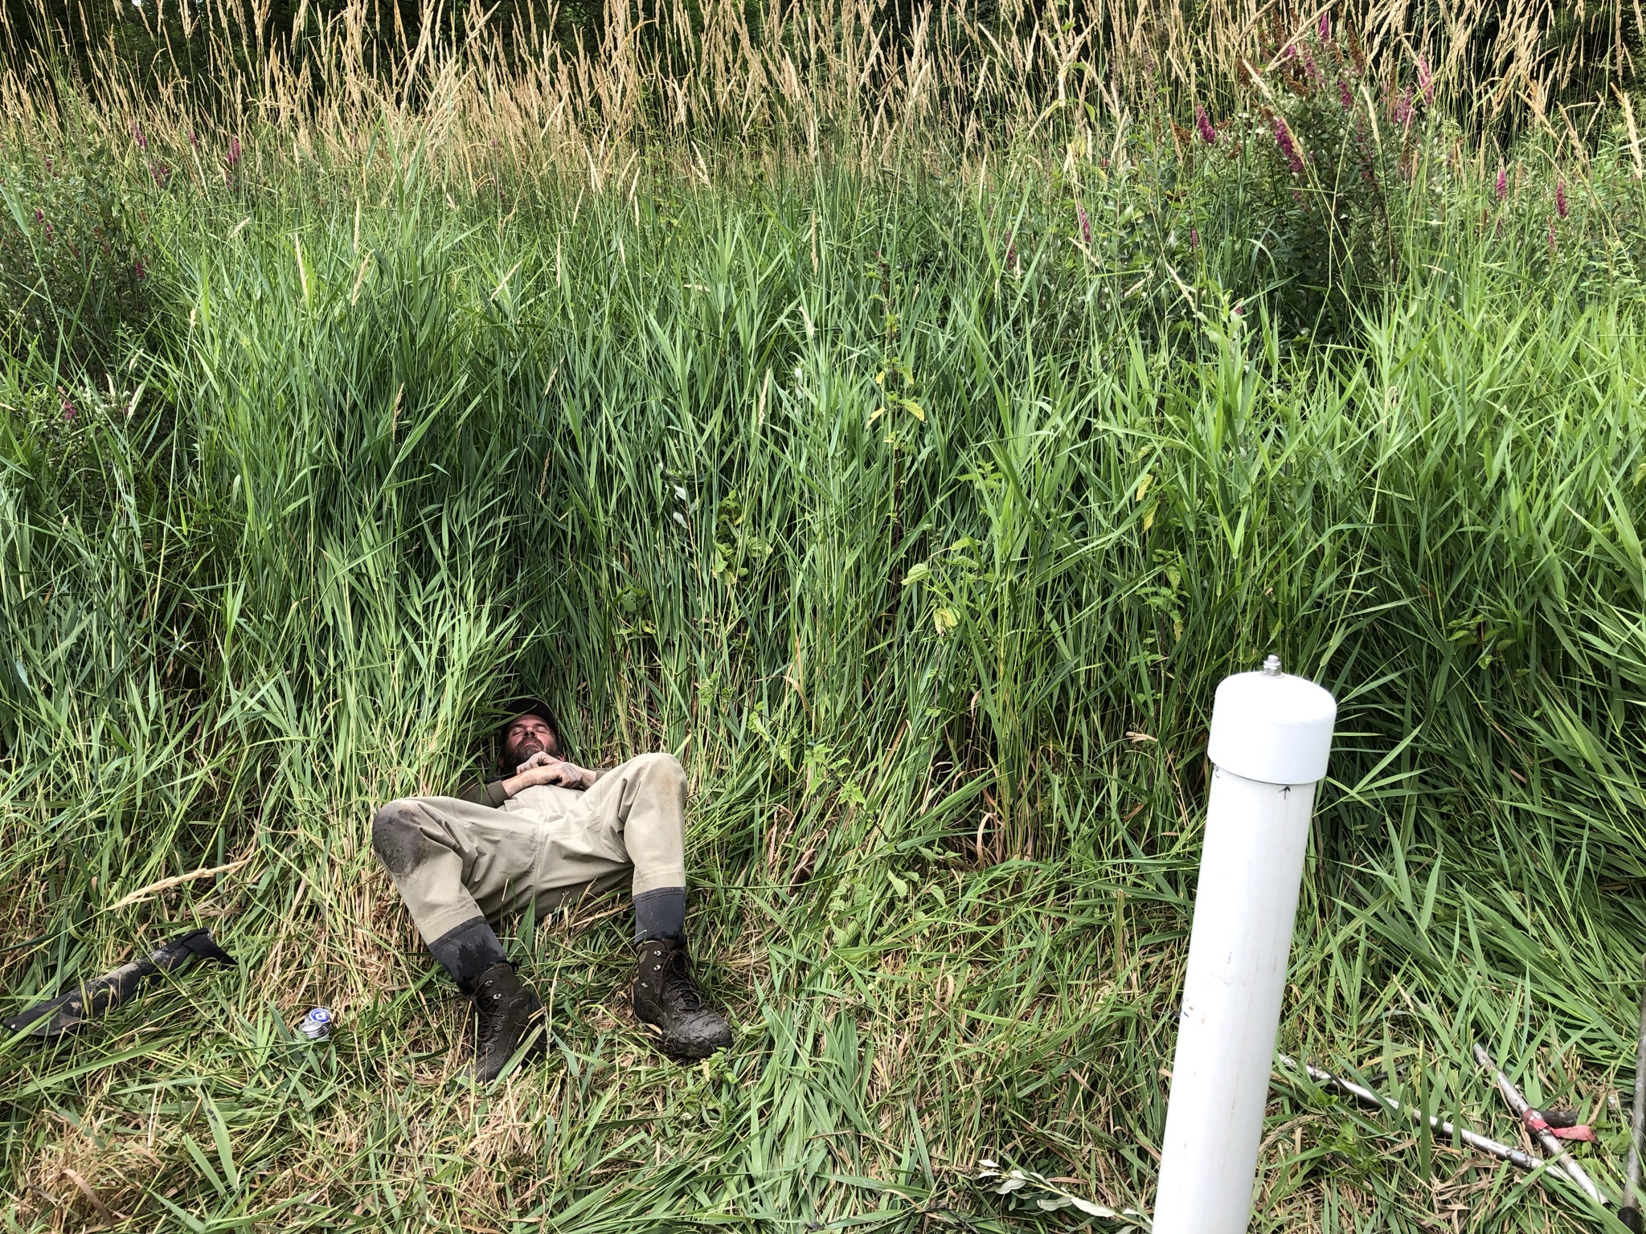
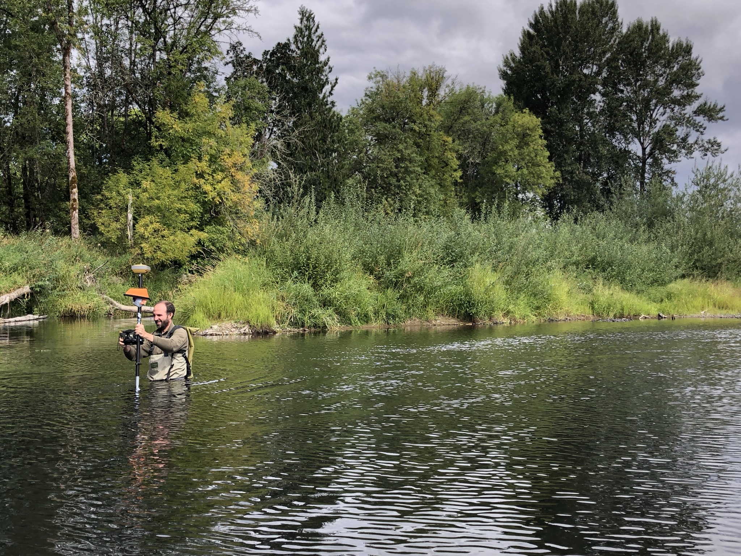
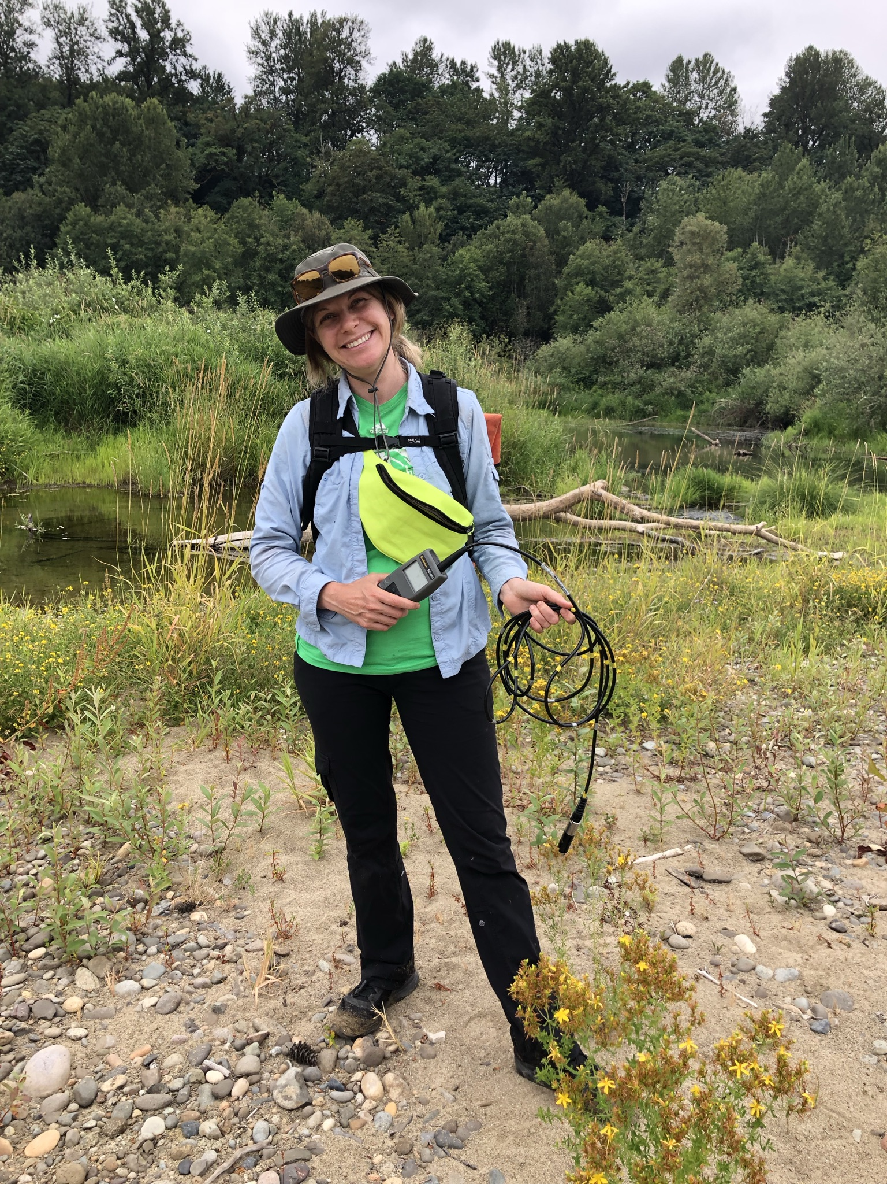
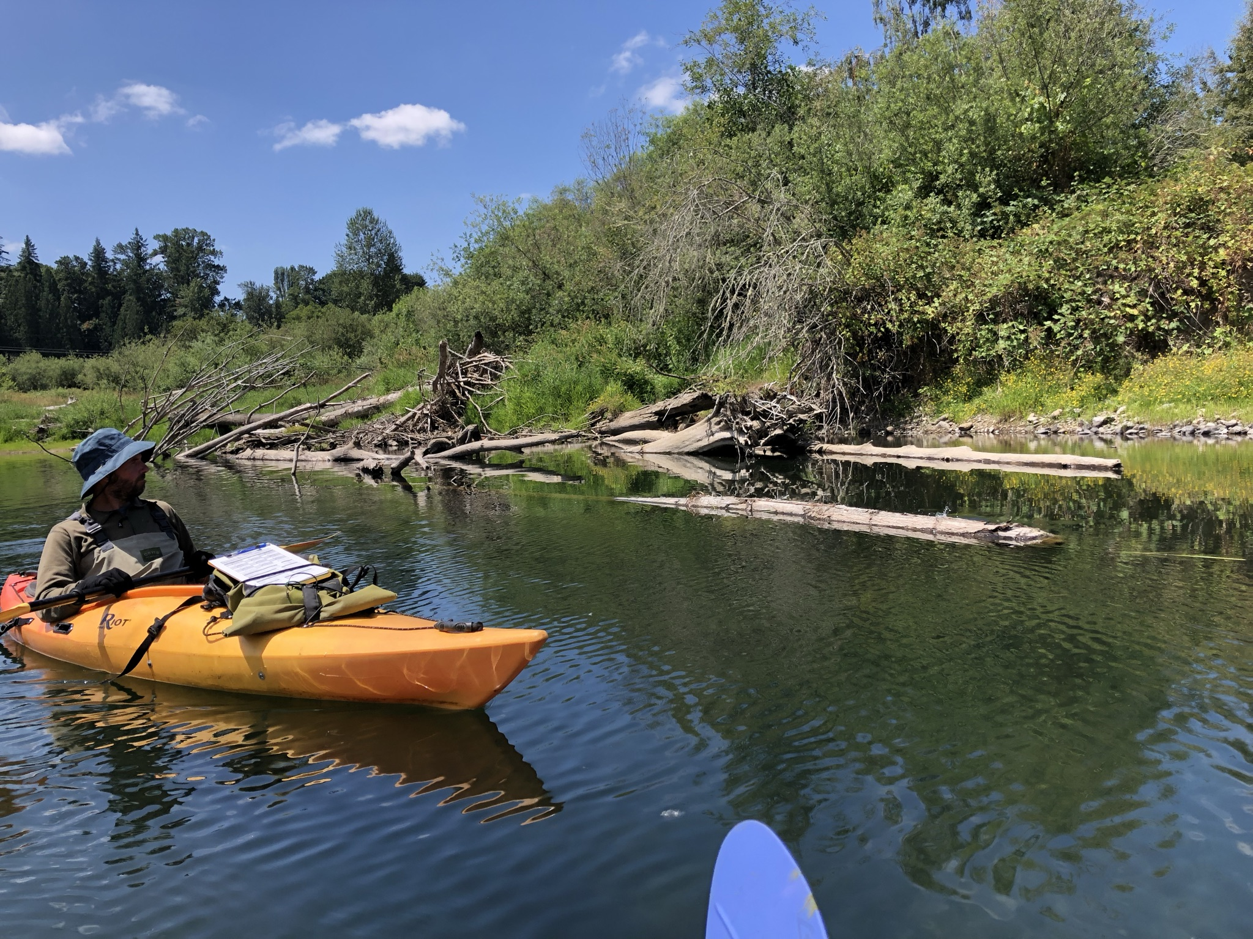
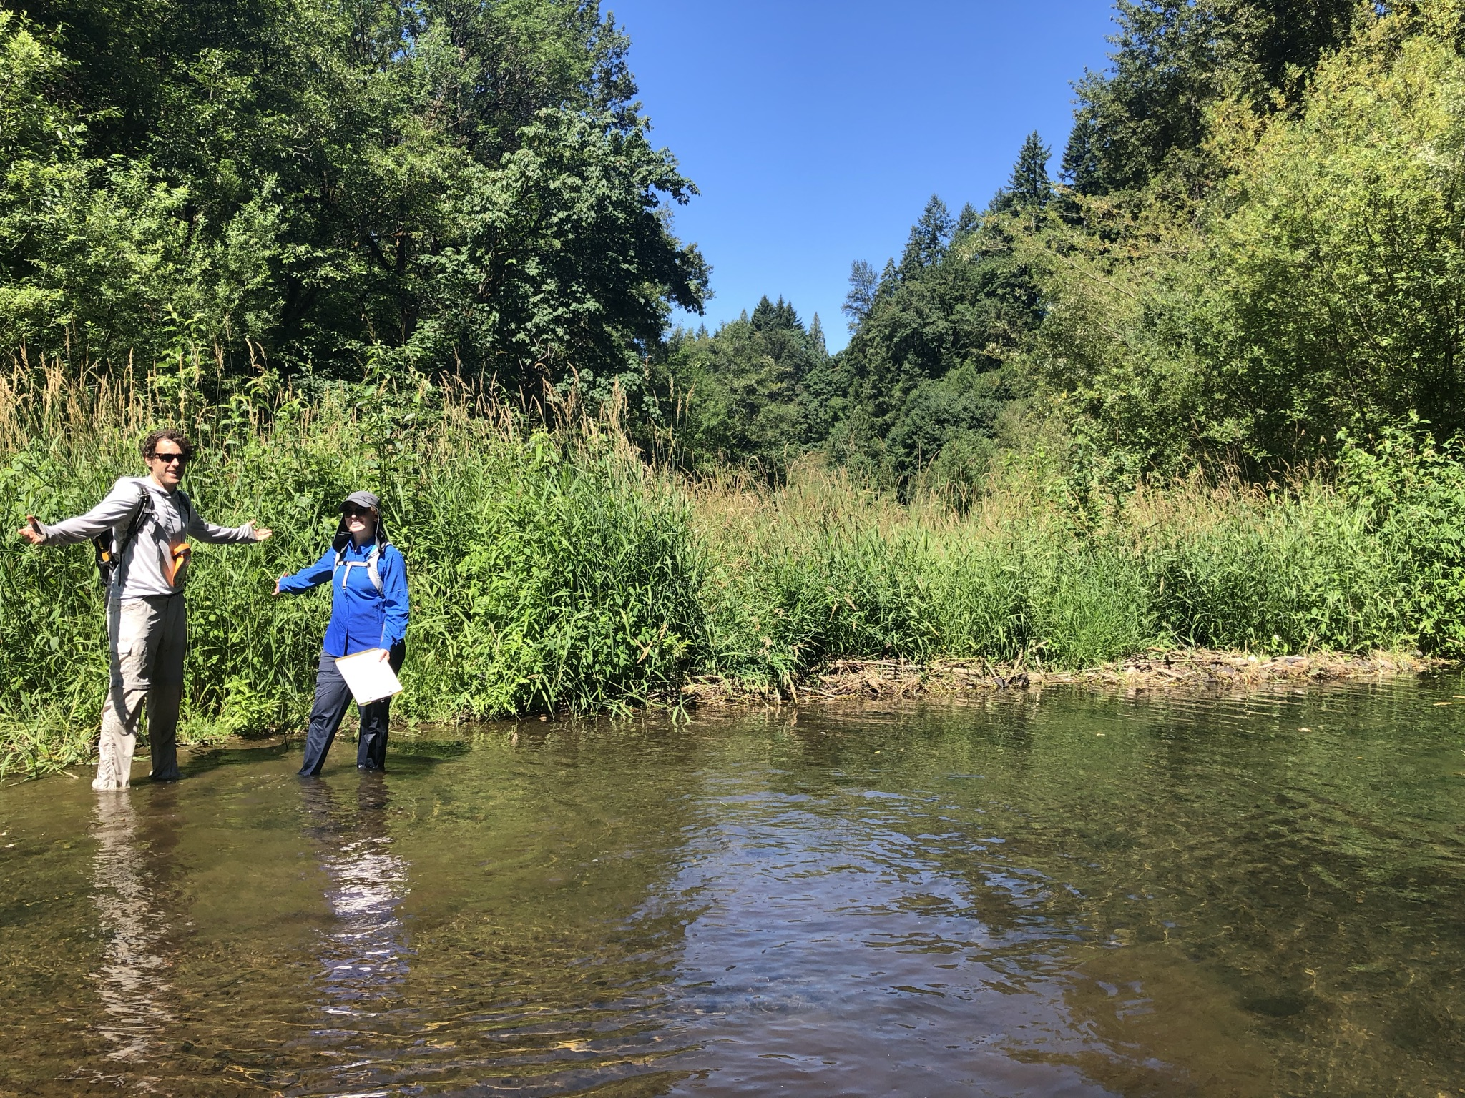
Thank you!
Keith Marcoe, Jenny Dezso, Paul Kolp (LCEP)

